Slide 1
PREDICTING PNEUMONIA IN LUNGS
Dhruv Ragunathan

Slide 2
Business Objectives
Pneumonia is caused from an infection within the lungs either from bacteria, virus, or other pathogens.
This condition could lead too hospitalizations and potentially death.
In the US alone,1 million people are hospitalized and 50,000 die every year.
The goal of this project is too create a model that can identify pneumonia lung X-rays.

Slide 3
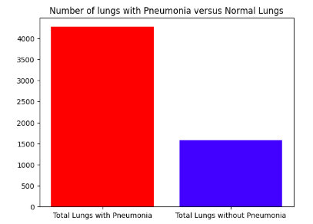
Data
Data sets off lungs with Pneumonia and healthy lungs were provided by Guangzhou Women and Children’s Medical Center, Guangzhou.
The data contains 3 data sets, train, test, and validation. In each file, there are two folders: Pneumonia and normal.
The records in each set were re-combined before they were split into training/validation set for modeling.

Slide 4
Model Results
A convolutional neural network was identified as the best performing model.
The final model was selected based on how accurately it identified pneumonia within the lungs.
False
1926
529
Actual Value
True
612
1648
False
True
Model Prediction

Slide 5
Recommendations
These results on the small subset off data are promising since a validation accuracy off 95% was achieved.
Further research is needed before this model is implemented in hospitals.
Training on larger and more diverse data sets are needed. This dataset only contained lung x-rays off children under 5.

Slide 6
Future Projects
Aggregate significantly more lung data across groups off different ages.
Enhance the model by allowing it too identify bacterial and viral pneumonia.
Implement model in a small hospital then scale it up.

Slide 7
Contact Information
Email: Dhruvragunathan@gmail.com
LinkedIn: https://www.linkedin.com/in/dhruv-ragunathan-908993b1/
Github: https://github.com/dragunat2016/Pneumonia_Image_Detection

