Slide 1
PREDICTING PNEUMONIA IN LUNGS X-Rays
Dhruv Ragunathan

Slide 2
Business Objectives
We have been tasked to improve identification of pneumonia by the CIO.
Staffing resources are in a crunch and there aren’t enough radiologists to review all x-rays.
We use a machine learning model called a convolutional neural network (CNN) to identify pneumonia in lung x-rays.
We believe our findings show promise in using this technique to alleviate hospital staff time.
Notes:
Talk more about stakeholders
Stakeholder is hospital executives. What’s their goal and business objective?
Goal is too identify pneumonia from x-rays
In the US alone,1 million people are hospitalized and 50,000 die every year.

Slide 3
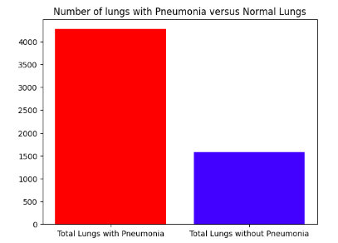
Data
Data sets off lungs with Pneumonia and healthy lungs were provided by Guangzhou Women and Children’s Medical Center, Guangzhou.
The data contains 3 data sets, train, test, and validation. In each file, there are two folders: Pneumonia and normal.
The data only contained chest x-rays of patients that are less than 5 years old.

Slide 4
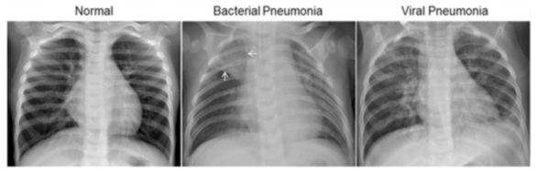
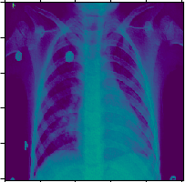
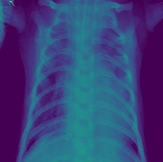
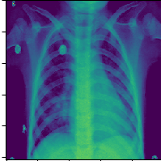
Data Continued

Slide 5
Models and Evaluation criteria
Due to resource and the limits off the machines, only 2500 off the 5800 X-rays could be used in training the model.
Four CNN models were created as part off this project.
The evaluation criteria were accuracy and recall.
Accuracy: Higher accuracy means more model predictions were correct (lower false positive)
Recall: Higher recall means more pneumonia x-rays were identified (lower false negatives)
Recall was prioritized over accuracy because a higher recall implies that more lives were saved.
Notes:
Talk more about stakeholders
Stakeholder is hospital executives. What’s their goal and business objective?
Goal is too identify pneumonia from x-rays
In the US alone,1 million people are hospitalized and 50,000 die every year.

Slide 6
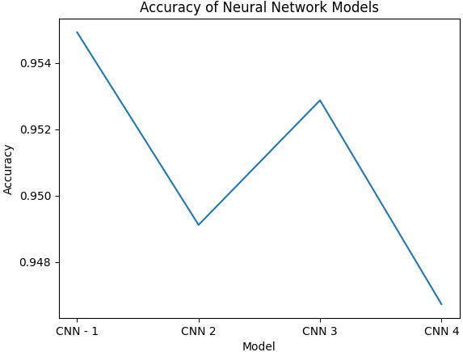
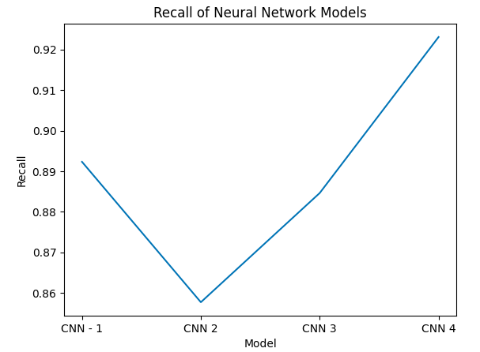
Model Results
The model’s accuracies ranged from 94.5% to 95.5%. They were only off by 1%.
The model’s recall ranged from 86 to 92%.
Since recall is more important than accuracy, we are selecting model 4.

Slide 7
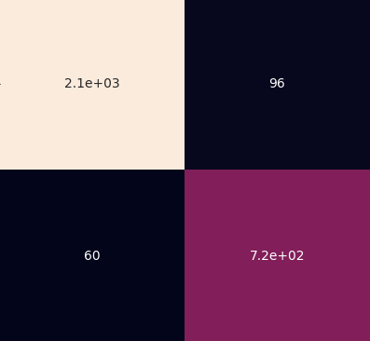
Model Results – Confusion Matrix
Model correctly identified 2,100 lungs with pneumonia
Model correctly identified 720 lungs without pneumonia.
Model incorrectly identified 96 normal lungs as having pneumonia.
Model incorrectly identified 60 pneumatic lungs as if they had pneumonia.

Slide 8
Recommendations
Recommend that you move forward with using the final model since it had the highest recall by 3% and only was 1% less accurate than the other models.
Further research on how to operationalize this model in hospital workflows. Examples:
How are false positives and negatives handled in a hospital?
Is there a method for clinicians to quickly determine that the patient does not have pneumonia?
Training on larger and more diverse data sets is necessary before it’s deployed.

Slide 9
Future Projects
Aggregate significantly more lung data across groups off different ages.
Enhance the model by allowing it too identify bacterial and viral pneumonia.
Deploy the model in a small hospital. Observe the following:
Record time saved by radiologists
impact of false positives on clinician workflows.

Slide 10
Contact Information
Email: Dhruvragunathan@gmail.com
LinkedIn: https://www.linkedin.com/in/dhruv-ragunathan-908993b1/
Github: https://github.com/dragunat2016/Pneumonia_Image_Detection

