Slide 1
PREDICTING PNEUMONIA IN LUNGS X-Rays
Dhruv Ragunathan

Slide 2
Business Objectives
We have been tasked to improve identification of pneumonia.
Staffing resources are in a crunch and there aren’t enough radiologists to review all x-rays.
We use a machine learning model called a convolutional neural network (CNN) to identify pneumonia in lung x-rays.
We believe our findings show promise in using this technique to alleviate hospital staff time.
Notes:
Talk more about stakeholders
Stakeholder is hospital executives. What’s their goal and business objective?
Goal is too identify pneumonia from x-rays
In the US alone,1 million people are hospitalized and 50,000 die every year.

Slide 3
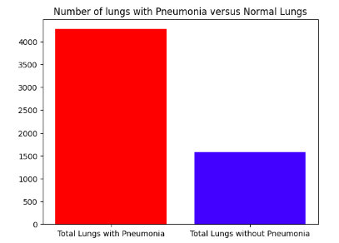
Data
Data sets off lungs with Pneumonia and healthy lungs were provided by Guangzhou Women and Children’s Medical Center, Guangzhou.
The data contains 3 data sets, train, test, and validation. In each file, there are two folders: Pneumonia and normal.
The data only contained chest x-rays of patients that are less than 5 years old.

Slide 4
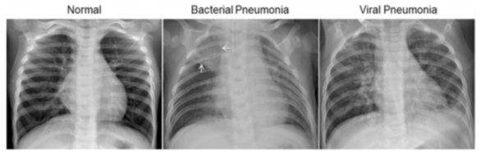
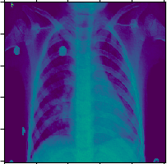
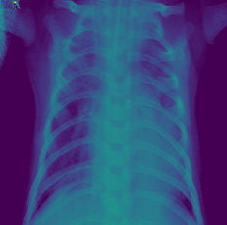
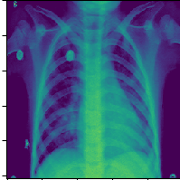
Data Continued

Slide 5
Models and Evaluation criteria
Due to resource and the limits off the machines, only 2500 off the 5800 X-rays could be used in training the model.
Four CNN models were created as part off this project.
The evaluation criteria were accuracy and recall.
Accuracy: Higher accuracy means more model predictions were correct (lower false positive)
Recall: Higher recall means more pneumonia x-rays were identified (lower false negatives)
Recall was prioritized over accuracy because a higher recall implies that more lives were saved.
Notes:
Talk more about stakeholders
Stakeholder is hospital executives. What’s their goal and business objective?
Goal is too identify pneumonia from x-rays
In the US alone,1 million people are hospitalized and 50,000 die every year.

Slide 6
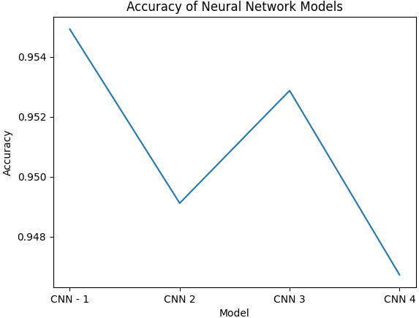
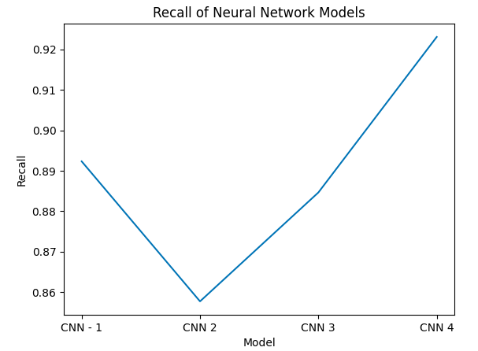
Model Results
The model’s accuracies ranged from 94.5% to 95.5%. They were only off by 1%.
The model’s recall ranged from 86 to 92%.
Since recall is more important than accuracy, we are selecting model 4.

Slide 7
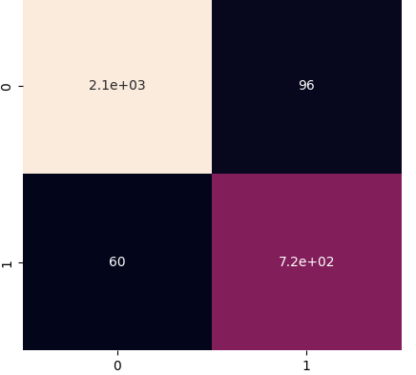
Model Results – Confusion Matrix

Slide 8
Recommendations
Recommend that you move forward with using the final model since it had the highest recall by 3% and only was 1% less accurate than the other models.
Further research on how to operationalize this model in hospital workflows. Examples:
How are false positives and negatives handled in a hospital?
Is there a method for clinicians to quickly determine that the patient does not have pneumonia?
Training on larger and more diverse data sets is necessary before it’s deployed.

Slide 9
Future Projects
Aggregate significantly more lung data across groups off different ages.
Enhance the model by allowing it too identify bacterial and viral pneumonia.
Deploy the model in a small hospital. Observe the following:
Record time saved by radiologists
impact of false positives on clinician workflows.

Slide 10
Contact Information
Email: Dhruvragunathan@gmail.com
LinkedIn: https://www.linkedin.com/in/dhruv-ragunathan-908993b1/
Github: https://github.com/dragunat2016/Pneumonia_Image_Detection

