Slide 1
Random Parallel Clause Learning with Simulated Annealing SAT Solver
Wong Cing Nian
2017/01/18

Slide 2
Content
Main Solve Algorithm
Multi-Thread Clause Learning
How to Make Learnt Clauses More Different
Random Parallel Clause Learning
Simulated Annealing
Experiments

Slide 3

Main Solve Algorithm
clause_db
watch_db
if !preproc, UNSAT
while(true)
if time to restart
restart
if !preproc, UNSAT
if !branch, SAT
while bcp get conflict
if no decision, UNSAT
analyze conflict, get back level
backtrack
maybe add learnt clause
to_assign_heap
assign_deque
value
score
antec
level
order
pos_vec
neg_vec
var_info_vec
Notes:
preproc: length 1 clause, one phase var

Slide 4
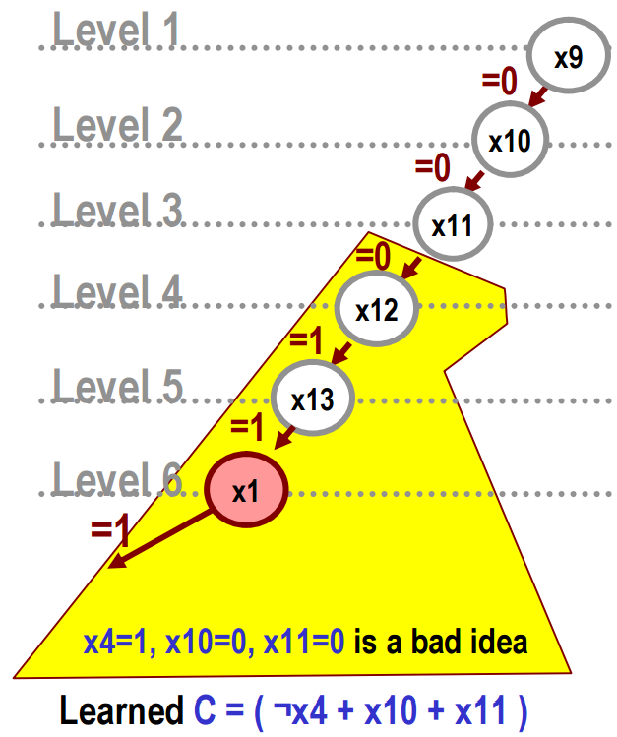
Main Solve Algorithm
One Learnt Clause per Conflict

Slide 5
Multi-Thread Clause Learning
Use Other Threads to Learn More Clauses
...
Learned C1
Learned C2

Slide 6
Multi-Thread Clause Learning
clause_db
watch_db
if !preproc, UNSAT
while(true)
if time to restart
restart
if !preproc, UNSAT
if !branch, SAT
while bcp get conflict
if no decision, UNSAT
analyze conflict, get back level
backtrack
maybe add learnt clause
if time to transfer clauses, NOT YET
to_assign_heap
assign_deque
value
score
antec
level
order
pos_vec
neg_vec
var_info_vec

Slide 7
Make Learnt Clauses More Different
Useless If The Learnt Clauses Are The Same.
...
How to Make Learned Clauses More Different ?
Different Branching Heuristic ?
Different Resolution Stage ?
Different Backtracking Level ?

Slide 8
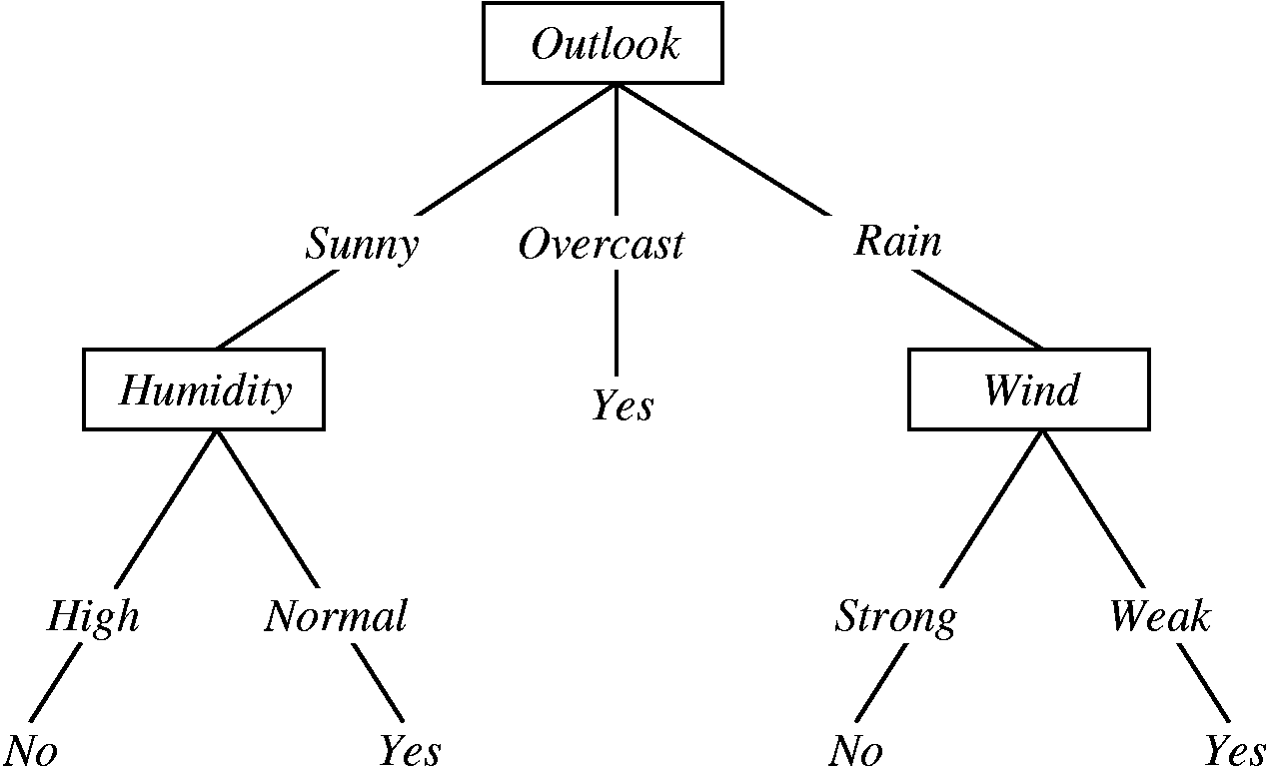
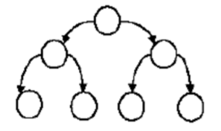
Make Learnt Clauses More Different
Learn a good hypothesis to classify The Data According to Features

Slide 9
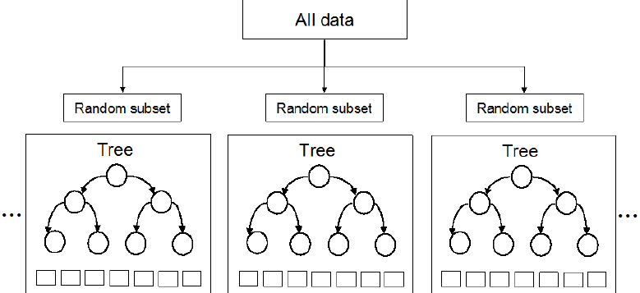
Make Learnt Clauses More Different
Random Subset, Random Feature Projection, Make the hypotheses different
Combine All the Different Hypotheses to Get Better Accuracy

Slide 10
Make Learnt Clauses More Different
Hypothesis of a Decision Tree <-> Learned Clauses of One Thread Path
Combine Different Hypotheses <-> Transfer Different Learned Clauses From Threads
...
Learned C1
Learned C2

Slide 11
Make Learnt Clauses More Different
How to Make Learned Clauses More Different ?
Different Branching Heuristic ?
Different Resolution Stage ?
Different Backtracking Level ?
...

Slide 12
Make Learnt Clauses More Different
How to Make Learned Clauses More Different ?
Different Branching Heuristic -> Add Random Branch
Different Resolution Stage -> Add Random Resolution Limit
Different Backtracking Level -> Add Random Backtracking
...
Exploit Randomness A_____A
with the help of Simulated Annealing !

Slide 13
RPCL-Thread Learn
clause_db
watch_db
if !preproc, UNSAT
while(true)
if time to restart
restart
simulated annealing
if !preproc, UNSAT
if !branch, SAT
while bcp get conflict
if no decision, UNSAT
analyze conflict, get back level
backtrack
maybe add learnt clause
if time to transfer clauses, NOT YET
to_assign_heap
assign_deque
value
score
antec
level
order
pos_vec
neg_vec
var_info_vec
Notes:
branch, analyze (resolution), backtrack 有 random

Slide 14
RPCL-Simulated Annealing
1. Set Parameters of Each Thread
2. Create Threads and Run
...
thread_learn
thread_learn
3. Join Threads and Collect Learnt Clauses
4. Simulated Annealing to Update Parameters for Next Run

Slide 15
Experiments
Benchmark | Time | Results
aim-100-1_6-no-1 | 0m0.006s | UNSAT
aim-100-1_6-yes-1-1 | 0m0.013s | SAT
aim-200-1_6-no-1 | 0m0.009s | UNSAT
aim-200-1_6-yes-1-1 | 0m0.056s | SAT
aim-50-1_6-no-1 | 0m0.002s | UNSAT
aim-50-1_6-yes-1-1 | 0m0.006s | SAT
dubois100 | 1m50.484s | UNSAT
dubois20 | 0m0.308s | UNSAT
ii16a1 | 0m0.031s | SAT
ii32a1 | 178m20.314s | SAT
ii8a1 | 0m0.002s | SAT
jnh10 | 0m0.022s | UNSAT
jnh11 | 0m0.036s | UNSAT
jnh1 | 0m0.023s | SAT
par16-1-c | 7m33.667s | SAT
Parameters Really Matters
Clause_db size issue may add pruning
Notes:
thread number
restart chance
random probability
when to transfer

Slide 16
Notes
1uip is just like an intersection.
clause evaluation is more important than size of clause. may need to add some evaluation method to help prune the clause database
I think I add too much ‘randomness’ to my sat solver for this milestone. Some part like resolution stage may not appreciate randomness...

