Slide 1
CLUSTERING IN ML

Slide 2
Content
What is cluster
Applications of Cluster
Types of cluster
Conclusions

Slide 3



What is Cluster Analysis?
Finding groups of objects such that the objects in a group will be similar (or related) to one another and different from (or unrelated to) the objects in other groups
Inter-cluster distances are maximized
Intra-cluster distances are minimized

Slide 4
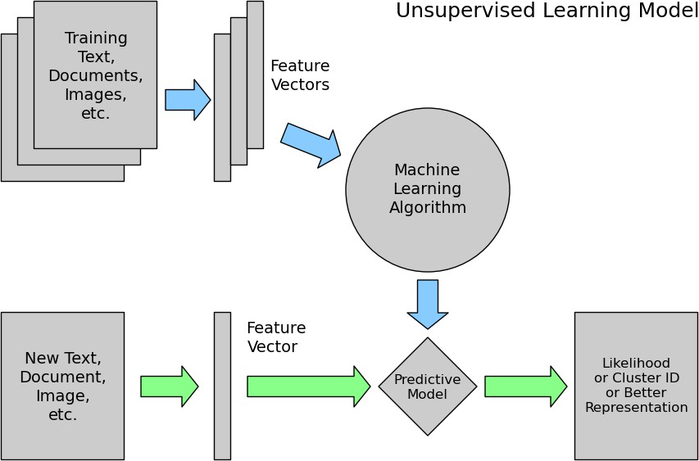
Unsupervised Learning

Slide 5
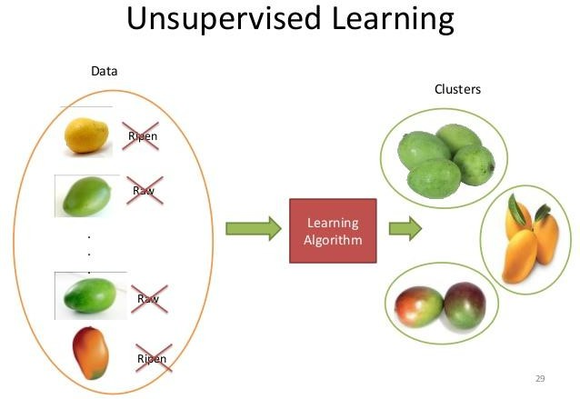
Applications of Cluster Analysis
Understanding
Group related documents for browsing, group genes and proteins that have similar functionality, or group stocks with similar price fluctuations
Summarization
Reduce the size of large data sets

Slide 6
Notion of a Cluster can be Ambiguous
How many clusters?
Six Clusters
Two Clusters
Four Clusters

Slide 7
Types of Clusterings
A clustering is a set of clusters
Important distinction between hierarchical and partitional sets of clusters
Partitional Clustering
A division data objects into non-overlapping subsets (clusters) such that each data object is in exactly one subset
Hierarchical clustering
A set of nested clusters organized as a hierarchical tree

Slide 8
Partitional Clustering
Original Points
A Partitional Clustering

Slide 9
Hierarchical Clustering
p1
p3
p4
p2
p1 p2 p3 p4
Traditional Dendrogram
Traditional Hierarchical Clustering
p1
p3
p4
p2
p1 p2 p3 p4
Non-traditional Dendrogram
Non-traditional Hierarchical Clustering

Slide 10
Other Distinctions Between Sets of Clusters
Exclusive versus non-exclusive
In non-exclusive clusterings, points may belong to multiple clusters.
Can represent multiple classes or ‘border’ points
Fuzzy versus non-fuzzy
In fuzzy clustering, a point belongs to every cluster with some
weight between 0 and 1
Weights must sum to 1
Probabilistic clustering has similar characteristics
Partial versus complete
In some cases, we only want to cluster some of the data
Heterogeneous versus homogeneous
Cluster of widely different sizes, shapes, and densities

Slide 11
Types of Clusters
Well-separated clusters
Center-based clusters
Contiguous clusters
Density-based clusters
Property or Conceptual
Described by an Objective Function

Slide 12
Types of Clusters: Well-Separated
Well-Separated Clusters:
– A cluster is a set of points such that any point in a cluster is closer (or more similar) to every other point in the cluster than to any point not in the cluster.
3 well-separated clusters

Slide 13
Types of Clusters: Center-Based
Center-based
A cluster is a set of objects such that an object in a cluster is closer (more similar) to the “center” of a cluster, than to the center of any other cluster
The center of a cluster is often a centroid, the average of all the points in the cluster, or a medoid, the most “representative” point of a cluster
4 center-based clusters

Slide 14
Types of Clusters: Contiguity-Based
Contiguous Cluster (Nearest neighbor or Transitive)
– A cluster is a set of points such that a point in a cluster is closer (or more similar) to one or more other points in the cluster than to any point not in the cluster.
8 contiguous clusters

Slide 15

Types of Clusters: Density-Based
Density-based
A cluster is a dense region of points, which is separated by low- density regions, from other regions of high density.
Used when the clusters are irregular or intertwined, and when noise and outliers are present.
6 density-based clusters

Slide 16
Types of Clusters: Conceptual Clusters
Shared Property or Conceptual Clusters
– Finds clusters that share some common property or represent a particular concept.
.
2 Overlapping Circles

Slide 17
Types of Clusters: Objective Function
Clusters Defined by an Objective Function
Finds clusters that minimize or maximize an objective function.
Enumerate all possible ways of dividing the points into clusters and evaluate the `goodness' of each potential set of clusters by using the given objective function. (NP Hard)
Can have global or local objectives.
Hierarchical clustering algorithms typically have local objectives
Partitional algorithms typically have global objectives
A variation of the global objective function approach is to fit the data to
a parameterized model.
Parameters for the model are determined from the data.
Mixture models assume that the data is a ‘mixture' of a number of statistical
distributions.

Slide 18
Clustering Algorithms
Hierarchical Clustering
Agglomerative
Algorithms
Divisive
Algorithms
Others

Slide 19
Clustering Algorithms
Partitioning Algorithms
K-medoids
K-means
Probabilistic
Density based

Slide 20
Clustering Algorithms
Others
Evolutionary
Heuristics
Grid Based
Artificial Neural
Networks
Deep Learning

Slide 21
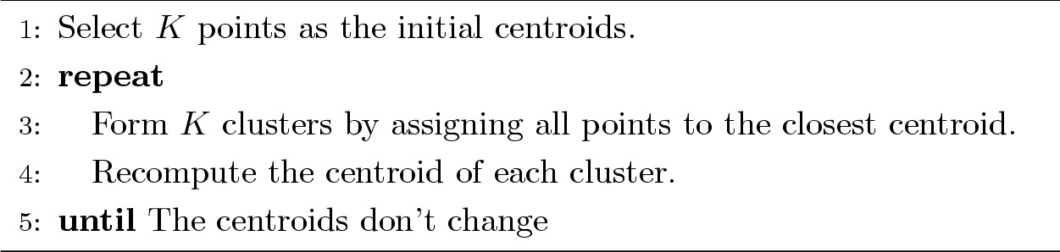
K-means Clustering
Partitional clustering approach
Each cluster is associated with a centroid (center point)
Each point is assigned to the cluster with the closest centroid
Number of clusters, K, must be specified
The basic algorithm is very simple

Slide 22
K-means Clustering – Details
Initial centroids are often chosen randomly.
Clusters produced vary from one run to another.
The centroid is (typically) the mean of the points in the cluster.
‘Closeness’ is measured by Euclidean distance, cosine similarity,
correlation, etc.
K-means will converge for common similarity measures
mentioned above.
Most of the convergence happens in the first few iterations.
Often the stopping condition is changed to ‘Until relatively few points
change clusters’
Complexity is O( n * K * I * d )
n = number of points, K = number of clusters,
I = number of iterations, d = number of attributes

Slide 23
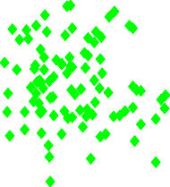

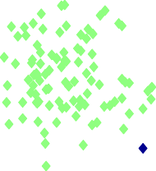
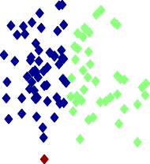

Two different K-means Clusterings
3
2.5
2
Original Points
1.5
1
0.5
0
y
-2
-1.5
-1
-0.5
0
x
0.5
1
1.5
2
3
3
2.5
2.5
2
2
1.5
1.5
y
1
y
1
0.5
0.5
0
0
-2 -1.5 -1
-0.5 0 0.5 1 1.5
x
2
-2 -1.5 -1
-0.5 0 0.5 1 1.5 2
x
Optimal Clustering
Sub-optimal Clustering

Slide 24
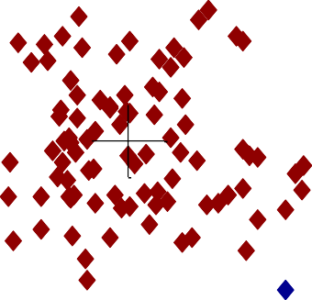
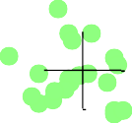
Importance of Choosing Initial Centroids
Iteration 6
Iteration 1
Iteration 2
Iteration 3
Iteration 4
Iteration 5
3
2.5
2
1.5
1
0.5
0
3
2.5
2
1.5
1
0.5
0
-2 -1.5 -1 -0.5 0 0.5 1 1.5 2
x
3
2.5
2
1.5
1
0.5
0
-2 -1.5 -1 -0.5 0 0.5 1 1.5 2
x
3
2.5
2
1.5
1
0.5
0
-2 -1.5 -1 -0.5 0 0.5 1 1.5 2
x
3
2.5
2
1.5
1
0.5
0
-2 -1.5 -1 -0.5 0 0.5 1 1.5 2
x
3
2.5
2
1.5
1
0.5
0
-2 -1.5 -1 -0.5 0 0.5 1 1.5 2
x
y
y
y
y
y
y
-2
-1.5
-1
-0.5
0
x
0.5
1
1.5
2

Slide 25
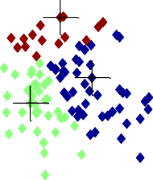
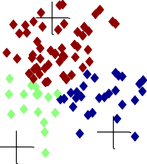
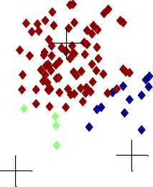

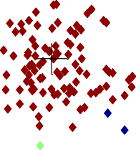
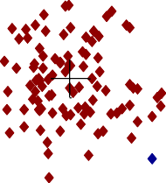




Importance of Choosing Initial Centroids
Iteration 1
Iteration 2
Iteration 3
3
3
3
2.5
2.5
2.5
2
2
2
1.5
1.5
1.5
y
1
y
1
y
1
0.5
0.5
0.5
0
0
0
-2
-1.5
-1
-0.5 0
x
0.5
1
1.5
2
-2
-1.5
-1
-0.5 0
x
0.5
1
1.5
2
-2
-1.5
-1
-0.5 0
x
0.5
1
1.5
2
Iteration 4
Iteration 5
Iteration 6
3
3
3
2.5
2.5
2.5
2
2
2
1.5
1.5
1.5
y
1
y
1
y
1
0.5
0.5
0.5
0
0
0
-2
-1.5
-1
-0.5 0
x
0.5
1
1.5
2
-2
-1.5
-1
-0.5 0
x
0.5
1
1.5
2
-2
-1.5
-1
-0.5 0
x
0.5
1
1.5
2

Slide 26
Evaluating K-means Clusters
Most common measure is Sum of Squared Error (SSE)
For each point, the error is the distance to the nearest cluster
To get SSE, we square these errors and sum them.
K
SSE =
∑∑
2
dist (m , x)
i
i=1 x∈C_{i}
x is a data point in cluster C_{i} and m_{i} is the representative point for cluster C_{i}
can show that m_{i} corresponds to the center (mean) of the cluster
Given two clusters, we can choose the one with the smallest error
One easy way to reduce SSE is to increase K, the number of
clusters
A good clustering with smaller K can have a lower SSE than a poor clustering with higher K

Slide 27
Problems with Selecting Initial Points
If there are K ‘real’ clusters then the chance of selecting one
centroid from each cluster is small.
Chance is relatively small when K is large
If clusters are the same size, n, then
For example, if K = 10, then probability = 10!/10¹⁰ = 0.00036
Sometimes the initial centroids will readjust themselves in ‘right’ way, and sometimes they don’t

Slide 28
Solutions to Initial Centroids Problem
Multiple runs
Helps, but probability is not on your side
Sample and use hierarchical clustering to determine initial centroids
Select more than k initial centroids and then select among these initial centroids
Select most widely separated

Slide 29
Limitations of K-means
K-means has problems when clusters are of differing
Sizes
Densities
Non-globular shapes
K-means has problems when the data contains outliers.

Slide 30
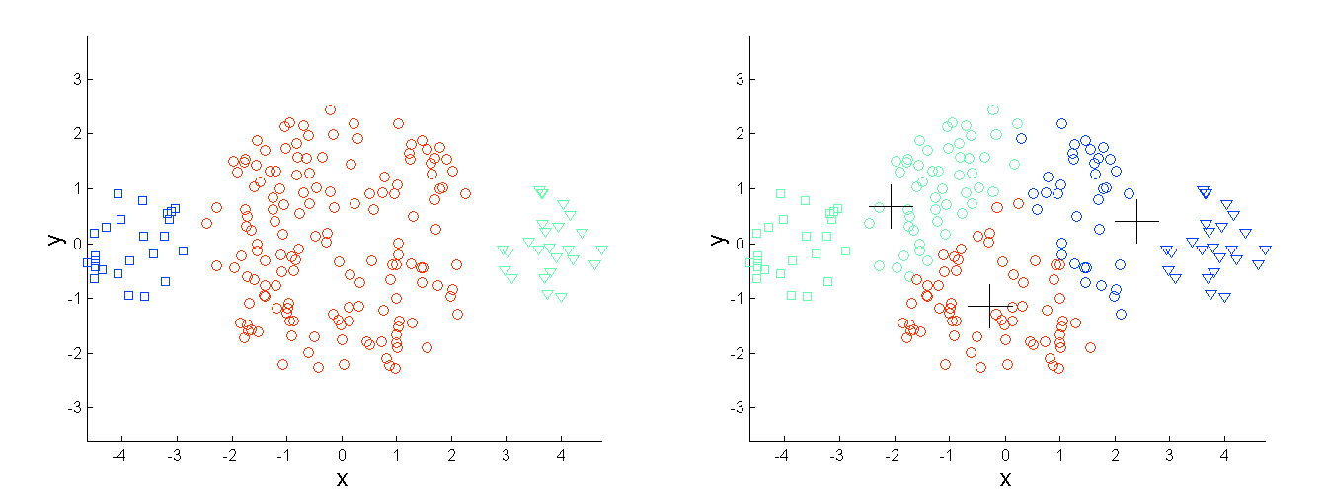
Limitations of K-means: Differing Sizes
Original Points
K-means (3 Clusters)

Slide 31
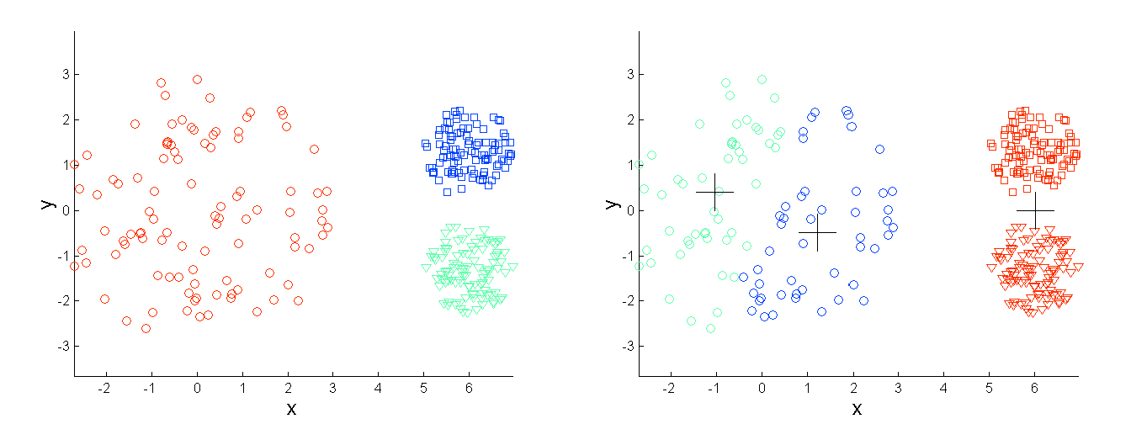
Limitations of K-means: Differing Density
Original Points
K-means (3 Clusters)

Slide 32
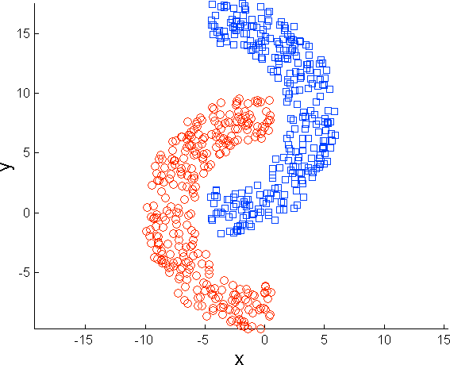
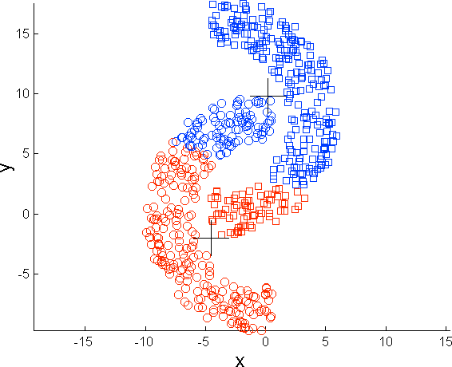
Limitations of K-means: Non-globular Shapes
Original Points
K-means (2 Clusters)

Slide 33
Hierarchical Clustering
Produces a set of nested clusters organized as a hierarchical tree
Can be visualized as a dendrogram
– A tree like diagram that records the sequences of merges or splits
6
5
0.2
4
3
2
4
0.15
5
2
0.1
1
3
0.05
1
0
1
3
2
5
4
6

Slide 34
Strengths of Hierarchical Clustering
Do not have to assume any particular number of clusters
Any desired number of clusters can be obtained by
‘cutting’ the dendogram at the proper level
They may correspond to meaningful taxonomies
Example in biological sciences (e.g., animal kingdom, phylogeny reconstruction, …)

Slide 35
Hierarchical Clustering
Two main types of hierarchical clustering
Agglomerative:
Start with the points as individual clusters
At each step, merge the closest pair of clusters until only one cluster (or k clusters) left
Divisive:
Start with one, all-inclusive cluster
At each step, split a cluster until each cluster contains a point (or
there are k clusters)
Traditional hierarchical algorithms use a similarity or distance matrix
Merge or split one cluster at a time

Slide 36
Agglomerative Clustering Algorithm
More popular hierarchical clustering technique
Basic algorithm is straightforward
Compute the proximity matrix
Let each data point be a cluster
Repeat
Merge the two closest clusters
Update the proximity matrix
Until only a single cluster remains
Key operation is the computation of the proximity of two clusters
– Different approaches to defining the distance between clusters
distinguish the different algorithms

Slide 37



Starting Situation
Start with clusters of individual points and a
proximity matrix
 | p1 | p2 | p3 | p4 | p5 | .
p1
p2
p3
p4
p5
.
. .
.
.
Proximity Matrix
...
p1
p2
p3
p4
p9
p10
p11
p12

Slide 38







Intermediate Situation
After some merging steps, we have some clusters
 | C1 | C2 | C3 | C4 | C5
C1
C2
C3
C4
C5
C3
C4
Proximity Matrix
C1
C2
C5
...
p1
p2
p3
p4
p9
p10
p11
p12

Slide 39






Intermediate Situation
We want to merge the two closest clusters (C2 and C5) and
update the proximity matrix.
 | C1 | C2 | C3 | C4 | C5
C1
C2
C3
C4
C5
C3
C4
Proximity Matrix
C1
C2
C5
...
p1
p2
p3
p4
p9
p10
p11
p12

Slide 40






After Merging
The question is “How do we update the proximity matrix?”
C2 U
 | C1 | C5 | C3 | C4
C1 |  | ?
C5 | ? | ? | ? | ?
C3 |  | ?
C4 |  | ?
C2 U
C3
C4
Proximity Matrix
C1
C2 U C5
...
p1
p2
p3
p4
p9
p10
p11
p12

Slide 41

How to Define Inter-Cluster Similarity
 | p1 | p2 | p3 | p4 | p5 | .
p1
p2
p3
p4
p5
.
. .
Similarity?
MIN MAX
Group Average
Distance Between Centroids
.
.
Proximity Matrix
Other methods driven by an objective function
– Ward’s Method uses squared error

Slide 42
How to Define Inter-Cluster Similarity
 | p1 | p2 | p3 | p4 | p5 | .
p1
p2
p3
p4
p5
.
. .
MIN MAX
Group Average
Distance Between Centroids
.
.
Proximity Matrix
Other methods driven by an objective function
– Ward’s Method uses squared error

Slide 43
How to Define Inter-Cluster Similarity
 | p1 | p2 | p3 | p4 | p5 | .
p1
p2
p3
p4
p5
.
. .
MIN MAX
Group Average
Distance Between Centroids
.
.
Proximity Matrix
Other methods driven by an objective function
– Ward’s Method uses squared error

Slide 44
How to Define Inter-Cluster Similarity
 | p1 | p2 | p3 | p4 | p5 | .
p1
p2
p3
p4
p5
.
. .
MIN MAX
Group Average
Distance Between Centroids
.
.
Proximity Matrix
Other methods driven by an objective function
– Ward’s Method uses squared error

Slide 45
How to Define Inter-Cluster Similarity
 | p1 | p2 | p3 | p4 | p5 | .
p1
p2
p3
p4
p5
.
. .
×
×
MIN MAX
Group Average
Distance Between Centroids
.
.
Proximity Matrix
Other methods driven by an objective function
– Ward’s Method uses squared error

Slide 46
Cluster Similarity: MIN or Single Link
Similarity of two clusters is based on the two most similar (closest) points in the different clusters
– Determined by one pair of points, i.e., by one link in
the proximity graph.
 | I1 | I2 | I3 | I4 | I5
I1 | 1.00 | 0.90 | 0.10 | 0.65 | 0.20
I2 | 0.90 | 1.00 | 0.70 | 0.60 | 0.50
I3 | 0.10 | 0.70 | 1.00 | 0.40 | 0.30
I4 | 0.65 | 0.60 | 0.40 | 1.00 | 0.80
I5 | 0.20 | 0.50 | 0.30 | 0.80 | 1.00
1
2 3
4
5

Slide 47
Hierarchical Clustering: MIN
5
1
3
5
0.2
2
1
2
0.15
3
6
0.1
4
0.05
4
0
3
6
2
5
4
1
Nested Clusters
Dendrogram

Slide 48
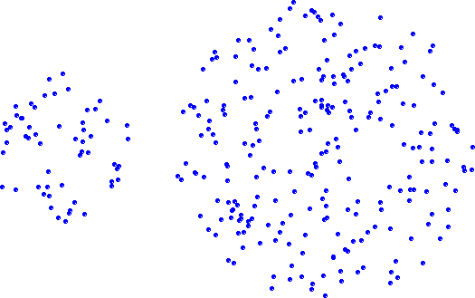
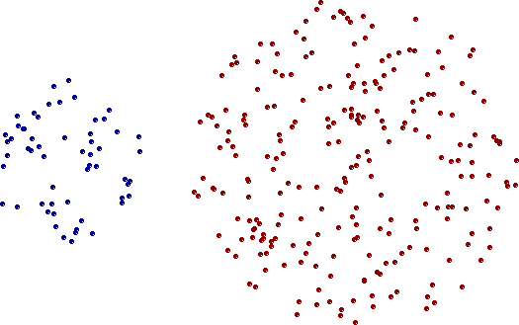
Strength of MIN
Original Points
Two Clusters
Can handle non-elliptical shapes

Slide 49
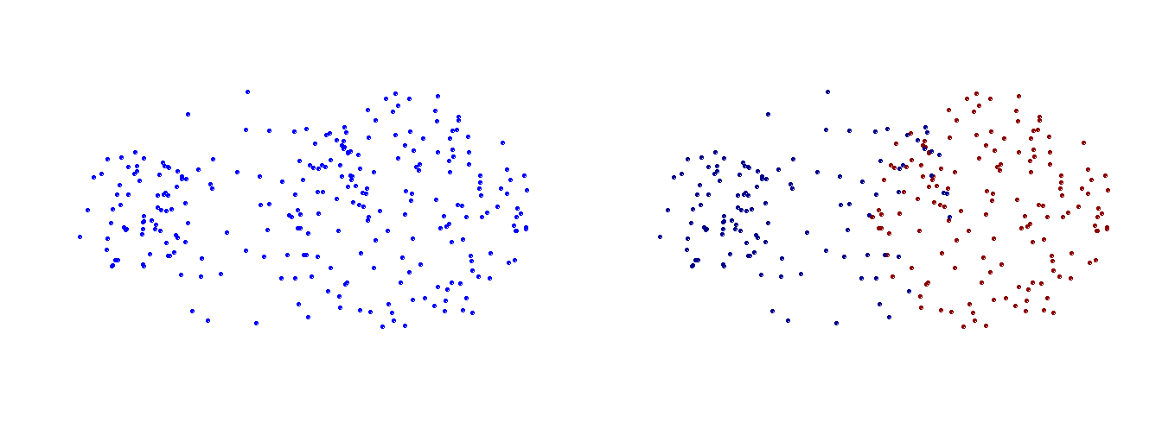
Limitations of MIN
Original Points
Two Clusters
Sensitive to noise and outliers

Slide 50
Cluster Similarity: MAX or Complete Linkage
Similarity of two clusters is based on the two least similar (most distant) points in the different clusters
–_{I1}Det_{I}e₂rmin_{I3}ed b_{I}y₄ all p_{I5}airs of points in the two clusters
I1 | 1.00 | 0.90 | 0.10 | 0.65 | 0.20
I2 | 0.90 | 1.00 | 0.70 | 0.60 | 0.50
I3 | 0.10 | 0.70 | 1.00 | 0.40 | 0.30
I4 | 0.65 | 0.60 | 0.40 | 1.00 | 0.80
I5 | 0.20 | 0.50 | 0.30 | 0.80 | 1.00
1
2 3 4
5

Slide 51
Hierarchical Clustering: MAX
4
1
2
5
0.4
5
0.35
0.3
0.25
2
3
6
0.2
0.15
3
1
0.1
4
0.05
0
3
6
4
1
2
5
Nested Clusters
Dendrogram

Slide 52
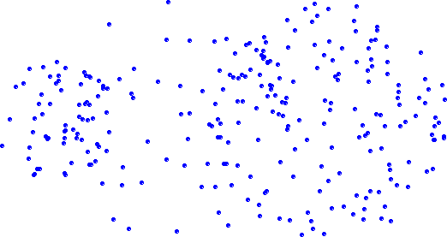
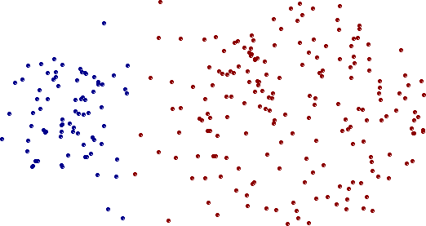
Strength of MAX
Original Points
Two Clusters
Less susceptible to noise and outliers

Slide 53
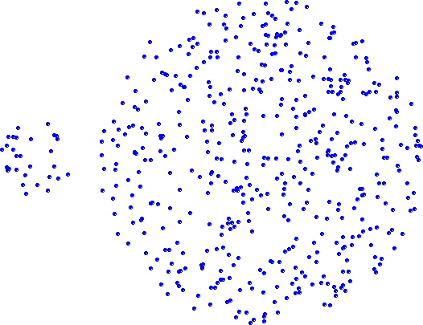
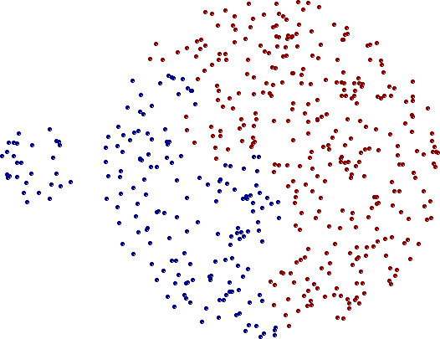
Limitations of MAX
Original Points
Two Clusters
Tends to break large clusters
Biased towards globular clusters

Slide 54
Cluster Similarity: Group Average
Proximity of two clusters is the average of pairwise proximity
between points in the two clusters.
∑proximity(p_{i} ,p_{j} )
p_{i}∈Cluster_{i}
proximity(Cluster_{i} , Cluster_{j} ) =
p ∈Cluster
j j
|Cluster_{i}|∗|Cluster_{j} |
Need to use average connectivity for scalability since total proximity favors large clusters
I1 I2 I3 I4 I5
I1 1.00 0.90 0.10 0.65 0.20
I2 0.90 1.00 0.70 0.60 0.50
I3 0.10 0.70 1.00 0.40 0.30
I4 0.65 0.60 0.40 1.00 0.80
I5 0.20 0.50 0.30 0.80 1.00
1
2 3
4
5

Slide 55
Hierarchical Clustering: Group Average
5
4
1
2
0.25
5
0.2
2
0.15
3
6
0.1
1
0.05
4
3
0
3
6
4
1
2
5
Nested Clusters
Dendrogram

Slide 56
Hierarchical Clustering: Group Average
Compromise between Single and Complete Link
Strengths
Less susceptible to noise and outliers
Limitations
Biased towards globular clusters

Slide 57
Cluster Similarity: Ward’s Method
Similarity of two clusters is based on the increase in squared error when two clusters are merged
Similar to group average if distance between points is distance squared
Less susceptible to noise and outliers
Biased towards globular clusters
Hierarchical analogue of K-means
Can be used to initialize K-means

Slide 58
Hierarchical Clustering: Time and Space requirements
O(N²) space since it uses the proximity matrix.
N is the number of points.
O(N³) time in many cases
There are N steps and at each step the size, N²,
proximity matrix must be updated and searched
Complexity can be reduced to O(N² log(N) ) time for some approaches

Slide 59
Hierarchical Clustering: Problems and Limitations
Once a decision is made to combine two clusters, it cannot be undone
No objective function is directly minimized
Different schemes have problems with one or more of the following:
Sensitivity to noise and outliers
Difficulty handling different sized clusters and convex shapes
Breaking large clusters

Slide 60
References
Introduction to Data Mining by Tan, Steinbach, Kumar (Lecture Slides)
https://www.iula.upf.edu/materials/040701wanner.pdf

Slide 61
Questions!

