Slide 1
How to Draft a Research Paper
Dr. Ahmed Awais

Slide 2
Outline
Overview of Process (The art and craft of making a draft)
Informal hacks
The abstract
IMRaD
My own method LR-IMRaD
Overview of:
Google Scholar
Overleaf
Conclusion
Q&A ~15 minutes

Slide 3
The art and craft of making a draft: writing a good-quality research paper
The Big Picture: Art & Craft of Drafting
Why writing is both creative and systematic
Mental shift: from “perfect first draft” to “iterative drafting”

Slide 4
Informally Quick Hacks
Reading
Are you good at reading
How to read papers – an art
Understanding
Summarize in your own words
Brainstorming (Visualization)
Mind maps, bullet lists, free-writing

Slide 5
Abstract
What is an abstract: Key points of paper?
There are two types of Abstract:
Simplify and clearly state: (1) problem, (2) method in one sentence, (3) anticipated results, (4) implication.
Descriptive abstracts: brief, highlight purpose and scope, do not include results.
Simplify and clearly state: (1) problem, (2) method, (3) key results, (4) implication.
Informative abstracts: detailed, include purpose, methods, results, and conclusions.
IMRAD: Problem → Method → Results → Implication

Slide 6
Abstract
Abstract provides a brief overview of work being proposed.
Abstract can enable readers to judge whether they want to read the larger body paragraphs of the paper.
Additionally, an abstract introduces your topic and includes your argument about the topic.
This way, readers can understand your approach to the topic and your writing tone and use it for their own research.

Slide 7
Abstract
This paper talks about exercise and mental health. We did a study with some college students. They exercised and then we asked them questions. The results showed that exercise is good. This is important for students and schools. More research could be done.
✅ Too vague – “some college students,” “asked them questions”
✅ No structure – Missing clear IMRAD flow
✅ No specifics – No sample size, method, or measurable results
✅ Weak implication – “Important for students and schools” is not concrete
✅ Informal language – “talks about,” “good”

Slide 8
Abstract
This study investigates the impact of a 30-minute daily aerobic exercise regimen on anxiety and depression levels among college students. A sample of 200 undergraduate students was randomly assigned to either an exercise group or a control group over eight weeks. Anxiety and depression were measured using the GAD-7 and PHQ-9 scales pre- and post-intervention. Results indicated a statistically significant reduction in anxiety (p < 0.01) and depression scores (p < 0.05) in the exercise group compared to controls. These findings suggest that integrating structured daily exercise into campus wellness programs could improve student mental health outcomes. Further research is needed to explore long-term effects across diverse populations.

Slide 9
IMRAD
IMRAD is short for Introduction, Methodology, Results and Discussion
The most common method.
Let’s Discuss each component

Slide 10
I for Introduction
A good introduction captures the reader's attention, provides necessary background information, and presents a clear thesis statement that outlines the main argument of your essay.
The Hook
The Background Information
Clearlu state main argument

Slide 11
Strategies for Writing an Effective Introduction
Be Concise: Avoid long, dense sentences. Aim for clarity and brevity to maintain the reader's interest.
Engage the Reader: Use a compelling hook to make the reader want to continue. An interesting introduction sets the tone for the rest of the essay and encourages engagement.
Tailor to Your Audience: Consider the expectations of your audience and the conventions of your discipline. Different types of essays may require different approaches to introductions.

Slide 12
Common Mistakes
Vagueness: Avoid general statements that do not provide specific information about your topic. Be clear and direct in your introduction.
Overloading with Information: While context is important, too much detail can overwhelm the reader. Focus on what is essential for understanding your thesis.
Neglecting the topic: Ensure that your key statement is present and clearly articulated. This is crucial for guiding the reader through your argument.

Slide 13
M for Methodology
Briefly, here we should focus on the the key method being proposed
Detailed design of your work
A well-crafted methodology is essential for any research project, providing a clear framework for how you will collect and analyze data to answer your research questions

Slide 14
Key Components of a Good Methodology
Mostly we focus:
Introduction->Research Design-> Data Collection Methods-> Sampling-> Brief Data Analysis
Sometime we prefer to introduce a seperate section about Data Processing
Sometimes, we also consider discussing
Ethical Considerations: Limitations

Slide 15
R for Results and D for Discussion
Think of Results as “Here’s what we found” and Discussion as “Here’s what it means and why it matters.” Keeping that separation clear makes your paper sharper and more persuasive.

Slide 16
My proposed method for research
LR – IMRaD --- Do the detailed literature work before proceeding with your desired task
PaperID | KeyMethod | Results | Limitations | Future Work

Slide 17
Tools
Google Scholar - Paper Searching
Overleaf - Collaborative LaTeX Writing (Kind of Markup based language)

Slide 18
Key takeaway
Start messy, refine systematically.

Slide 19
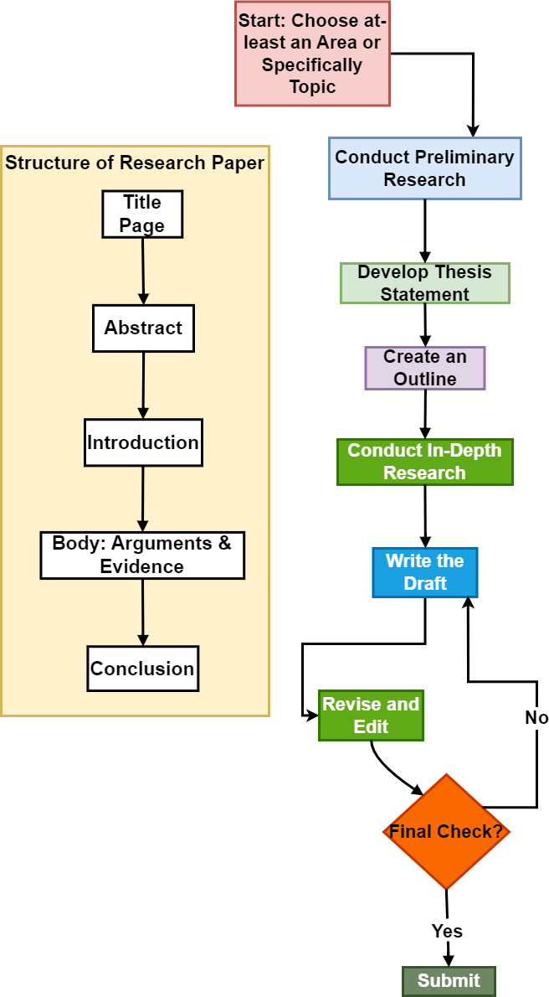
Step-by-Step Guide to Writing a Research Paper
Choose a Topic:
Select a topic that interests you and is manageable within your timeframe. Ensure it has enough depth for exploration and aligns with your academic goals.
Conduct Preliminary Research:
Gather background information to refine your topic and formulate a research question or thesis statement. Use reliable sources such as academic journals, books, and reputable websites.
Develop a Thesis/Paper Statement:
Create a clear and concise thesis/paper statement that presents the main argument or focus of your paper. This will guide your research and writing.

Slide 20
Step-by-Step Guide to Writing a Research Paper
Create an Outline:
Organize your ideas into a structured outline. This should include sections for the introduction, body, and conclusion, along with key points and supporting evidence for each section.
Conduct In-Depth Research:
Dive deeper into your topic by collecting data and evidence from various sources. Take notes and keep track of your references for citations.

Slide 21
Step-by-Step Guide to Writing a Research Paper
Write the Draft:
Begin writing your paper based on your outline. Start with the introduction, which should provide background information and state your thesis. The body should present your arguments and evidence, while the conclusion should summarize your findings and suggest further research.
Revise and Edit:
After completing your draft, take time to revise for clarity, coherence, and logical flow. Check for grammatical errors and ensure proper citation of sources. Consider seeking feedback from peers or mentors.

Slide 22
Step-by-Step Guide to Writing a Research Paper
Structure of a Research Paper
Title Page: Includes the title, author’s name, and affiliation.
Abstract: A brief summary of the research, typically 150-300 words.
Introduction: Sets the context, explains the significance, and presents the thesis statement.
Body: Contains the main arguments, evidence, and analysis.
Conclusion: Summarizes the findings and discusses implications or future research directions.
By following these steps and maintaining a structured approach, one can effectively draft a research paper that meets academic standards and contributes to your field of study.

Slide 23
Icebreaker Questions ☺
Raise your hand if you’ve ever struggled starting a paper
Which section do you dread writing?
What does IMRaD mean?
What is my preferred method?

Slide 24
Thank you for your attention Any Questions? ahmedawais@cwnu.edu.cn

