Slide 1
ACID Properties

Slide 2
ACID Properties – Basic Introduction now more will be covered in Transaction Chapter

Slide 3
Transaction
The comprehension and demonstration of the ACID principles in database systems significantly rely on understanding the pivotal concept of database transaction — an indivisible unit of work executed within a database management system.
Atomicity
Consistency
Isolation
Durability

Slide 4
Atomicity
Atomicity, a core principle within the ACID properties, ensures that transactions in a database system are treated as indivisible units of work.
It guarantees that all operations within a transaction are executed entirely or not at all.
Understanding atomicity is crucial for maintaining database integrity and consistency.

Slide 5
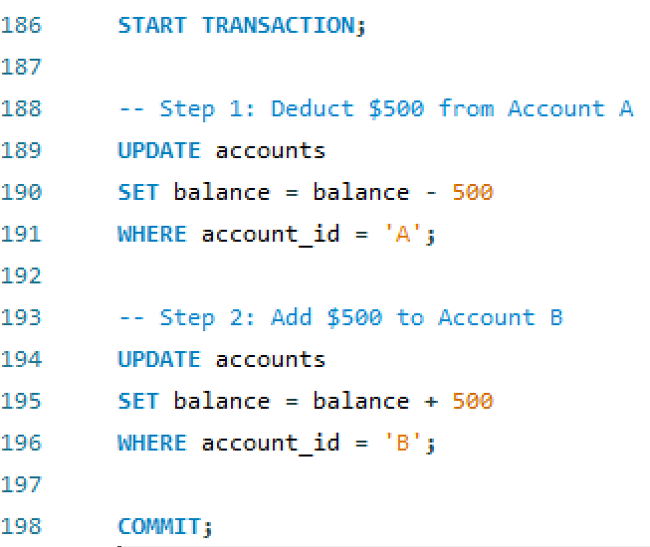
Atomicity
Consider a banking application where 500 RMB is transferred from Account A to Account B.
What Happens: If Step 1 succeeds but Step 2 fails (e.g., due to a server crash or insufficient database storage), Atomicity ensures the database rolls back to its previous state, leaving Account A and Account B unchanged.

Slide 6
Atomicity
Consider a banking application where 500 RMB is transferred from Account A to Account B.
Consider, without encapsulating these operations within a transaction, if a network disruption or any other failure occurs after deducting funds from ‘Account A’ but before updating ‘Account B’, the database would be left in an inconsistent state. ‘Account A’ would have deducted funds, but ‘Account B’ would not have received the corresponding amount, leading to a discrepancy in the system.

Slide 7
Consistency
Definition: Ensures that a database remains in a valid state before and after a transaction.
Enforces all defined constraints (e.g., foreign keys, unique constraints).
This SQL statement creates an ‘accounts’ table where the ‘balance’ column must always have a non-negative value due to the defined CHECK constraint. This consistency constraint prevents any transaction from causing a negative balance, maintaining the integrity of account balances.
CREATE TABLE accounts ( account_id SERIAL PRIMARY KEY, account_number VARCHAR(20) UNIQUE, balance DECIMAL NOT NULL CHECK (balance e >= 0) );

Slide 8
Consistency
Assuming ‘account_number = ‘123456’’ has a current balance of $1000, executing this query deducts $500, resulting in a balance of $500. However, if the defined constraint (balance >= 0) is violated due to this transaction, for instance, by attempting to withdraw an amount exceeding the available balance, database should prevents the transaction from completing.
This enforcement of consistency constraints ensures that the database remains in a valid state, thereby preventing anomalies like negative balances.
UPDATE accounts SET balance = balance - 500 WHERE account_number = '123456';
the database might utilize triggers or stored procedures to implement more complex consistency checks.

Slide 9
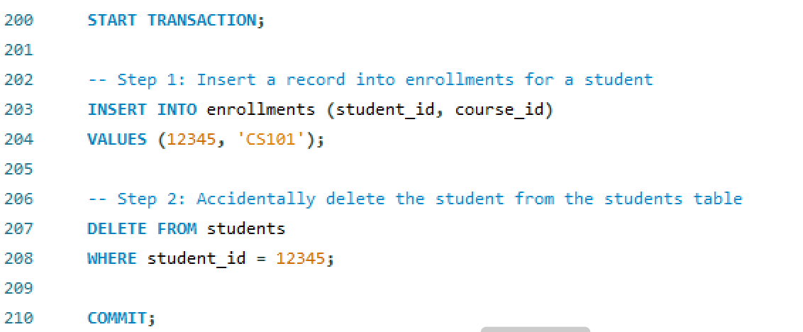
Consistency
Suppose we have two tables: students and enrollments, where a foreign key constraint links enrollments.student_id to students.student_id.

Slide 10
Consistency
What Happens: If the foreign key constraint is in place, the transaction will fail and rollback because student_id in enrollments cannot exist without a corresponding record in the students table. The database remains consistent.

Slide 11
Isolation
Definition: Ensures that concurrent transactions do not interfere with each other, preventing issues like dirty reads, non-repeatable reads, and phantom reads.
DBMS offers multiple isolation levels, each defining the degree of isolation between concurrent transactions and impacting their behaviour.
Achieved through isolation levels: READ UNCOMMITTED, READ COMMITTED, REPEATABLE READ, SERIALIZABLE.

Slide 12
Consistency
Two users, User A and User B, are simultaneously updating the same inventory record.
START TRANSACTION;
UPDATE inventory
SET quantity = quantity - 10
WHERE product_id = 'P001';
-- (Transaction not yet committed)
START TRANSACTION;
SELECT quantity
FROM inventory
WHERE product_id = 'P001';
-- User B reads the value of quantity before User A commits
Dirty Reads — A dirty read happens when one transaction reads data that has been altered by another transaction but hasn’t been committed yet.

Slide 13
Consistency
Dirty Reads: Transaction A modifies a record, and before it commits, Transaction B reads this modified but uncommitted data. If Transaction A is later rolled back, Transaction B will have read incorrect or misleading information.
Homework to read
Non-Repeatable Reads
Phantom Reads

Slide 14
Durability
Ensures that once a transaction is committed, the changes are permanently saved, even in case of a system crash.
START TRANSACTION;
-- Step 1: Place an order
INSERT INTO orders (order_id, customer_id, amount)
VALUES (1001, 123, 250.00);
COMMIT;
What Happens:
Once the transaction is committed, the order data is permanently stored on disk. Even if the database server crashes immediately after the commit, the data will be available upon restart.

Slide 15
A
This property states that a transaction must be treated as an atomic unit, that is, either all of its operations are executed or none. There must be no state in a database where a transaction is left partially completed. States should be defined either before the execution of the transaction or after the execution/abortion/failure of the transaction.
C
The database must remain in a consistent state after any transaction. No transaction should have any adverse effect on the data residing in the database. If the database was in a consistent state before the execution of a transaction, it must remain consistent after the execution of the transaction as well.
I
In a database system where more than one transaction are being executed simultaneously and in parallel, the property of isolation states that all the transactions will be carried out and executed as if it is the only transaction in the system. No transaction will affect the existence of any other transaction
D
The database should be durable enough to hold all its latest updates even if the system fails or restarts. If a transaction updates a chunk of data in a database and commits, then the database will hold the modified data. If a transaction commits but the system fails before the data could be written on to the disk, then that data will be updated once the system springs back into action.

Slide 16
Serializability
Serializability is a key concept in database management that refers to the ability to execute concurrent transactions in such a way that the outcome is equivalent to some serial execution of those transactions. In simpler terms, it ensures that the results of transactions remain consistent and isolated from each other, even when they are processed simultaneously. Achieving serializability guarantees the integrity of data in a multi-user environment.

Slide 17
Triggers – Hold on (hopefully we will reach to this topic)

Slide 18
Types of Triggers
In MySQL, a trigger is a stored program that is automatically invoked in response to specific events such as INSERT, UPDATE, or DELETE on a table.
Triggers are used to enforce business rules, validate data, maintain audit trails, and perform other tasks automatically.
A trigger is a database object that is automatically executed or fired when a specific event occurs on a table.
In simple terms When an Event occur, do something – obviously SQL INSERT, UPDATE, DELETE

Slide 19
Types of Triggers
MySQL supports six types of triggers, which are categorized based on the timing of their execution relative to the event:
Before Insert Trigger: Activated before a new row is inserted into a table.
After Insert Trigger: Activated after a new row is inserted into a table.
Before Update Trigger: Activated before an existing row is updated.
After Update Trigger: Activated after an existing row is updated.
Before Delete Trigger: Activated before a row is deleted from a table.
After Delete Trigger: Activated after a row is deleted from a table

Slide 20
BEFORE INSERT Trigger
Purpose: Execute actions before a row is inserted into a table.
Use Case: Automatically validate or modify data before insertion.
Example: Ensure that salaries being inserted are not negative.

