Slide 1
Object-Based Programming with Python

Slide 2
Objects
Python is an object-oriented programming language
An object is a combination of variables (also called attributes or instance variables or object variables) and behaviors (i.e., functions, which are referred to as methods in the object context)
To create an object, you need to create a class using the keyword class as follows:
class Student:
sname = “Ahmed"
An attribute; you can have as many attributes as you want

Slide 3
Creating Objects Out of Classes
After defining a class, you can create any number of objects out of it
Guess the output…
s1 = Student()
print(s1.sname)
s2 = Student ()
print(s2.sname)
s3 = Student ()
print(s3.sname)

Slide 4
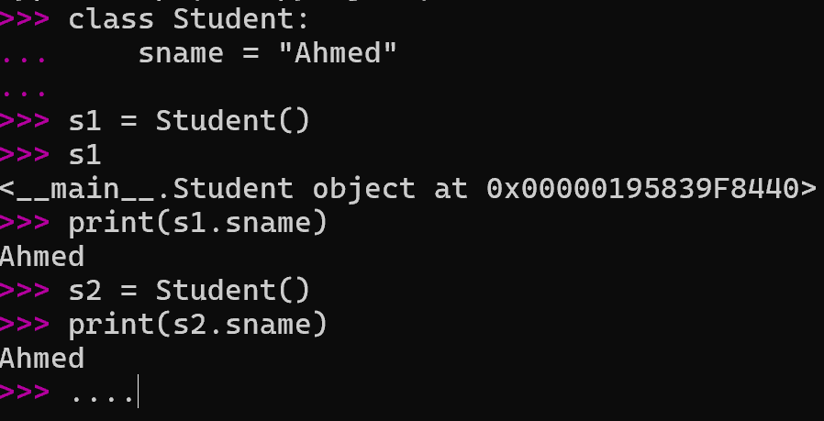
All of the above students have the same name!
How can we have student objects with different names?

Slide 5
Class Constructor
All classes in Python have a function called __init__(), which is always executed when the class is being initiated (i.e., an object out of it is created)
the __init__ method is a special method that is called when an instance (object) of a class is created. It is commonly used to initialize the attributes of the class.
We can use the __init__() function to assign values to object attribute(s)– as a matter of fact, you can add any code in the __init__() function that you may find necessary for creating objects out of your class
class Student:
def __init__(self, sn):
self.sname = sn
The __init__() function is called
the constructor or the initializer

Slide 6
class Person:
def __init__(self, name, age):
self.name = name
self.age = age
def greet(self):
return f"Hello, my name is {self.name} and I am {self.age} years old."
# Creating an instance of the Person class
person1 = Person("Alice", 30)
# Using the greet method
print(person1.greet())

Slide 7
Class Constructor
class Student:
def __init__(self, sn):
self.sname = sn
The constuctor should always have the keyword self as its first parameter – really?? How about this keyword?

Slide 8
Creating Objects Out of Classes
You can now create as many students as you like with different names
Is there any other way for assigning different names to different students?
s1 = Student12(“Moustafa")
print(s1.sname)
s2 = Student12(“Parvaiz")
print(s2.sname)
s3 = Student12(“Ali")
print(s3.sname)

Slide 9
Methods
You can assign different values to attributes through functions/methods, which you can define in your classes
class Student:
sname = ""
def setSName(self, sn):
self.sname = sn
s1 = Student12()
s1.setSName("Omar")
print(s1.sname)
Every method in a Python class
should have self as its first parameter

Slide 10
Methods
You can assign different values to attributes through functions/methods, which you can define in your classes
class Student:
sname = ""
def setSName(self, sn):
self.sname = sn
s1 = Student12()
s1.setSName("Omar")
print(s1.sname)
Every attribute in a Python class
should be always prefaced with self. upon accessing it

Slide 11
Constructor and Methods
You can also define __init__() alongside any other function/method
class Student:
def __init__(self, sn):
self.sname = sn
def setSName(self, sn):
self.sname = sn
def getSName(self):
return self.sname
s1 = Student(“Abdullah")
print(s1.getSName())
s1.setSName(" Abdullah2")
print(s1.getSName())

Slide 12
Example: Students and Courses
Let us write an object-based program for the following two classes
Class: Student
Attributes (or Instance Variables)
sname
sid
syear
Behaviors (or Methods)
getSName()
getSid()
getSYear()
setSYear(year)
Class: Course
Attributes (or Instance Variables)
cname
cid
slist (a list which holds student objects)
Behaviors (or Methods)
getCName()
getCid()
printAllStudents()
addStudent(Student)
Many students can register for one course

Slide 13
Example: Students and Courses
class Student:
def __init__(self, sn, sid, sy):
self.sname = sn
self.sid = sid
self.syear = sy
def getSName(self):
return self.sname
def getSid(self):
return self.sid

Slide 14
Example: Students and Courses
def getSYear(self):
return self.syear
def setSYear(self, sy):
if type(sy) is str and (sy.lower() == "freshman" or sy.lower() == "sophomore" or sy.lower() == "junior" or sy.lower() == "senior"):
self.syear = sy
else:
print("You have input an invalid value! The only allowable input are freshman, sophomore, junior, and senior")

Slide 15
Example: Students and Courses
class Course:
def __init__(self, cn, cid, sl):
self.cname = cn
self.cid = cid
self.slist = sl
def getCName(self):
return self.cname
def getCid(self):
return self.cid

Slide 16
Example: Students and Courses
def printAllStudents(self):
for i in self.slist:
print(i.getSName(), i.getSid(), i.getSYear())
def addStudent(self, st):
if type(st) is Student:
for i in self.slist:
if i is st:
print("This student is already added to the course!")
return
self.slist.append(st)
else:
print("Sorry, this is not a student!")

Slide 17
Example: Students and Courses
c1 = Course("Prinicples of Computing", 15110, [])
s1 = Student("Eman", 100, "Freshman")
s2 = Student("Omar", 101, "Freshman")
s3 = Student("Khaled", 102, "Junior")
c1.addStudent(s1)
c1.addStudent(s2)
c1.addStudent(s3)
c1.printAllStudents()

Slide 18
Example: A Simplified Bank Software
Let us write a simplified object-based program for a bank
Class: Customer
Attributes (or Instance Variables)
cname
cid
cjob
Behaviors (or Methods)
getCName()
getCid()
getCJob()
setCJob(new_job)
Class: Account
Attributes (or Instance Variables)
Customer
account_number
balance
Behaviors (or Methods)
deposit(amount)
withdraw(amount)
getCustomer()
getAccountNumber() getBalance()
Class: BankAccounts
Attributes (or Instance Variables)
alist (a list which holds Account objects)
Behaviors (or Methods)
addAccount(Account)
removeAccount(Account)
printAllCBalances()
Many accounts can be held in BankAccounts
One customer can have 1 or many accounts

Slide 19
Example: A Simplified Bank Software
Let us write a simplified object-based program for a bank
Class: Customer
Attributes (or Instance Variables)
cname
cid
cjob
Behaviors (or Methods)
getCName()
getCid()
getCJob()
setCJob(new_job)
Class: Account
Attributes (or Instance Variables)
Customer
account_number
balance
Behaviors (or Methods)
deposit(amount)
withdraw(amount)
getCustomer()
getAccountNumber() getBalance()
Class: BankAccounts
Attributes (or Instance Variables)
alist (a list which holds Account objects)
Behaviors (or Methods)
addAccount(Account)
removeAccount(Account)
printAllCBalances()
Many accounts can be held in BankAccounts
One customer can have 1 or many accounts

Slide 20
Example: A Simplified Bank Software
class Customer:
def __init__(self, cname, cid, cjob):
self.cname = cname
self.cid = cid
self.cjob = cjob
def getCName(self):
return self.cname
def getCid(self):
return self.cid

Slide 21
Example: A Simplified Bank Software
def getCJob(self):
return self.cjob
def setCJob(self, new_job):
self.cjob = new_job

Slide 22
Example: A Simplified Bank Software
Let us write a simplified object-based program for a bank
Class: Customer
Attributes (or Instance Variables)
cname
cid
cjob
Behaviors (or Methods)
getCName()
getCid()
getCJob()
setCJob(new_job)
Class: Account
Attributes (or Instance Variables)
Customer
account_number
balance
Behaviors (or Methods)
deposit(amount)
withdraw(amount)
getCustomer()
getAccountNumber() getBalance()
Class: BankAccounts
Attributes (or Instance Variables)
alist (a list which holds Account objects)
Behaviors (or Methods)
addAccount(Account)
removeAccount(Account)
printAllCBalances()
Many accounts can be held in BankAccounts
One customer can have 1 or many accounts

Slide 23
Example: A Simplified Bank Software
class Account:
def __init__(self, customer, account_number, balance):
self.customer = customer
self.account_number = account_number
self.balance = balance
def deposit(self, amount):
self.balance = self.balance + amount
def withdraw(self, amount):
if amount <= self.balance:
self.balance = self.balance - amount
else:
print("You do not have sufficient funds to make this withdrawal!")

Slide 24
Example: A Simplified Bank Software
def getCustomer(self):
return self.customer
def getAccountNumber(self):
return self.account_number
def getBalance(self):
return self.balance

Slide 25
Example: A Simplified Bank Software
Let us write a simplified object-based program for a bank
Class: Customer
Attributes (or Instance Variables)
cname
cid
cjob
Behaviors (or Methods)
getCName()
getCid()
getCJob()
setCJob(new_job)
Class: Account
Attributes (or Instance Variables)
Customer
account_number
balance
Behaviors (or Methods)
deposit(amount)
withdraw(amount)
getCustomer()
getAccountNumber() getBalance()
Class: BankAccounts
Attributes (or Instance Variables)
alist (a list which holds Account objects)
Behaviors (or Methods)
addAccount(Account)
removeAccount(Account)
printAllCBalances()
Many accounts can be held in BankAccounts
One customer can have 1 or many accounts

Slide 26
Example: A Simplified Bank Software
class BankAccounts:
def __init__(self, accounts):
self.alist = accounts
def addAccount(self, account):
for i in self.alist:
if account is i:
print("This account has already been added")
return
self.alist.append(account)

Slide 27
Example: A Simplified Bank Software
def removeAccount(self, account):
counter = 0
for i in self.alist:
if account is i:
self.alist.pop(counter)
return
counter = counter + 1
print("This account does not exist!")
def printAllCBalances(self):
for i in self.alist:
print(i.getCustomer().getCName(), i.getBalance())

Slide 28
Example: A Simplified Bank Software
c1 = Customer("Maram", 12345, "Student")
c2 = Customer("Jack", 12333, "Teacher")
c1_account = Account(c1, 100, 0)
c2_account = Account(c2, 101, 5000)
bas = BankAccounts([])
bas.addAccount(c1_account)
bas.addAccount(c2_account)
bas.addAccount(c2_account)

Slide 29
Example: A Simplified Bank Software
c1_account.deposit(20000)
c1_account.withdraw(230)
c2_account.withdraw(1500)
bas.printAllCBalances()
bas.removeAccount(c2_account)
bas.printAllCBalances()

Slide 30
Online Shopping
Objective: Design a system to manage an online shopping platform, allowing users to browse products, manage their shopping cart, and make purchases.
Product Class
Attributes: product_id: Unique identifier for the product name: Name of the product price: Price of the product stock: Available stock for the product Methods: is_in_stock(): Returns whether the product is in stock. update_stock(quantity): Updates the stock level. get_product_details(): Returns details of the product.

Slide 31
Cart Class
Attributes: cart_id: Unique identifier for the cart products: A dictionary that holds product_id as keys and a tuple of (quantity, product) as values. Methods: add_product(product, quantity): Adds a product to the cart (increases quantity if already added). remove_product(product_id): Removes a product from the cart. calculate_total(): Calculates the total price of all items in the cart. clear_cart(): Clears all items from the cart.
User
Attributes: user_id: Unique identifier for the user name: User's name email: User's email cart: An instance of the Cart class for the user. Methods: view_cart(): Shows the contents of the user's shopping cart. checkout(): Handles the checkout process, which includes calculating the total cost and confirming the purchase. add_product_to_cart(product, quantity): Adds product to the user's cart.

Slide 32
Online Shopping
Store Class
Attributes: products: A list of Product objects available in the store. Methods: add_product(product): Adds a new product to the store. remove_product(product_id): Removes a product from the store. get_product(product_id): Retrieves a product by its identifier. search_product(name): Searches for products by name.

