Slide 1
Introduction to Python
Dr. Ahmed Awais

Slide 2
Introduction
Python is a dynamically-typed programming language, meaning that you don’t need to declare the type of variable when you create it.
Python supports several data types, which can be broadly classified into two categories: mutable and immutable types.
In this lecture, we'll explore the major data types in Python, including numeric types, sequences, dictionaries, sets, and Booleans.

Slide 3
Why Python?
Readability and ease-of-maintenance
Python focuses on well-structured easy to read code
Easier to understand source code…
..hence easier to maintain code base
Portability
Scripting language hence easily portabble
Python interpreter is supported on most modern OS’s
Extensibility with libraries
Large base of third-party libraries that greatly extend functionality. Eg., NumPy, SciPy etc.

Slide 4
Python Interpreter
The system component of Python is the interpreter.
The interpreter is independent of your code and is required to execute your code.
Two major versions of interpreter are currently available:
Python 2.7.X (broader support, legacy libraries)
Python 3.6.X (newer features, better future support)

Slide 5
Python execution model
Source Code
Byte Code
Execution by PVM
Interpreter has two phases:
Source code is compiled into byte code
Byte code is executed on the Python Virtual Machine
Byte code is regenerated every time source code OR the python version on the machine changes.
Byte code generation saves repeated compilation
time.

Slide 6
Script vs. command line
Code can be written in a python script that is interpreted as a block.
Code can also be entered into the Python command line interface.
You can exit the command line with Ctrl-z on windows and Ctrl-d on unix
For complex projects use an IDE (For example, PyCharm, Jupyter notebook).
PyCharm is great for single-developer projects
Jupyter is great sharing code and output with markup

Slide 7
Variables and Objects
Variables are the basic unit of storage for a program.
Variables can be created and destroyed.
At a hardware level, a variable is a reference to a location in memory.
Programs perform operations on variables and alter or fill in their values.
Objects are higher level constructs that include
one or more variables and the set of operations that work on these variables.
An object can therefore be considered a more complex variable.

Slide 8
Classes vs. Objects
Every Object belongs to a certain class.
Classes are abstract descriptions of the structure and functions of an object.
Objects are created when an instance of the class is created by the program.
For example, “Fruit” is a class while an “Apple” is an object.

Slide 9
What is an Object?
Almost everything is an object in Python, and it belongs to a certain class.
Python is dynamically and strongly typed:
Dynamic: Objects are created dynamically when they are initiated and assigned to a class.
Strong: Operations on objects are limited by the type of the object.
Every variable you create is either a built-in data type object OR a new class you created.

Slide 10
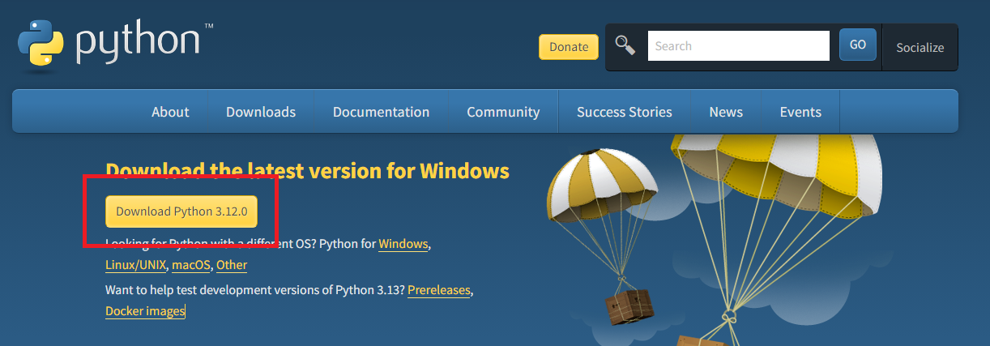
Installing Python
On Windows
To install Python, first download its setup from python.org/downloads.

Slide 11
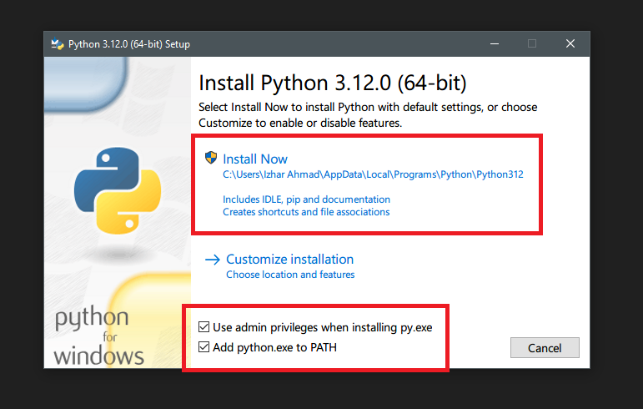
Installing Python

Slide 12
Installing Python
Use admin privileges when installing py.exe ensures installation is done as administrator to prevent any potential permission issues while installation.
Add python.exe to PATH allows you to use the python in command line to run your programs or use interpreter on command line. This would be useful throughout this guide.
After clicking Install Now, Python installation would start. Click "Yes" when prompted with administrator popup.

Slide 13
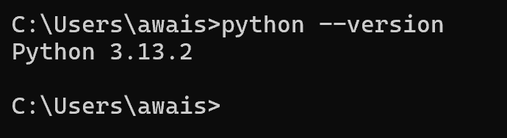
Confirm Installation
Type python --version

Slide 14
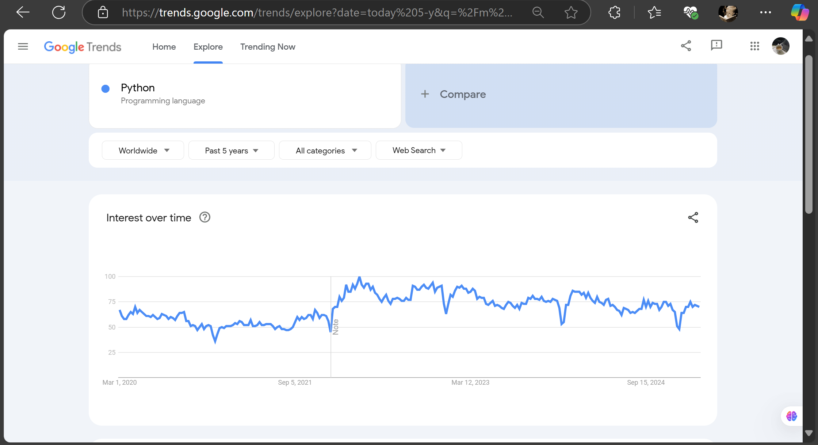

Slide 15
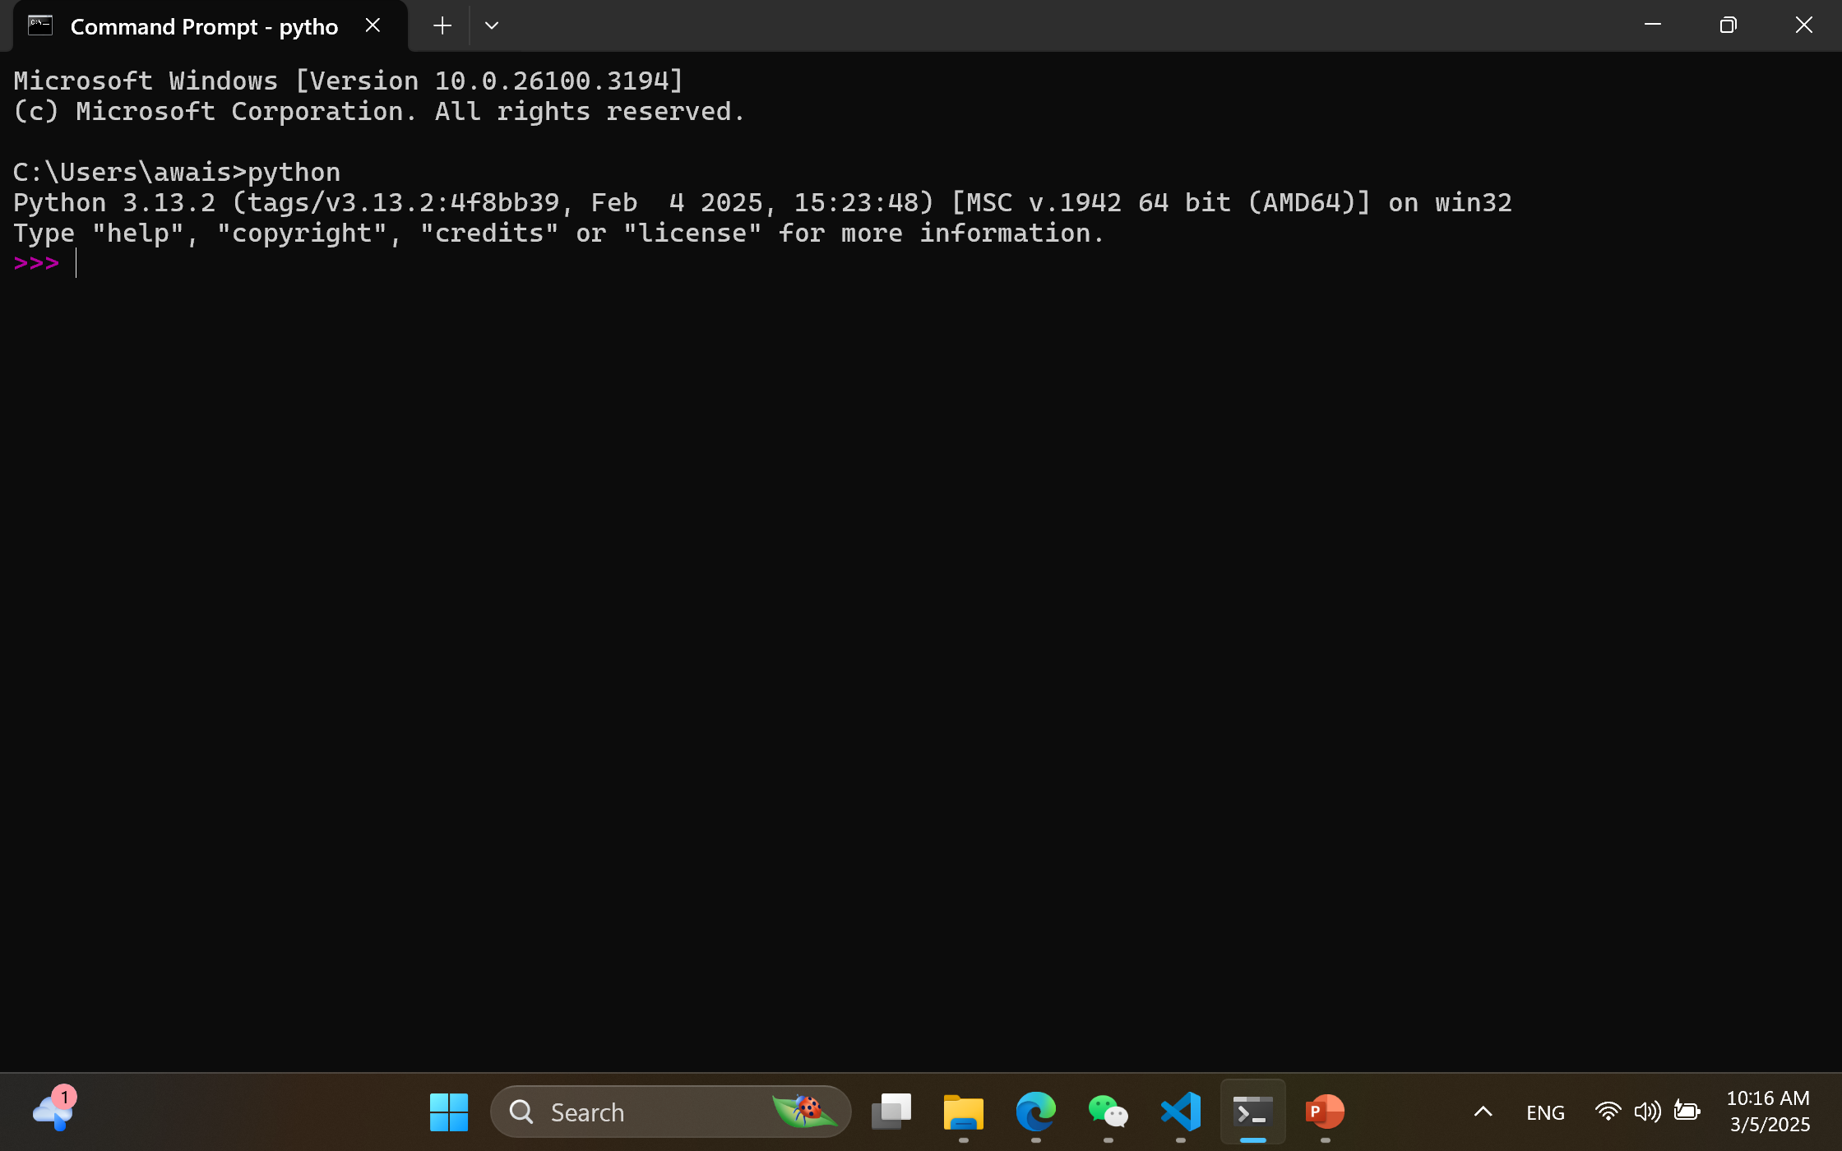

Slide 16
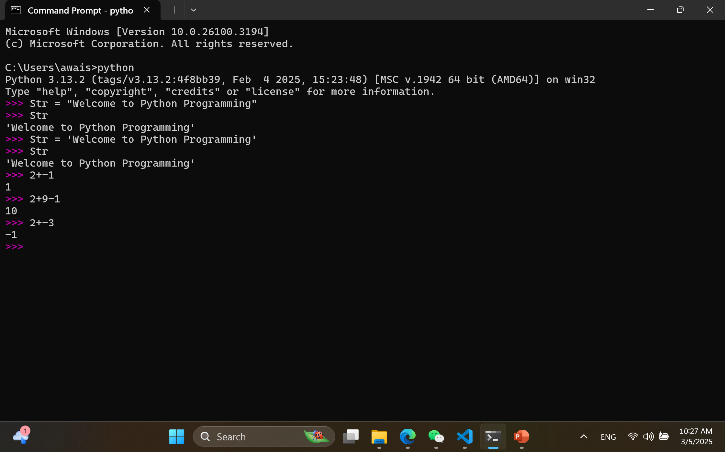

Slide 17
Directly on terminal
string1 = "Welcome to Python"
string2 = 'Welcome to Python'
print(string1 == string2) # This will output: True
Save following in Program1.py and run on terminal
string1 = "Welcome to Python"
string2 = 'Welcome to Python'
print(string1 == string2) # This will output: True

Slide 18
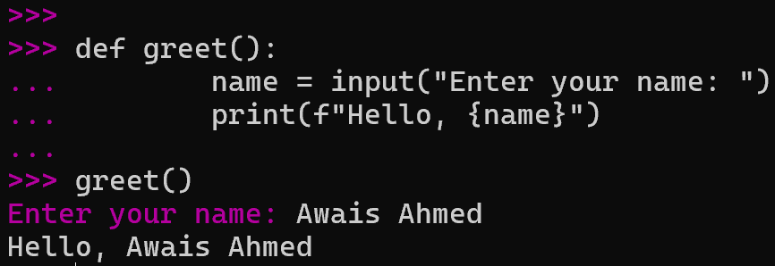

Slide 19
Is Python Case Sensitive?
Do you know what does case sensitivity mean?

Slide 20
Is Python Case Sensitive?
Yes, Python is a case-sensitive programming language. This means that Python differentiates between uppercase and lowercase characters, treating them as distinct entities. For example, the identifiers variable, Variable, and VARIABLE are considered entirely separate in Python.

Slide 21
Is Python Case Sensitive?
Examples of Case Sensitivity
To illustrate Python's case sensitivity, consider the following examples:
Incorrect Case Usage
def myFunction():
return "Hello, Python!"
# Attempting to call the function with the wrong case
print(Myfunction()) # This will result in a NameError because 'Myfunction' is not defined
Output:
NameError: name 'Myfunction' is not defined
Correct Case Usage
def myFunction():
return "Hello, Python!"

Slide 22
Is Python Case Sensitive?
How about Writing a case-insensitive string comparison program?
https://stackoverflow.com/questions/319426/how-do-i-do-a-case-insensitive-string-comparison

Slide 23
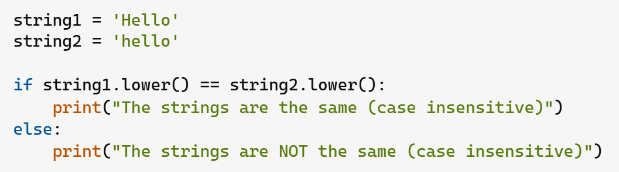
Is Python Case Sensitive?
How about Writing a case-insensitive string comparison program?
https://stackoverflow.com/questions/319426/how-do-i-do-a-case-insensitive-string-comparison

Slide 24
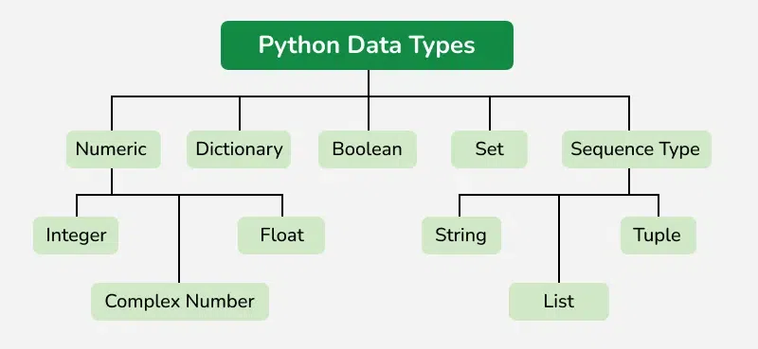
Python Data Types
Built-in Types — Python 3.13.2 documentation
https://docs.python.org/3/library/stdtypes.html

Slide 25
mutable and immutable types
In Python, Every variable in Python holds an instance of an object.
There are two types of objects in Python i.e. Mutable and Immutable objects.
Whenever an object is instantiated, it is assigned a unique object id.
The type of the object is defined at the runtime and it can’t be changed afterward. However, its state can be changed if it is a mutable object.

Slide 26
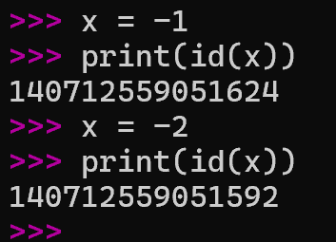
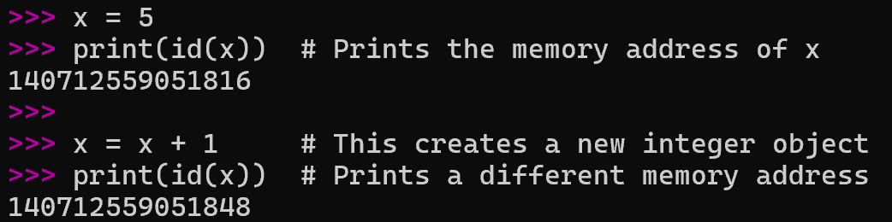
mutable and immutable types
Immutable Objects are of in-built datatypes like int, float, bool, string, Unicode, and tuple.
In simple words, an immutable object can’t be changed after it is created.

Slide 27
mutable and immutable types
my_tuple = (1, 2, 3)
# my_tuple[0] = 0 # This will raise a TypeError
my_set = {1, 2, 3}
my_set.add(4) # Set is now {1, 2, 3, 4}
my_set.remove(2) # Set is now {1, 3, 4}
my_string = "Hello"
my_string = my_string + " World!" # Creates a new string
Feature | Mutable | Immutable
Changeability | Can be changed after creation | Cannot be changed after creation
Examples | List, Dictionary, Set | Tuple, String, Frozenset
Memory | Changes may affect the same object in memory | Creates a new object for changes
Performance | Generally faster for modifications | Slower for modifications due to object creation

Slide 28
Python Data Types
Numeric Data Types in Python
The numeric data type in Python represents the data that has a numeric value. A numeric value can be an integer, a floating number, or even a complex number. These values are defined as Python int, Python float and Python complex classes in Python.
Integers – This value is represented by int class. It contains positive or negative whole numbers (without fractions or decimals). In Python (specifically Python 3), there is no limit to how long an integer value can be.
Float – This value is represented by the float class. It is a real number with a floating-point representation. It is specified by a decimal point. Optionally, the character e or E followed by a positive or negative integer may be appended to specify scientific notation.
Complex Numbers – A complex number is represented by a complex class. It is specified as (real part) + (imaginary part)j . For example – 2+3j

Slide 29
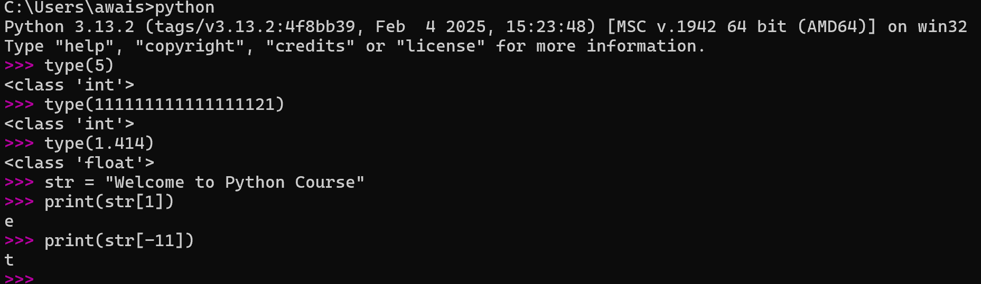

Slide 30
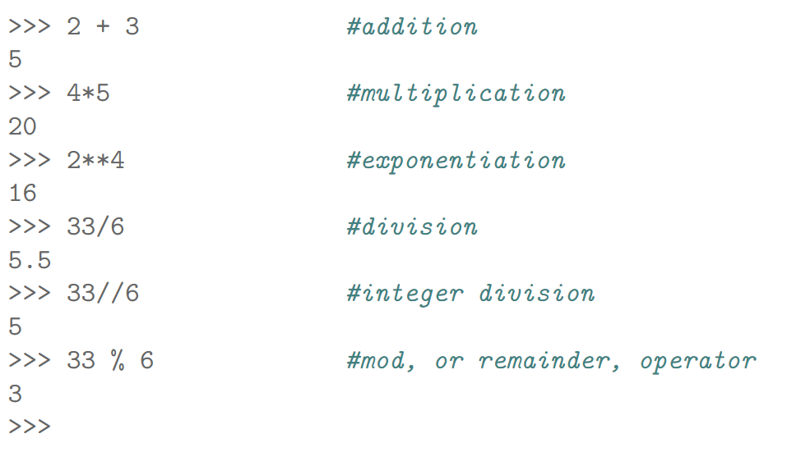
Basics

Slide 31
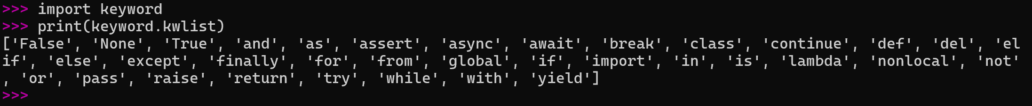
Python keywords

Slide 32
Control Structures
age = 25
if age >= 18:
print("Congratulations! You are eligible for BS Degree/Voting")
age = 19
if age > 18: print("Eligible to Vote.")
age = 10
if age <= 12:
print(“Pay half ticket.")
else:
print("Pay full ticket.")
payment = “Need to pay half” if age <=12 else “Need to pay full”

Slide 33
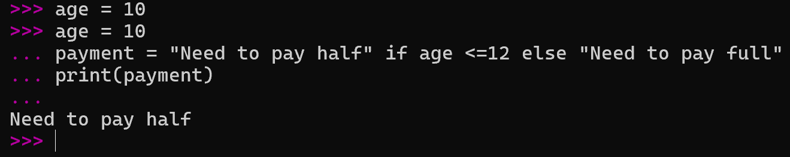
A ternary conditional statement is a compact way to write an if-else condition in a single line. It’s sometimes called a "conditional expression."
age = 70
is_member = True
if age >= 60:
if is_member:
print("30% senior discount!")
else:
print("20% senior discount.")
else:
print("Not eligible for a senior discount.")
age = 25
if age <= 12:
print("Child.")
elif age <= 19:
print("Teenager.")
elif age <= 35:
print("Young adult.")
else:
print("Adult.")
Nested if..else Conditional

Slide 34
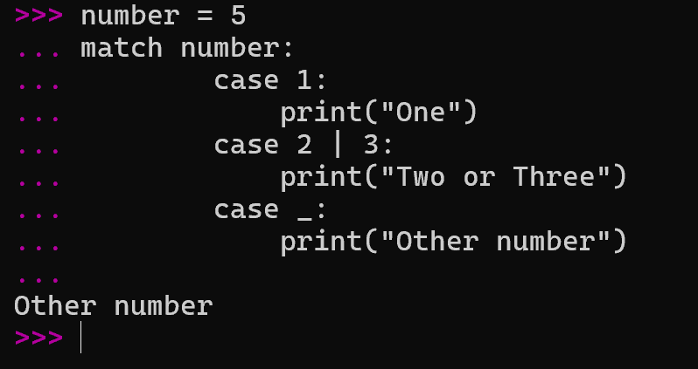
Match-Case Statement in Python
match-case statement is Python's version of a switch-case found in other languages. It allows us to match a variable's value against a set of patterns.

Slide 35
2- Session lecture and 1- Session practice

Slide 36
Python Switch Case?
Python does not have a built-in switch or case statement like some other programming languages (e.g., C, Java).
However, we can achieve similar functionality using various techniques, such as if-else, dictionaries etc
if value == 1:
return "You selected option 1"
elif value == 2:
return "You selected option 2"
elif value == 3:
return "You selected option 3"
else:
return "Invalid option"

Slide 37
Match case statement
The match statement in Python, introduced in version 3.10, provides a way to perform pattern matching, similar to switch statements in other languages. It allows you to check a variable against a series of patterns and execute code based on which pattern matches. This feature can simplify complex conditional logic.

Slide 38
Match-Case Statement in Python
match-case statement is Python's version of a switch-case found in other languages. It allows us to match a variable's value against a set of patterns.

Slide 39
User Input in Python
In Python, we can take input from the user using the input() function. This function reads a line from the input, converts it into a string, and returns it.
Example
name = input("Enter your name: ")
print("Hello, " + name + "!")
Taking Different Data Types as Input such as Integer Input
To take an integer input, you need to convert the input string to an integer using the int() function.
age = int(input("Enter your age: "))
print("You are " + str(age) + " years old.")

Slide 40
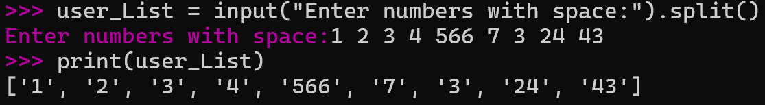
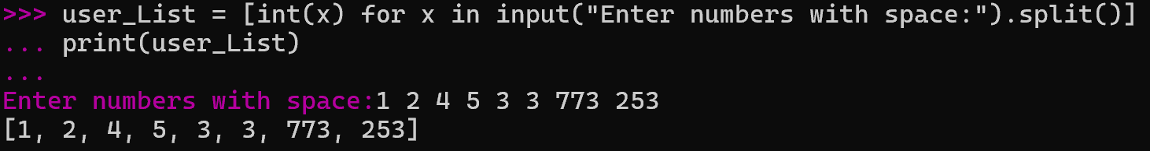
User Input in Python

Slide 41
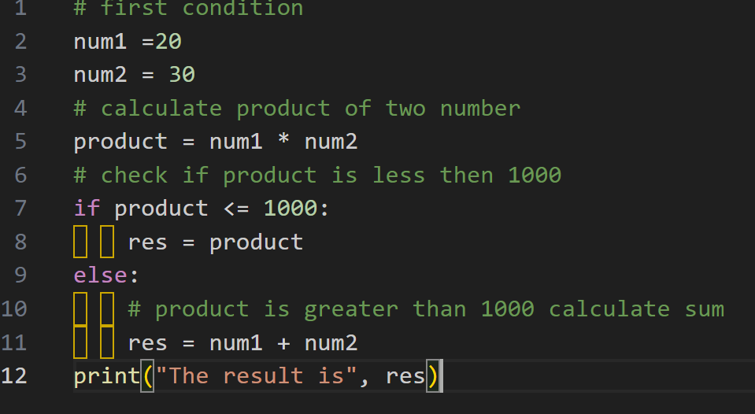
Given two integer numbers, write a Python code to return their product only if the product is equal to or lower than 1000. Otherwise, print/return their sum.

Slide 42
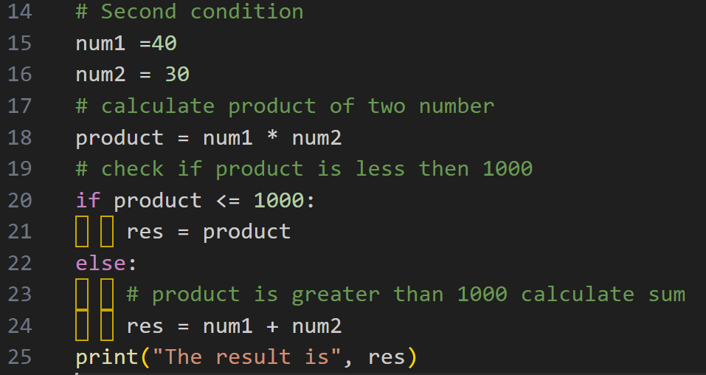
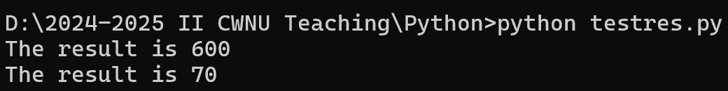
Given two integer numbers, write a Python code to return their product only if the product is equal to or lower than 1000. Otherwise, print/return their sum.

Slide 43
How about writing/converting it function
def multiplicationSum(num1, num2):
# calculate product of two number
product = num1 * num2
# check if product is less then 1000
if product <= 1000:
return product
else:
# product is greater than 1000 calculate sum
return num1 + num2
# first condition
result = multiplicationSum(20, 30)
print("The result is", result)
# Second condition
result = multiplicationSum(40, 30)
print("The result is", result)

Slide 44
Python functions def()
Definition: A function is a block of reusable code that performs a specific task. Functions help in organizing code and promoting reusability.
def my_function(): print("Hello from a function")
def function_name(parameters):
"""Docstring explaining the function."""
# Function body
return value
def add_numbers(a, b):
"""Return the sum of two numbers."""
return a + b
result = add_numbers(5, 3)
print(result) # Output: 8

Slide 45
Python functions def()
Definition: A function is a block of reusable code that performs a specific task. Functions help in organizing code and promoting reusability.
Variable (information) can be passed into functions as arguments.
Arguments are specified after the function name, inside the parentheses. You can add as many arguments as you want, just separate them with a comma.

Slide 46
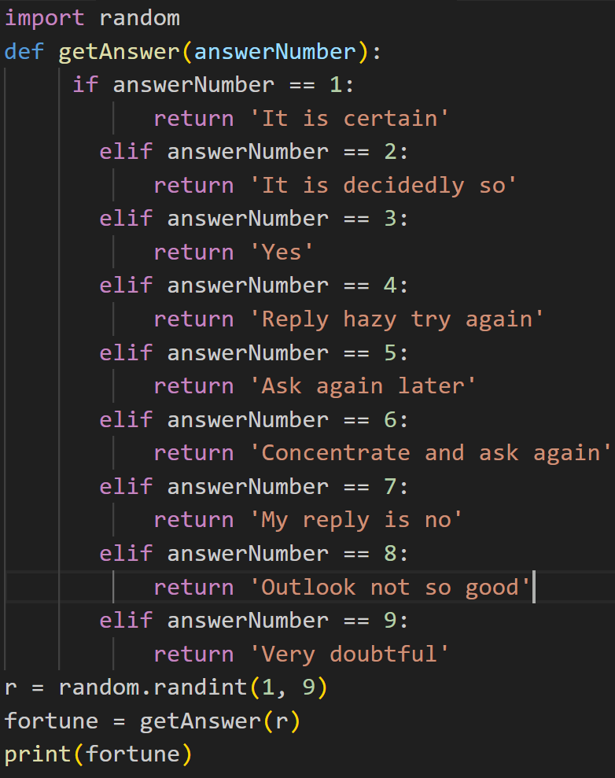
Type it and experience the output
What is import --- ??
Imports are like external modules or libraries into your current program
What is import random ??
Generate random numbers
Select random elements from a list
Shuffle a list randomly

Slide 47
import random
# Generate a random integer between 1 and 10
random_integer = random.randint(1, 10)
print(random_integer)
# Select a random item from a list
items = ['apple', 'banana', 'cherry']
random_choice = random.choice(items)
print(random_choice)
# Shuffle a list randomly
random_list = [1, 2, 3, 4, 5]
random.shuffle(random_list)
print(random_list)
Type it and experience the output
What is import --- ??
Imports are like external modules or libraries into your current program
What is import random ??
Generate random numbers
Select random elements from a list
Shuffle a list randomly

Slide 48
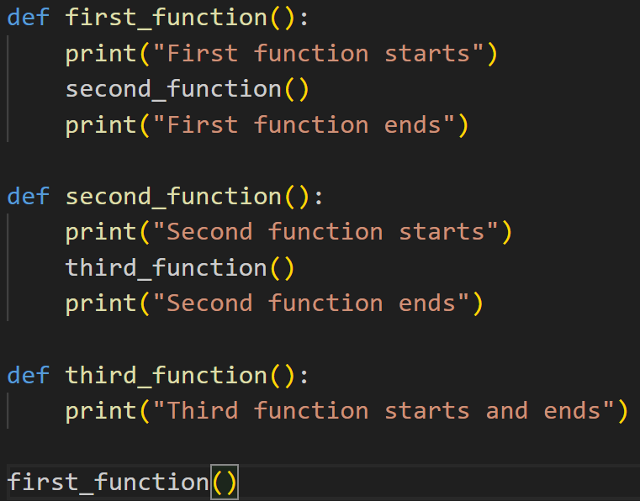
The CALL Stack
The call stack is a mechanism that keeps track of function calls in a program. It stores information about the active subroutines (functions) of a computer program.

Slide 49
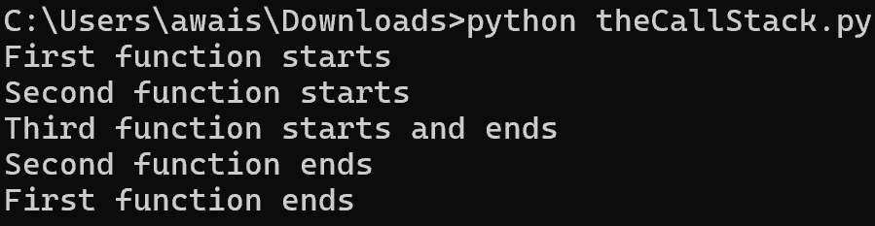
The CALL Stack

Slide 50
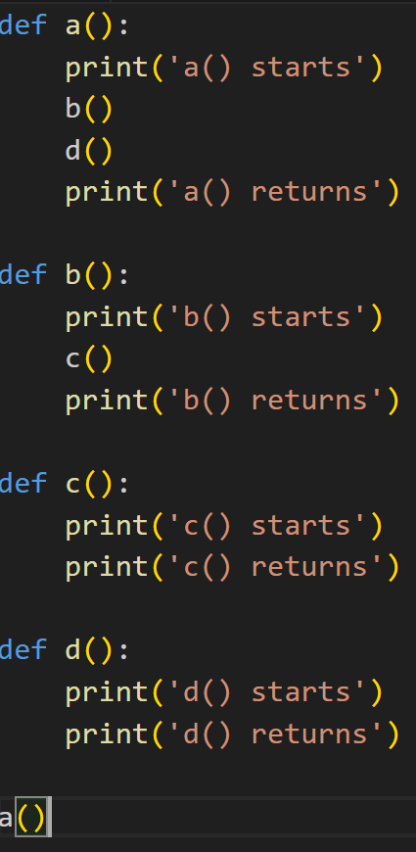
Trace the output

Slide 51
Local and Global Scope
Parameters and variables that are assigned in a called function are said to exist in that function’s local scope.
Variables that are assigned outside all functions are said to exist in the global scope.
A variable that exists in a local scope is called a local variable, while a variable that exists in the global scope is called a global variable.
A variable must be one or the other; it cannot be both local and global.

Slide 52
Scopes matter for several reasons:
Code in the global scope, outside of all functions, cannot use any local variables.
However, code in a local scope can access global variables.
Code in a function’s local scope cannot use variables in any other local scope.
You can use the same name for different variables if they are in different scopes.

Slide 53
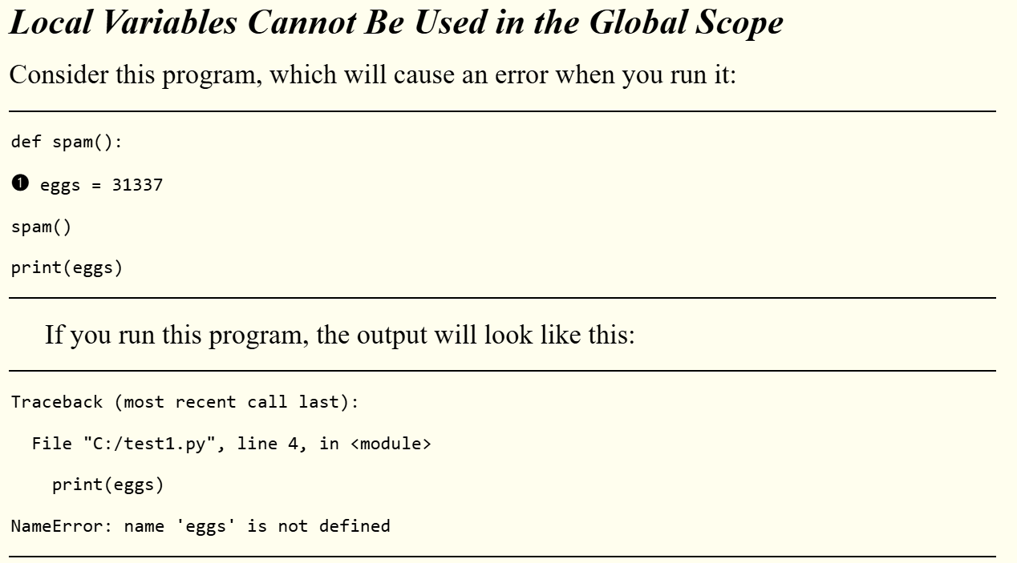

Slide 54
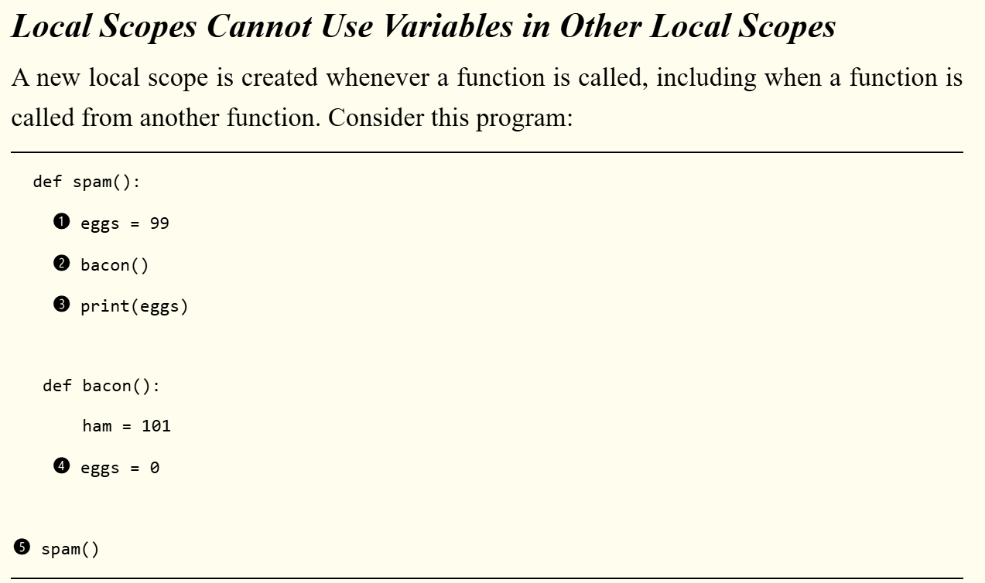

Slide 55
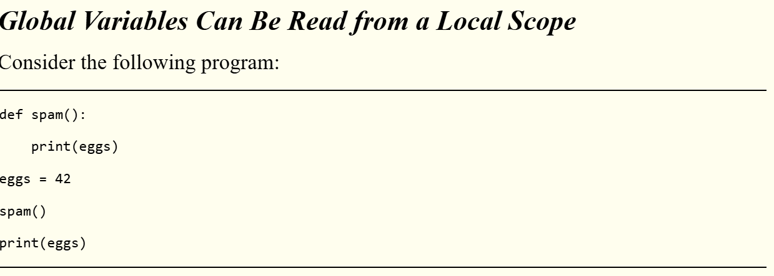

Slide 56
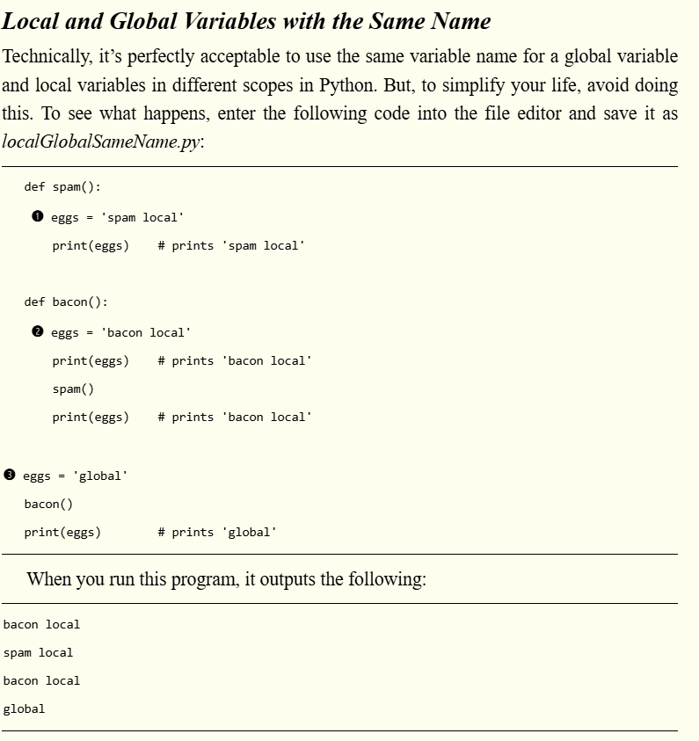

Slide 57
Lambda Function Python
Python lambda functions are:
Anonymous: They are defined using the lambda keyword.
Single-expression functions: Useful for concise operations.
Commonly used in functional programming contexts: Such as map(), filter(), and reduce().
Often employed within higher-order functions like list comprehensions and conditional rendering in UI frameworks.

Slide 58
Exception Handling
Homework – next week’s (Week#05) topic/coverage

Slide 59
Python Loop
Types of Loops in Python
For Loop
While Loop
for variable in sequence:
# execute code block
fruits = ["apple", "banana", "cherry"]
for fruit in fruits:
print(fruit)

Slide 60
Python Loop
Used to terminate the loop, regardless of the condition.
for i in range(10):
if i == 5:
break
print(i)
Types of Loops in Python
For Loop
While Loop
count = 0
while count < 5:
print(count)
count += 1
for i in range(5):
if i == 2:
continue
print(i)
Skips the current iteration and proceeds to the next one.

Slide 61
for i in range(3):
for j in range(2):
print(f"i={i}, j={j}")
Common Use Cases for Loops
Iterating through data structures (lists, dictionaries, etc.)
Performing repetitive calculations
Processing items in a collection (e.g., files, databases)

Slide 62
Write a Python code to iterate the first 10 numbers, and in each iteration, print the sum of the current and previous number.
print("Printing current and previous number and their sum within a range of 10")
previous_num = 0
# loop from 1 to 10
for i in range(1, 11):
x_sum = previous_num + i
print("Current Number", i, "Previous Number ", previous_num, " Sum: ", x_sum)
# modify previous number
# set it to the current number
previous_num = i

Slide 63
Questions:
Which approach is preferred iterative (loops ) or recursion
Does Python supports do while?

Slide 64
Parameters
Overhead
Memory Usage
Performance

Slide 65
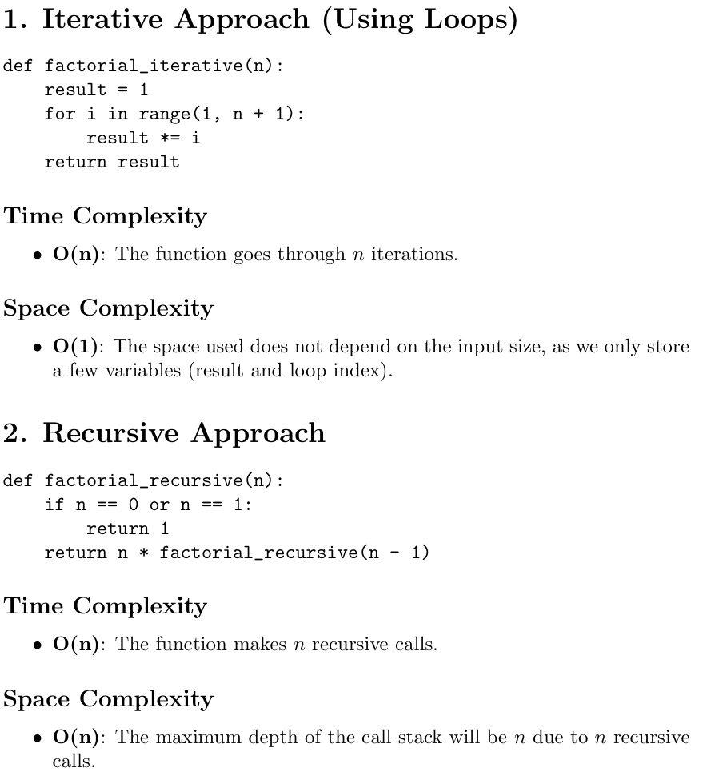
Factorial Calculation Iterative vs Recursive

Slide 66
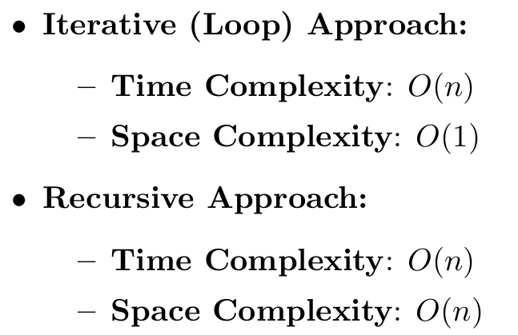
Factorial Calculation Iterative vs Recursive
While both approaches have the same time complexity, the iterative approach is more space efficient than the recursive approach due to the lack of additional stack space used for function calls.
This is particularly important when dealing with large values of n in recursion, which could lead to a stack overflow error.
The iterative solution is safer and more efficient in terms of memory usage.

Slide 67
When to use Recursion
Simplifying Code and Enhancing Readability
Divide and Conquer Approach
Breaking Problems Down: Many problems can be solved using a divide-and-conquer approach, where a problem is divided into smaller subproblems that are easier to solve. Recursion allows for this kind of breakdown naturally. Examples include:
Merge Sort and Quick Sort algorithms, where the array is split recursively and sorted.
Data Structures
Navigating Tree Structures: Recursion is particularly useful for traversing complex data structures like trees and graphs. For instance:
Binary tree traversals (preorder, inorder, postorder) are more intuitive when written recursively.
Depth-first search (DFS) algorithms use recursion to explore paths in graphs.
Notes:
Backtracking Problems
Dynamic Programming and Memoization eg (Fibonacci sequence, where each value relies on previous values).
n!=n×(n−1)!
While recursion has many advantages, it's important to also consider the trade-offs:
Performance: Recursion can lead to higher time and space complexity due to function call overhead and stack usage. Iterative solutions can be more efficient in some cases.
Stack Overflow: Deep recursion can lead to stack overflow errors if the recursion depth exceeds the maximum stack size. In such cases, an iterative solution may be required.

Slide 68
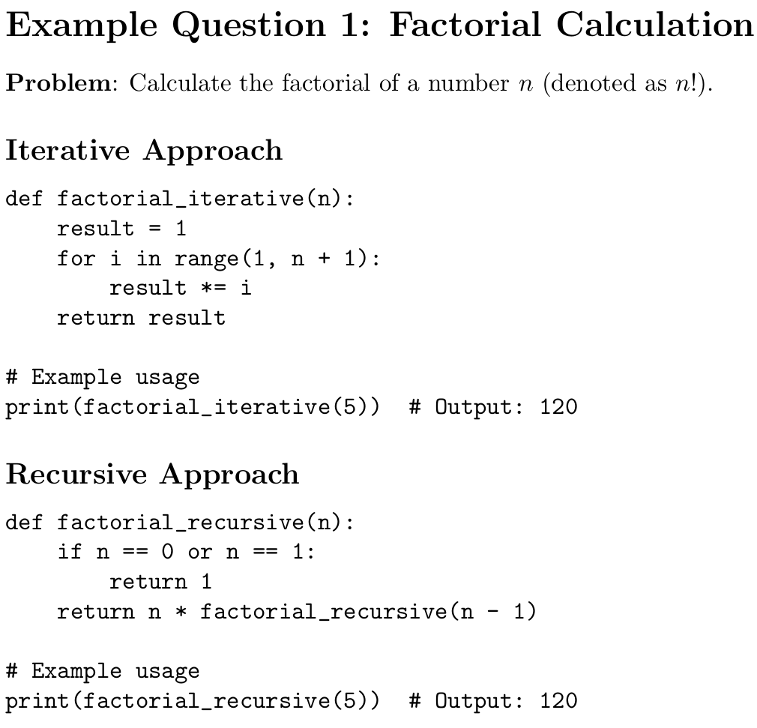

Slide 69
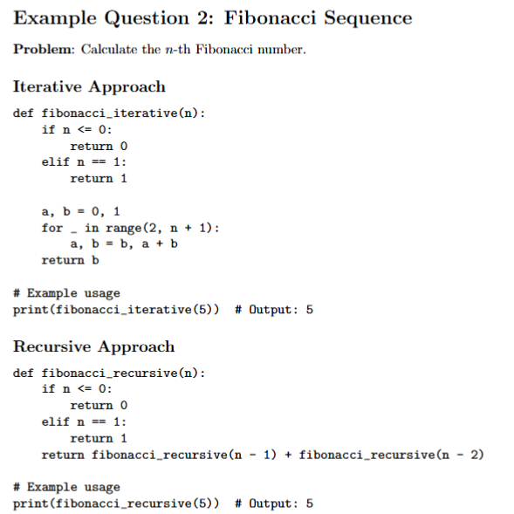

Slide 70
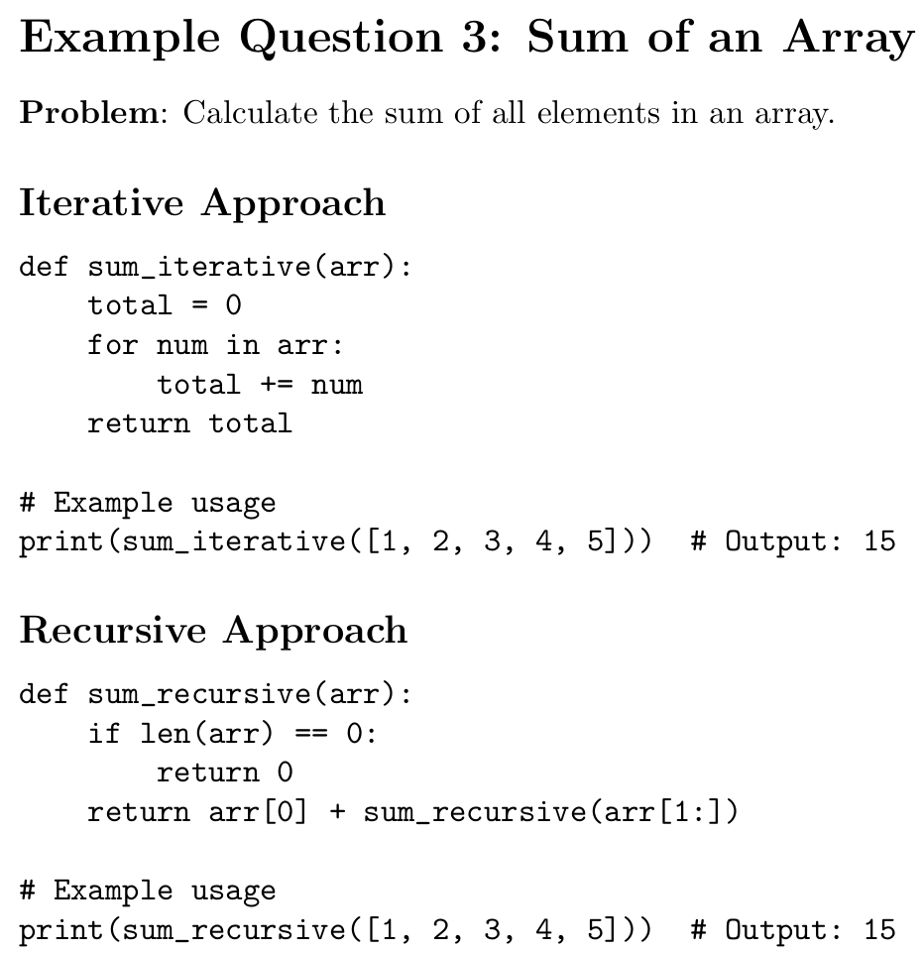

Slide 72
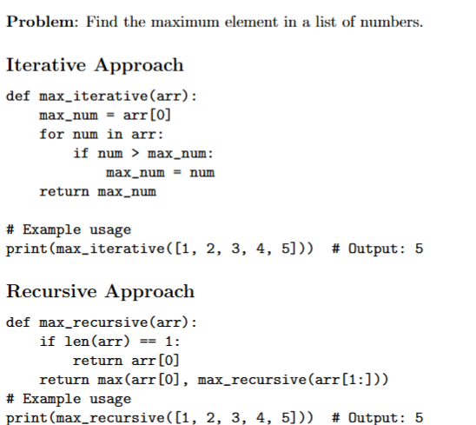

Slide 74
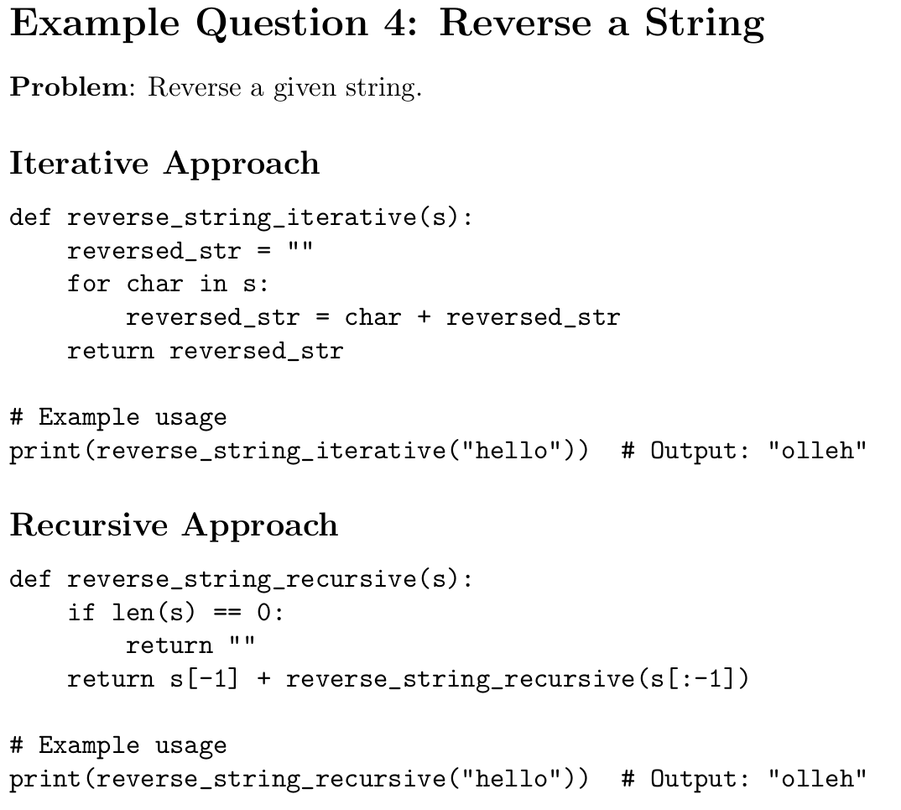

Slide 76
Write a Python code to accept a string from the user and display characters present at an even index number.
Such as “Welcome to Python Programming” should be printed as Wloe t yhnPormn

Slide 77
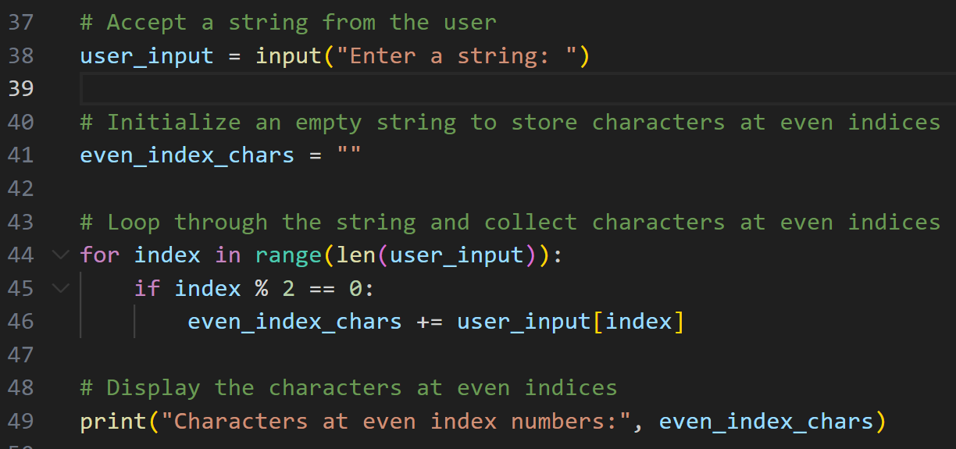
Write a Python code to accept a string from the user and display characters present at an even index number. Such as “Welcome to Python Programming” should be printed as Wloe t yhnPormn

Slide 78
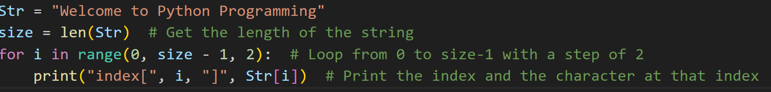
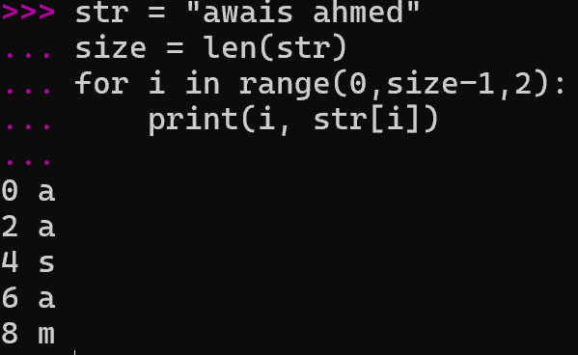
Write a Python code to accept a string from the user and display characters present at an even index number. Such as “Welcome to Python Programming” should be printed as Wloe t yhnPormn

Slide 79
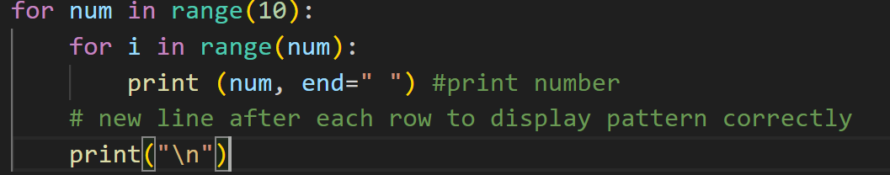
Trace the Program and write output in your notebook

Slide 80
