Slide 1
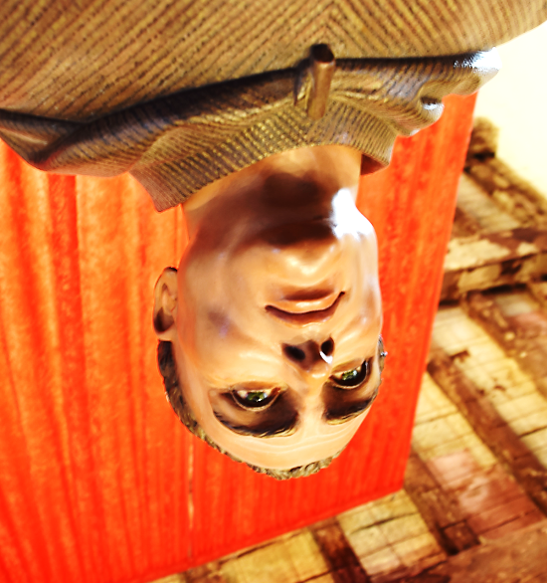
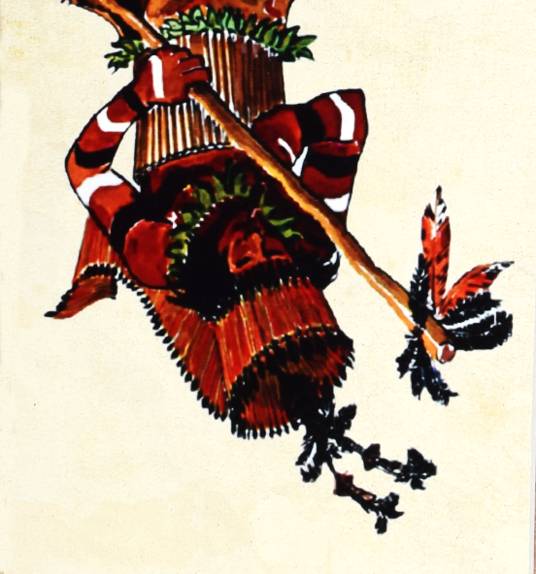
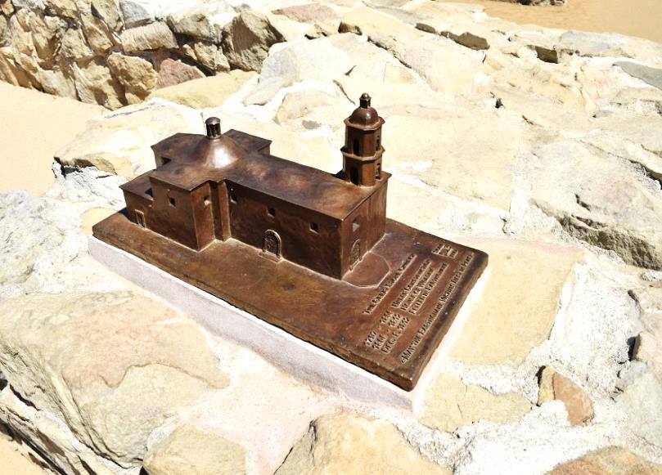
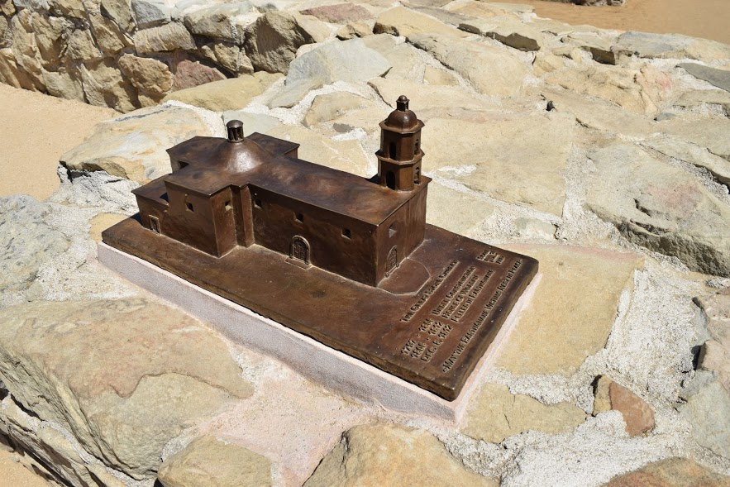





San Juan Capistrano
Mission
Juaneño
Father Serra
Forward 2 Spaces
Forward 2 Spaces
Forward 2 Spaces
Junípero Serra was a man to whom his religion was every thing. All his actions were governed by the ever-present.
Junípero Serra was a man to whom his religion was every thing.
Junípero Serra was a man to whom his religion was every thing.

Slide 2
San Juan Capistrano
Mission
Juaneño
Father Serra
Take 2 steps
Return to home
Move 1 forward
Serra walked so much he hurt his leg and had to use a cane to walk.
The mission fell down on you.
The Indians built most of the missions.

Slide 3
San Juan Capistrano
Mission
Juaneño
Father Serra
Return to home
Move 1 forward
Move 3 forward
The first mission Serra founded was San Feranondo de Velicata in May 1769.
Mission Capistrano was the 7th mission built of the 21 missions in California.
The Indians that lived around the mission spoke 8 different langugues.

Slide 4
San Juan Capistrano
Mission
Juaneño
Father Serra
Move 2 forward
Move 2forward
Move 2 back
Father Serra died on August 28, 1784 at San Carlos Borromeo del Rio Carmelo.
San Juan Capistrano is the oldest building in California
The Indians planted poppies around the mission.

Slide 5
San Juan Capistrano
Mission
Juaneño
Father Serra
Move 1 back
Move 1 back
Move 1 forward
Serra was born November 24, 1713.
Swallows live at the ruins of the mission and migrate but come back every March.
The Indians huts were built near creeks.

Slide 6
San Juan Capistrano
Mission
Juaneño
Father Serra
Move 3 forward
Move 1 forward
Move 1 back
Serra's parents were Maragarita Ferrer and Antonio Serra.
The mission was re-founded in 1776.
More than 2800 Indians came to live in San Juan Capistrano.

Slide 7
San Juan Capistrano
Mission
Juaneño
Father Serra
Lose a turn
Move 1 forward
Move 1 forward
Serra died at the age 70
Capistrano was founded in 1775, but was attacked by California Indians and one preist was killed.
When the mission came around there where between 35-300

Slide 8
San Juan Capistrano
Mission
Juaneño
Father Serra
Move 2 back
Stay were you are
Return to home
He became a priest in 1730
Capistrano is 120 feet tall, 180 feet long, and 40 feet wide.
The Indians hunted all animals

Slide 9
San Juan Capistrano
Mission
Juaneño
Father Serra
Move 1 back
Move 2 forward
Move 1 forward
Serra converted 6700 Native Americans to Missions
San Juan Capistrano was named in honor of St. John Capitan, a 15th century scholar, also known as the Jewel of the Missions.
When the mission was first built, there were estimated to be around 10,000 Juaneno living around the mission.

Slide 10
San Juan Capistrano
Mission
Juaneño
Father Serra
Move 2 forward
Move 1 forward
Move 2
Father Serra was very social, so when he stopped to talk to a Native Americans he would talk with them for hours until he was told to get moving.
On October 23, there is a huge party each year to celebrate the return of the swallows
In 1973, there were between 200-300 Juanenos.

Slide 11
San Juan Capistrano
Mission
Juaneño
Father Serra
Move 1 forward
Move 1 forward
Move 3forward
Father Serra founded nine missions in California
San Juan Capistrano is 200 years old.
In 1812, there were 1361 living at the mission

