Slide 1

ULM – Class Diagram
Natnael Tsige
Andrew Chimbanga
Afoke Abogidi

Slide 2



Agenda
Modeling
UML
Class diagram
Demo code class diagram
Demo code implementation
Q and A

Slide 3

What is UML?
Unified modeling language is a graphic or visual representation of an application.
Is industry standard
Independent of a language.
Examples of UML
Class diagram
Component diagram
package diagram
Use case diagram
State machine diagram
Sequence diagram

Slide 4
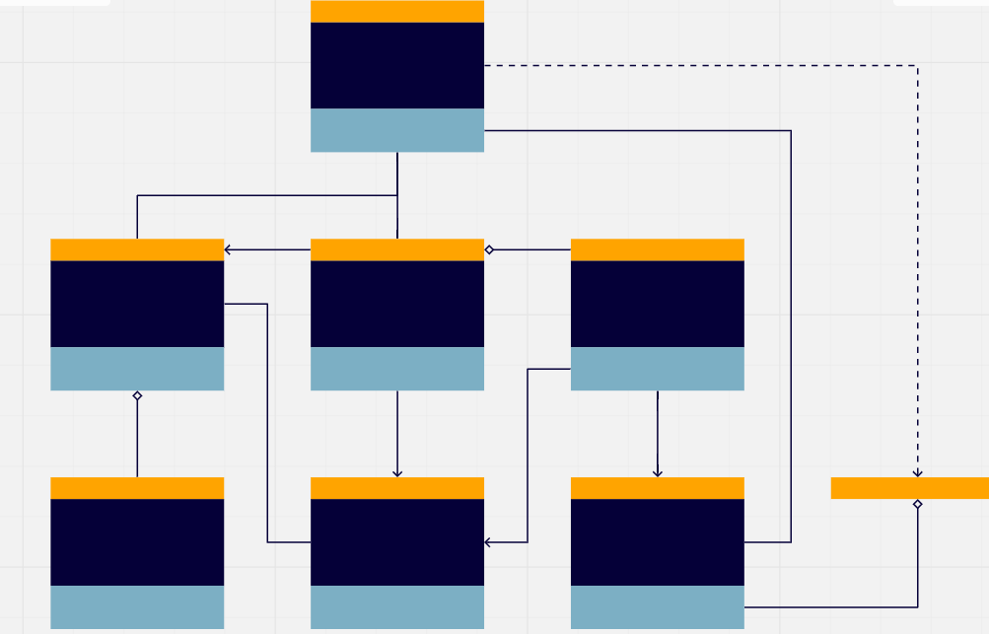
What is UML Class Diagram
A graphical notation used to construct and visualize object-oriented systems.
Specifically, a Class Diagram is a type of static structure that describes the structure of a system by showing the systems classes, their attributes, methods, and the relationships among objects.

Slide 5
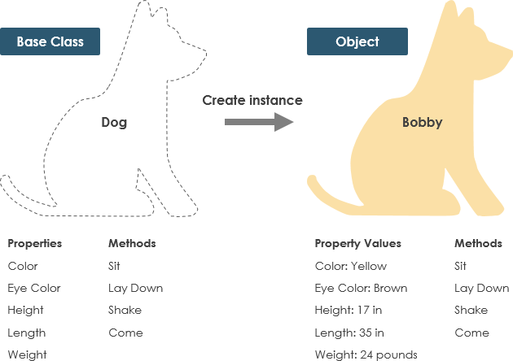
What is a class?
Blueprint of an object.
Objects and classes go hand in hand. Classes are what create objects.
Describe what an object will be but isn’t the object itself.
Classes describe the type of objects, while objects are usable instances of classes.
Each object is built from the same set of blueprints and therefore contains the same components (properties and methods.
An object is an instance of a class and object – Objects have states and behaviors.
A dog has states – color, name, breed as well as behaviors

Slide 6
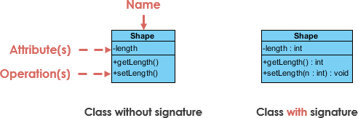
UML Class Notation
Two types of classes.
A class represents a concept which encapsulates state (attributes) and behaviors (operations).
Each attribute has type.
Each operation has a signature.
In a class diagram, the class name is the only mandatory information.

Slide 7
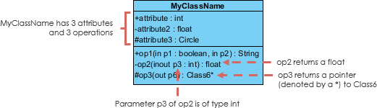
UML Class Notation cont.
Class name appears in the first partition
Class Attributes, shown in second partition, map onto member variables (data members) in code.
Attribute type is shown after the colon.
Class Operations are shown in the third partition. They are the services the class provides.
The return type is shown after the colon at the end of the method signature.
The return type of method parameters are shown after the colon following the parameter name. Operations map onto class methods in code

Slide 8
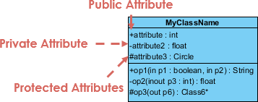
Class Visibility
The +, - and the # symbols before an attribute and operation name in a class denote the visibility of the attribute ad operation.
Modifier | Symbols | Description
Public | + | Accessible for all elements within the namespace.
Private | - | Accessible for all elements within the class.
Protected | # | Accessible for all classes that inherited the class its declared in.
Internal | ~ | Accessible within the entire scope of the Assembly (project)

Slide 9
Perspectives of Class Diagrams
choice of perspective depends on how far along you are in the development process. During the formulation of a
Domain model: during its formulation, for example, you would seldom move past the conceptual perspective.
Analysis models will typically feature a mix of conceptual and specification perspectives.
Design model development will typically start with heavy emphasis on the specification perspective and evolve into the implementation perspective.

Slide 10
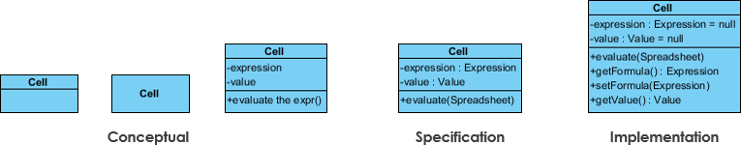
Perspectives of Class Diagrams cont.
Conceptual: represents the concepts in the domain
Specification: focus is on the interfaces of Abstract Data Type (ADTs) in the software
Implementation: describes how classes will implement their interfaces

Slide 11
Importance
UML precisely conveys how code should be implemented from diagrams when it is used correctly.
If precisely interpreted, the implemented code will correctly reflect the intent of the designer.

Slide 12
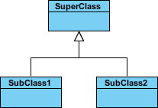
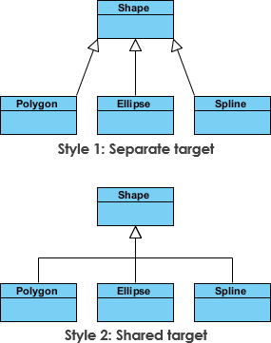
Relationships between classes
Inheritance (or Generalization)
A generalization is a taxonomic relationship between a more general classifier and a more specific classifier.
Each instance of the specific classifier is also an indirect instance of the general classifier. Thus, the specific classifier inherits the features of the more general classifier.
Represents an "is-a" relationship.
An abstract class name is shown in italics.
SubClass1 and SubClass2 are specializations of Super Class.

Slide 13

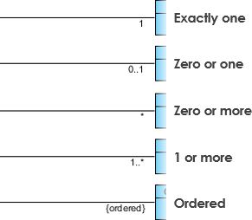
Relationships between classes cont.
Association
Structural link between two peer classes.
There is an association between Class1 and Class2
Cardinality (Multiplicity)
indicates the number of instances of one class linked to one instance of the other class. For example, one company will have one or more employees, but each employee works for just one company.
Cardinality is expressed in terms of:
One to one
One to many
Many to many

Slide 14


Relationships between classes cont.
The relationship is displayed as a solid line with a unfilled diamond at the association end, which is connected to the class that represents the aggregate.
Aggregation
A special type of association.
It represents a "part of" relationship.
Class2 is part of Class1.
Many instances (denoted by the *) of Class2 can be associated with Class1.
Objects of Class1 and Class2 have separate lifetimes.
Composition
A special type of aggregation where parts are destroyed when the whole is destroyed.
Objects of Class2 live and die with Class1.
Class2 cannot stand by itself.
The relationship is displayed as a solid line with a filled diamond at the association end, which is connected to the class that represents the whole or composite.

Slide 15


Relationships between classes cont.
Dependency
An object of one class might use an object of another class in the code of a method. If the object is not stored in any field, then this is modeled as a dependency relationship.
A special type of association.
Exists between two classes if changes to the definition of one may cause changes to the other (but not the other way around).
Class1 depends on Class2
The relationship is displayed as a dashed line with an open arrow.
The Person class might have a hasRead method with a Book parameter that returns true if the person has read the book (perhaps by checking some database).

Slide 16
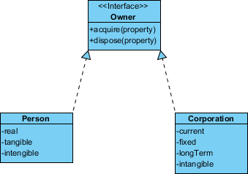
Relationships between classes cont.
Realization
Realization is a relationship between the blueprint class and the object containing its respective implementation level details. This object is said to realize the blueprint class. In other words, you can understand this as the relationship between the interface and the implementing class.
For example, the Owner interface might specify methods for acquiring property and disposing of property. The Person and Corporation classes need to implement these methods, possibly in very different ways.

Slide 17
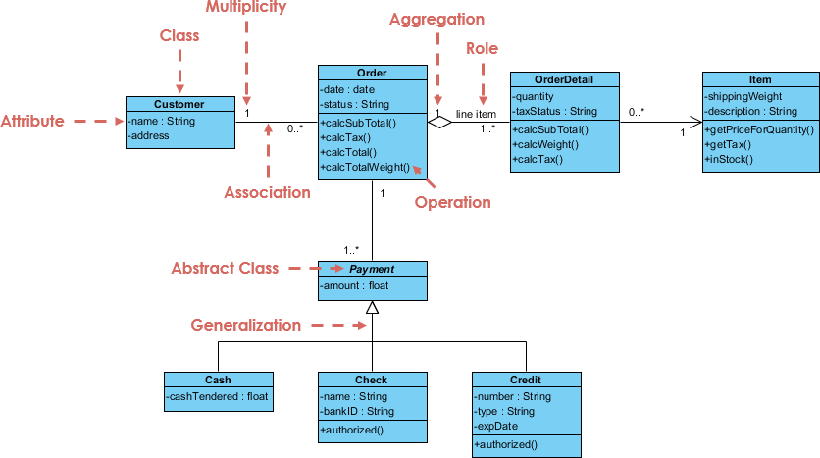
Class Diagram Example: Order System

Slide 18
Exercise
You are contracted be Goldman Sachs to implement an ATM software that will process the following customer transactions:
Deposit cash
Withdraw cash
Check balance
What classes would you need?
What type of relationships would exist between these classes?
How would you construct the class diagram?

Slide 19
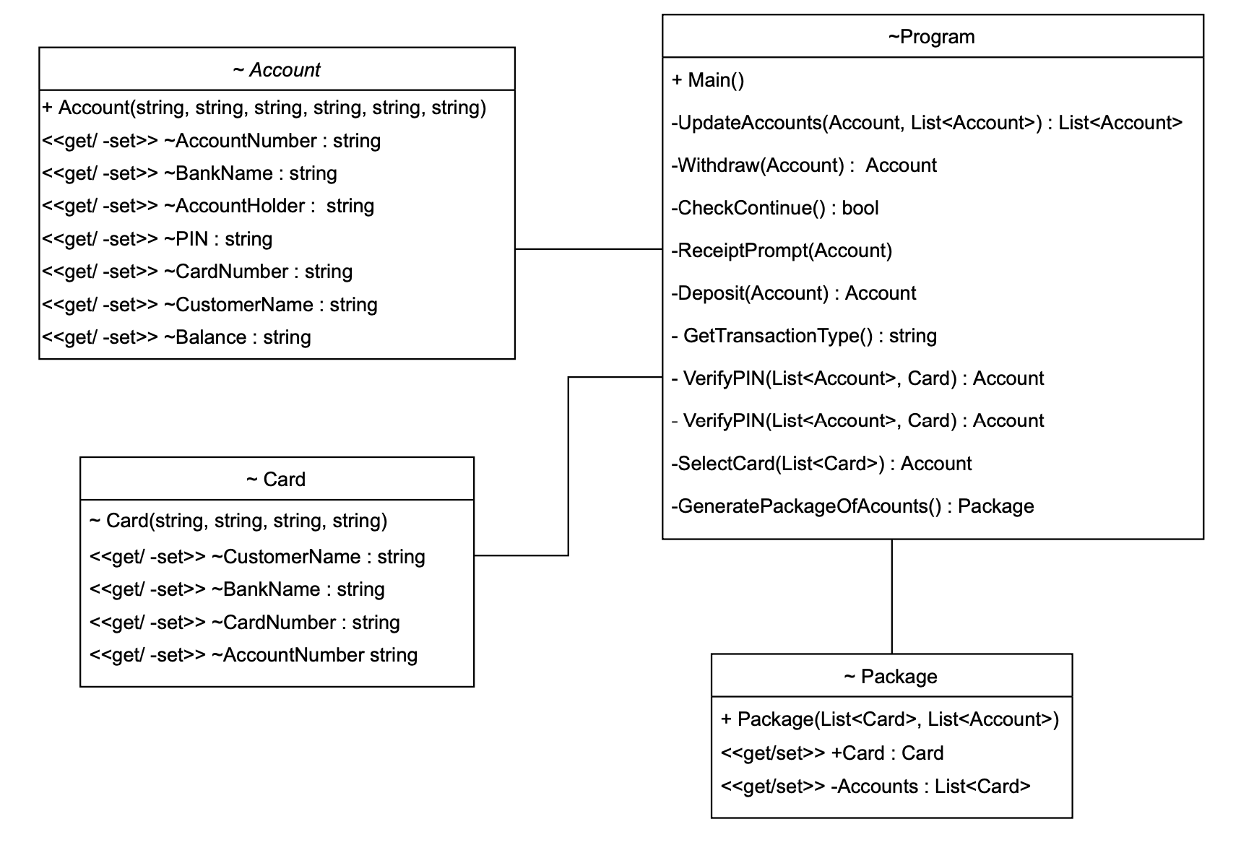
ATM Application
How can this be better implemented?

Slide 20
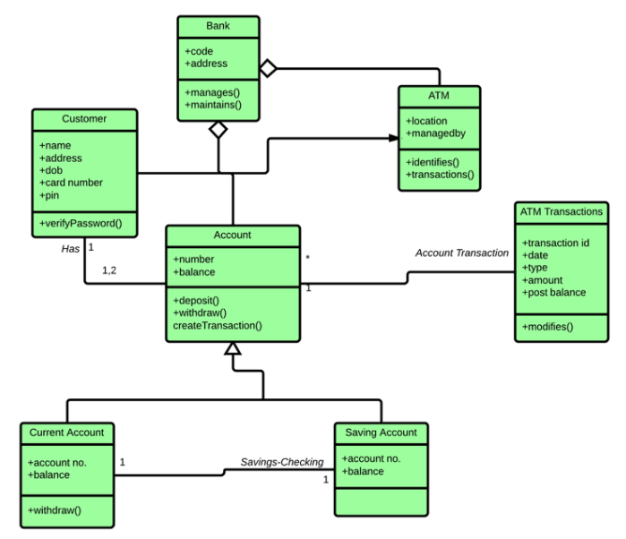
Better Class Diagram

Slide 21
Q and A

Slide 22

Summary

Slide 23


Thank You
Presenter name
Email address
Website address

