Slide 1
Project:Reliability asset management control

Slide 3
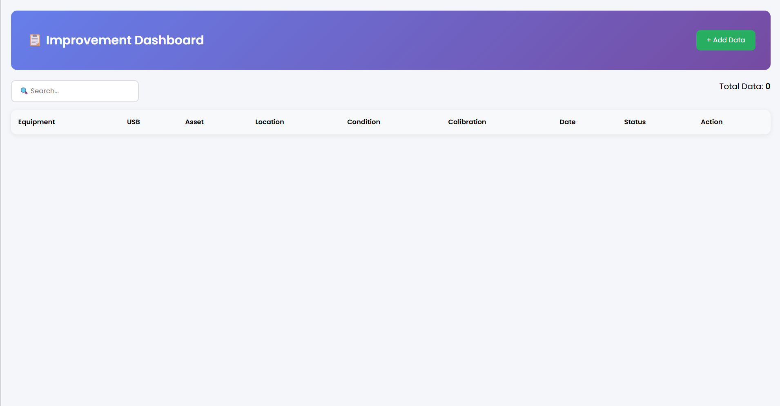
Project
Reliability asset management control (RAMC)
EXC
ORG
PIC
Mr.Shin Hyun Woo (FSE),Pak Amri (Team Leader)
Raihan,Andy,Rafi,Riki,Fauzul
KPI
All equipment is recorded in the system
Data is complete and well-maintainen
User-friendly and easy to use
Team
Name
DQA Team
Preview
Details
1.BackgroundThe Reliability Asset Management Control (RAMC) system is developed to manage and monitor equipment data effectively within the DQA Team. Previously, data recording was done manually, which caused inefficiency, data inconsistency, and difficulty in tracking equipment status.
2. ObjectiveTo digitalize equipment data recordingTo improve data accuracy and consistencyTo simplify monitoring of equipment condition and calibration status
3. System DescriptionThe system is a web-based application developed using Node.js, Express.js, and PostgreSQL for the backend, and HTML, CSS, and JavaScript for the frontend.It allows users to perform basic data management such as:Add new equipment dataView equipment listUpdate equipment informationDelete equipment data
4. Key FeaturesEquipment data management (CRUD)Search functionalityStatus and condition trackingCalibration date monitoringSimple and user-friendly interface
5. Expected BenefitsFaster data input and retrievalReduced human errorCentralized data storageBetter control of equipment status
6. Current StatusThe system has successfully connected frontend, backend, and database. Data can be displayed and managed through the web interface. Further improvements are focused on enhancing user interface and system stability
NOTED:This interface is not fully finalized and is currently presented for demonstration purposes only. Some columns will need to be removed, and additional features or columns are planned to be implemented in the dashboard in future revisions.

Slide 4
Reliability asset management control (RAMC)
Project Reliability Asset Management Control Team: DQA Team PIC: (nama kamu)

