Slide 1
SwitP: Mobile Application for Real-Time Swimming Analysis
Semester Thesis Daniel Wirzberger Raimundo (wirdanie@ethz.ch) Supervised by D.Melnyk and S.Tanner

Slide 2
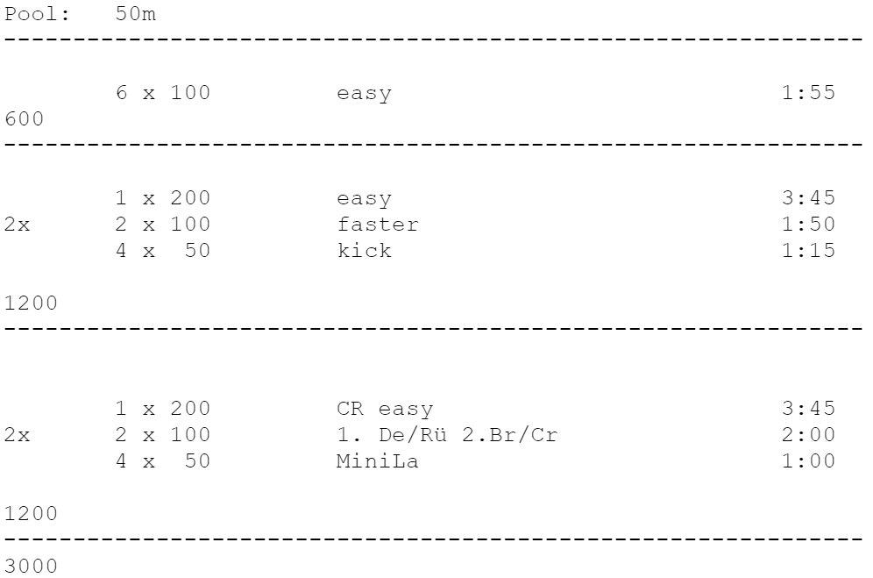
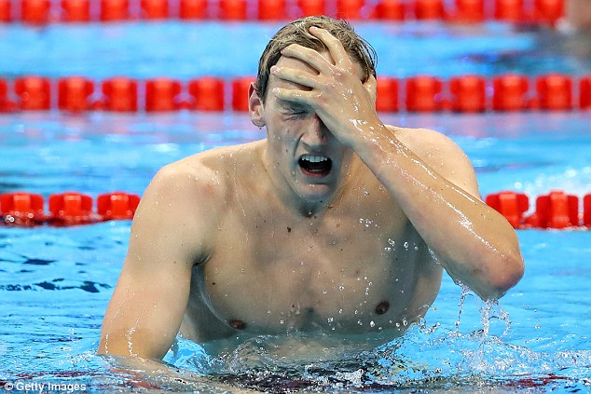
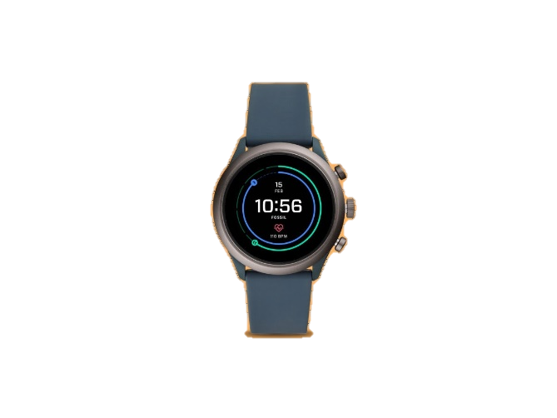
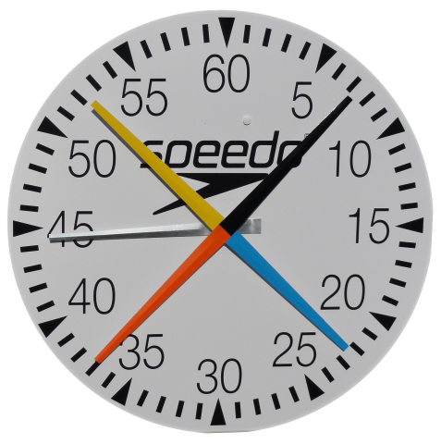
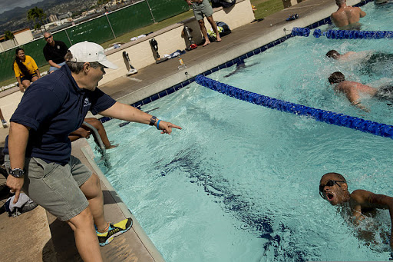


Slide 3
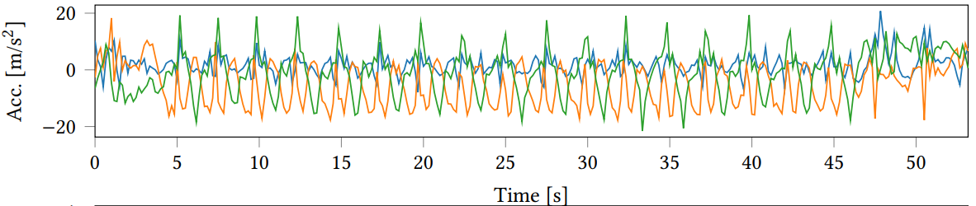
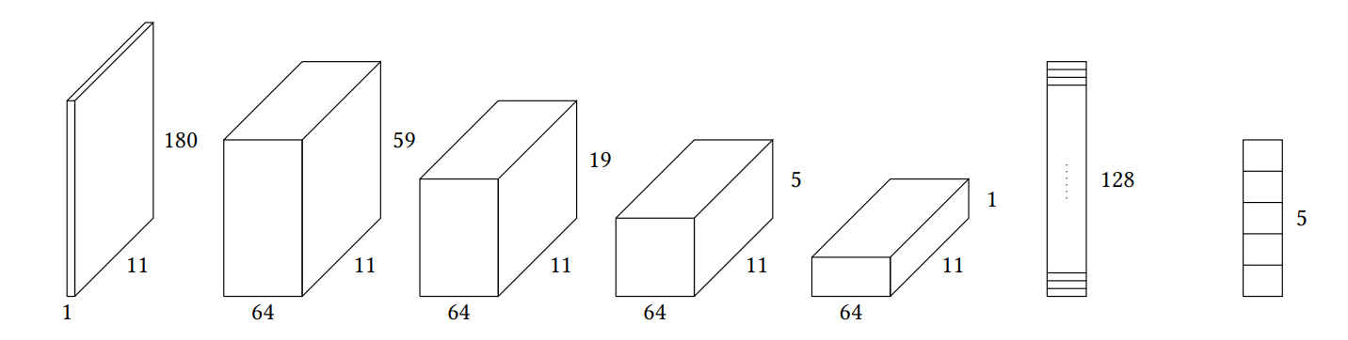
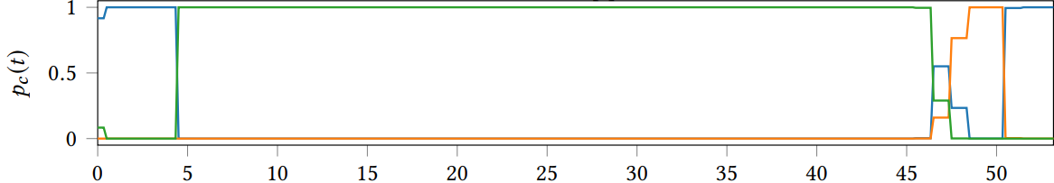
Background
Brunner et al. : Swimming Style Recognition and Lap Counting Using a Smartwatch and Deep Learning (2019)
Notes:
Blue-ptr
Green-pfr
Orange-pbreast

Slide 4
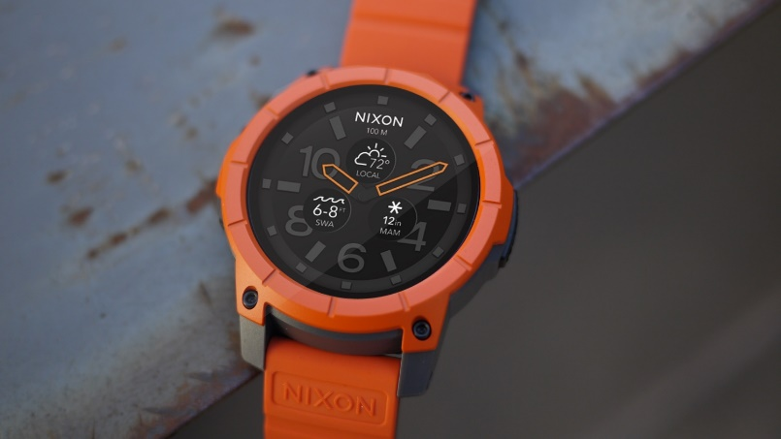
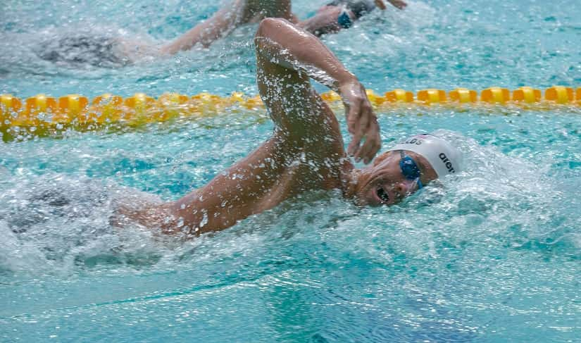
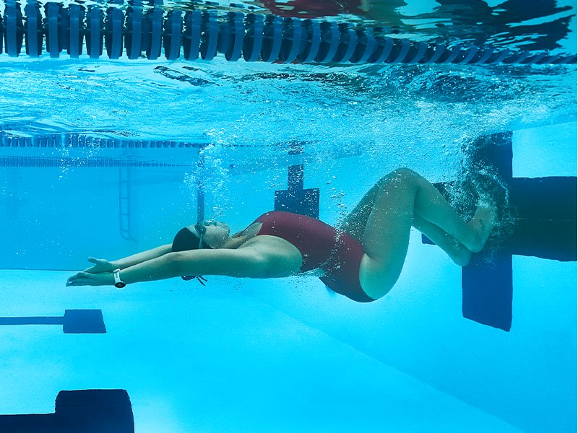
Goals

Slide 5
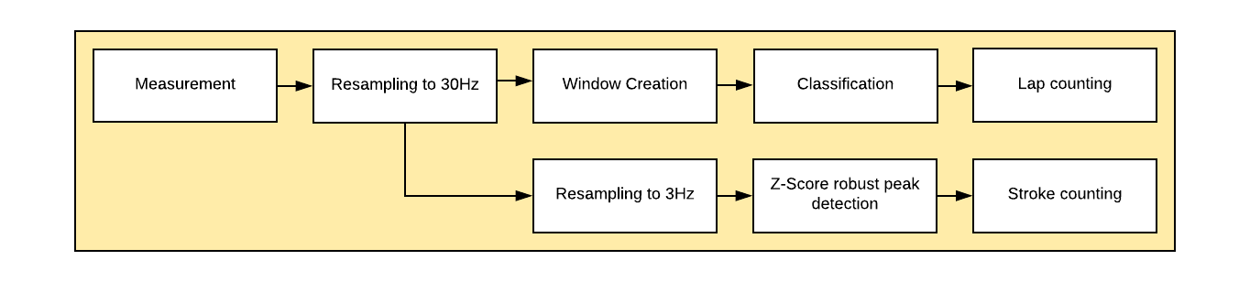
Data processing pipeline

Slide 6
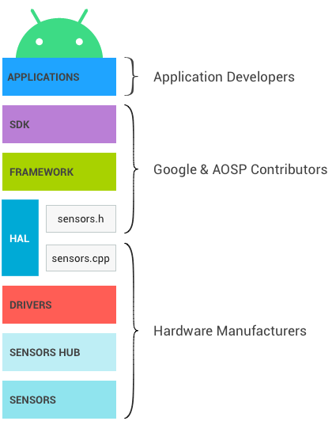
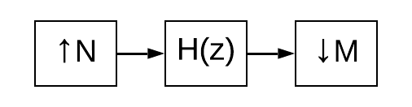
Data Preprocessing

Slide 7

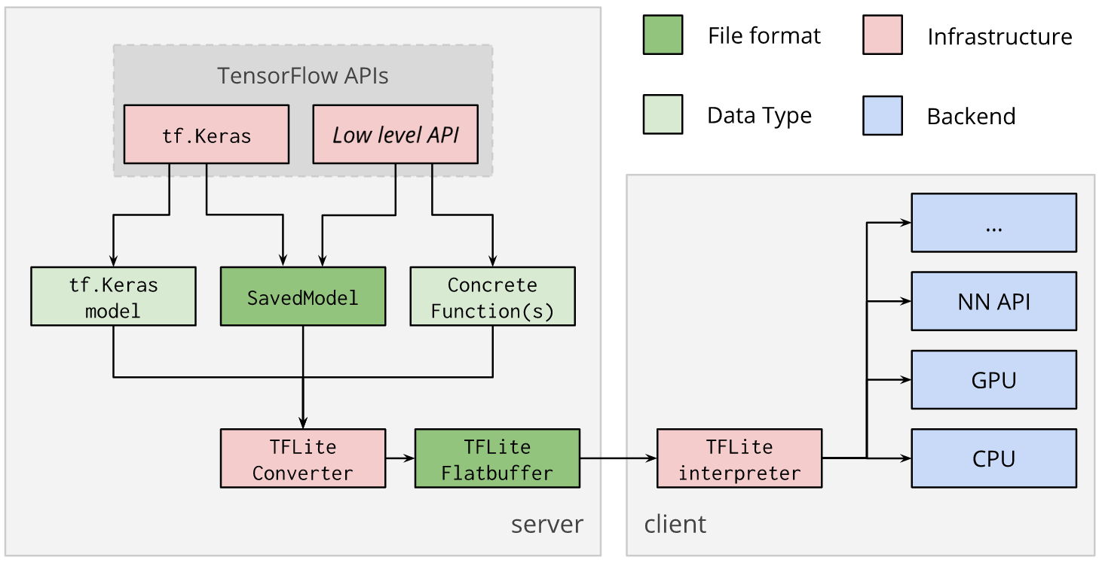
Neural Network Conversion

Slide 8
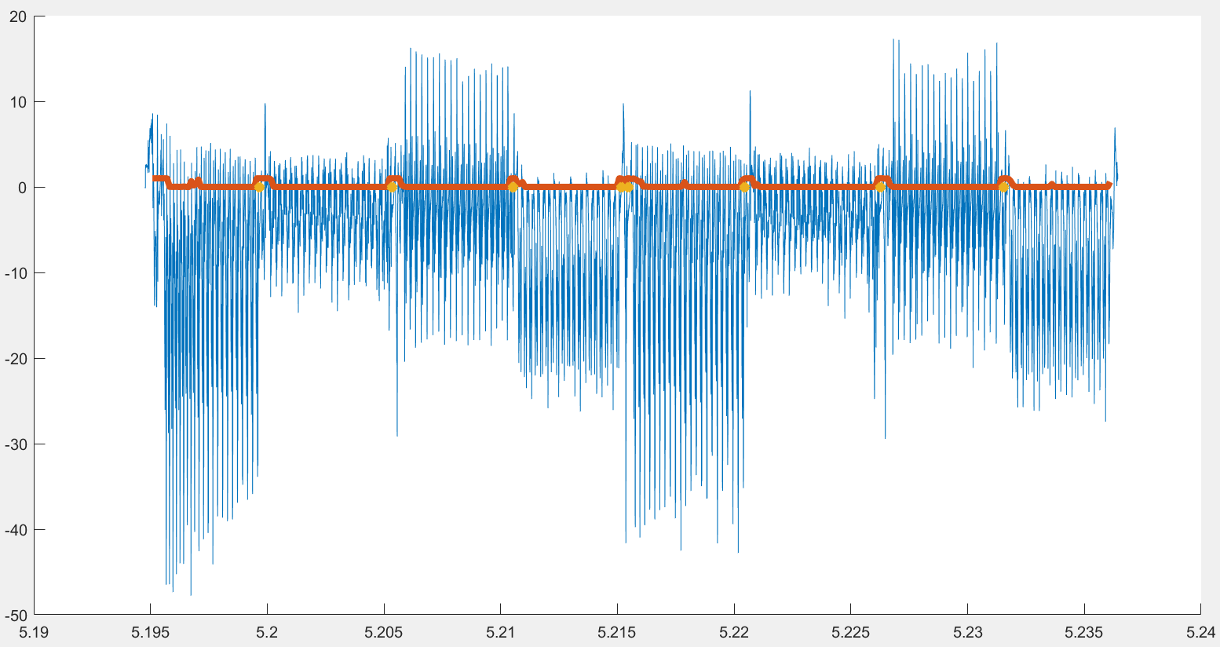
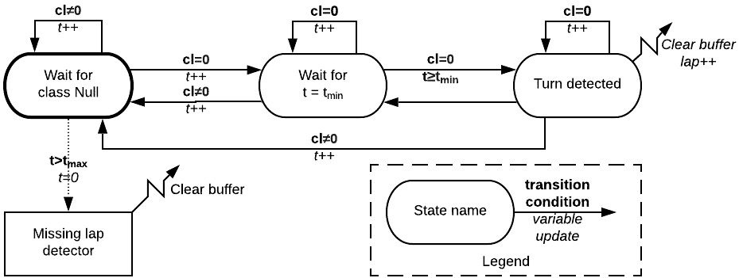
Lap Counting
Notes:
Orange: prob_0

Slide 9
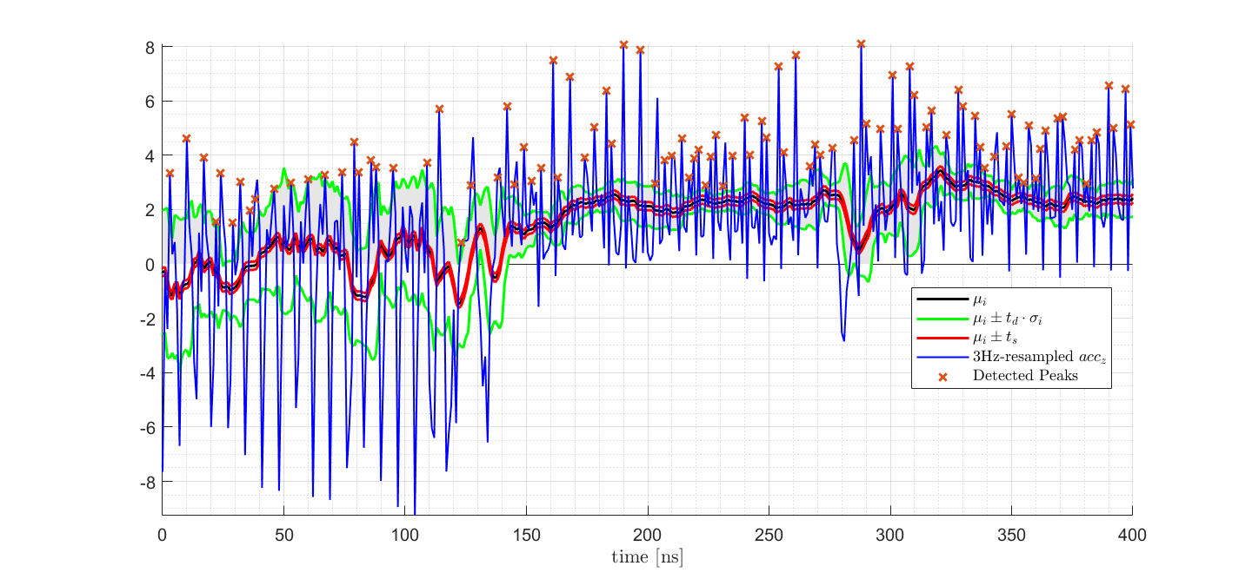

Stroke Counting
Based on a «Moving z-Score» computation $z=\frac{x−μ}{σ}$

Slide 10
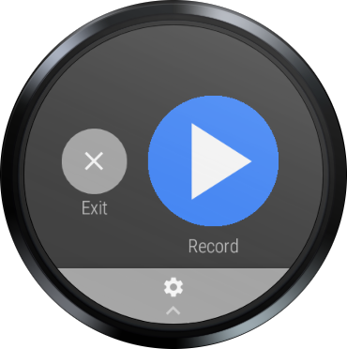
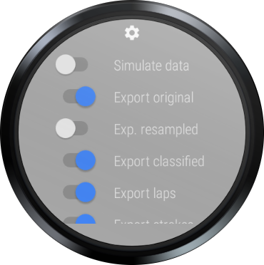

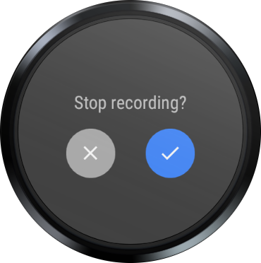
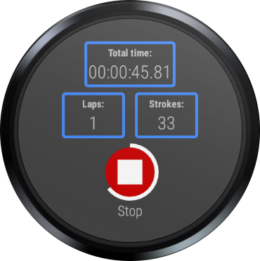
Graphical User Interface

Slide 11
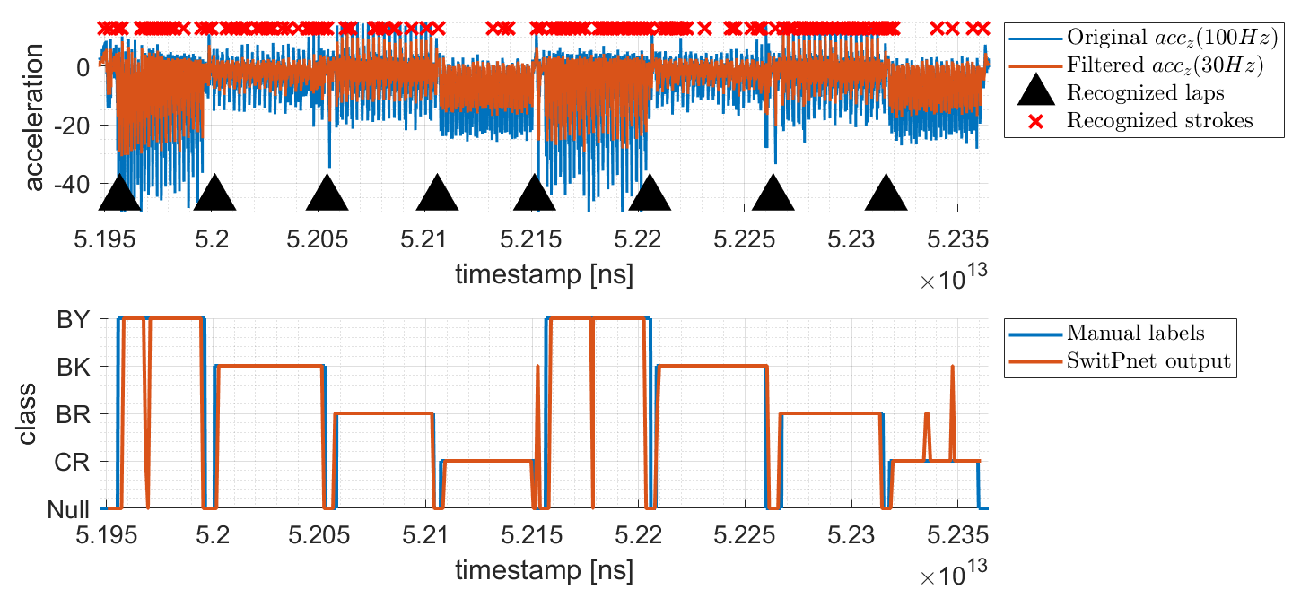
Testing & Results (1)
Testing: Using the simulation option

Slide 12
Testing & Results (2)
Against the original network, for three randomly chosen users (152 windows), simulated on the watch:
Really depends on the user (here just user 7):
Notes:
~150MB measurement data
-Really depends on the user / crawl especially problematic
-LOSO – can be adapted to be trained with the specific subject
-Can do more windows and do majority voting/some kind of averaging (50% of 400%CPU (1/16th))

Slide 13
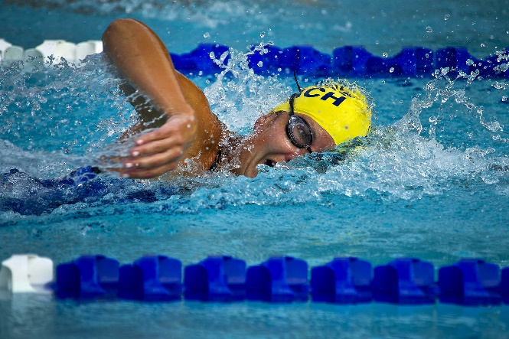
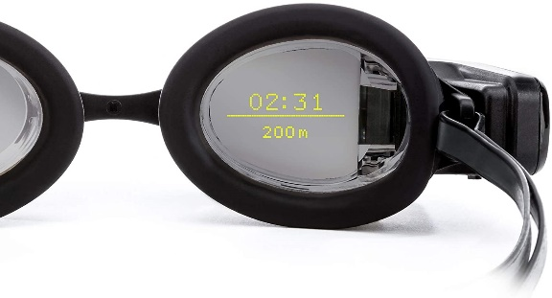
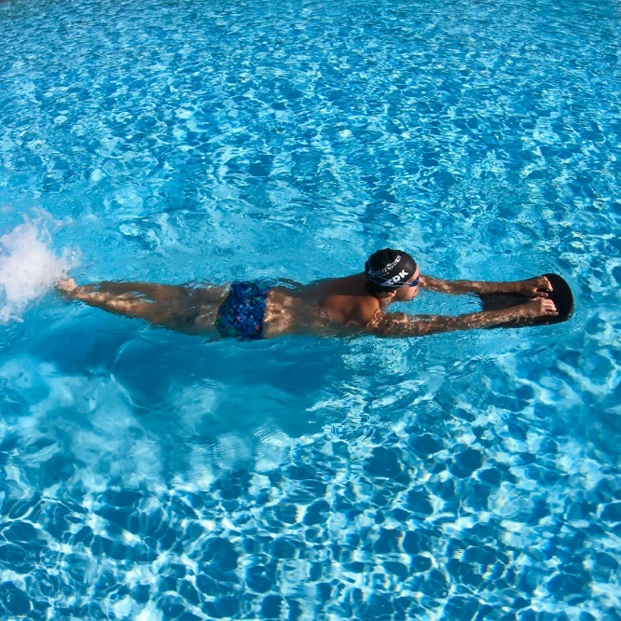
Future Work
Notes:
FORM smart swim goggles
Testing / Parameter Tuning
Kicking Recognition
Follow a Trainings Plan
Implement on other smartwatches / devices

Slide 14
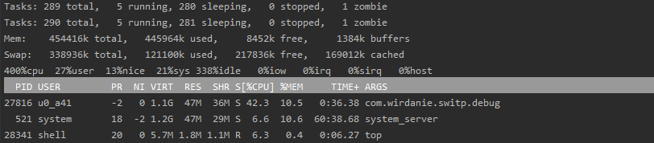
Backup

Slide 15
