Slide 1
umbra.
Pay, swap & sell
privately on Portaldot
Zero-knowledge payments and merchant checkout
Drained99
Portaldot Hacker House 2026
Testnet beta. Test assets only.
Notes:
I built Umbra to make private payments useful beyond a deposit and withdrawal. It is a working Portaldot V3 testnet app for payments, requests, swaps and digital-product checkout. This deck describes a testnet demonstration, not production financial infrastructure.
Sources: https://github.com/drained69/umbra/blob/main/README.md

Slide 2
THE PROBLEM
A payment can expose far more than its price
Who paid whom?
How much?
What else is in the wallet?
For people
Receiving money can expose an address and its visible financial history.
For businesses
Public payment relationships can reveal customers, suppliers and commercial activity.
Privacy needs to fit the way people already pay.
Umbra / Portaldot Hacker House 2026
02
Notes:
A public transfer exposes the payment relationship, amount and addresses. Address reuse can connect that payment to other visible activity. For creators and freelancers this affects customer relationships and earnings. Umbra addresses on-chain disclosure while making the remaining privacy limits explicit.
Sources: https://github.com/drained69/umbra/blob/main/README.md

Slide 3
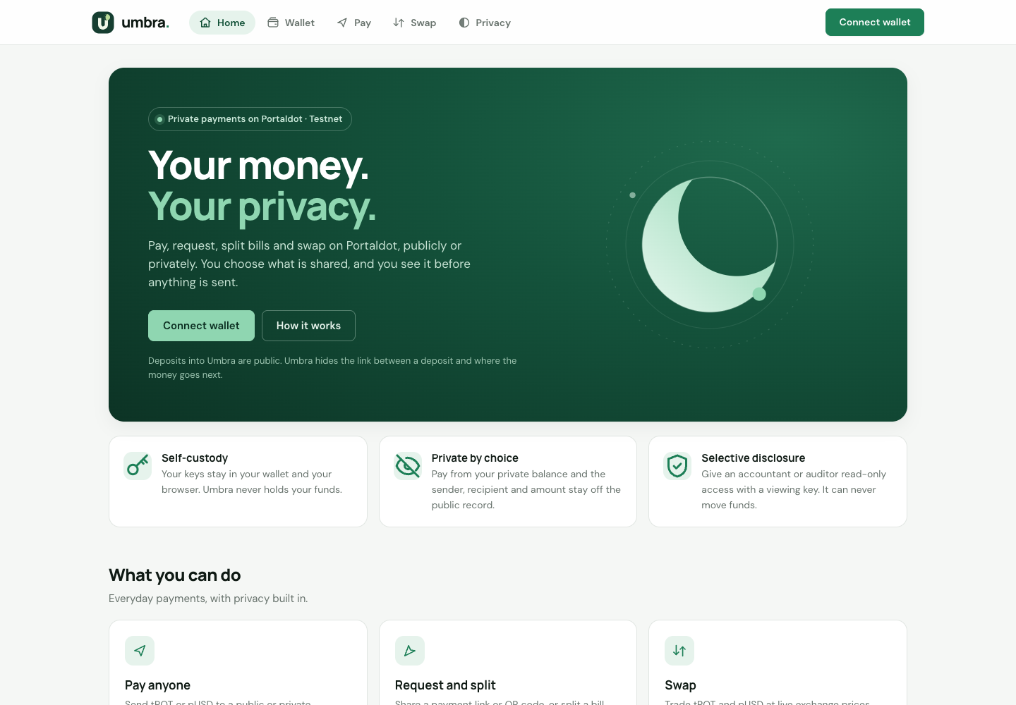
THE PRODUCT
One private balance, everyday payment flows
tPOT + pUSD
Private transfers and withdrawals
Payment links and QR codes
Bill splitting and request tracking
Digital-product storefronts
Private and public swaps
A web app for users.
A TypeScript SDK for builders.
Umbra / Portaldot Hacker House 2026
03
Notes:
The app supports tPOT and pUSD in a shared multi-asset shielded pool. Users can pay, request, split a bill, swap and withdraw. Checkout receives merchant payments into that same private account. The screenshot shows the actual local app interface without a connected wallet. Contacts and activity live locally in the browser.
Sources: https://github.com/drained69/umbra/blob/main/README.md

Slide 4
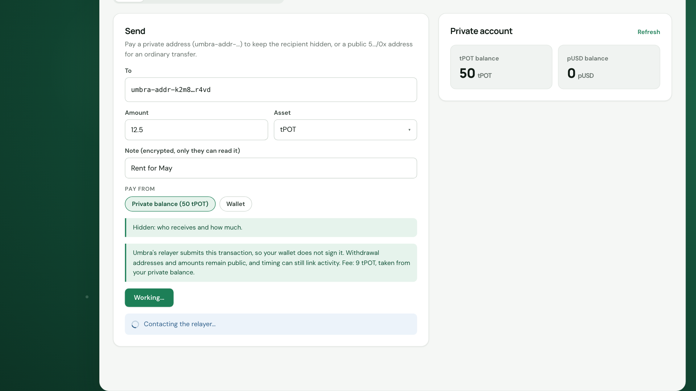
PAY
Private payments without a wallet-signed spend
Deposit once
Your wallet signs the public entry into the pool.
Pay from encrypted notes
The relayer submits the spend. The recipient decrypts the payment and optional note.
Demo illustration. Example addresses and balances.
Umbra / Portaldot Hacker House 2026
04
Notes:
The user signs the public deposit. For later private payments, the browser generates a Groth16 proof and sends it to the relayer. The relayer submits the spend, so the user wallet is not its submitter. Proof-bound recipient and fee terms constrain the relayer. The screenshot is a product-demo illustration with example values, not a new payment made for this deck. Deposits, timing and network metadata can still weaken privacy.
Sources: https://github.com/drained69/umbra/blob/main/README.md

Slide 5
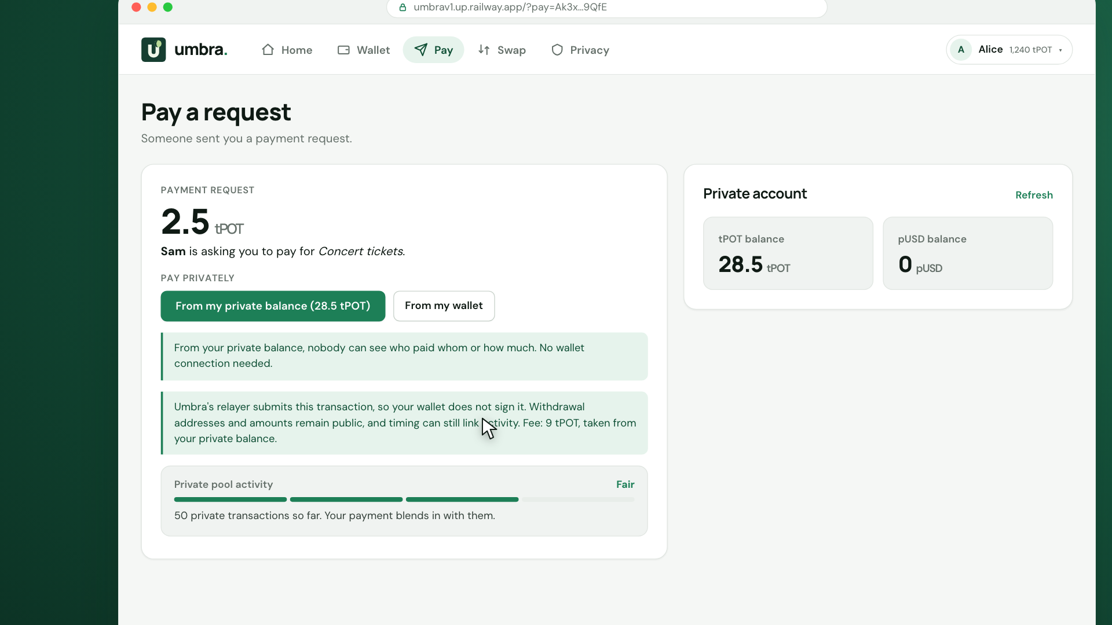
REQUEST AND SPLIT
Payment requests that recognize settlement
Share a link or QR
Request tPOT or pUSD.
Keep the request off chain until payment.
Split a bill accurately
Create one link per person.
Track private payments automatically.
Demo illustration. Request details travel with the link.
Umbra / Portaldot Hacker House 2026
05
Notes:
Requests encode amount, asset and destination in a link or QR. Nothing is published on chain until a payment. An encrypted request identifier lets private payments match automatically. Supported native public payments bind the transfer and reference in the same successful transaction, producing a verifiable receipt. EVM public payments do not provide that native receipt mechanism. Bill shares sum exactly to the total. The image comes from the existing demo and uses example data.
Sources: https://github.com/drained69/umbra/blob/main/README.md

Slide 6
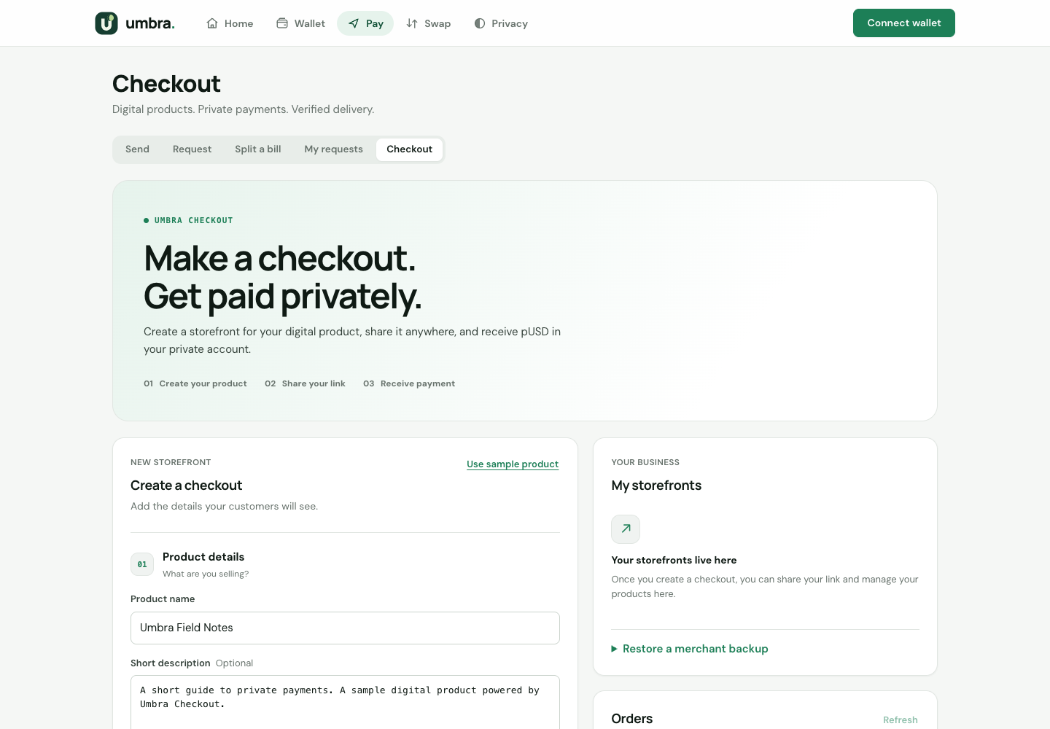
SELL
Umbra Checkout gives private payments a storefront
Create a product.
Share its checkout.
Receive private pUSD.
Hosted storefront and QR code
Embeddable checkout link
Merchant dashboard and backups
Buyer recovery links
Current delivery: text download, up to 6,000 characters.
Umbra / Portaldot Hacker House 2026
06
Notes:
Checkout is implemented on the deployed multi-asset pool. A merchant creates one immutable product, chooses a pUSD price and provides a private receiving address and text to deliver. The generated storefront has a link, QR and embeddable link button. Buyers can use private pUSD or a connected wallet. The merchant dashboard tracks orders and supports access backup restoration. The screenshot is the actual local merchant interface with the sample product loaded, without publishing a storefront.
Sources: https://github.com/drained69/umbra/blob/main/README.md

Slide 7
CHECKOUT VERIFICATION
Finalized payment unlocks the download
01
Matching payment
The expected amount, asset and merchant note must match.
02
Finalized pool event
The server checks the configured contract and encrypted ciphertext.
03
Verified delivery
A paid order gains access to its download and recovery link.
The operator sees order details and controls hosted content. No escrow or automatic refunds.
Umbra / Portaldot Hacker House 2026
07
Notes:
The server requires the exact payment commitment and merchant-encrypted ciphertext in finalized events from the configured pool. It checks amount, asset, recipient and the order-specific note. A transaction hash or browser-side paid flag is insufficient. Merchant spending keys remain outside the server. The operator knows order details and hosts the content, so can withhold delivery. This is not escrow or a refund mechanism. Order links are bearer credentials. Sources: https://github.com/drained69/umbra/blob/main/docs/CHECKOUT.md and https://github.com/drained69/umbra/blob/main/docs/CHECKOUT_AUDIT.md
Sources: https://github.com/drained69/umbra/blob/main/README.md

Slide 8
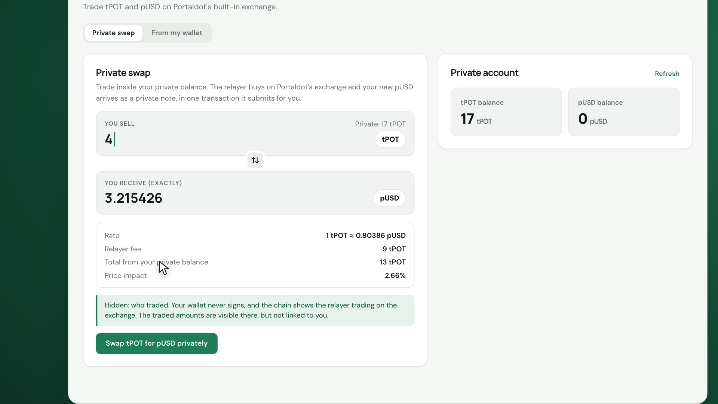
SWAP
Private swaps settle in one atomic native batch
tPOT / pUSD
Exchange trade
Token approval when required
Shielded settlement
The quoted output settles in full,
or the batch reverts.
The user wallet does not sign. Exchange trade sizes remain public.
Umbra / Portaldot Hacker House 2026
08
Notes:
The relayer fills tPOT/pUSD swaps using pallet-asset-conversion and calls the EVM multi-asset pool in utility.batchAll. The pool requires the quoted output from the named counterparty before releasing the input. Any failure rolls back the batch. The deployed testnet private swap is documented at block 215680, after the user deposit at 215672. The exchange reveals the relayer trade and its size. The illustration uses example quote values, not current market prices. Sources: https://github.com/drained69/umbra/blob/main/docs/PRIVATE_SWAPS.md and README deployment evidence.
Sources: https://github.com/drained69/umbra/blob/main/README.md

Slide 9
WHY PORTALDOT V3
Portaldot makes the composition possible
EVM contracts
Shielded pools and Groth16 verification
Native accounts
Portaldot Extension calls through revive.call
Native assets and DEX
pUSD asset #7777 and pallet-asset-conversion
Atomic execution
utility.batchAll combines exchange and settlement
No separate chain is needed for the deployed swap flow.
Umbra / Portaldot Hacker House 2026
09
Notes:
The deployed path uses EVM and native runtime capabilities on one chain. Native 5-address accounts call EVM pools through revive.call. pUSD is pallet-assets asset 7777 via an ERC-20 precompile. Native swap liquidity comes from pallet-asset-conversion. utility.batchAll supplies atomicity. BN254 precompiles handle Groth16 verification in the EVM. The WASM verifier is separate tested work, not a live dependency. Sources: https://github.com/drained69/umbra/blob/main/docs/PORTALDOT_INTEGRATION.md
Sources: https://github.com/drained69/umbra/blob/main/README.md

Slide 10
HOW IT WORKS
Browser proofs, encrypted notes, self-custody
Ownership stays local
On-chain verification
The browser creates proofs.
A backed-up spend key restores private funds.
Groth16 proofs, Poseidon commitments,
Merkle membership and nullifiers.
Notes stay encrypted
Disclosure stays optional
x25519 and XChaCha20-Poly1305 protect payment note contents.
Viewing keys reveal supported pool history without allowing spending.
Umbra / Portaldot Hacker House 2026
10
Notes:
The multi-asset circuit is a 2-input/2-output Groth16 join-split design using Circom and snarkjs. Poseidon commits to note fields and a Merkle tree supplies membership. Nullifiers prevent reuse. The circuit enforces its asset-balance and counterparty rules. Notes use x25519 and XChaCha20-Poly1305. PBKDF2-SHA256 and AES-256-GCM protect an optional locally remembered spend key. A key backup rebuilds private funds, but does not restore all browser-local contact or request data. Viewing keys cover supported pool history and grant no spending authority.
Sources: https://github.com/drained69/umbra/blob/main/README.md

Slide 11
TRUST MODEL
Privacy has clear boundaries
Action | Hidden within the pool | Visible to observers
Deposit | Which notes will later be spent | Depositor, asset and amount
Relayed payment | Wallet link, recipient and amount | Relayer, fee and transaction timing
Private swap | Trader wallet and private history | Relayer exchange trade and size
Withdrawal | Which deposit funded the spend | Destination and amount
Pool size, timing and network metadata affect privacy. Checkout also exposes order details to its operator.
Umbra / Portaldot Hacker House 2026
11
Notes:
A small pool does not provide a strong anonymity set merely because notes are encrypted. Timing and amounts at the boundary can correlate activity. RPC providers and relayers may observe IP and request metadata. The relayer can censor, delay or quote prices. Self-submission exposes the submitting account. Checkout exposes order details to the operator, who controls delivery. There is no claim of production anonymity or independent audit. The app provides activity-based privacy warnings.
Sources: https://github.com/drained69/umbra/blob/main/README.md

Slide 12
WHAT IS BUILT
Real proofs and reproducible deployment evidence
75
30
23
15
Contract tests
SDK end-to-end checks
Relayer checks
Checkout tests
7 WASM verification tests
Private swap documented at block 215,680
Reported repository results. Real-proof local checkout purchase and merchant spend included.
Umbra / Portaldot Hacker House 2026
12
Notes:
These are documented validation results in the repository, not tests rerun to make this deck and not a count of users or transactions. The repository reports 75 Foundry tests, 7 WASM tests, 30 SDK local end-to-end checks, 23 relayer checks and 15 checkout tests, plus a real-proof local purchase, delivery and merchant spend. The public deployment record documents the private swap in testnet block 215680. The independent security audit remains future work. Sources: https://github.com/drained69/umbra/blob/main/docs/CHECKOUT_AUDIT.md and https://github.com/drained69/umbra/blob/main/deployments/testnet.json
Sources: https://github.com/drained69/umbra/blob/main/README.md

Slide 13
USERS AND OPERATING MODEL
A creator-first path to adoption
Initial audience
Distribution hypothesis
Creators and freelancers who need payment links, private receiving and simple digital delivery.
Each shared request or storefront introduces another person to the payment flow.
Current fee mechanism
Production economics
The relayer charges a transaction fee. Private swaps can include a configured spread.
Storage costs and liquidity shape pricing. Testnet fees do not establish commercial viability.
Current defaults: 9 tPOT per multi-asset transaction and 0.5% swap spread. Test assets only.
Umbra / Portaldot Hacker House 2026
13
Notes:
This is a proposed adoption approach, not evidence of customers, revenue or market share. Creators are an initial focus because a checkout link supplies a visible product experience. The relayer currently charges 9 tPOT or a pUSD equivalent per multi-asset transaction, with the default swap spread set to 50 basis points. Storage deposits consume much of the transaction fee. Testnet assets have no monetary value. Merchant commerce infrastructure scaling and pricing remain future decisions. Sources: README costs and relayer configuration.
Sources: https://github.com/drained69/umbra/blob/main/README.md

Slide 14
ROADMAP
The next milestones are security and useful adoption
Live testnet
Private balance, payments, requests, swaps and Checkout
Before real funds
Independent audit and multi-party trusted setup
Product expansion
Merchant infrastructure and batched private swaps
Exploratory work
WASM verifier and one-way bridge prototype
WASM: tested, undeployed. Bridge: local, operator-trusted prototype, undeployed.
Umbra / Portaldot Hacker House 2026
14
Notes:
The live testnet product includes multi-asset payments, requests, swaps and Checkout. Separate exploratory work includes an ink!/arkworks WASM verifier built, tested and dry-run but not deployed, and a local one-way operator-trusted Sepolia to Portaldot bridge prototype. Neither is a live product capability. Production gates include an independent audit and a multi-party trusted setup because the current setup has a single contributor. Batched private swaps and stronger merchant data infrastructure are planned without dates or claims of secured funding.
Sources: https://github.com/drained69/umbra/blob/main/README.md

Slide 15
BUILDER AND NEXT STEP
Umbra is ready for testnet feedback
Drained99
christopherakwuba4@gmail.com
Try a private payment. Create a sample storefront.
Share what would make it useful to you.
Live app
Merchant checkout
Demo video
Source code
umbrav1.up.railway.app
Umbra / Portaldot Hacker House 2026
15
Notes:
Drained99 is the builder name supplied for this submission. Public contact: christopherakwuba4@gmail.com. Ask judges and community members to try the testnet app and sample storefront, review the source, and share feedback on the payment flow. SDK reuse, security review and testnet merchant pilots are the next conversations to pursue, not partnerships already established. The code is MIT except generated verifier files under GPL-3.0. Use test assets only.
Sources: https://github.com/drained69/umbra/blob/main/README.md

