Slide 1
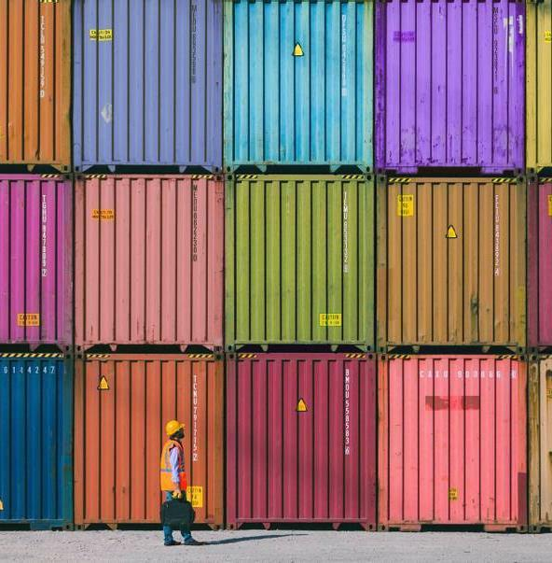
CrashDash
Lisa Drain
Dhawn Alexander
Karen Fuentes
Kayla Bailey

Slide 2
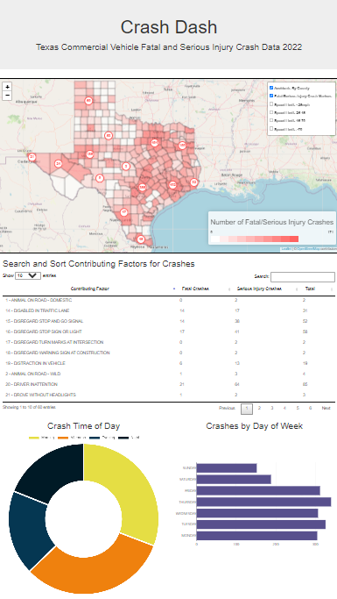
The aim of our project is to uncover patterns in commercial vehicle related accidents in Texas resulting in fatality or serious injury. The Crash Dash will allow users to examine relationships between location, factors contributing to crashes, time of day, and day of the week.

Slide 3
Method
Extract
Sourced Data From CRIS Query, filtering the data wanted
Transform
Merged, cleaned, and exported the data
Load
Loaded the data into a SQLite Database
Flask API
A Python Flask API was developed to create a data source for the front-end visualizations.
JavaScript application dashboard for user interactivity
JavaScript

Slide 4
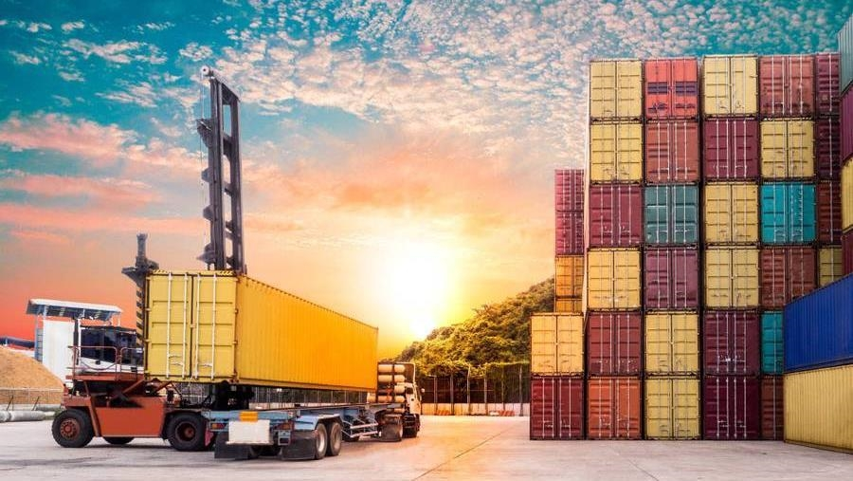
Back end

Slide 5
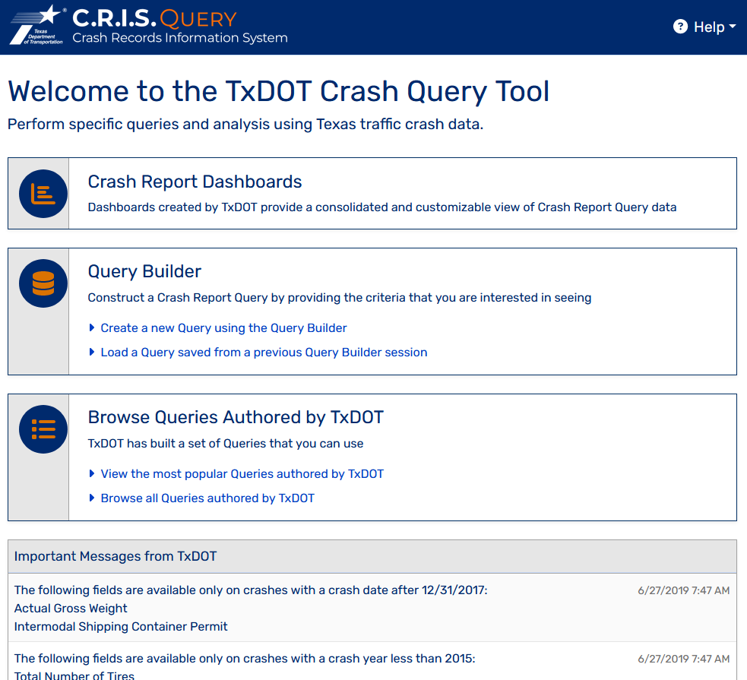
Extraction Our crash data set comes from using the Texas Department of Transportation [CRIS Query] where we were able to create a csv file for Fatal and Serious Injury crashes in Texas involving commercial vehicles in 2022, which we further filtered to capture data related to date, time, and contributing factors. We also extracted the Texas Counties Centroid Map to get coordinates by county due to some missing values in the original dataset.

Slide 6
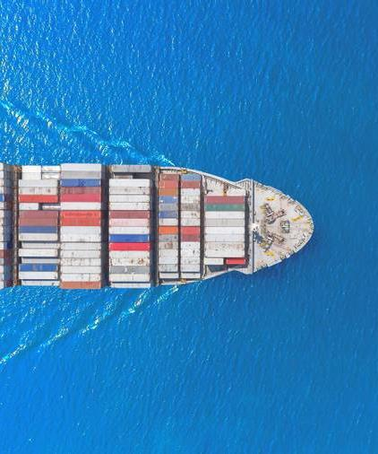
Transformation We merged the crash data and the county data together in order to fill in the missing coordinates where needed and dropped the remaining county data. We filled in the missing values for the other columns and formatted the data types. We exported this as a csv and a geojson file.

Slide 7
Loading We then loaded the transformed data (as well as the Texas County Boundaries) into a SQLite database.
Flask A Python Flask API was developed to create a data source for the front-end visualizations.

Slide 8
Front end

Slide 9
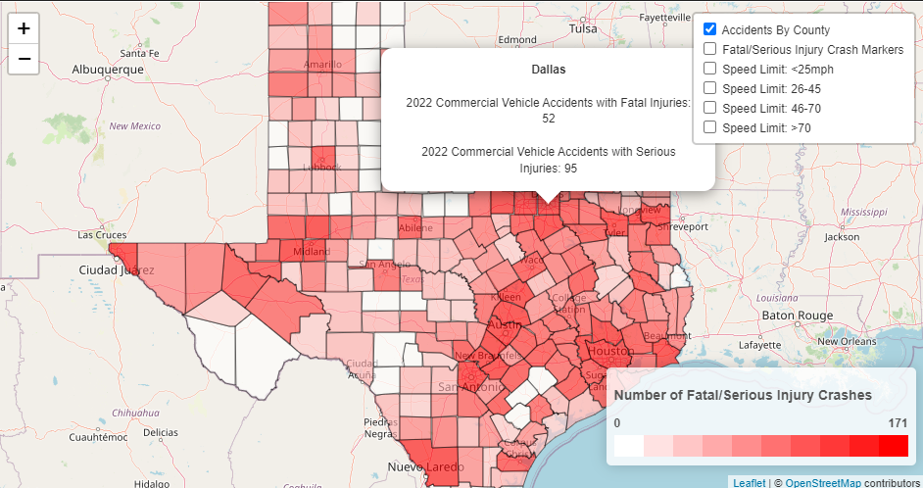
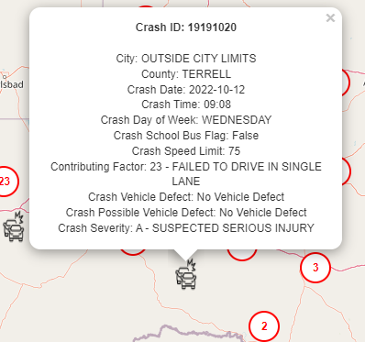
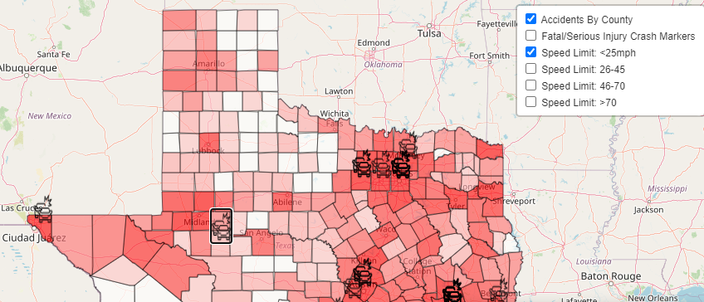
Map (Leaflet)

Slide 10
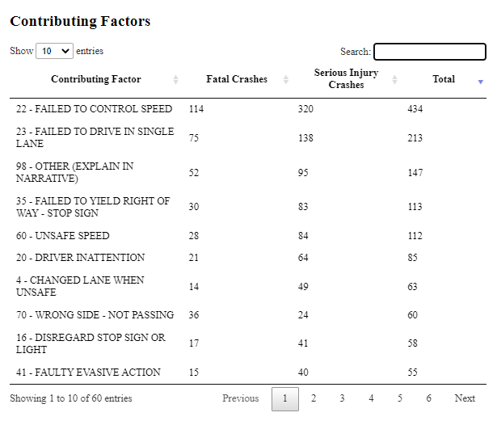
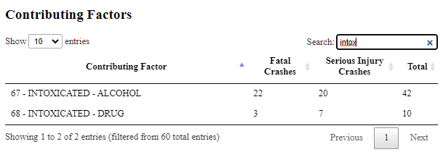
Contributing Factors (DataTable)

Slide 11
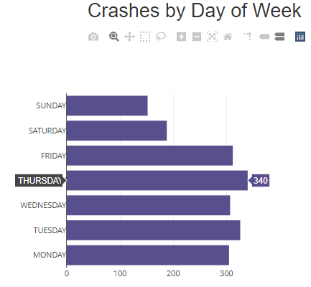
Day of Week Bar Chart (Plotly)

Slide 12
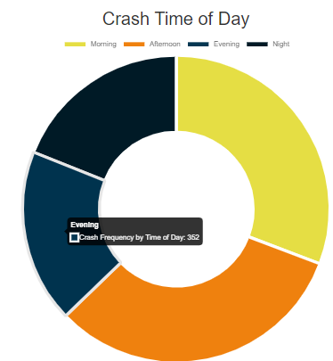
Time of Day Doughnut(Crash.js)

Slide 13
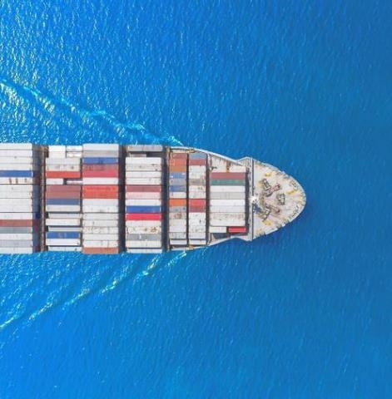
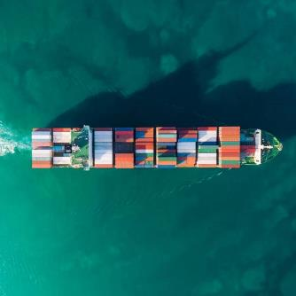
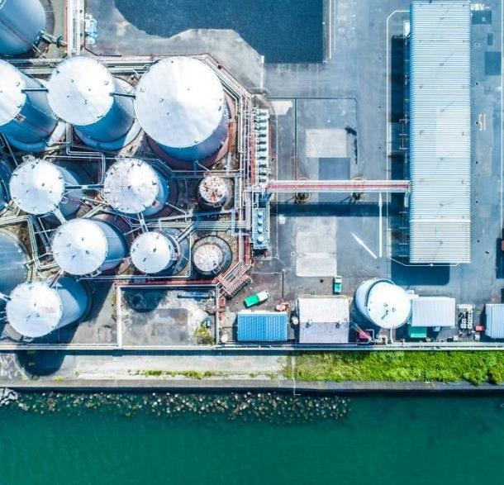
Live Demo

