Slide 1
Outline
Git
Technical details

Slide 2
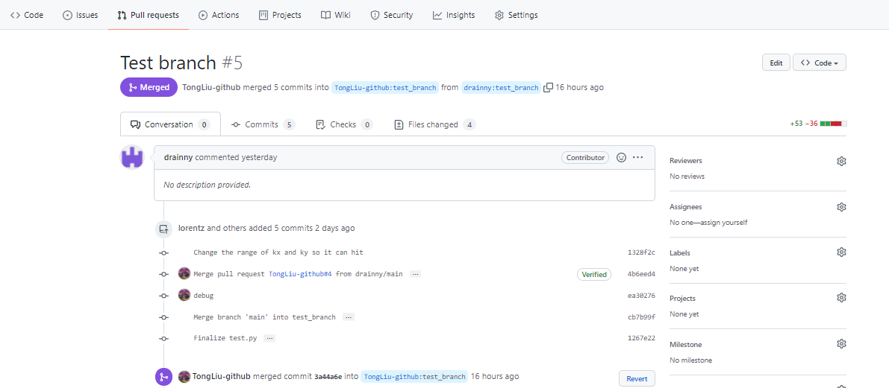
Basic use of git
Pull/merge request
clone/push/pull/add/commit/…

Slide 3
Outline
Git
Technical details

Slide 4
Problem review
0.1m
source
x
1m
z
y
Parametric formulation:
Source at least hits one sensor:

Slide 5
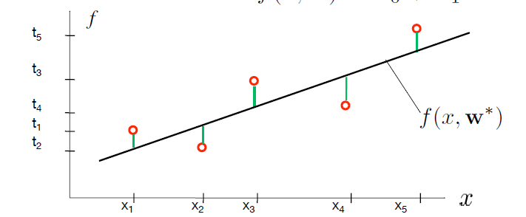


Basic: linear regression
Parametric formulation:
To determine a function f, we need an error function:
We search for parameters $w^{∗}$, s.t. ${E(w}^{∗})$ is minimal:

Slide 6

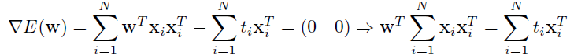
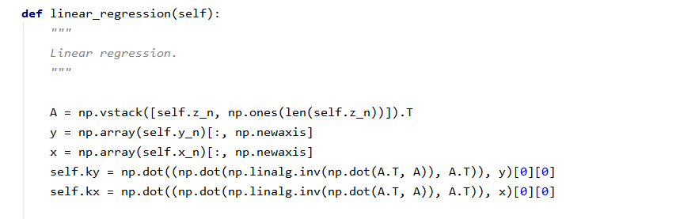
Basic: linear regression
We search for parameters $w^{∗}$, s.t. $E(w^{∗}$) is minimal:
Using vector notation:
Programming:

Slide 7
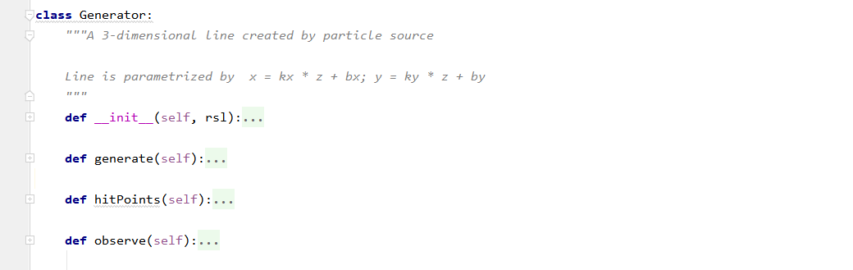
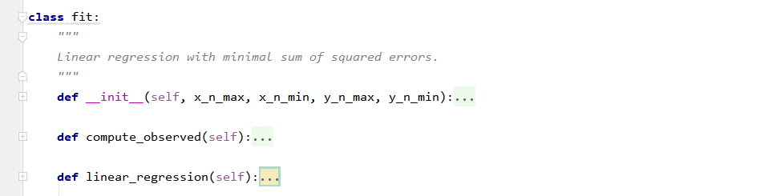
Total codes
generator.py:
fitting.py:

Slide 8
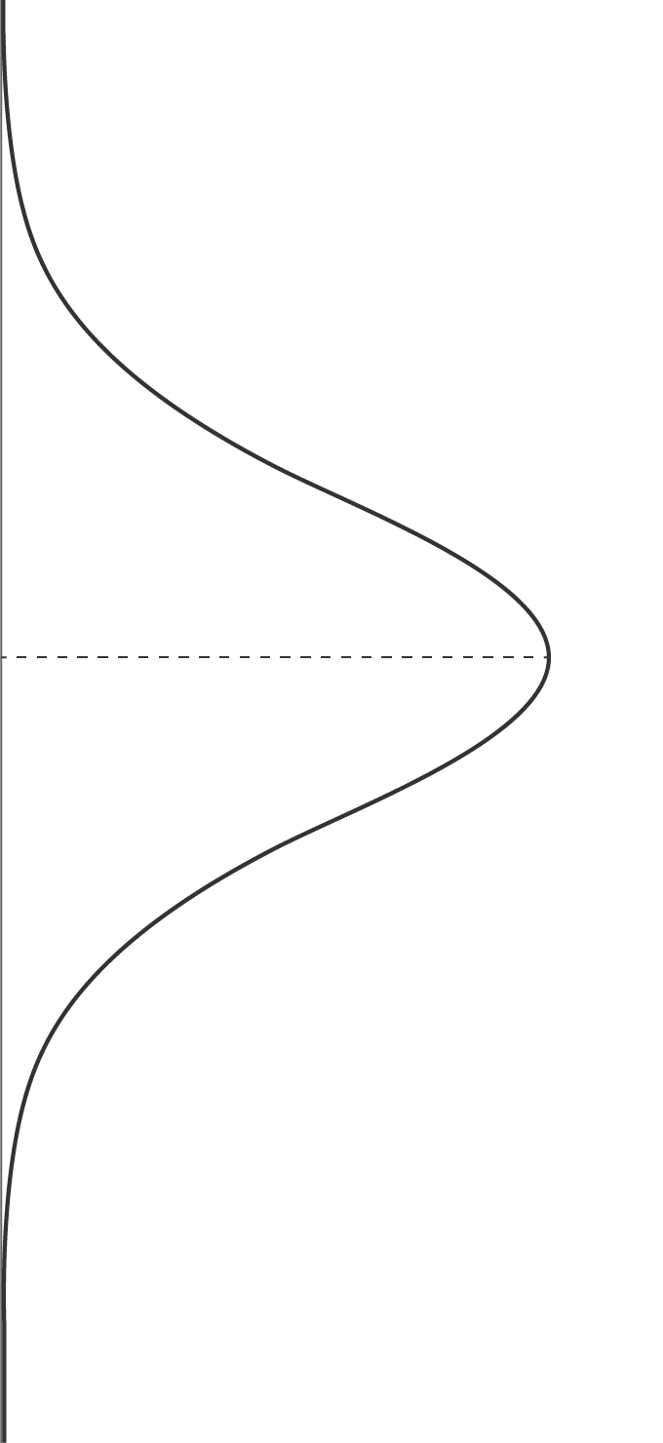



The problem from a different view
We don’t know the precise place within a resolution: assume a Gaussian distribution.
Assume that y is affected by Gaussian noise :
where
Thus, we have

Slide 9

The problem from a different view
Aim: we want to find the w that maximizes p .
is the likelihood of the measured data given a model.
Intuitively:
Find parameters w that maximize the probability of measuring the already measured data t.
“Maximum Likelihood Estimation”
We can think of this as fitting a model w to the data t.

