Slide 1
Zillow’s Home Value Prediction
Abhishek Dhameja (4868345770)
Eswar (7534803085)
Deepti (1716400396)

Slide 2
Problem to be solved
To build a ML model on the residuals of Zillow Prediction System

Slide 3
DATA and Features
The Data is split into two files
Houses sold in 2016 (Transaction data)-90k Properties
Properties data– 27 Million Properties (58 attributes)
Mortgage Records Attached
Tax Assessments
Physical features of the Property(Bed Count , Living Area, Age of the building)
Location Details about the properties
Amenities available in the property

Slide 4
Chosen approach
Exploratory Data Analysis
Impute
Missing Values
Feature Engineering
Model Building & Fine Tuning

Slide 5
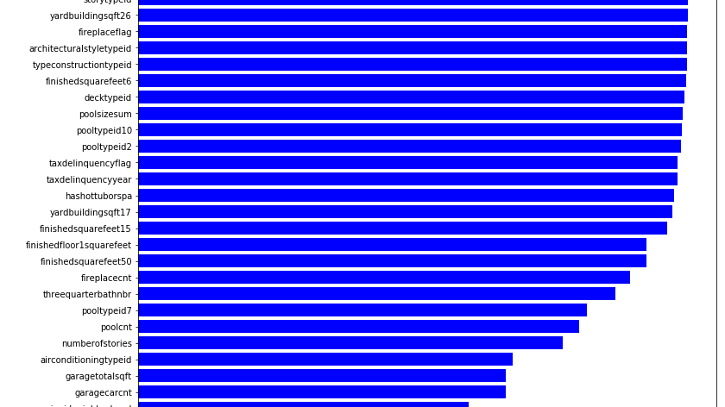

Slide 6
ImPUTATION
The Data is split into two files
Transaction data-90k Properties
Properties data – 27 Million Properties
Knn Imputation (Euclidean distance)
Imputation after join operation -90k
Imputation before join operation -27 millions records

Slide 7
Feature Engineering
Creating new features using variable interaction
Total rooms = bath_count + bedroom_count
Average room size = total_finished_living_area_sqft/roomcnt
Ratio of structure tax to land tax = structure_tax/land_tax
ExtraSpace = lot_area_sqft - total_finished_living_area_sqft

Slide 8
Feature SELECTION & Dimensionality Reduction
Used the following techniques
Recursive feature elimination (RFE)
XgBoost feature importance (Information Gain & Gini Index)
TreeRegressor feature importance (Information Gain & Gini Index)
PCA (Principal Component Analysis)

Slide 9
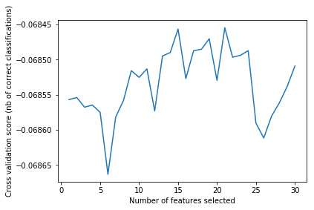

Slide 10
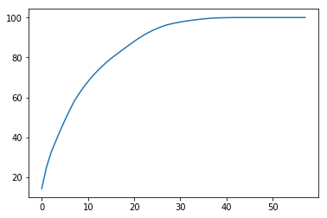

Slide 11
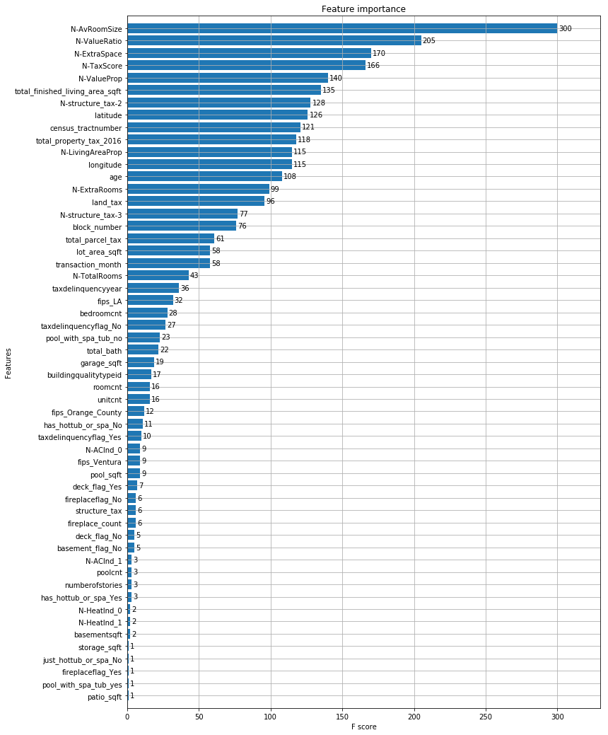

Slide 12
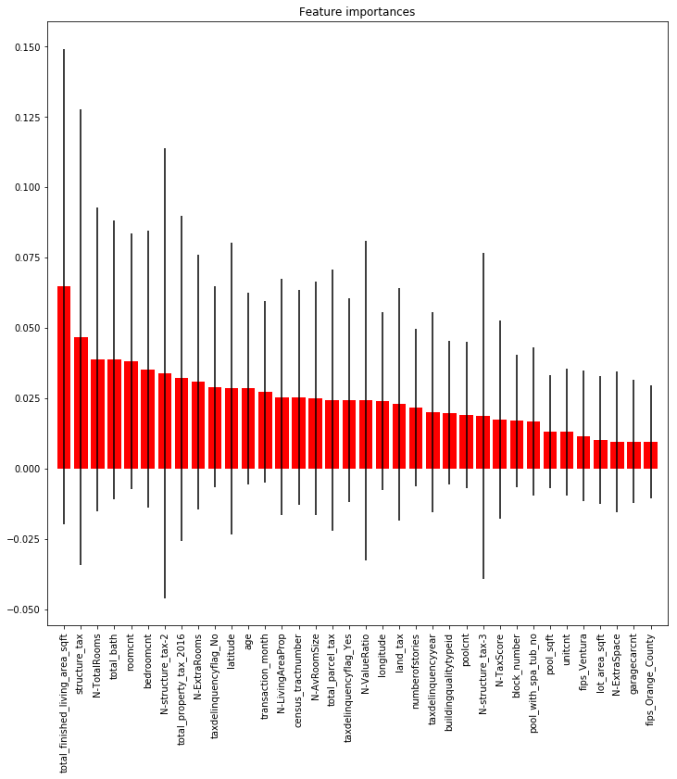

Slide 13
Results (MAE)
Kaggle Benchmark : 0.064
Each of these model was run on RFE, Xgboost selection and Tree regressor selection
Imputation on transaction data` | Imputation on Properties data | PCA
Linear Regression = 0.0672 | Linear Regression=0.0672 | Linear Regression = 0.0673
Ridge Regression = 0.0672 | Ridge Regression=0.0672 | Ridge Regression= 0.0672
Random Forest =0.673 | Random Forest =0.673 | Random Forest =0.673
Gradient Boosting=0.0671 | Gradient Boosting=0.0671 | Gradient Boosting= 0.0671
XgBoost =0.0670 | XgBoost=0.0670 | XgBoost=0.0672

Slide 14
Lesson LEarnt
Careful inspection of null values
Ensemble learning outperforms a single model
Minimizing the categorical attribute levels

