Slide 1
Big Mountain Resort
Project report, analysis and recommendations

Slide 2
Problem Identification
Problem Statement: Big Mountain Resort wants to increase their ticket charge a premium above the average price of resorts in its market segment. Given the facilities and services that Big Mountain Resort is providing the current price on just the market average. So now the Resorts want to revise their ticket prices to capitalise on its facilities as much as it could. Also, they are considering a number of changes to cut down the maintenance costs. With these analysis we should be able to identity a price hike that shouldn’t undermining the ticket price or will support an even higher ticket price
Objective: By using Data exploration methods and using machine learning algorithms we want to reduce the current obtaining cost and increase the ticket price to be align with the market pricing
Data Source: Ski_report_data.csv Ski Resort Data collected over last year
Target Feature: Ticket Price

Slide 3
Recommendations
Immediate Recommendations:
1. Increase the price of the ticket to a minimum amount recommended by the model which is $83.83 per day ticket. So the slight increase of $3.83 should drive the revenue to 2.3% high and this can be validated using the recent sales data
2. Our plan is to bring up the ticket price all the way up to $104.61 from observing the positive results from step by step price increasing
3. One of the main agendas of our model is to decrease some operating costs, the model suggests to close the runs which are less popular or least traveled. Per the results yield by the model it’s expected closing one run shouldn't affect the revenue however, closing multiple runs will lead to a non profit. Consider operating these runs only when observed an increase in demand. In the meantime, the operating costs saved during off days can be added to the resort’s savings.

Slide 4
Recommendations
Short Term Recommendations:
1. As mentioned earlier the key features that can support the ticket pricing greatly are Snow Making, Runs and Vertical drops. By considering the suggestions yield from the model adding a run, increasing the vertical drop by 150 feet, and installing an additional chair lift increases the ticket price by $1.99 and this can increase the revenue by about $3.48M per season. These add ons accommodate and offset the $1.54M increase in resort’s operational cost and bring in profit of $1.94M above that amount.
2. One of the suggestions is increasing the snow making space and these may not make any difference in the pricing from the last recommendations and increase in ticket price by $1.99 and annual revenue increase to $3.48M. This change can attract more visitors and eventually helps in increasing the overall revenue.

Slide 5
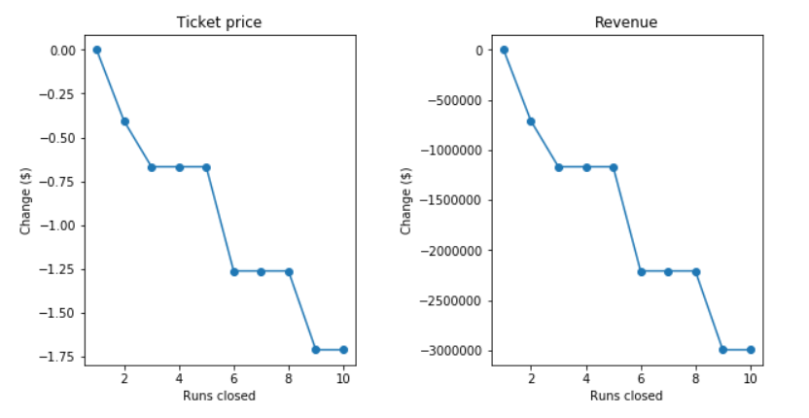
Key Findings
Observation from Model
The model says closing one run makes no difference. Closing 2 and 3 successively reduces support for ticket price and so revenue. If Big Mountain closes down 3 runs, it seems they may as well close down 4 or 5 as there's no further loss in ticket price. Increasing the closures down to 6 or more leads to a large drop.

Slide 6
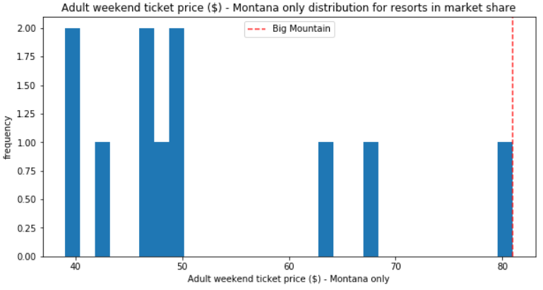
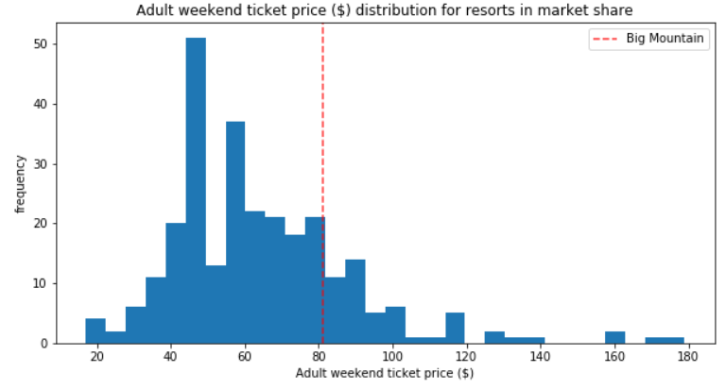
Model & Analysis (Ticket Prices)

Slide 7
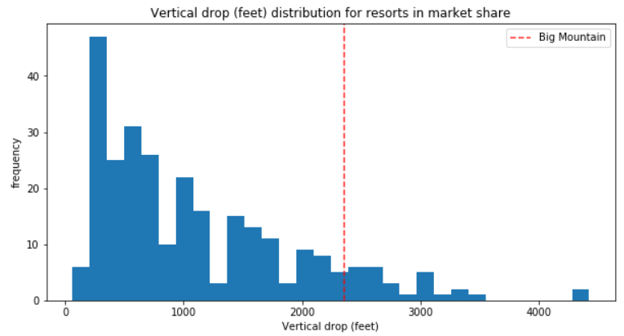
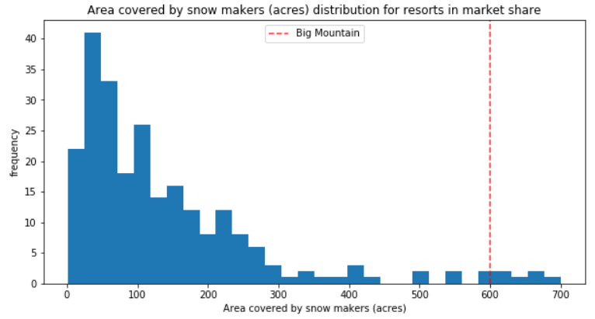
Model & Analysis (Vertical drop & Snowmaking area)
Big Mountain is doing well for vertical drop, but there are still quite a few resorts with a greater drop.
Big Mountain is very high up the league table of snowmaking area.

Slide 8
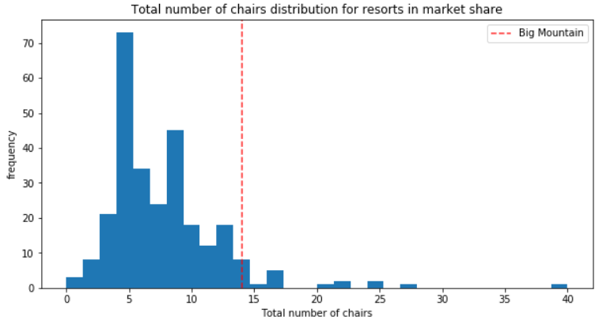
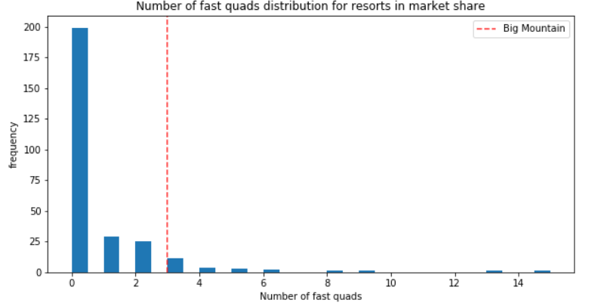
Model & Analysis (No. of Chairs & Fast quads)
Big Mountain has amongst the highest number of total chairs, resorts with more appear to be outliers.
Most resorts have no fast quads. Big Mountain has 3, which puts it high up that league table.

Slide 9
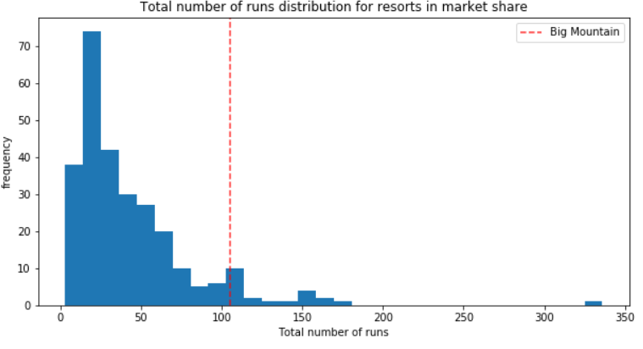
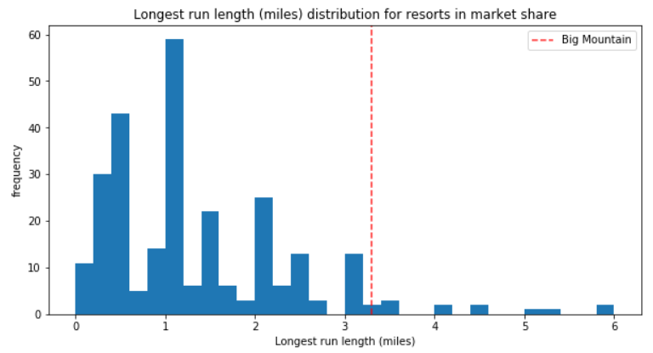
Model & Analysis (Runs)
Big Mountain compares well for the number of runs. There are some resorts with more, but not many.
Big Mountain has one of the longest runs. Although it is just over half the length of the longest, the longer ones are rare.

Slide 10
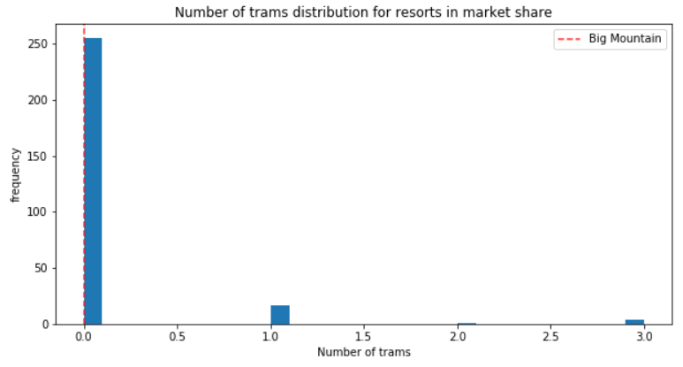
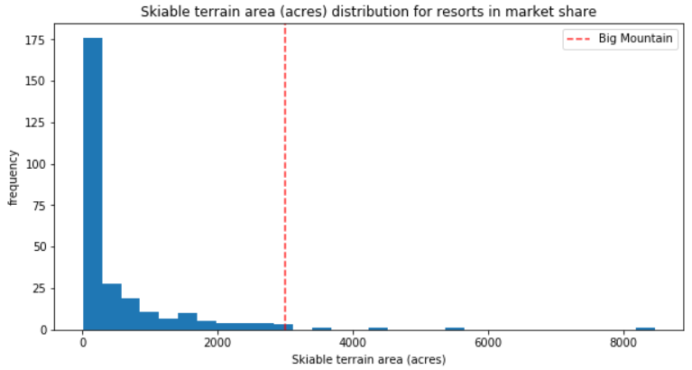
Model & Analysis (Trams & Skiable terrain area)
The vast majority of resorts, such as Big Mountain, have no trams.
Big Mountain is amongst the resorts with the largest amount of skiable terrain.

Slide 11
Summary & Conclusion
The Big Mountain resort has to increase it’s ticket prices and the increase should take place gradually from $83.3 to $104.61. While in the process of increasing the ticket price need to closely monitor the sales data to makes sure the increment only yielding positive results. During this increase the expected revenue is anywhere between $4.95M to $41.32M
To reduce the optimize the operational costs need to close the lease used runs
Increasing the vertical drop by 150 ft and including additional run, chairlift will help the resort to increase the annual revenue

Slide 12
Project By: D Rajsagar
Thank you

