Slide 1
Statistical Analysis of Advanced Encryption Standard
David Josephs,
Hannah Kosinovsky,
Carson Drake,
Volodymyr Orlov

Slide 2
Introduction
[ABSTRACT]

Slide 3
Components layout

Slide 4
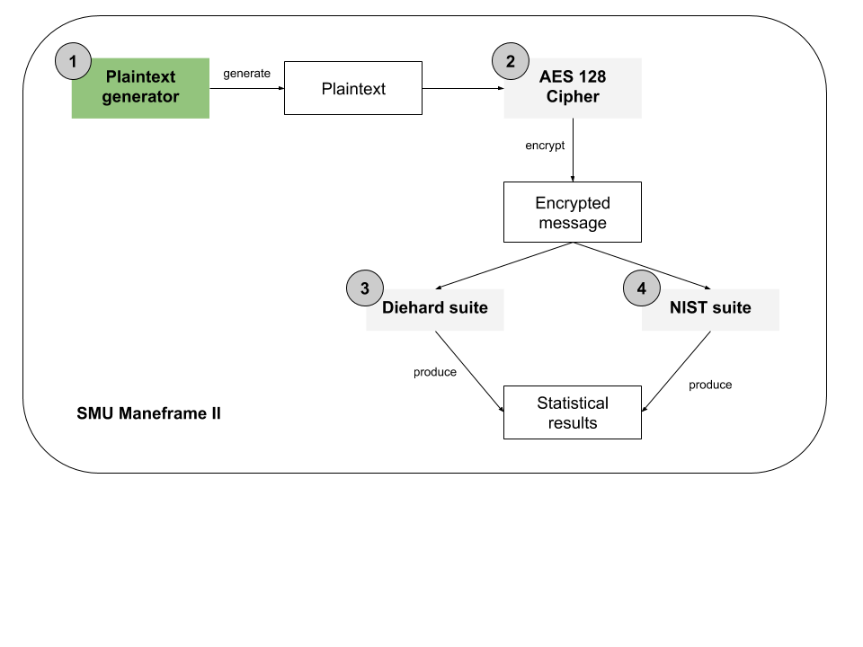
Ciphertext Generation
Low Density Plaintext
Low Density 128-bit Keys
High Density Plaintext
High Density 128-bit Keys

Slide 5
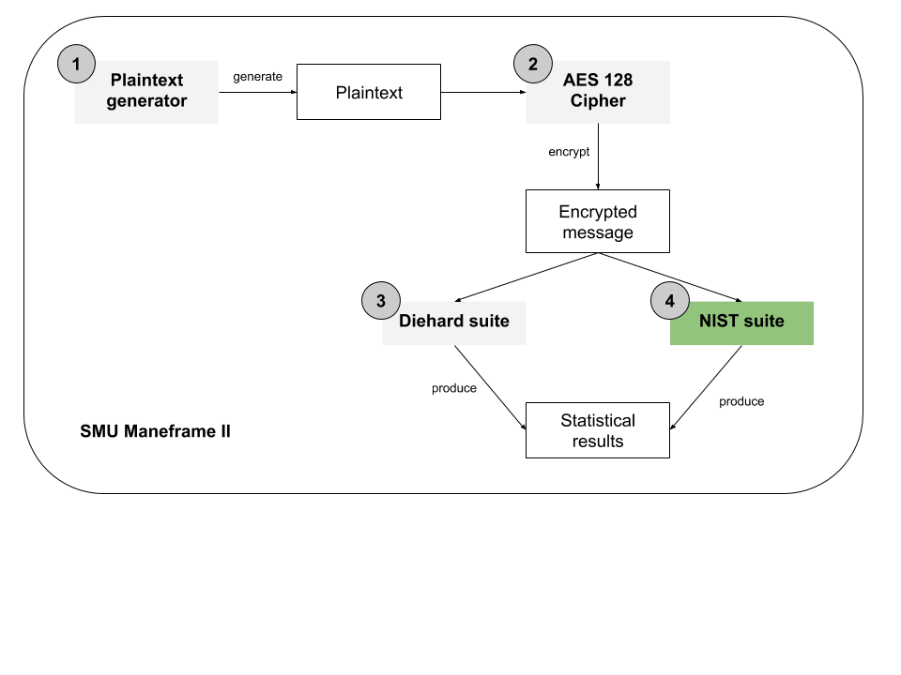
NIST Statistical Test Suite
Comes with 15 tests
These tests produce a real number between 0 and 1, the p-value, which shows the probability of finding the observed, or more extreme, results with respect to certain randomness

Slide 6
NIST Tests
Two Frequency Tests | Maurer’s ”Universal Statistical” test
Two runs test | Linear complexity test
Binary matrix rank test | Serial test
Discrete Fourier transform test | Approximate entropy test
Overlapping and non-overlapping template matching tests | Cumulative sums test
Random excursions tests | Random excursions variant tests

Slide 7
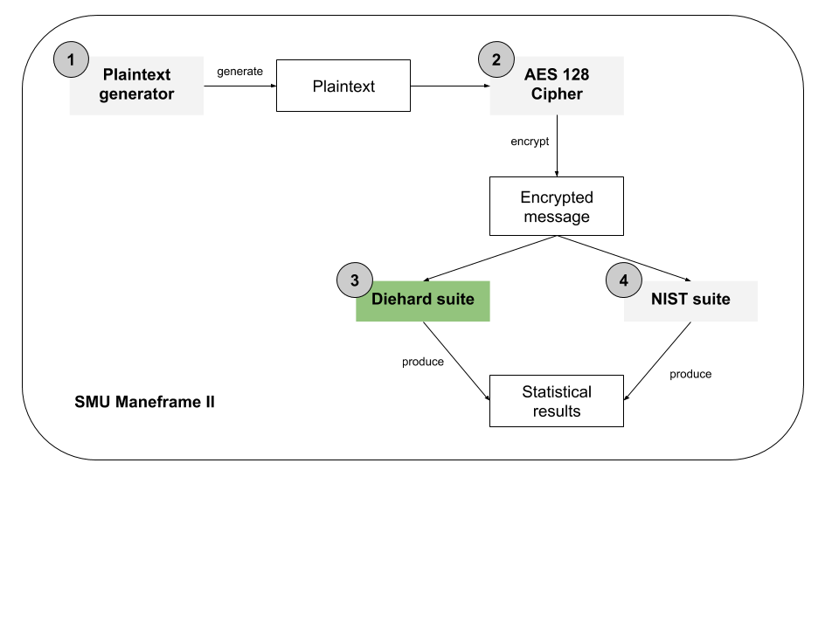
Diehard Statistical Test Suite
Comes with 11 types of statistical tests for randomness with several possible variations.
We ran 19 total Diehard tests
The output of the tests is a p-value between 0 and 1
A bit stream will “fail” the test at alpha = .05 level if p < 0.025 or p > 0.975

Slide 8
Diehard Tests
The “Birthday spacings” Test | The “Random spheres” Test
The “Overlapping permutations” Test | The “squeeze” Test
The “Ranks of matrices” Test | The “Overlapping sums” Test
The “Monkey” Tests | The “Runs” Test
The “Parking lot” Test | The “craps” Test “
The “Minimum distance” Test

Slide 9

Demo

Slide 10
Q&A

