Slide 1
Statistical Analysis of Advanced Encryption Standard
David Josephs,
Hannah Kosinovsky,
Carson Drake,
Volodymyr Orlov

Slide 2
Introduction
Thought 1
Thought 2
Thought 3

Slide 3
Components layout

Slide 4
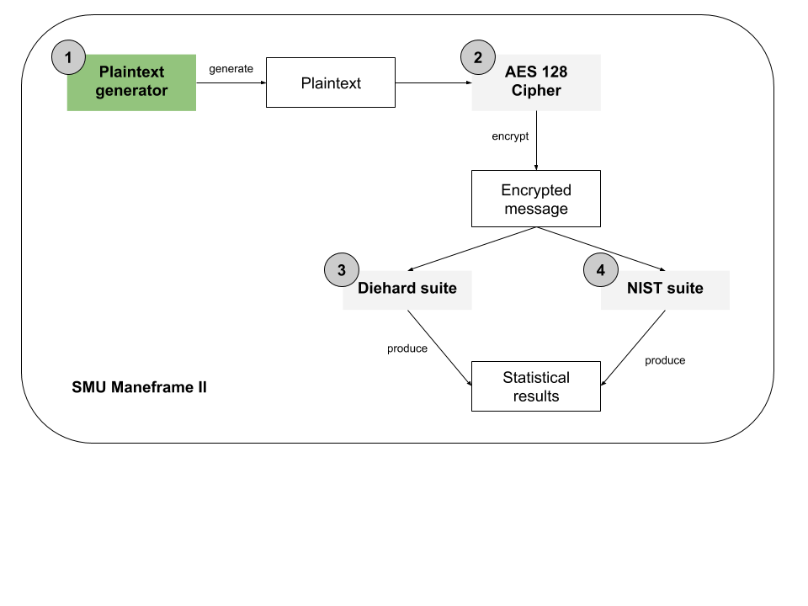
Plaintext Generator
Thought 1
Thought 2
Thought 3

Slide 5
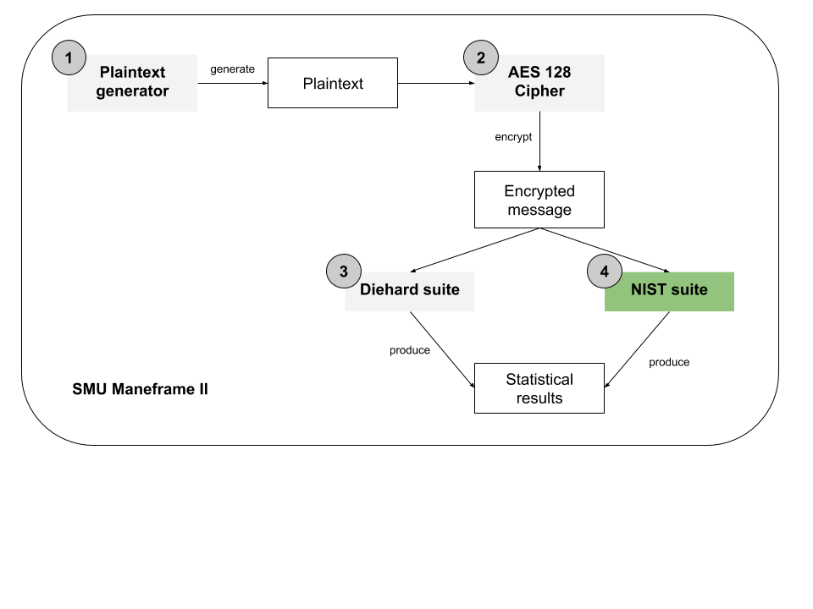
NIST Statistical Test Suite
Comes with 15 tests
These tests produce a real number between 0 and 1, the p-value, which shows the probability of finding the observed, or more extreme, results with respect to certain randomness

Slide 6
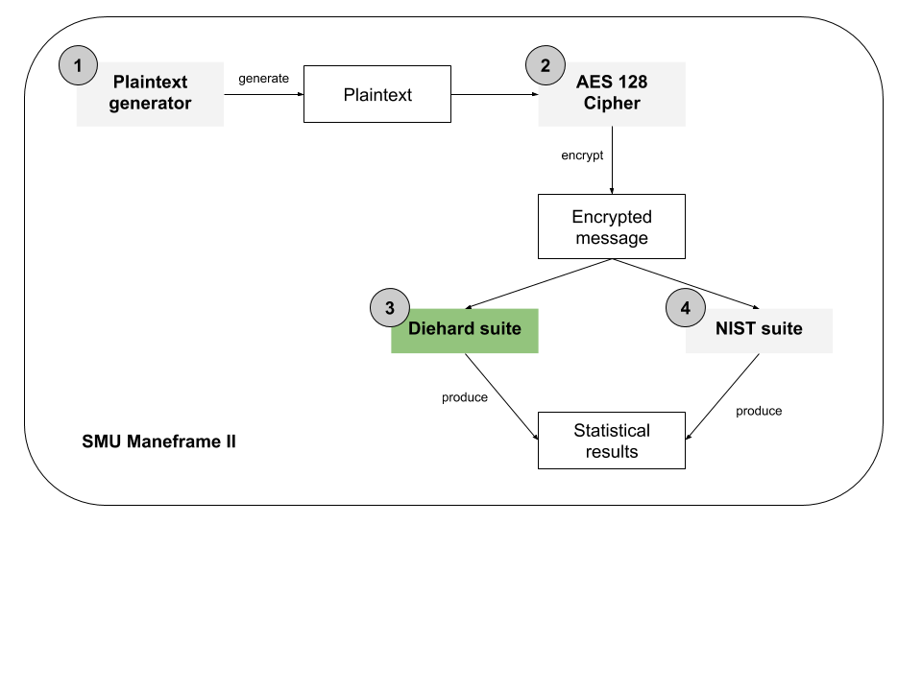
Diehard Statistical Test Suite
Thought 1
Thought 2
Thought 3

Slide 7
NIST Tests
Two Frequency Tests | Maurer’s ”Universal Statistical” test
Two runs test | Linear complexity test
Binary matrix rank test | Serial test
Discrete Fourier transform test | Approximate entropy test
Overlapping and non-overlapping template matching tests | Cumulative sums test
Random excursions tests | Random excursions variant tests

Slide 8
Demo

Slide 9
Results
Tables?

Slide 10
Q&A

