Slide 1
Machine Learning-Based Mouse Movement Controller (Virtual Mouse)
A Touchless Interface Using Computer Vision
Presented by: Prashant, Riya, Aryan, Soumya
C.V. Raman Global University, Bhubaneswar

Slide 2
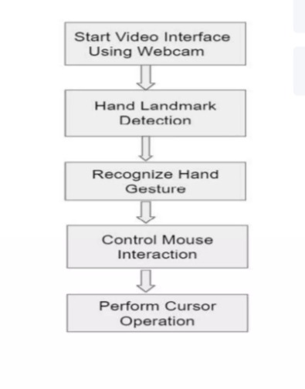
Project Overview
• A virtual mouse system based on hand gesture recognition
• Uses a standard webcam for input
• Recognizes hand gestures in real-time
• Translates gestures into mouse actions

Slide 3
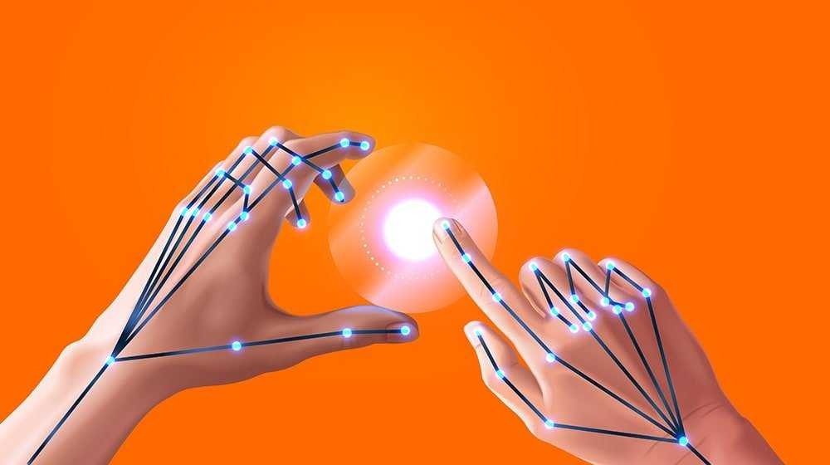
Key Features
• Cursor movement via finger tracking
• Left and right mouse clicks using gesture combinations
• Scroll functionality with hand gestures
• Volume control using thumb-index finger distance
• Screenshot capture with specific gesture

Slide 4



Technologies Used
• MediaPipe: Hand landmark detection
• OpenCV: Real-time video processing
• PyAutoGUI: Mouse actions, screenshots
• PyCaw: Volume control
• Python Libraries: NumPy, Time, Math

Slide 5
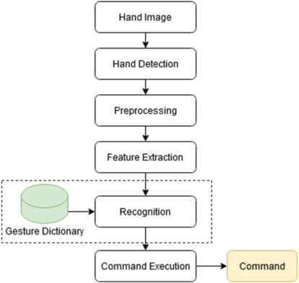
System Flow
➡️ Input: Live video stream from webcam.
➡️ Hand Detection: MediaPipe identifies hand landmarks.
➡️ Gesture Recognition: OpenCV + Python logic.
➡️ Action Mapping: Gestures mapped to mouse functions.
➡️ Execution: PyAutoGUI and PyCaw perform actions.

Slide 6
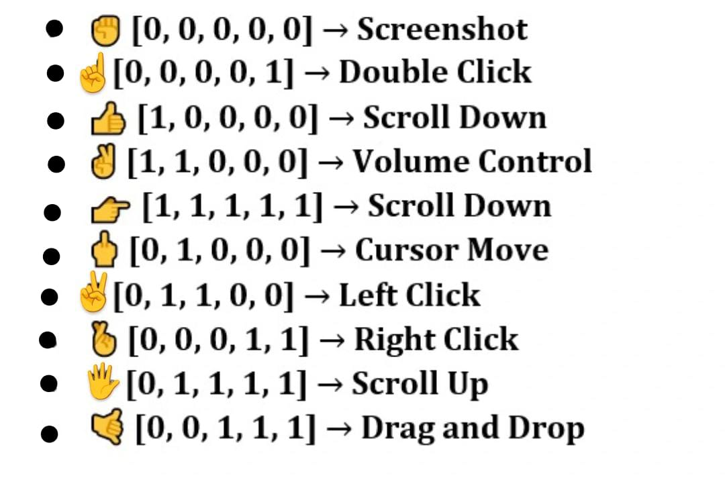
Supported Gestures & Actions
✊ [0,0,0,0,0] → Take Screenshot
☝ [0,0,0,0,1] → Left Click
👍 [1,0,0,0,0] → Scroll Down
🤘 [1,0,0,0,1] → Scroll Up
✌️ [1,1,0,0,0] → Volume Control
🖐 [1,1,1,1,1] → Cursor Movement

Slide 7

Benefits of the System
Touchless Control: Enhances hygiene and accessibility
User-Friendly Interface: Simple hand gestures
Real-Time Performance: Responsive interaction
No Specialized Hardware: Uses only a webcam
Platform-independent (Python-based)

Slide 8
Challenges & Limitations
Lighting conditions affect accuracy.
Background noise can interfere.
Gesture ambiguity in fast movements.
Requires fine-tuning for responsiveness.

Slide 9
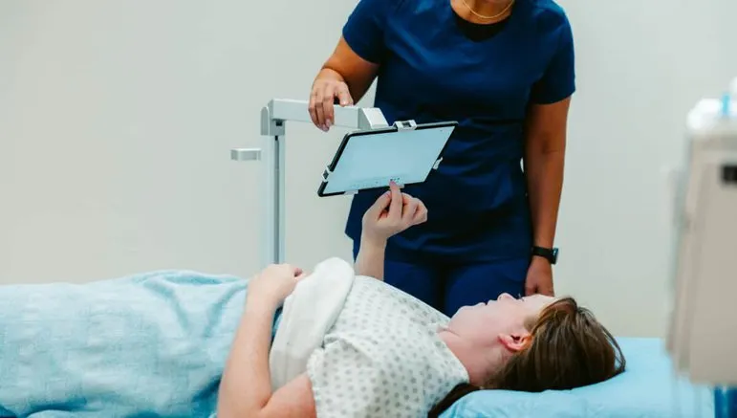
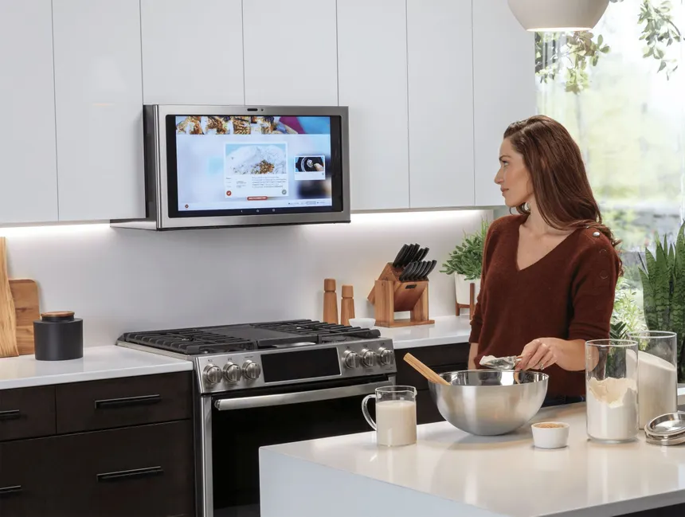
Application Scenarios
• Hospitals and Labs: Sterile environments
• Assistive Technologies: For physically challenged users
• Smart Homes & TVs: Remote gesture control
• Public Kiosks: Reduces contamination risk.

Slide 10
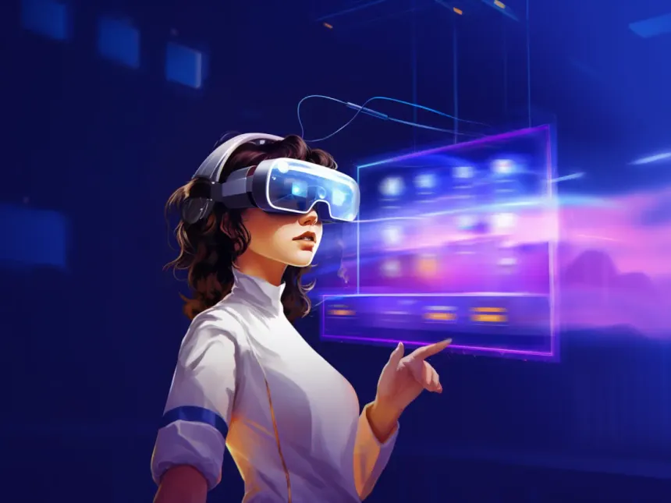
Future Scope
Integration with AR/VR interfaces.
Add voice command support.
Support for disabled users.
Gesture customization (user-defined gestures).

Slide 11
Conclusion
Seamless human-computer interaction.
Gesture-based control empowers users.
Combines powerful libraries in an intelligent system.
Bridges the gap between AI and usability.
Achieved real-time mouse control using computer vision.
No need for hardware – only a webcam
Opens doors for accessible, futuristic human-computer interaction

Slide 12
References
PyAutoGUI - GUI Automation for Python
https://pyautogui.readthedocs.io
PyCaw - Python Core Audio Windows Library https://github.com/AndreMiras/pycaw
Hand Gesture Recognition Using MediaPipe and OpenCV
YouTube tutorials, GitHub repositories, and blog posts on implementing gesture recognition with MediaPipe and OpenCV.
Computer Vision: Algorithms and Applications
Richard Szeliski, Springer, 2011.

Slide 13


