Slide 1
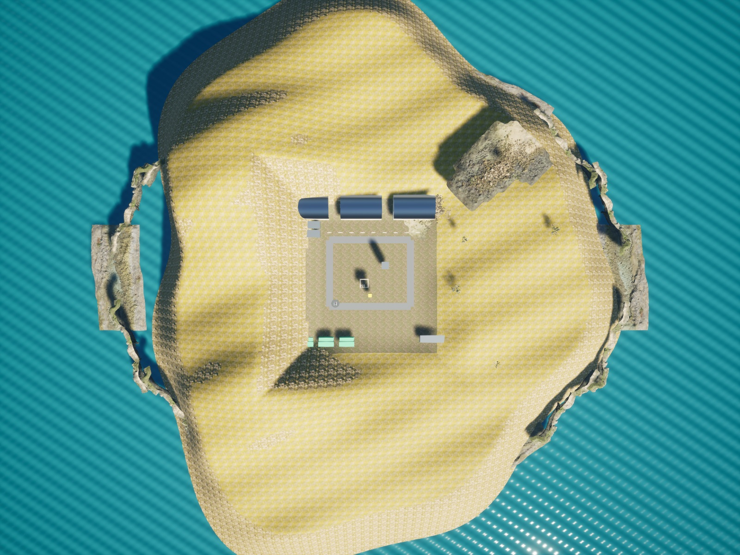
SKYFORGE
Autonomous humanitarian
reconnaissance & rescue support
IEEE RAS & AESS ENSIT / DRONATHON 3.0
SKYFORGE / DRONATHON 3.0
01
Notes:
Suggested time: 15 seconds.
Open with the mission: autonomous humanitarian reconnaissance and medical support. The objective is to detect hazards, support casualties and return safely.
Sources: dronathon.pdf; validation/submission-summary.json; configs/airframes/x500-research.json. All simulation images are actual renderer outputs.

Slide 2
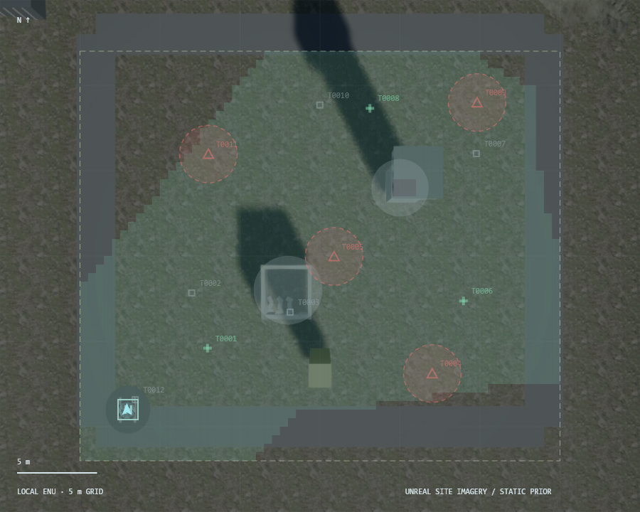
The mission
Explore the coastal environment and map hazards.
Locate casualties and prioritize feasible aid.
Continue through radio loss and return with reserve.
SKYFORGE / DRONATHON 3.0
02
Notes:
Suggested time: 30 seconds.
Describe the humanitarian scenario. Mines and weapons are inert mapped hazards; hostile units are avoided. Medical delivery is simulated. Scoring prioritizes autonomy and decision intelligence, 20% each.
Sources: dronathon.pdf; validation/submission-summary.json; configs/airframes/x500-research.json. All simulation images are actual renderer outputs.

Slide 3
Two agents. Independent flight protection.
RGB + depth
Two detectors
Perception
Agent
Planner
Agent
Route shield
bounded velocity commands
Physical simulator
Classical reflex
CRC/HMAC • buffered replay
Journal + radio
Ground station
SKYFORGE / DRONATHON 3.0
03
Notes:
Suggested time: 55 seconds.
Follow the editable diagram from sensors to control. Exactly two deterministic LangGraph nodes: PerceptionAgent and PlannerAgent. No language model runs in the control loop. The radio module is asynchronous and is not a third agent.
Sources: dronathon.pdf; validation/submission-summary.json; configs/airframes/x500-research.json. All simulation images are actual renderer outputs.

Slide 4
INIT → autonomous mission
INIT
EXPLORER
DÉTECTER
TRIAGE
POSÉ
RETOUR BASE
LIVRER
NAVIGUER
Priority interrupts: energy reserve • link loss • authenticated goal update
SKYFORGE / DRONATHON 3.0
04
Notes:
Suggested time: 30 seconds.
Initialization checks stationary launch, odometry, sensors, model availability and energy. Show the mission state sequence. Priority interrupts handle low energy, radio loss and revised station objectives.
Sources: dronathon.pdf; validation/submission-summary.json; configs/airframes/x500-research.json. All simulation images are actual renderer outputs.

Slide 5
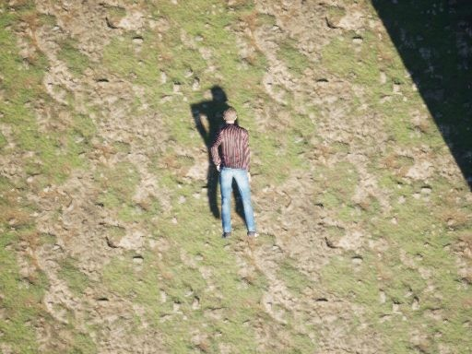
DÉTECTER / from pixels to mapped objects
Primary: waste, mines and weapons.
Secondary: injured people and hostile units.
Depth + timestamp-aligned pose localize detections.
Repeated observations maintain persistent tracks.
SKYFORGE / DRONATHON 3.0
05
Notes:
Suggested time: 55 seconds.
Explain the five classes and two models. RGB letterbox preprocessing, class-wise NMS, depth and aligned pose produce ENU positions. Persistent tracks and role votes reduce unstable classifications. The displayed image is a real recorded simulator frame.
Sources: dronathon.pdf; validation/submission-summary.json; configs/airframes/x500-research.json. All simulation images are actual renderer outputs.

Slide 6
TRIAGE / urgency before proximity
Decision gate | Rule
1 / Confirmation | Repeated visual evidence; conservative role voting
2 / Feasibility | Rescue + return + landing + reserve must fit
3 / Medical priority | Urgency 3 → urgency 2 → urgency 1
4 / Tie breaker | Lower predicted travel time
SKYFORGE / DRONATHON 3.0
06
Notes:
Suggested time: 45 seconds.
Rank confirmed feasible casualties by urgency, then travel time. A distress beacon guides search; visual confirmation is still required. The example priorities are the scenario inputs, not a medical diagnosis from the image.
Sources: dronathon.pdf; validation/submission-summary.json; configs/airframes/x500-research.json. All simulation images are actual renderer outputs.

Slide 7
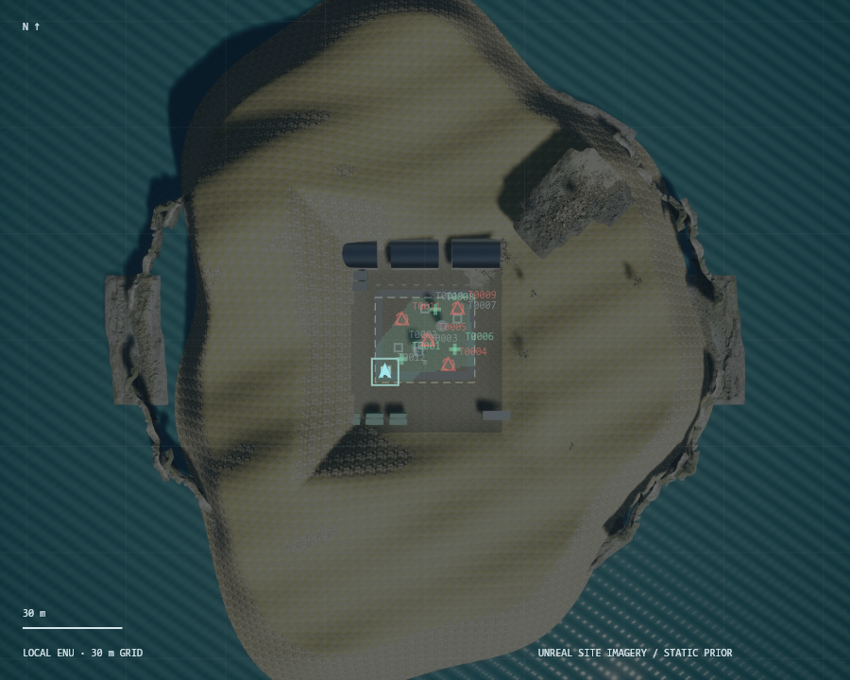
NAVIGUER / checked routes and local reflex
A* with inflated obstacle and exclusion geometry.
Independent route shield checks bounds and intersections.
Lidar braking, wind compensation and stale-data holds.
Authenticated goal changes preempt the current objective.
SKYFORGE / DRONATHON 3.0
07
Notes:
Suggested time: 55 seconds.
A* inflates hazards and obstacles. Every shortcut and route is checked independently by the safety shield. The reflex applies bounded feedback, acceleration/jerk limits and lidar braking. It can stop a planner command without waiting for inference.
Sources: dronathon.pdf; validation/submission-summary.json; configs/airframes/x500-research.json. All simulation images are actual renderer outputs.

Slide 8
Physics / an auditable X500 reference
2.2543 kg
74 Wh nominal
Airframe, rotors, three 50 g kits
and a 40 g payload mount
14.8 V × 5 Ah
59.2 Wh usable assumption
T = kT ω² / 4T = mg
E = ∫ P(t) dt / 3600
Hover ≈ 804 rad/s
Maximum thrust / weight = 1.547
Wind-relative drag, climb and electronics
20 Wh declared mission allowance
SKYFORGE / DRONATHON 3.0
08
Notes:
Suggested time: 55 seconds.
These are source-backed simulation parameters plus explicitly selected payload and battery assumptions. PX4 source hashes are in the reference JSON. Explain thrust balance and energy, rather than claiming measured physical calibration. Sources: https://github.com/PX4/PX4-gazebo-models ; configs/airframes/x500-research.json.
Sources: dronathon.pdf; validation/submission-summary.json; configs/airframes/x500-research.json. All simulation images are actual renderer outputs.

Slide 9
LIVRER → RETOUR BASE
Confirm target
Stable hover
Virtual aid
Audit position
Recompute return energy for wind, distance and landing.
Return when reserve is threatened or supplies are delivered.
Verify touchdown before disarming.
SKYFORGE / DRONATHON 3.0
09
Notes:
Suggested time: 30 seconds.
Delivery requires a confirmed casualty, a stable hover and fresh visual or depth corroboration. The evaluator checks actual position against ground truth after the flight. Delivery is virtual. The dynamic reserve includes return, descent, landing and margin.
Sources: dronathon.pdf; validation/submission-summary.json; configs/airframes/x500-research.json. All simulation images are actual renderer outputs.

Slide 10
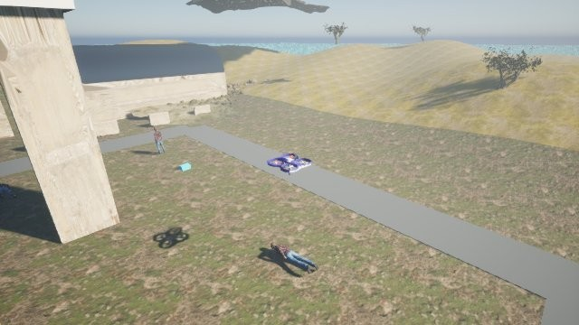
Recorded autonomous mission
Actual simulation + synchronized station telemetry / accelerated replay
SKYFORGE / DRONATHON 3.0
10
Notes:
Suggested time: 90 seconds.
Play the embedded 90-second cut. It contains actual simulator camera frames and synchronized station telemetry. The full recording is supplied separately. The telemetry panel is composed from recorded station JSON, not a browser screen capture. The clip is sped up; the source and speed factor are retained in artifacts/demo-recording/recording.json.
Sources: dronathon.pdf; validation/submission-summary.json; configs/airframes/x500-research.json. All simulation images are actual renderer outputs.

Slide 11
Resilience / autonomy survives the outage
Event journal
Link unavailable
Buffer onboard
Replay + ACK
Versioned JSON: at most 999 wire bytes.
CRC32 + HMAC-SHA256; sequence and expiry checks.
4,096-event ring, persistent journal and receiver cursor.
State corruption triggers a reflex hold.
SKYFORGE / DRONATHON 3.0
11
Notes:
Suggested time: 55 seconds.
Describe the recorded 20-second radio blackout, buffering and ordered replay. CRC detects modeled corruption; HMAC authenticates packets. Sequence/TTL reject replay and stale control. The modeled bit-flip test is not an arbitrary hardware error guarantee.
Sources: dronathon.pdf; validation/submission-summary.json; configs/airframes/x500-research.json. All simulation images are actual renderer outputs.

Slide 12
Measured mission results
Acceptance measure | Recorded result
Virtual deliveries + return | 3/3 • 159.7 s
Hazard entries / static collision segments | 0 / 0
Largest delivery position error | 6.7 cm
Energy remaining | 9.10 Wh from 20 Wh
Command dispatch / RPC completion p95 | 143.5 / 164.3 ms
SKYFORGE / DRONATHON 3.0
12
Notes:
Suggested time: 45 seconds.
Read the values from the accepted flight. Distinguish software command dispatch from simulator RPC completion. Model metrics come from 100 unseen views in the same scene, not an unseen-world or real-image benchmark. Source: validation/submission-summary.json.
Sources: dronathon.pdf; validation/submission-summary.json; configs/airframes/x500-research.json. All simulation images are actual renderer outputs.

Slide 13
Applications and operating model
Civil protection: reconnaissance and casualty support.
Environmental teams: coastal litter and hazard mapping.
Offer: mission software, integration, training and maintenance.
Budget: aircraft + sensors + compute + power + validation.
SKYFORGE / DRONATHON 3.0
13
Notes:
Suggested time: 25 seconds.
These are proposed applications and commercial directions, not market or deployment claims. Initial users include civil protection and environmental teams. Budget the complete system: airframe, propulsion, flight controller, sensors, compute, battery, integration and testing. Do not present an unquoted full-system price or invented ROI.
Sources: dronathon.pdf; validation/submission-summary.json; configs/airframes/x500-research.json. All simulation images are actual renderer outputs.

Slide 14
SKYFORGE
Observe. Prioritize.
Deliver. Return.
Autonomous humanitarian mission support
github.com/drakedeveloper/dronathon
SKYFORGE / DRONATHON 3.0
14
Notes:
Suggested time: 15 seconds.
Close on the actual mission: observe, prioritize, deliver and return. Invite questions on planning, physics, detection, resilience and deployment. Main talk including the video is exactly ten minutes; the following slides are backup.
Sources: dronathon.pdf; validation/submission-summary.json; configs/airframes/x500-research.json. All simulation images are actual renderer outputs.

Slide 15
Backup / vision evaluation
Native simulation class | AP50 | Test domain
Waste | 99.5% | 100 unseen scene views
Mine | 99.5% | 100 unseen scene views
Weapon | 98.6% | 100 unseen scene views
Injured Person | 93.8% | 100 unseen scene views
Hostile Unit | 97.8% | 100 unseen scene views
SKYFORGE / DRONATHON 3.0
BACKUP / 15
Notes:
Suggested time: 0 seconds.
Sources: validation/native-v2-primary-map.json, validation/native-v2-secondary-map.json and the frozen v2 point evaluations. Do not combine AP50 with fixed-threshold recall; they describe different measurements.
Sources: dronathon.pdf; validation/submission-summary.json; configs/airframes/x500-research.json. All simulation images are actual renderer outputs.

Slide 16
Backup / separate real-image work
Team dataset model | Precision | Recall | mAP50
Gun detection | 88.0% | 73.0% | 81.0%
Waste segmentation | 84.3% | 81.0% | 83.8%
Separate model track — not used by the simulator
Notebook checkpoints and reported image timings remain separate from mission acceptance.
SKYFORGE / DRONATHON 3.0
BACKUP / 16
Notes:
Suggested time: 0 seconds.
Team-supplied charts: 39bd966f-17a3-414f-b5ba-f3bfadab54c7.jpg; cf9d2047-4e13-4252-b0ba-7317d16a1f3d.jpg; e846daec-091d-457b-a8de-7a98c4f588f7.jpg. These are reported dataset results from separate notebooks and were not used in the flight runtime. Their inference speed is not end-to-end mission timing.
Sources: dronathon.pdf; validation/submission-summary.json; configs/airframes/x500-research.json. All simulation images are actual renderer outputs.

Slide 17
Backup / dashboard controls
Map objective / checked rerouting / radio blackout and autonomous continuation
SKYFORGE / DRONATHON 3.0
BACKUP / 17
Notes:
Suggested time: 0 seconds.
Optional 32-second demonstration outside the ten-minute main sequence. The clip records actual camera frames and station telemetry. Objective and blackout requests use the same authenticated HTTP endpoints as the dashboard buttons; the clip is not a browser screen recording. Explain: Map objective, choose a safe point, watch the checked route and motion; blackout buffers events while autonomy continues.
Sources: dronathon.pdf; validation/submission-summary.json; configs/airframes/x500-research.json. All simulation images are actual renderer outputs.

