Slide 1
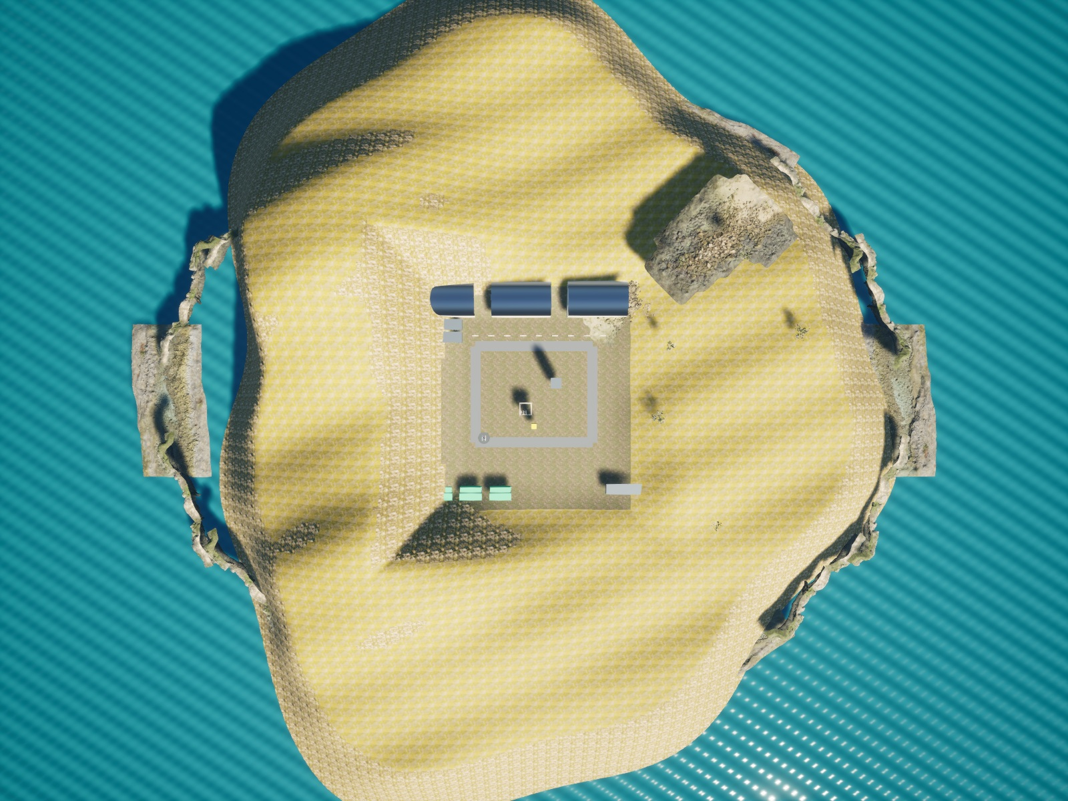
SKYFORGE
Autonomous humanitarian
reconnaissance & rescue support
IEEE RAS & AESS ENSIT / DRONATHON 3.0
SKYFORGE / DRONATHON 3.0
01
Notes:
Suggested time: 15 seconds.
Open with the mission: autonomous humanitarian reconnaissance and medical support. The objective is to detect hazards, support casualties and return safely.
Sources: dronathon.pdf; validation/submission-summary.json; configs/airframes/x500-research.json. All simulation images are actual renderer outputs.

Slide 2
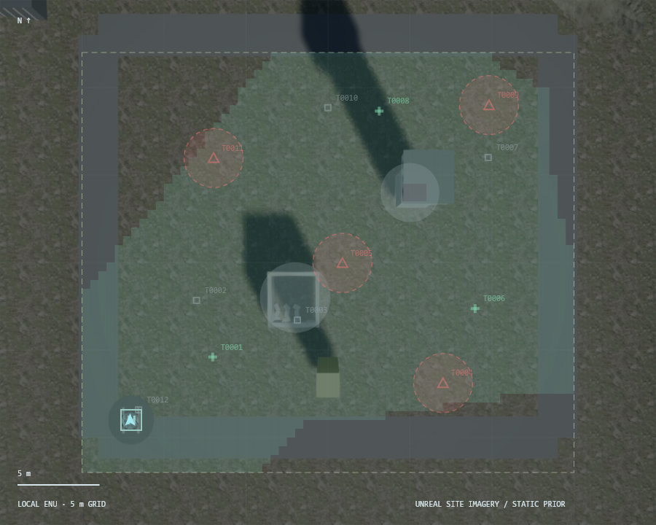
The mission
Explore the coastal environment and map hazards.
Locate casualties and prioritize feasible aid.
Continue through radio loss and return with reserve.
SKYFORGE / DRONATHON 3.0
02
Notes:
Suggested time: 30 seconds.
Describe the humanitarian scenario. Mines and weapons are inert mapped hazards; hostile units are avoided. Medical delivery is simulated. Scoring prioritizes autonomy and decision intelligence, 20% each.
Sources: dronathon.pdf; validation/submission-summary.json; configs/airframes/x500-research.json. All simulation images are actual renderer outputs.

Slide 3
Two agents. Independent flight protection.
RGB + depth
Two detectors
Perception
Agent
Planner
Agent
Route shield
bounded velocity commands
Physical simulator
Classical reflex
CRC/HMAC • buffered replay
Journal + radio
Ground station
SKYFORGE / DRONATHON 3.0
03
Notes:
Suggested time: 35 seconds.
Follow the editable diagram from sensors to control. Exactly two deterministic LangGraph nodes: PerceptionAgent and PlannerAgent. No language model runs in the control loop. The radio module is asynchronous and is not a third agent.
Sources: dronathon.pdf; validation/submission-summary.json; configs/airframes/x500-research.json. All simulation images are actual renderer outputs.

Slide 4
Initialize / autonomous mission
INITIALIZE
EXPLORE
DETECT
TRIAGE
LANDED
RETURN TO BASE
DELIVER
NAVIGATE
Priority interrupts: energy reserve • link loss • authenticated goal update
SKYFORGE / DRONATHON 3.0
04
Notes:
Suggested time: 30 seconds.
Initialization checks stationary launch, odometry, sensors, model availability and energy. Show the mission state sequence. Priority interrupts handle low energy, radio loss and revised station objectives.
Sources: dronathon.pdf; validation/submission-summary.json; configs/airframes/x500-research.json. All simulation images are actual renderer outputs.

Slide 5
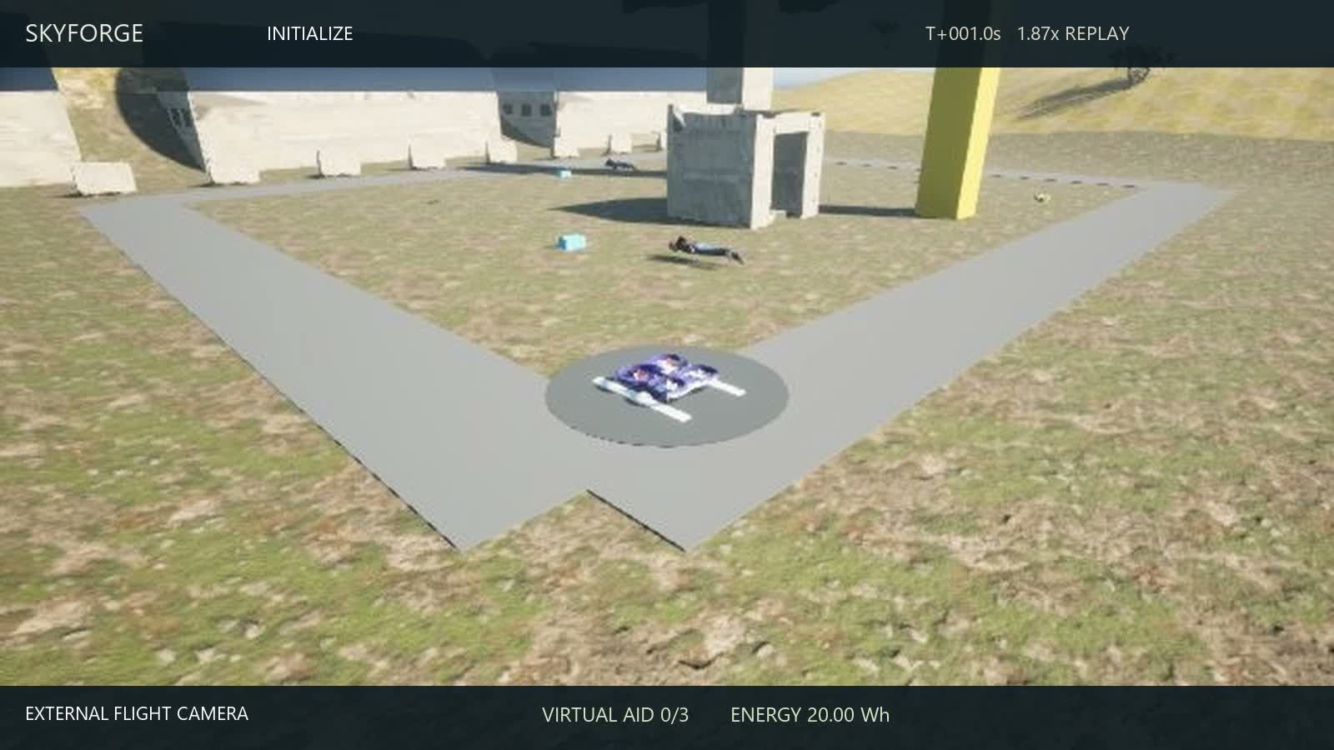
Flight recording / Launch and initial climb
Actual simulation footage / 1.87x replay / click video to play
SKYFORGE / DRONATHON 3.0
05
Notes:
Suggested time: 10 seconds.
Play this embedded chapter, then continue the explanation. Actual recorded AirSim imagery, edited at 1.87x. The English caption maps the original mission phase to its display label. The chapters follow the recorded flight chronologically. Camera cuts preserve the real aircraft motion and detector output.
Sources: dronathon.pdf; validation/submission-summary.json; configs/airframes/x500-research.json. All simulation images are actual renderer outputs.

Slide 6
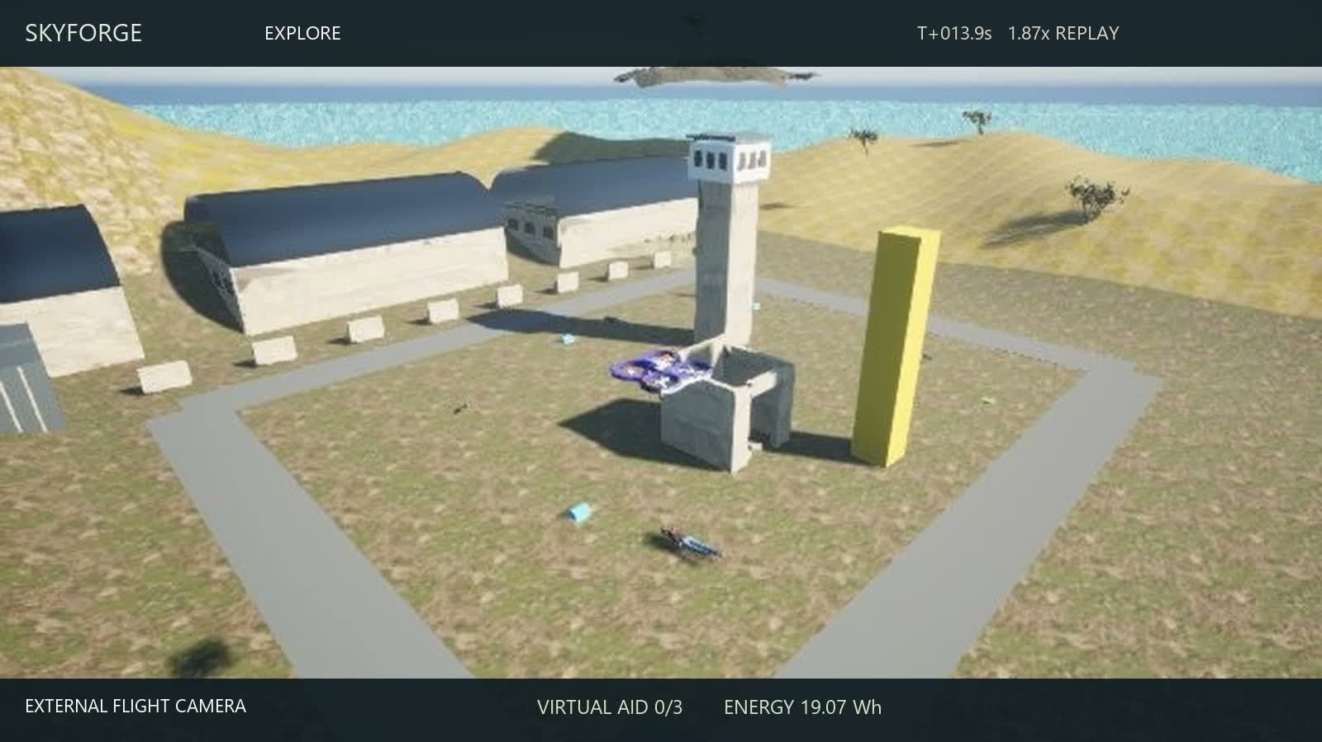
Flight recording / Exploration and first observations
Actual simulation footage / 1.87x replay / click video to play
SKYFORGE / DRONATHON 3.0
06
Notes:
Suggested time: 10 seconds.
Play this embedded chapter, then continue the explanation. Actual recorded AirSim imagery, edited at 1.87x. The English caption maps the original mission phase to its display label. The chapters follow the recorded flight chronologically. Camera cuts preserve the real aircraft motion and detector output.
Sources: dronathon.pdf; validation/submission-summary.json; configs/airframes/x500-research.json. All simulation images are actual renderer outputs.

Slide 7
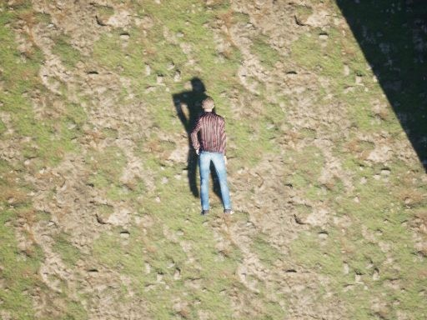
Detect / from pixels to mapped objects
Primary: waste, mines and weapons.
Secondary: injured people and hostile units.
Depth + timestamp-aligned pose localize detections.
Repeated observations maintain persistent tracks.
SKYFORGE / DRONATHON 3.0
07
Notes:
Suggested time: 45 seconds.
Explain the five classes and two models. RGB letterbox preprocessing, class-wise NMS, depth and aligned pose produce ENU positions. Persistent tracks and role votes reduce unstable classifications. The displayed image is a real recorded simulator frame.
Sources: dronathon.pdf; validation/submission-summary.json; configs/airframes/x500-research.json. All simulation images are actual renderer outputs.

Slide 8
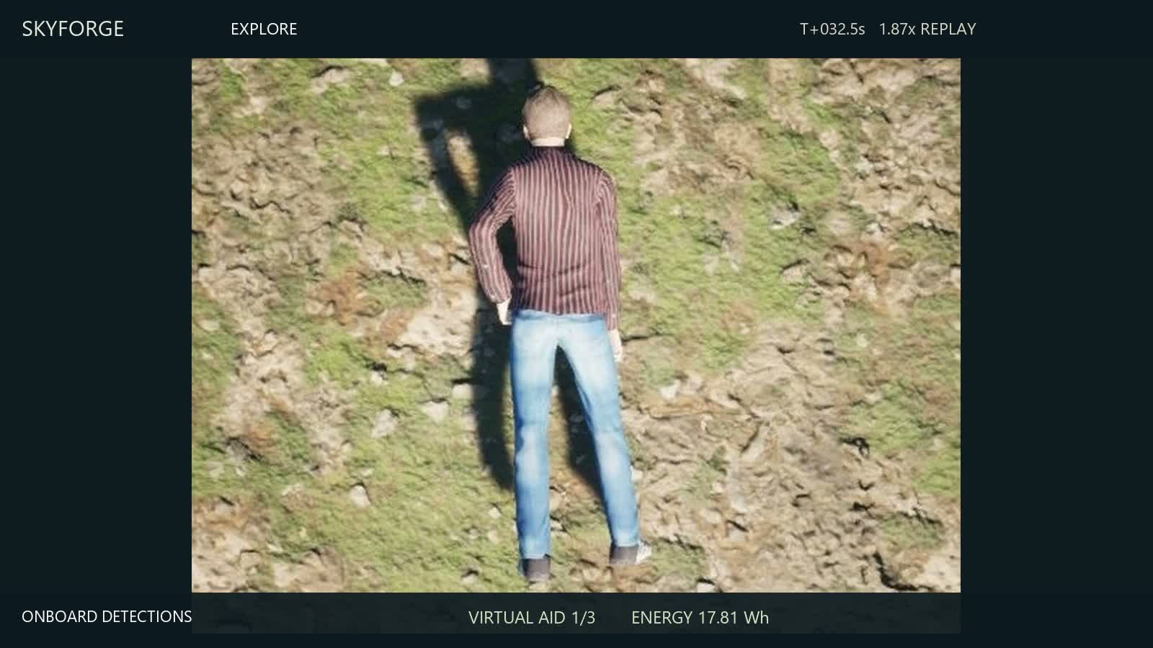
Flight recording / Visual confirmation and mapping
Actual simulation footage / 1.87x replay / click video to play
SKYFORGE / DRONATHON 3.0
08
Notes:
Suggested time: 10 seconds.
Play this embedded chapter, then continue the explanation. Actual recorded AirSim imagery, edited at 1.87x. The English caption maps the original mission phase to its display label. The chapters follow the recorded flight chronologically. Camera cuts preserve the real aircraft motion and detector output.
Sources: dronathon.pdf; validation/submission-summary.json; configs/airframes/x500-research.json. All simulation images are actual renderer outputs.

Slide 9
Triage / urgency before proximity
Decision gate | Rule
1 / Confirmation | Repeated visual evidence; conservative role voting
2 / Feasibility | Rescue + return + landing + reserve must fit
3 / Medical priority | Urgency 3 → urgency 2 → urgency 1
4 / Tie breaker | Lower predicted travel time
SKYFORGE / DRONATHON 3.0
09
Notes:
Suggested time: 40 seconds.
Rank confirmed feasible casualties by urgency, then travel time. A distress beacon guides search; visual confirmation is still required. The example priorities are the scenario inputs, not a medical diagnosis from the image.
Sources: dronathon.pdf; validation/submission-summary.json; configs/airframes/x500-research.json. All simulation images are actual renderer outputs.

Slide 10
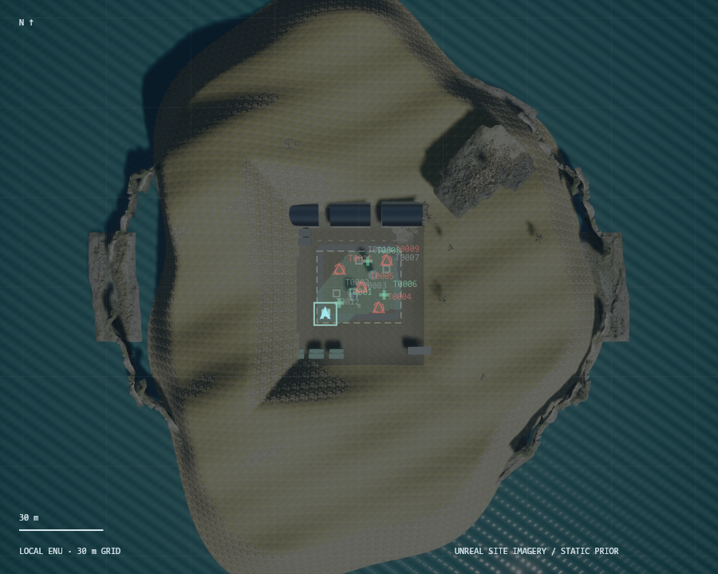
Navigate / checked routes and local reflex
A* with inflated obstacle and exclusion geometry.
Independent route shield checks bounds and intersections.
Lidar braking, wind compensation and stale-data holds.
Authenticated goal changes preempt the current objective.
SKYFORGE / DRONATHON 3.0
10
Notes:
Suggested time: 45 seconds.
A* inflates hazards and obstacles. Every shortcut and route is checked independently by the safety shield. The reflex applies bounded feedback, acceleration/jerk limits and lidar braking. It can stop a planner command without waiting for inference.
Sources: dronathon.pdf; validation/submission-summary.json; configs/airframes/x500-research.json. All simulation images are actual renderer outputs.

Slide 11
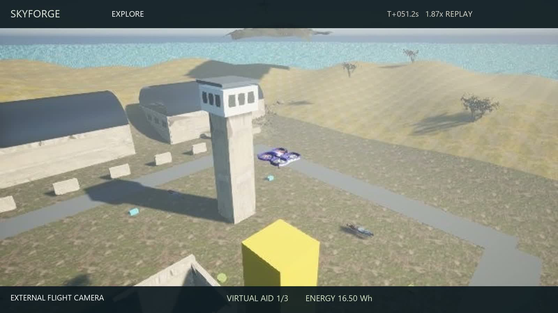
Flight recording / Checked navigation and approach
Actual simulation footage / 1.87x replay / click video to play
SKYFORGE / DRONATHON 3.0
11
Notes:
Suggested time: 15 seconds.
Play this embedded chapter, then continue the explanation. Actual recorded AirSim imagery, edited at 1.87x. The English caption maps the original mission phase to its display label. The chapters follow the recorded flight chronologically. Camera cuts preserve the real aircraft motion and detector output.
Sources: dronathon.pdf; validation/submission-summary.json; configs/airframes/x500-research.json. All simulation images are actual renderer outputs.

Slide 12
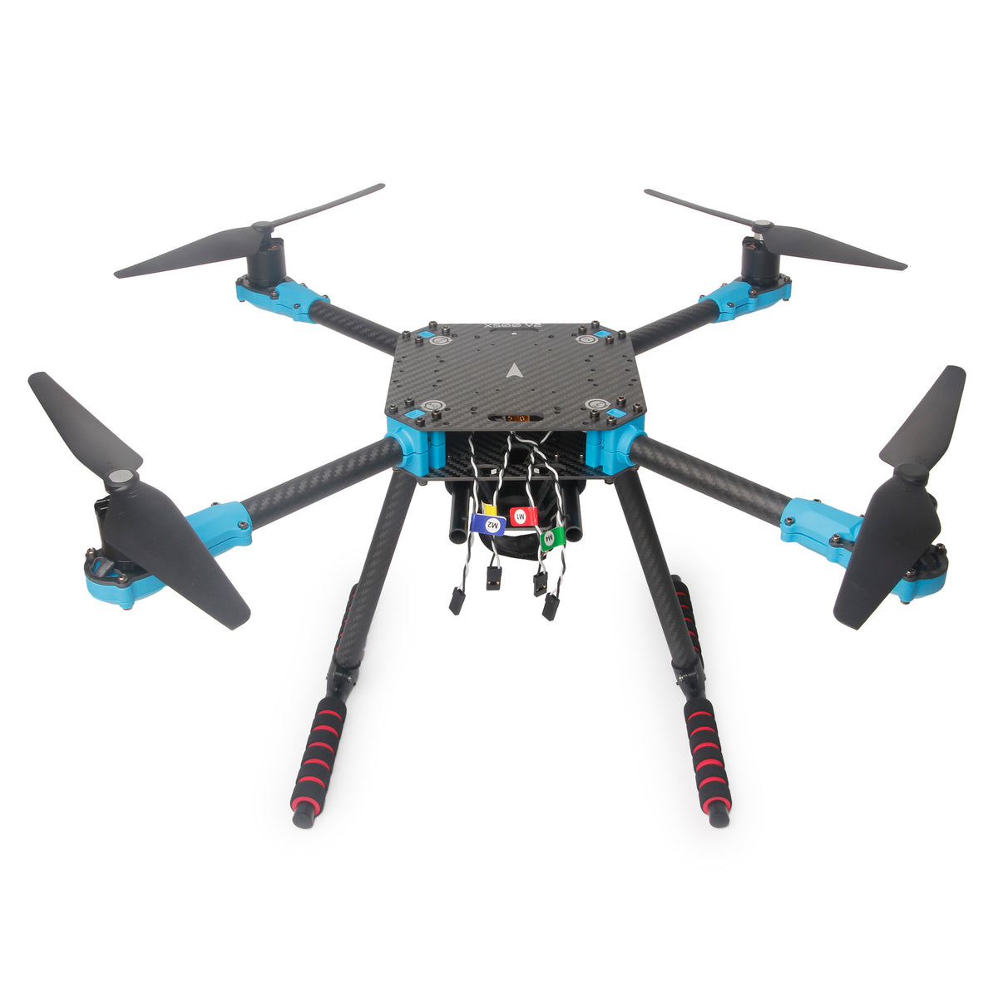
Mechanical design / the X500 platform
500 mm carbon-fiber frame with replaceable arms.
Central battery and payload placement limits CG shift.
Camera rails and companion-computer mounting.
Simulation mass: 2.2543 kg, including three 50 g aid kits.
Holybro X500 V2 product reference / photo: Holybro
SKYFORGE / DRONATHON 3.0
12
Notes:
Suggested time: 30 seconds.
The photograph shows the Holybro X500 V2 reference product, not a built SKYFORGE aircraft. Its carbon-fiber frame has a 500 mm wheelbase, modular arms, landing gear, companion-computer mounting and camera rails. Product ARF propulsion: 2216 KV920 motors, 20 A ESCs and 1045 propellers. Our simulation uses a separately documented PX4-derived reference with a 0.28 m propeller assumption. Keep that distinction clear. Position battery and payload near the central plate to limit CG offset and attitude coupling. Photograph and product source: https://holybro.com/collections/multicopter-kit/products/x500-v2-kits .
Sources: dronathon.pdf; validation/submission-summary.json; configs/airframes/x500-research.json. All simulation images are actual renderer outputs.

Slide 13
Physics / an auditable X500 reference
2.2543 kg
74 Wh nominal
Airframe, rotors, three 50 g kits
and a 40 g payload mount
14.8 V × 5 Ah
59.2 Wh usable assumption
T = kT ω² / 4T = mg
E = ∫ P(t) dt / 3600
Hover ≈ 804 rad/s
Maximum thrust / weight = 1.547
Wind-relative drag, climb and electronics
20 Wh declared mission allowance
SKYFORGE / DRONATHON 3.0
13
Notes:
Suggested time: 25 seconds.
These are source-backed simulation parameters plus explicitly selected payload and battery assumptions. PX4 source hashes are in the reference JSON. Explain thrust balance and energy, rather than claiming measured physical calibration. Sources: https://github.com/PX4/PX4-gazebo-models ; configs/airframes/x500-research.json.
Sources: dronathon.pdf; validation/submission-summary.json; configs/airframes/x500-research.json. All simulation images are actual renderer outputs.

Slide 14
Deliver / return to base
Confirm target
Stable hover
Virtual aid
Audit position
Recompute return energy for wind, distance and landing.
Return when reserve is threatened or supplies are delivered.
Verify touchdown before disarming.
SKYFORGE / DRONATHON 3.0
14
Notes:
Suggested time: 30 seconds.
Delivery requires a confirmed casualty, a stable hover and fresh visual or depth corroboration. The evaluator checks actual position against ground truth after the flight. Delivery is virtual. The dynamic reserve includes return, descent, landing and margin.
Sources: dronathon.pdf; validation/submission-summary.json; configs/airframes/x500-research.json. All simulation images are actual renderer outputs.

Slide 15
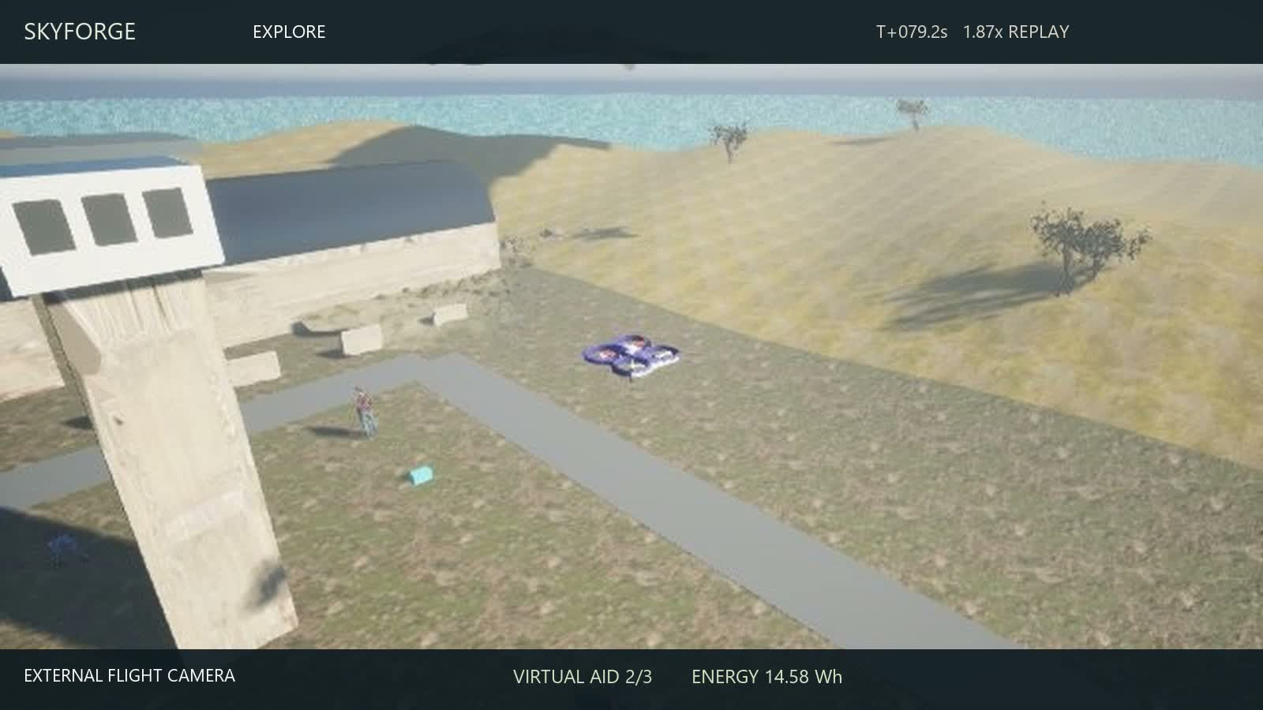
Flight recording / Target confirmation and virtual aid
Actual simulation footage / 1.87x replay / click video to play
SKYFORGE / DRONATHON 3.0
15
Notes:
Suggested time: 18 seconds.
Play this embedded chapter, then continue the explanation. Actual recorded AirSim imagery, edited at 1.87x. The English caption maps the original mission phase to its display label. The chapters follow the recorded flight chronologically. Camera cuts preserve the real aircraft motion and detector output.
Sources: dronathon.pdf; validation/submission-summary.json; configs/airframes/x500-research.json. All simulation images are actual renderer outputs.

Slide 16
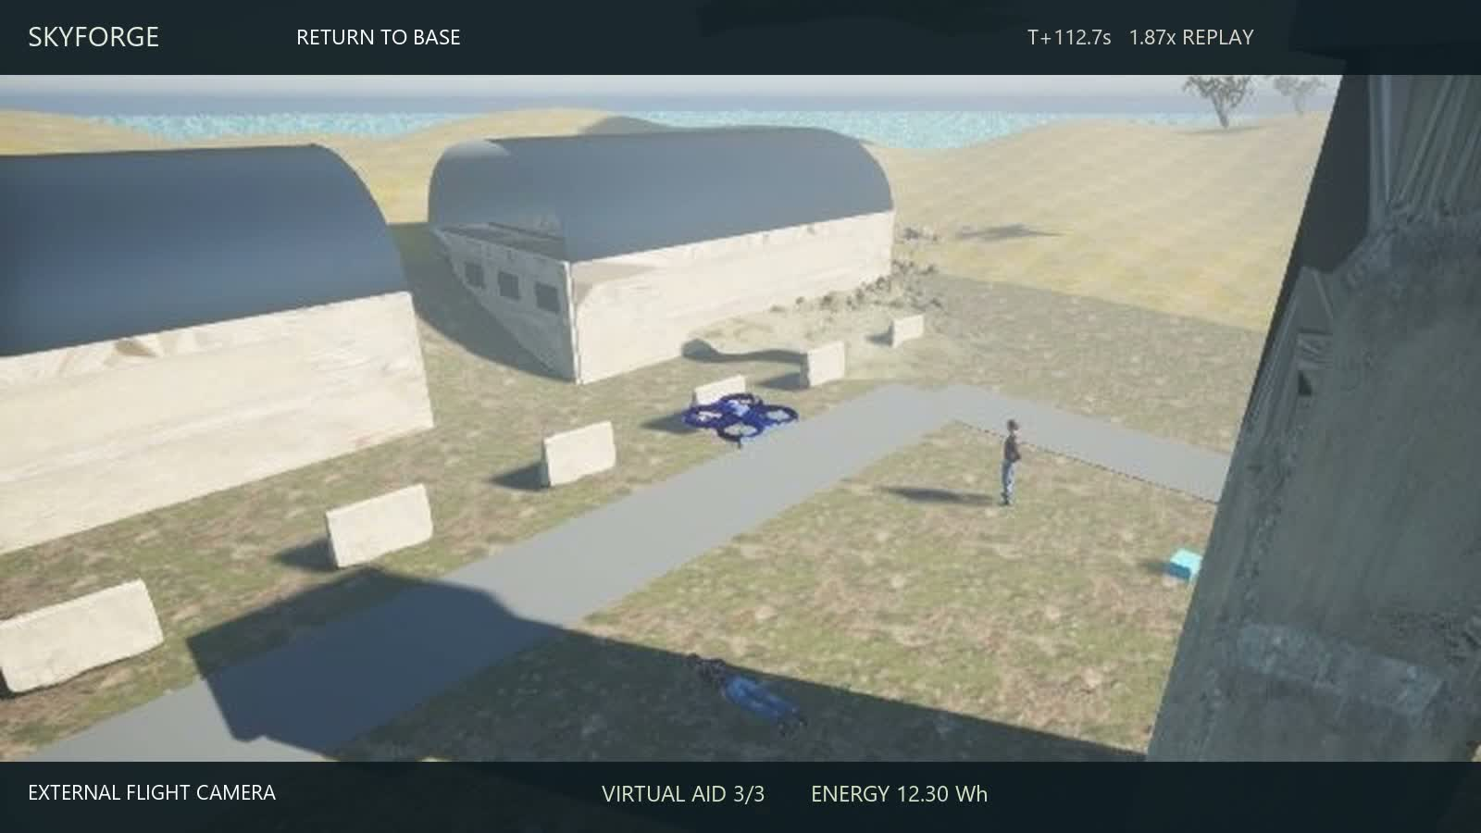
Flight recording / Return, descent and touchdown
Actual simulation footage / 1.87x replay / click video to play
SKYFORGE / DRONATHON 3.0
16
Notes:
Suggested time: 27 seconds.
Play this embedded chapter, then continue the explanation. Actual recorded AirSim imagery, edited at 1.87x. The English caption maps the original mission phase to its display label. The chapters follow the recorded flight chronologically. Camera cuts preserve the real aircraft motion and detector output.
Sources: dronathon.pdf; validation/submission-summary.json; configs/airframes/x500-research.json. All simulation images are actual renderer outputs.

Slide 17
Resilience / autonomy survives the outage
Event journal
Link unavailable
Buffer onboard
Replay + ACK
Versioned JSON: at most 999 wire bytes.
CRC32 + HMAC-SHA256; sequence and expiry checks.
4,096-event ring, persistent journal and receiver cursor.
State corruption triggers a reflex hold.
SKYFORGE / DRONATHON 3.0
17
Notes:
Suggested time: 45 seconds.
Describe the recorded 20-second radio blackout, buffering and ordered replay. CRC detects modeled corruption; HMAC authenticates packets. Sequence/TTL reject replay and stale control. The modeled bit-flip test is not an arbitrary hardware error guarantee.
Sources: dronathon.pdf; validation/submission-summary.json; configs/airframes/x500-research.json. All simulation images are actual renderer outputs.

Slide 18
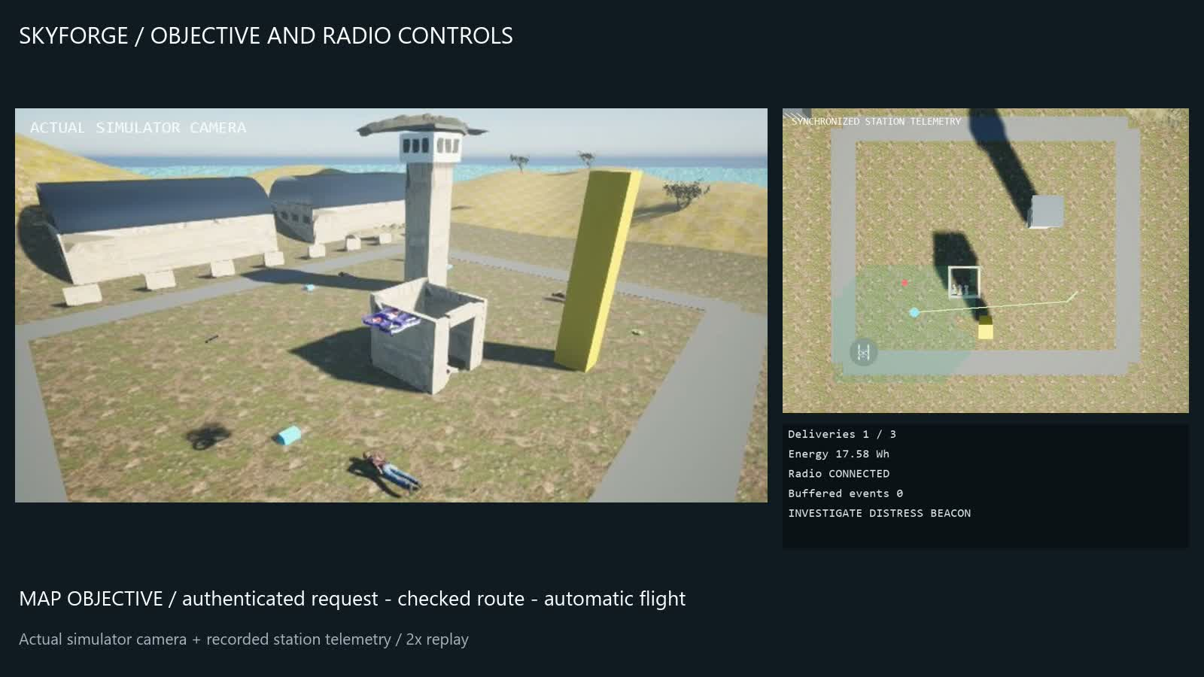
Dashboard controls / objective and radio
Map objective / checked rerouting / radio blackout and autonomous continuation
SKYFORGE / DRONATHON 3.0
18
Notes:
Suggested time: 33 seconds.
Play the 32.5-second controls demonstration within the ten-minute main sequence. The clip records actual camera frames and station telemetry. Objective and blackout requests use the same authenticated HTTP endpoints as the dashboard buttons; the clip is not a browser screen recording. Explain: Map objective, choose a safe point, watch the checked route and motion; blackout buffers events while autonomy continues.
Sources: dronathon.pdf; validation/submission-summary.json; configs/airframes/x500-research.json. All simulation images are actual renderer outputs.

Slide 19
Measured mission results
Acceptance measure | Recorded result
Virtual deliveries + return | 3/3 • 159.7 s
Hazard entries / static collision segments | 0 / 0
Largest delivery position error | 6.7 cm
Energy remaining | 9.10 Wh from 20 Wh
Command dispatch / RPC completion p95 | 143.5 / 164.3 ms
SKYFORGE / DRONATHON 3.0
19
Notes:
Suggested time: 40 seconds.
Read the values from the accepted flight. Distinguish software command dispatch from simulator RPC completion. Model metrics come from 100 unseen views in the same scene, not an unseen-world or real-image benchmark. Source: validation/submission-summary.json.
Sources: dronathon.pdf; validation/submission-summary.json; configs/airframes/x500-research.json. All simulation images are actual renderer outputs.

Slide 20
Edge deployment / ONNX INT8
Model | Format | Size (MiB) | Median (ms) | p95 (ms)
Primary | FP32 | 10.11 | 54.7 | 66.7
Primary | INT8 | 2.98 | 83.4 | 91.6
Secondary | FP32 | 10.11 | 55.3 | 65.9
Secondary | INT8 | 2.98 | 48.3 | 83.6
Measured host: Ryzen 5 7535HS / CPU only / 2 threads per model
Deployment target: Raspberry Pi ARM64 + ONNX Runtime CPU
70.6% smaller files / FP32 retained for flight / accuracy comparison in backup
SKYFORGE / DRONATHON 3.0
20
Notes:
Suggested time: 30 seconds.
Quantized candidate models are measured on the AMD Ryzen 5 7535HS Windows laptop CPU, using CPUExecutionProvider and two intra-op threads per model. This is a host CPU benchmark, not Raspberry Pi hardware measurements or a performance emulation. Static QDQ S8S8 per-channel Conv quantization uses 32 training images per model, with MinMax calibration. Latency covers session.run only: batch one, 512 input, 10 warmups, 100 timed runs. Accuracy is separately checked on 100 existing rendered test views at IoU 0.5. The flight runtime retains the accepted FP32 models. Source: validation/edge-onnx-benchmark.json; https://onnxruntime.ai/docs/performance/model-optimizations/quantization.html . Raspberry Pi is the planned ARM64 CPU deployment target.
Sources: dronathon.pdf; validation/submission-summary.json; configs/airframes/x500-research.json. All simulation images are actual renderer outputs.

Slide 21
Applications and operating model
Civil protection: reconnaissance and casualty support.
Environmental teams: coastal litter and hazard mapping.
Offer: mission software, integration, training and maintenance.
Budget: aircraft + sensors + compute + power + validation.
SKYFORGE / DRONATHON 3.0
21
Notes:
Suggested time: 22 seconds.
These are proposed applications and commercial directions, not market or deployment claims. Initial users include civil protection and environmental teams. Budget the complete system: airframe, propulsion, flight controller, sensors, compute, battery, integration and testing. Do not present an unquoted full-system price or invented ROI.
Sources: dronathon.pdf; validation/submission-summary.json; configs/airframes/x500-research.json. All simulation images are actual renderer outputs.

Slide 22
SKYFORGE
Observe. Prioritize.
Deliver. Return.
Autonomous humanitarian mission support
github.com/drakedeveloper/dronathon
SKYFORGE / DRONATHON 3.0
22
Notes:
Suggested time: 15 seconds.
Close on the actual mission: observe, prioritize, deliver and return. Invite questions on planning, physics, detection, resilience and deployment. Main talk including the video is exactly ten minutes; the following slides are backup.
Sources: dronathon.pdf; validation/submission-summary.json; configs/airframes/x500-research.json. All simulation images are actual renderer outputs.

Slide 23
Backup / vision evaluation
Native simulation class | AP50 | Test domain
Waste | 99.5% | 100 unseen scene views
Mine | 99.5% | 100 unseen scene views
Weapon | 98.6% | 100 unseen scene views
Injured Person | 93.8% | 100 unseen scene views
Hostile Unit | 97.8% | 100 unseen scene views
SKYFORGE / DRONATHON 3.0
BACKUP / 23
Notes:
Suggested time: 0 seconds.
Sources: validation/native-v2-primary-map.json, validation/native-v2-secondary-map.json and the frozen v2 point evaluations. Do not combine AP50 with fixed-threshold recall; they describe different measurements.
Sources: dronathon.pdf; validation/submission-summary.json; configs/airframes/x500-research.json. All simulation images are actual renderer outputs.

Slide 24
Backup / separate real-image work
Team dataset model | Precision | Recall | mAP50
Gun detection | 88.0% | 73.0% | 81.0%
Waste segmentation | 84.3% | 81.0% | 83.8%
Separate model track — not used by the simulator
Notebook checkpoints and reported image timings remain separate from mission acceptance.
SKYFORGE / DRONATHON 3.0
BACKUP / 24
Notes:
Suggested time: 0 seconds.
Team-supplied charts: 39bd966f-17a3-414f-b5ba-f3bfadab54c7.jpg; cf9d2047-4e13-4252-b0ba-7317d16a1f3d.jpg; e846daec-091d-457b-a8de-7a98c4f588f7.jpg. These are reported dataset results from separate notebooks and were not used in the flight runtime. Their inference speed is not end-to-end mission timing.
Sources: dronathon.pdf; validation/submission-summary.json; configs/airframes/x500-research.json. All simulation images are actual renderer outputs.

Slide 25
Backup / quantization accuracy
Class | FP32 recall | INT8 recall
Mine | 100.0% | 100.0%
Weapon | 90.0% | 75.0%
Waste | 100.0% | 100.0%
Injured Person | 85.7% | 85.7%
Hostile Unit | 92.3% | 92.3%
SKYFORGE / DRONATHON 3.0
BACKUP / 25
Notes:
Suggested time: 0 seconds.
Measured on 100 existing rendered test views, same thresholds and IoU 0.5 for FP32 and INT8. This is a fixed-threshold comparison, not new mAP. The primary model loses weapon recall after quantization, so INT8 is kept as a deployment candidate. The secondary model has identical TP/FP/FN counts in this sample. Timing covers inference only and excludes preprocessing, NMS, agents, radio and flight control. See validation/edge-onnx-benchmark.json for calibration paths, SHA256 and exact counts.
Sources: dronathon.pdf; validation/submission-summary.json; configs/airframes/x500-research.json. All simulation images are actual renderer outputs.

