Slide 1
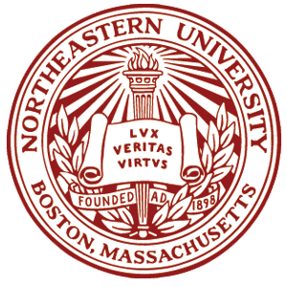
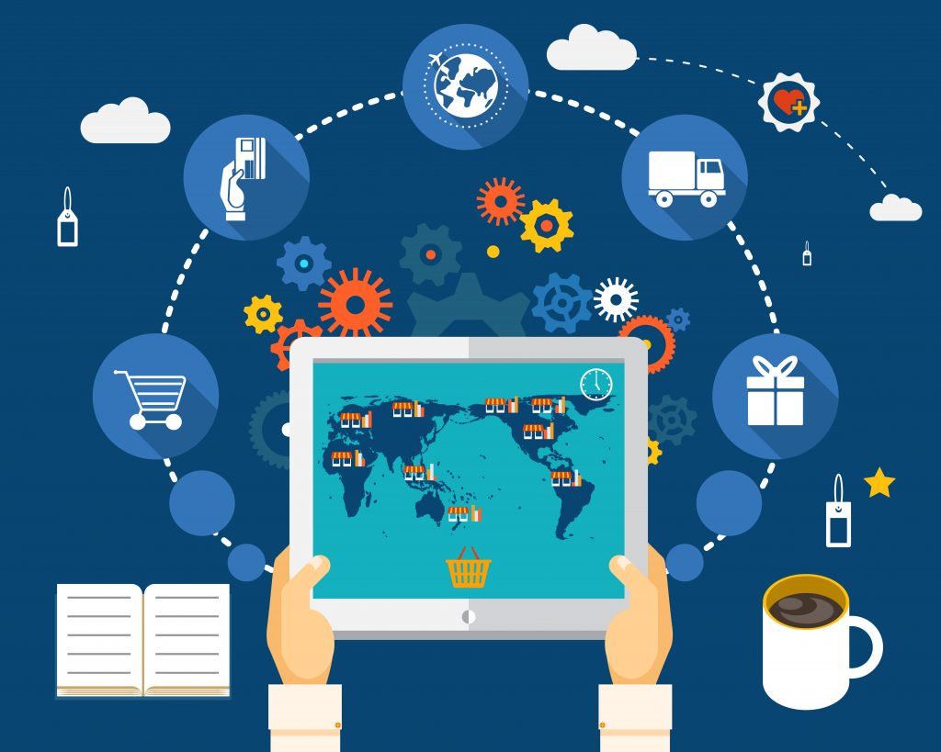
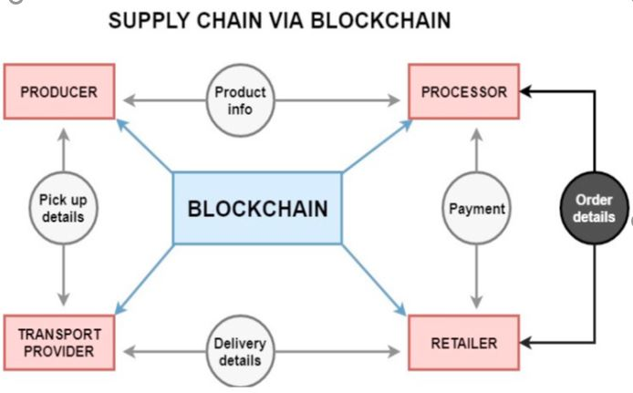
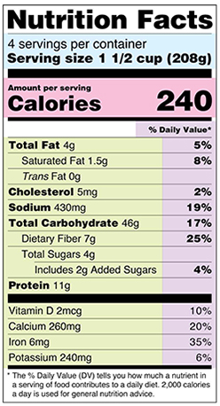
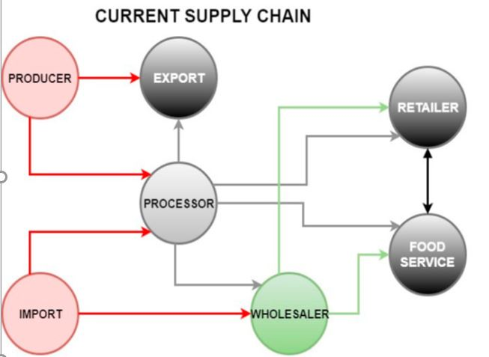
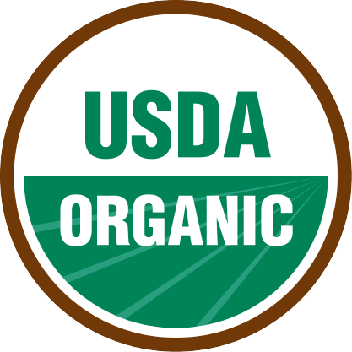
Blockchain, Produce Traceability and Economic Accountability:
An Agricultural Evolution.
David Mberingabo
Northeastern University, College of Computer & Information Science
Background
THE PROBLEM
BLOCKCHAIN AS A SOLUTION
METHODS AND MATERIALS
For thousands of years humans existed amongst the food they ate and had a shorter alimentary supply chain from their farms to their plates. Today, humans have lost this connection to the earth and with it, they lost sovereignty over their food due to detrimental sociological perspectives on urban and food planning.
Currently, the final consumer has some of their food information but not all of it, this obfuscation of information renders the job of the market (to price products by their quality) not as useful in a capitalistic society and leaves supply chain producers with no accountability for their bad produce or bad data.
Mberingabo proposes a data delivering system that removes human control over produce traceability information, while decentralizing the process of providing accurate data for the whole agricultural supply chain as a solution to agricultural sustainability, population resilience, productivity and wellbeing.
For some decades now, agricultural supply chains have existed in a linear system, where each stakeholder in the supply chain is incentivized to share as little data about their produce as they should or could.
Endogenous uncertainties, uncertainties created by human interaction with the traceability data, were found to be the most impactful factor when it came to uncertainty along the food supply chain, see [1].
Principal-agent problems can occur between the final consumer, the producer and the certification organization.
Information about produce is reduced to consumer graphics such as the “USDA Organic” sticker, ingredients box and the nutritional label as seen in Figures 1, 2 and 3.
What is Blockchain?
Blockchain is a collection of rules on which individual can read and write which data.
These rules are “open source” or can be viewed and thereby criticized by anybody.
Blockchains are usually decentralized as well, which allows for each member to provide its transaction data to the blockchain and since it takes two members to do a transaction they could even verify each other’s transaction entries along the supply chain.
Blockchain’s decentralization also means that anybody, with access, can read past transactions on any produce with their own specialized lens to view information, which increase readability and accessibility.
The Goal of this Blockchain
To reduce the ability of individuals in the supply chain to alter the readability or accuracy of the food traceability data,
to incentivize monitoring of stakeholders and certification organizations for any principal-agent problems and to reduce the cost and increase the accuracy of certifications,
to increase produce data’s re-traceability, accessibility, readability, updatability and trustworthiness.
Literature discussing research on the historical, academic and media discourse surrounding the successes, downfalls and overlooking of Urban Agriculture as a solution to population resilience are reviewed. Then research on food data traceability problems in the current alimentary supply chain is presented with a discussion on how this lack of traceability affects urban populations. Uncertainty along the food supply chain is also discussed as a result of poor data management along the chain. Finally, research on Blockchain as a food supply chain data traceability solution is reviewed and a conclusion on future steps is proposed.
FUTURE STEPS & ECONOMIC OPPORTUNITIES
Near Future Applications
The current certification operations and data standardization on food traceability in many of the modern nations is ready to be implemented in a blockchain system, simply through software. Whichever blockchain survives competitive scrutiny from all stakeholders will become the underlying infrastructure to much innovation, and all it takes is a collection of rules posted online for all to scrutinize and utilize.
Industry Applications & Opportunities
Innovation in software and hardware solutions to augmenting traceability of food would become well rewarded by the market that is thirsty for more accurate and readable data on their food produce:
A demand for constantly more high-tech and more accurate measuring tools can be expected to appear.
Solving the produce traceability problem in the food supply chain could result in ground-breaking solutions for other supply chains.
Third party software can be created to sift through the stakeholder’s data and present it in the most readable format.
A supply chain that is supported by blockchain would recover from geological, geopolitical and economic disruptions much faster than current supply chains.
Government’s Role
Education: common understanding of what is blockchain is quite low and must increase.
Law & Regulations: current laws on food data disclosure can make a solid foundation for food traceability blockchains and moving forward new laws should take into consideration this type of information system.
Public Health: with this blockchain data, we can derive much more accurate statistical results on relationship between health and produce quality.
Subsidization: we believe the government has a responsibility to subsidize key operations surrounding better produce traceability data, in order to encourage dynamic and accurate markets.
REFERENCES
[1] D. Mberingabo, “Can blockchain technology facilitate the adoption of urban agriculture: A Literature Review,” Nov 2019.
Figure 1. A supply chain stakeholder checking detailed produce’s data on his tablet.
Evolution of Produce Data Readability
Figure 4. Supply Chain Via Blockchain.
CONTACT
Author: David Mberingabo
Institution: Northeastern University
Email: Mberingabo.d@husky.neu.edu
Phone: +1 857 210 3777
Figure 2, 3. Typical information the final consumer sees.
Figure 6. Current Supply Chain.

