Slide 1
Unsupervised Learning
KMeans
Clustering is a type of Unsupervised learning. This is very often used when you don’t have labeled data. K-Means
Clustering is one of the popular clustering algorithm. The goal of this algorithm is to find groups(clusters) in the given data. Here, we will implement K-Means algorithm using Python from scratch.
K-Means Clustering
K-Means is a very simple algorithm which clusters the data into K number of clusters.

Slide 3
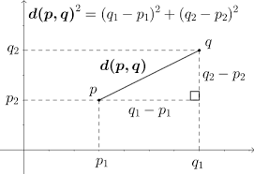
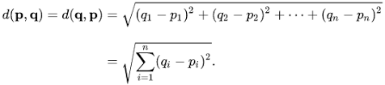
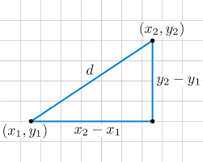
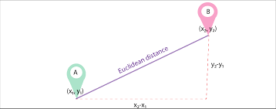
Euclidean Distance

Slide 4
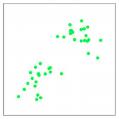
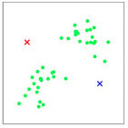
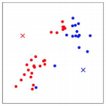
K is the number of clusters.
Means refers to the mean points of the K clusters.
Step 1
Step 2
Step 3
Initialise K and use the
Euclidean distance
Assign points to the closest cluster
based Euclidean distance

Slide 5
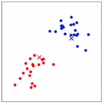
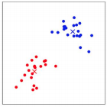
Step 4
Fin
Repeat step 2-4, updating class membership based on centroid distance.
Calculate mean of points assigned to centroid (2 here). Update new centroid positions to mean (ie: geometric center).
Convergence is met once all points no longer change to a new class (defined by closest centroid distance).
https://www.youtube.com/watch?v=_aWzGGNrcic

Slide 7
Use Cases
K-Means is widely used for many applications.
Image Segmentation
Clustering Gene Segmentation Data
News Article Clustering
Clustering Languages
Species Clustering
Anomaly Detection

Slide 9
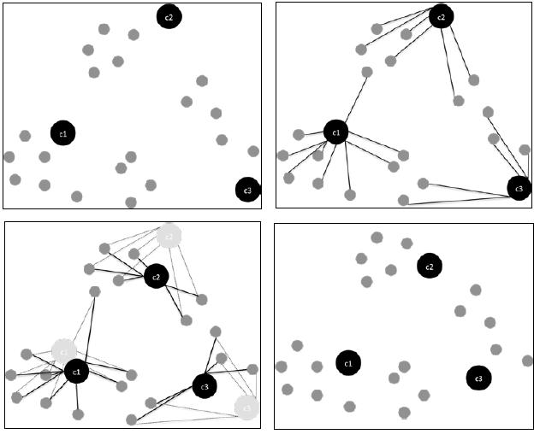
K-Means: a visual example

Slide 10
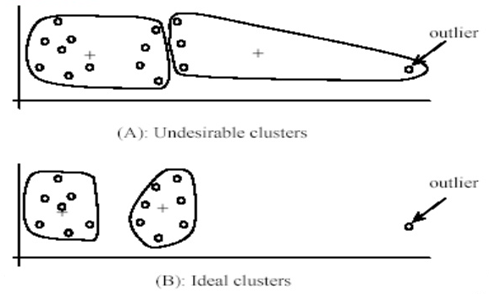
A few K-Means caveats..
Nothing's perfect!
K-Means is sensitive to outliers

Slide 11
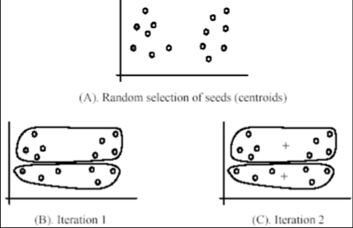
K-Means is sensitive to centroid initialization¶

Slide 12
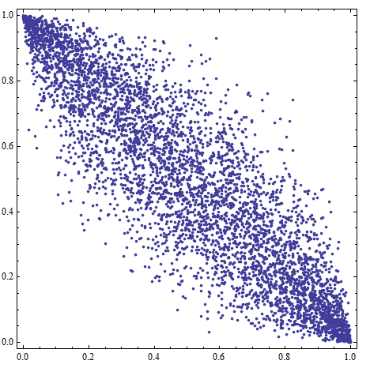
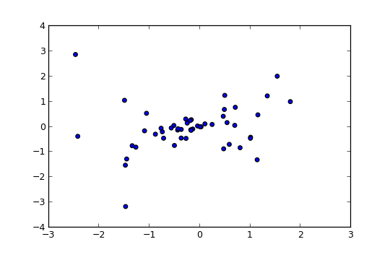
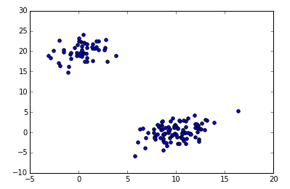
How many K?
Sometimes it's obvious, sometimes it's not!
Choosing K
There are different methods of initializing centroids. For instance:
Randomly
Manually
Special KMeans++ method in Sklearn (_This initializes the centroids to be generally distant from each other_)
Depending on your problem, you may find some of these are better than others.
Note: Manual is recommended if you know your data well enough to see the clusters without much help, but rarely used in practice.

Slide 13
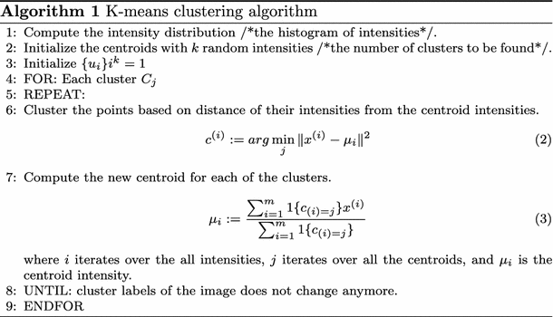

Slide 14
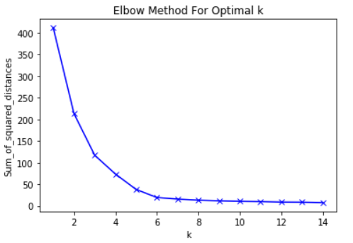
Sum_of_squared_distances = [] K = range(1,15) for k in K: km = KMeans(n_clusters=k) km = km.fit(data_transformed) Sum_of_squared_distances.append(km.inertia_)
plt.plot(K, Sum_of_squared_distances, 'bx-') plt.xlabel('k') plt.ylabel('Sum_of_squared_distances') plt.title('Elbow Method For Optimal k') plt.show()

Slide 16
Hierarchical Clustering

Slide 17
What is hierarchical clustering?
Hierarchical clustering, is an algorithm that groups similar objects into groups called clusters. The endpoint is a set of clusters, where each cluster is distinct from each other cluster, and the objects within each cluster are broadly similar to each other.
With this type of clustering we seek to do exactly what the name suggests:
- Build hierarchies of clusters.
- Connect the clusters in the hierarchy with links.
Once the links are determined, we can display them in what is called a **dendrogram** - a graph that displays all of these links in their hierarchical structure.

Slide 18
When does hierarchical clustering perform well?
Hierarchical clustering works well for **non-spherical clusters
- It also works well on “smaller datasets” - this algorithm has a longer computational time and doesn't work well for larger datasets
Hierarchical clustering works well when the underlying data has a hierarchical structure and you want to recover the hierarchy.
In hierarchical clustering, the algorithm builds classification trees using the data that merge groups of similar data points.
Hierarchical clustering does not require you to define "K" as an input!

Slide 19
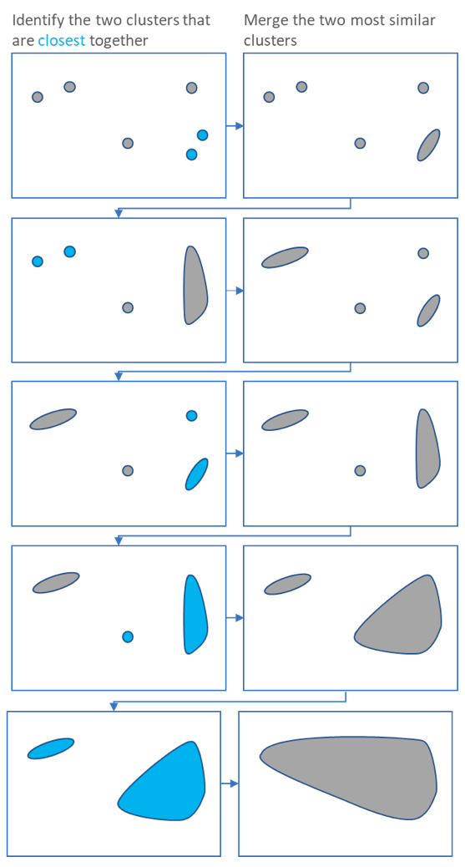
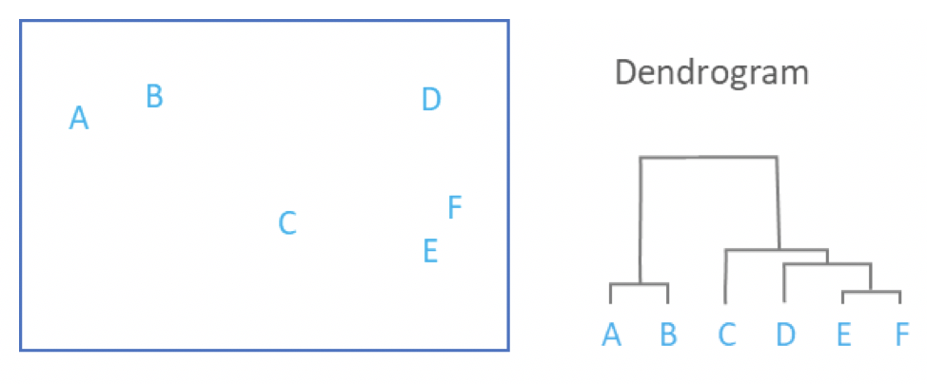
The main output of Hierarchical Clustering is a dendrogram, which shows the hierarchical relationship between the clusters:
Agglomerative Approach
This approach is also known as the bottom-up approach. In this, we start with each object forming a separate group. It keeps on merging the objects or groups that are close to one another. It keep on doing so until all of the groups are merged into one or until the termination condition holds.
The cophenetic distance between two objects is the height of the dendrogram where the two branches that include the two objects merge into a single branch.

Slide 20
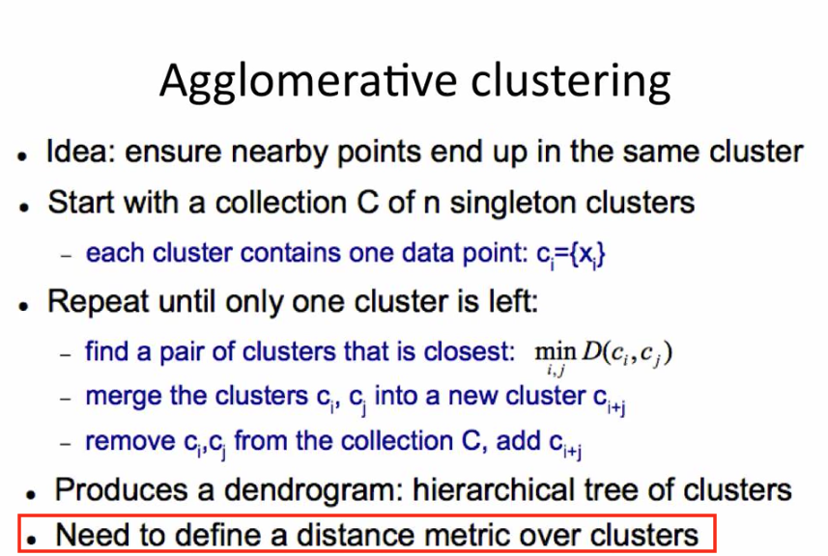

Slide 21
