Slide 1
Identification of Age-related Macular Degeneration among Retinal Images obtained via Optical Coherence Tomography
03/15/23
By Rami Dabit and Terry Wang
ECE 194N/594N

Slide 2
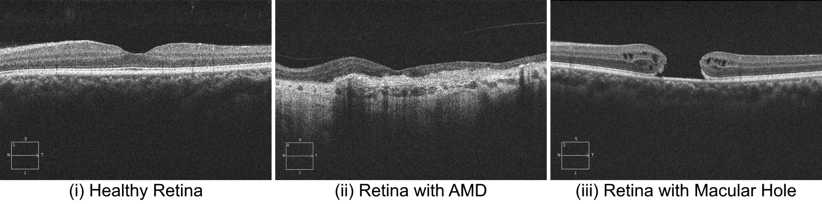
Background
Age-related macular degeneration (AMD) is an eye disease and leading cause of vision loss for older adults
AMD affects approximately 1-in-10 Americans aged 50+
Image credits: Bionic Vision Lab @ UCSB

Slide 3
Background
Optical Coherence Tomography introduced in 1991
Widely used imaging modality which bounces light waves at different depths within the eye to reconstruct a profile or slice
Limited literature available on AMD identification given retinal OCT image slices: one paper on Google Scholar
"Identification of age-related macular degeneration using oct images." by Arabi et al. (2018)

Slide 4
Literature for Landmark Extraction
Arabi et al. (2018)
Apply Gaussian filter to grayscale OCT images
Enhance via contrast stretching
Threshold retinal foreground from darker background
Divide image into 8 sub-images or quadrants, and classify based on the mean pixel value in each
Ghesu et al. (2016)
"An artificial agent for anatomical landmark detection in medical images."
Reinforcement learning for image parsing with feature extraction via deep learning
Not well suited for retinal scans such as macular hole, which include discontinuities

Slide 5
Question and Approach
Given some sets of retinal OCT image data, is it possible to computationally aid ophthalmologists in tasks such as identification of age-related macular degeneration using anatomical landmark detection and shape analysis?
Our approach: extract and analyze the inner and outer segment junction or IS/OS line for each retinal image to characterize unhealthy scans

Slide 6
Inner and Outer Segment Junction
Image credits: Bionic Vision Lab @ UCSB

Slide 7
I. Preprocessing
Read in 3 datasets from OCTID corresponding to healthy adult retinas (206), retinas with AMD (55), and retinas with a macular hole (102).
Total dataset size of 363 images
Resize images from the AMD dataset to 750x500
Remove dark background from images to enhance visibility of the retina shape and convert from BGR to RGB

Slide 8
II. IS/OS Line Extraction
Inner/outer segment of photoreceptors may be disturbed, indicating AMD or presence of a macular hole
Extract as an anatomical landmark using OpenCV
Convert RGB images to grayscale and use a binary threshold to detect any “hyper-reflective” bands
Iterate through the detected contours and compute the area of the band, extracting only the contour with maximum area

Slide 9
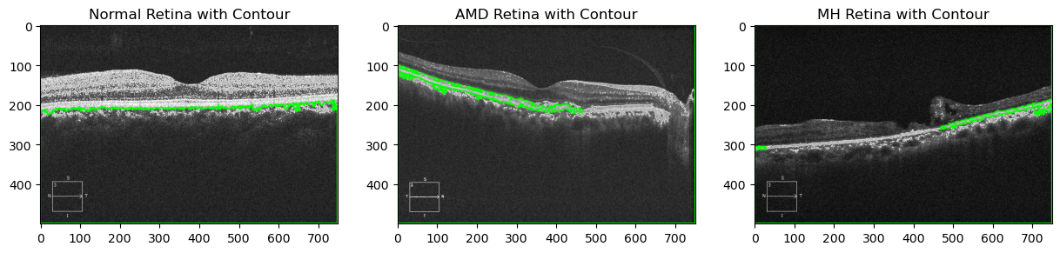
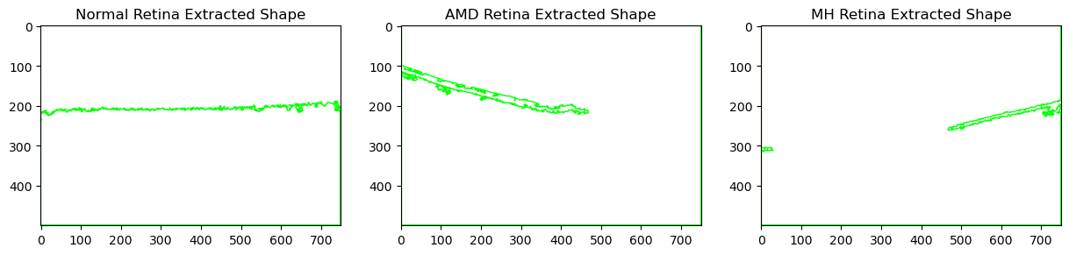
II. IS/OS Line Extraction

Slide 10
III. Shape Characteristics
Using our own implemented algorithms, we then measure two properties of the extracted IS/OS band:
Average contour thickness along the line
Average largest length of discontinuity in contour line

Slide 11

IV. Machine Learning
Modified support vector classifier from scikit-learn library
Two variations of SVC:
Classification using linear kernel
Find a best-fit line using normal OCT data and classify points deviating from the straight line as disturbed
Classification using radial basis function (RBF)
Point-to-point distance method using Euclidean or L₂-norm between point pairs, classifying distant points as belonging to different classes:

Slide 12
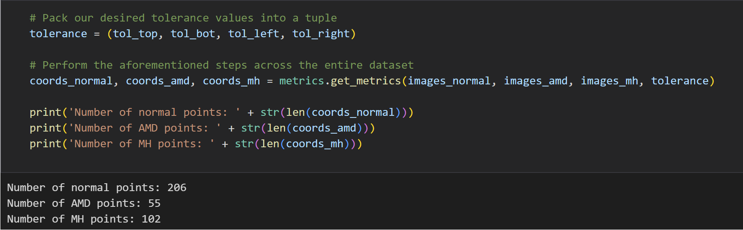
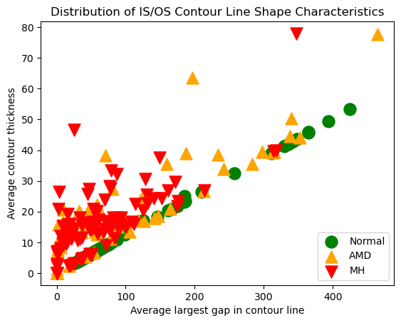
IV. Machine Learning: Input Data, Metrics
363 total labeled images
Train on 80% of datapoints,
reserve 20% for testing

Slide 13
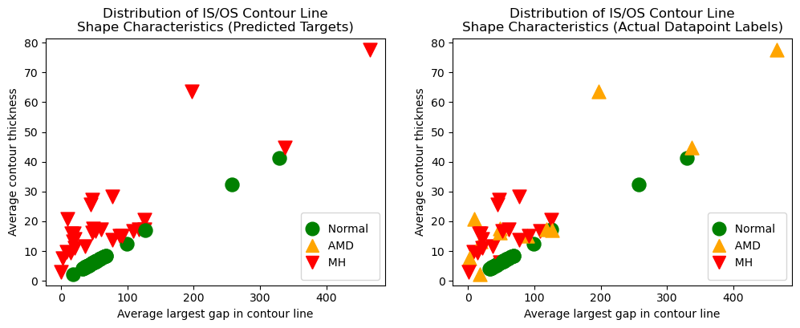

V. Results: Learning via Linear SVC

Slide 14
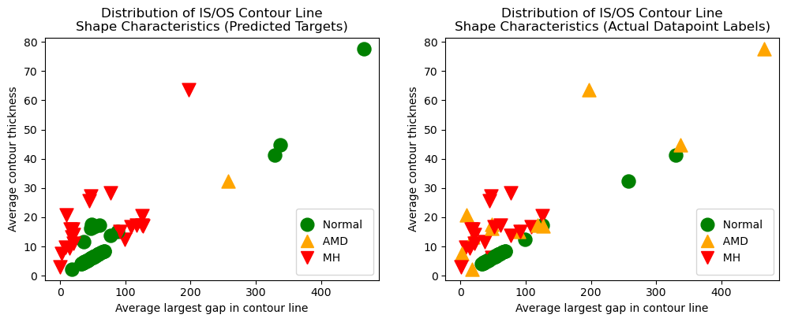

V. Results: Learning via RBF SVC

Slide 15
VI. SVC Directly on Image Samples
Alternative to classifying extracted IS/OS contour shapes
Directly dealing with the image data
Contains much more information for learning, considering that the IS/OS layer is one of 10 layers present in the retina

Slide 16
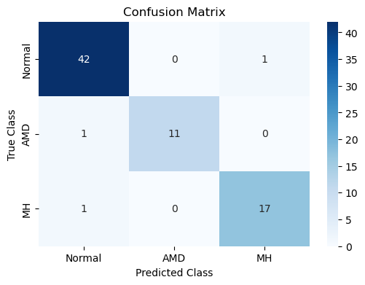
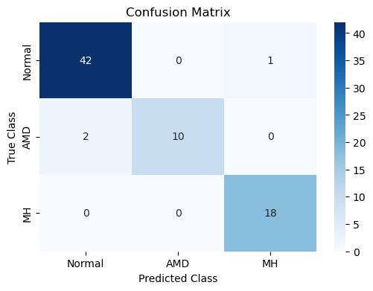


VI. Results: SVC Directly on Image Samples
Linear kernel:
RBF kernel:

Slide 17
VII. Future Directions
Try landmark extraction via reinforcement learning as proposed by Ghesu et al. (2016)
IS/OS contours are far from perfect, and more layers of the retina may be extracted for better classification results
Refine our implemented algorithms which compute thickness and discontinuity in the IS/OS shape
Explore other landmarks such as large quantities of drusen or cellular debris deposits underneath the retina
Indicator of high risk for macular disease

Slide 18
References
[1] Arabi, Punal M., Nanditha Krishna, V. Ashwini, and H. M. Prathibha. "Identification of age-related macular degeneration using oct images." In IOP Conference Series: Materials Science and Engineering, vol. 310, no. 1, p. 012096. IOP Publishing, 2018.
[2] Ghesu, Florin C., Bogdan Georgescu, Tommaso Mansi, Dominik Neumann, Joachim Hornegger, and Dorin Comaniciu. "An artificial agent for anatomical landmark detection in medical images." In Medical Image Computing and Computer-Assisted Intervention-MICCAI 2016: 19th International Conference, Athens, Greece, October 17-21, 2016, Proceedings, Part III 19, pp. 229-237. Springer International Publishing, 2016.
[3] Gholami, Peyman; Roy, Priyanka; Lakshminarayanan, Vasudevan, 2018, "Normal Retinal OCT images", https://doi.org/10.5683/SP/WLW4ZT, Borealis, V1
[4] Gholami, Peyman; Roy, Priyanka; Lakshminarayanan, Vasudevan, 2018, "Age-related Macular Degeneration Retinal OCT images", https://doi.org/10.5683/SP/YEM3RA, Borealis, V1
[5] Gholami, Peyman; Roy, Priyanka; Lakshminarayanan, Vasudevan, 2018, "Macular Hole Retinal OCT images", https://doi.org/10.5683/SP/MBMQGD, Borealis, V1
ECE 194N/594N

Slide 19
Thank you!
Questions?
ECE 194N/594N

