Slide 1
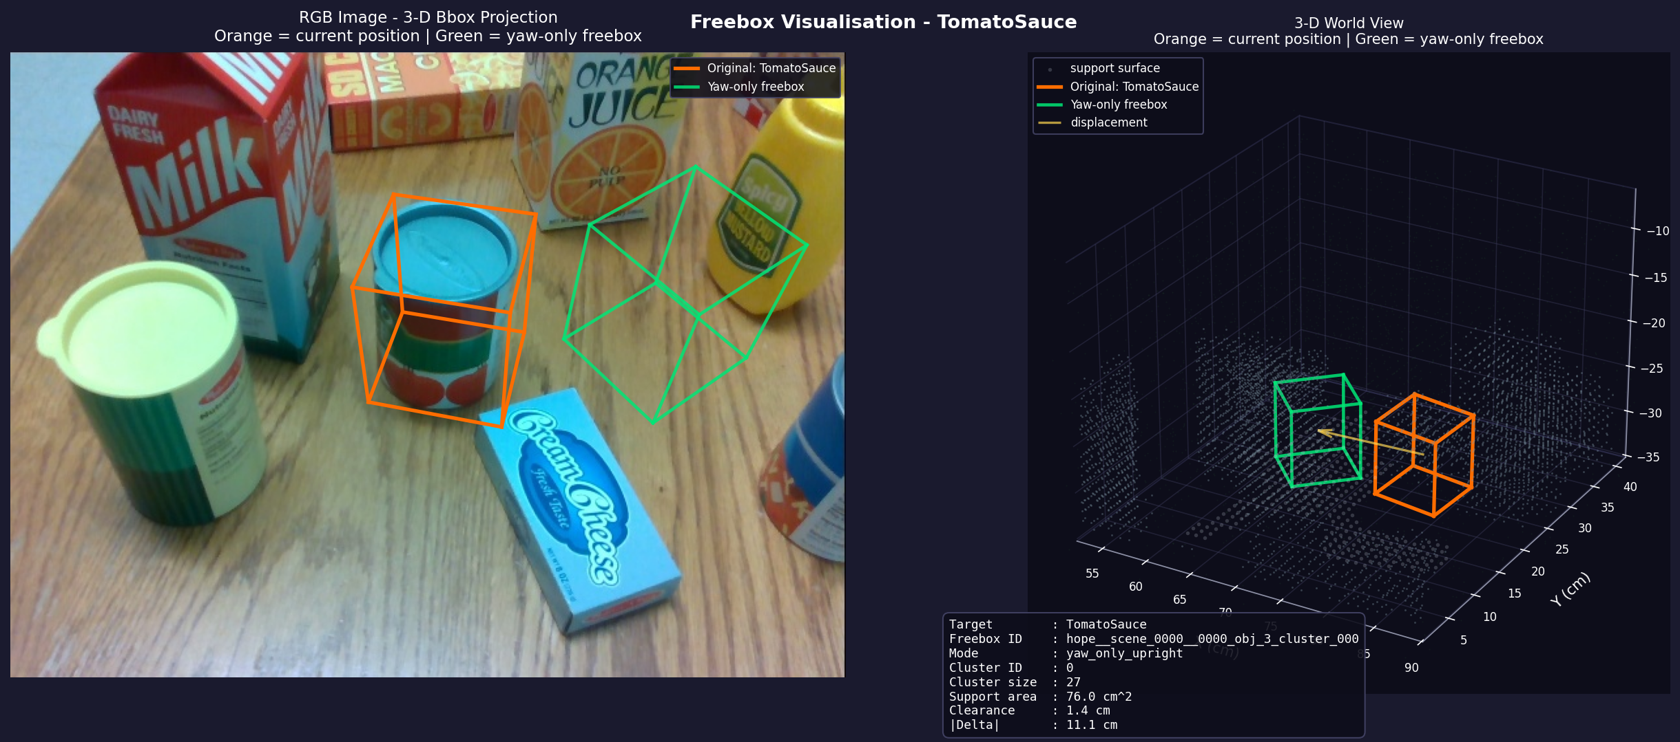
LC-BGPlaceNet-SC-SQ-HM:语言条件 3D 物体放置网络架构
Language-Conditioned · Box-Guided · Source-conditioned Support Context · Single-Query Grounding · Heatmap Placement
输入点云 points [N,6]
单帧 RGB-D 反投影 (x,y,z,r,g,b)
语言指令 instruction
自然语言放置指令 (str)
真实样本 (outputs/free_bbox_hope)
Sparse 3D Backbone
Sparse U-Net → F_3d [Nv,C] + 体素坐标
Text Encoder
RoBERTa(冻结) → text_tokens / text_global
Voxel-Language Fusion(Cross-Attention)
Q=F_3d, K=V=text_tokens → F_vl 语言条件体素特征 [Nv,C]
左:RGB 3D-Box 投影 | 右:3D 世界视图(橙=原位置, 绿=放置框, 蓝线=位移)
Single-Query Source Grounding
Transformer Decoder · 单可学习 query + 语言条件
→ source_box=(c,l,w,h), f_src
Support Surface Head (MLP)
逐体素 support_prob → topK 支撑候选点
support_points / features / prob [B,K,·]
instruction 示例
"Move Tomato Sauce Can located at the back left of Cream Cheese Box to the front left of Mustard Bottle."
Source-aware Support Placement Attention
Transformer Encoder:[source token(f_src + size_emb + text_global)] + K 个支撑 token 全局交互
→ placement_features [B,K,C]
训练监督信号 (来自 outputs)
总损失 L =
• support_mask.ply → L_sup 支撑面分割
• heatmap.ply(底面中心) → L_heat 放置热力
• box GT → L_src 源物体中心+尺寸
• yaw bin GT → L_yaw 各向异性加权 CE
λ_src·L_src + λ_sup·L_sup + λ_heat·L_heat + λ_yaw·L_yaw
Placement Heatmap Head
heatmap_logits [B,K] → 放在哪里
Placement Yaw Head
yaw_logits [B,K,24] → 怎么转 (24-bin)
Placement Decode → 最终输出
最高分底面中心 + h/2 得几何中心,继承 source 尺寸,取该位置 yaw → place_box=(cx,cy,cz,l,w,h,yaw)

