Slide 1
A PRESENTATION ON RACING GAME
Group members:
Season Maharjan (2070/BCT/48)
Shiwangi Shrestha (2070/BCT/50)
Smriti Mool (2070/BCT/52)
sushmita chaurasia(2070/BCT/57)
Yaju Shrestha (2070/BCT/64)

Slide 2
OVERVIEW
General Objectives
Project Detail (Smriti)
Introduction to the codes (Yaju)
Work flow diagram (Season)
Output Description (Shiwangi)
Future Extensions (Sushmita)
Conclusion
3/2/2016

Slide 3
GENERAL OBJECTIVES
To make a game for some fun time using the knowledge of graphics
To deal with the real world graphics in c language
To present the project with the required output

Slide 4
PROJECT DETAIL
Project title: “RACING GAME”
Brief detail:
We have a racing object facing many obstacles in its way and if the obstacle and the object collide, then the game is over.
Programming language: C++ language with Graphics library functions

Slide 5
INTRODUCTION TO CODES
We have used various new functions we studied for our graphics project and used as follows:
initgraph(): It initializes the graphics system by loading the passed graphics driver then changing the system into graphics mode

Slide 6
Contd:
random(): It returns a random number between 0 and (num-1). It is a macro defined in STDLIB.H
delay(): It is used to suspend execution of a program for a M milliseconds
circle(): It draws a circle with radius r and centre (x,y)
line(): It draws a straight line between two points on the screen

Slide 7
Contd:
arc(): It draws a circular arc from start angle till end angle
kbhit(): It checks to see if a keystroke is currently available. Any available keystrokes can be retrieved with getch. On success (if a keystroke is available), it returns a non-zero integer or else it returns 0
setcolor(): It sets the current drawing color to color, which can range from 0 to getmaxcolor
setfillstyle(): It sets the fill pattern & color

Slide 8
Contd:
bar3d(): It draws a 3-dimensional rectangular bar, then fills it using the current fill pattern and fill color
cleardevice(): It erases the entire graphics screen and moves the CP(current position) to home
Sector(): it is the function to create a ellipse structure in the screen
bar(): it draws a bar i.e. rectangular bar

Slide 9
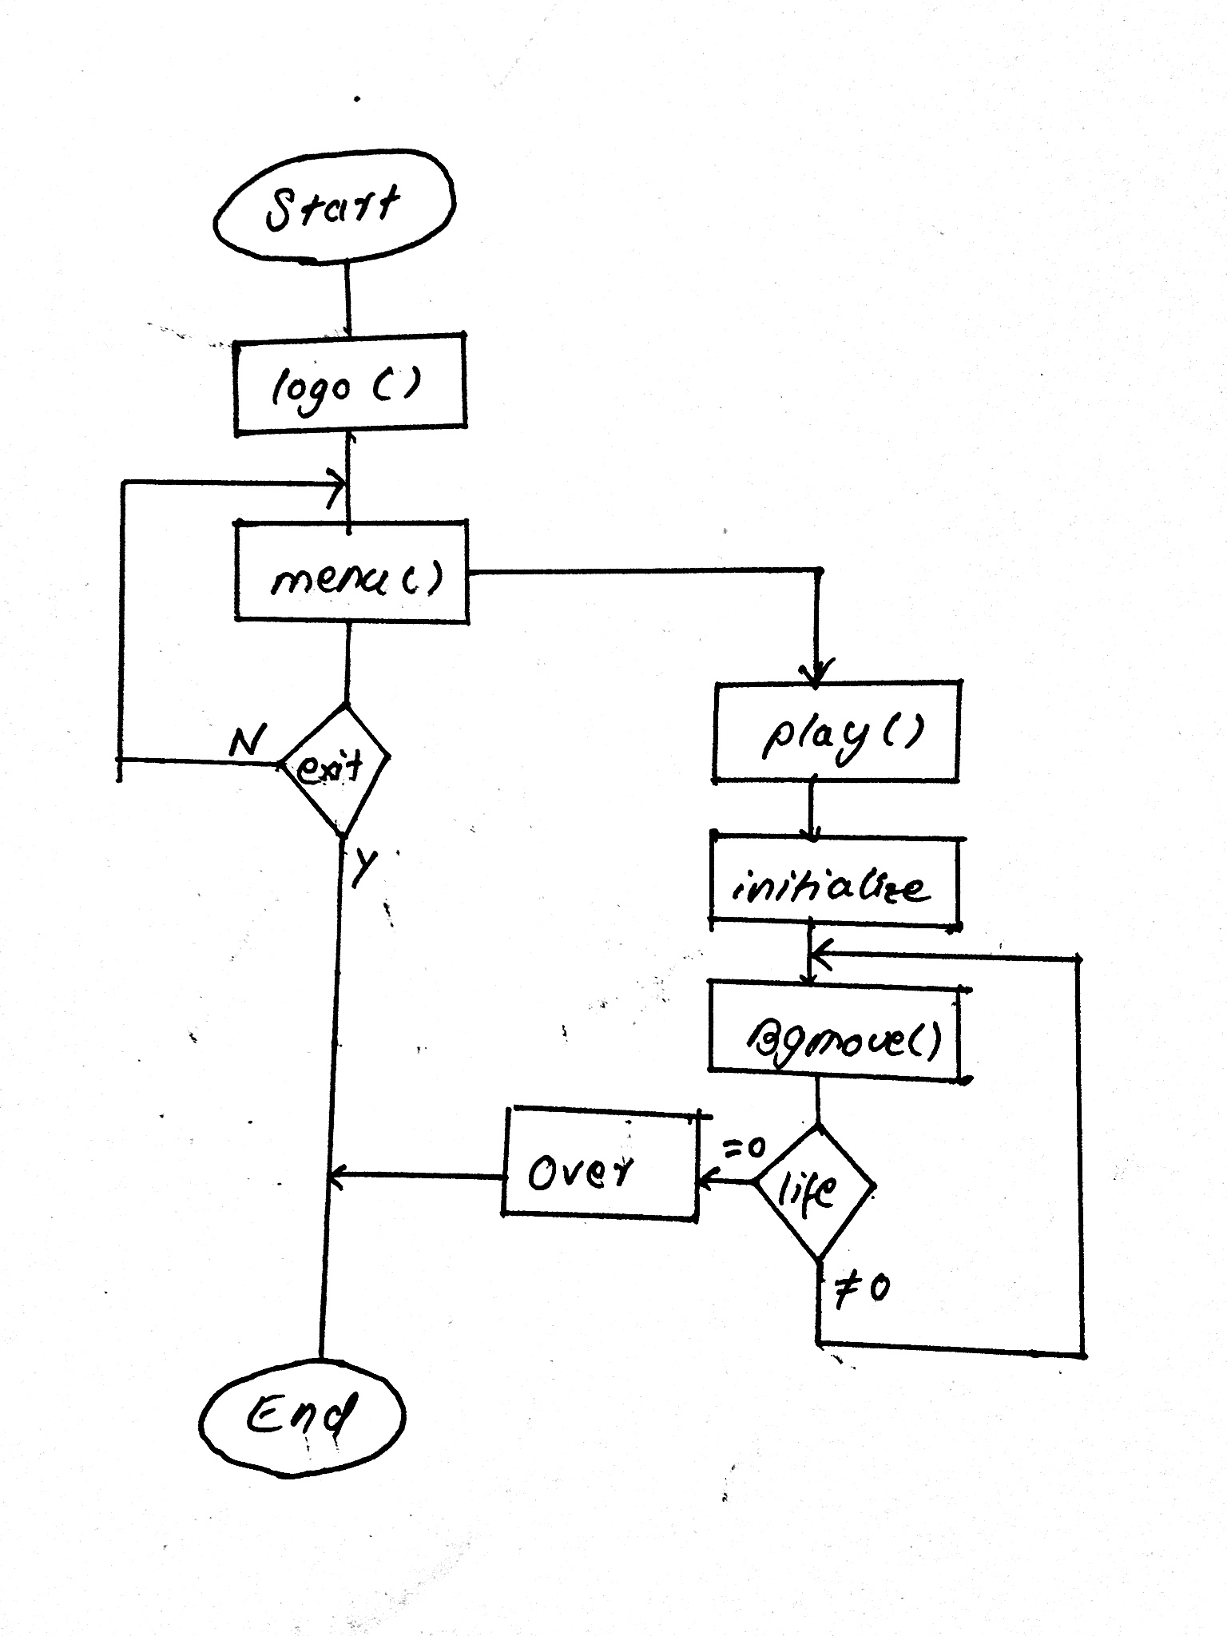
WORK FLOW DIAGRAM

Slide 10
OUTPUT DESCRIPTION
As our objective, we have an object (let as car)
in an straight multiple lane where it goes on moving forward facing the obstacles. The screenshot of our program code is as:

Slide 11
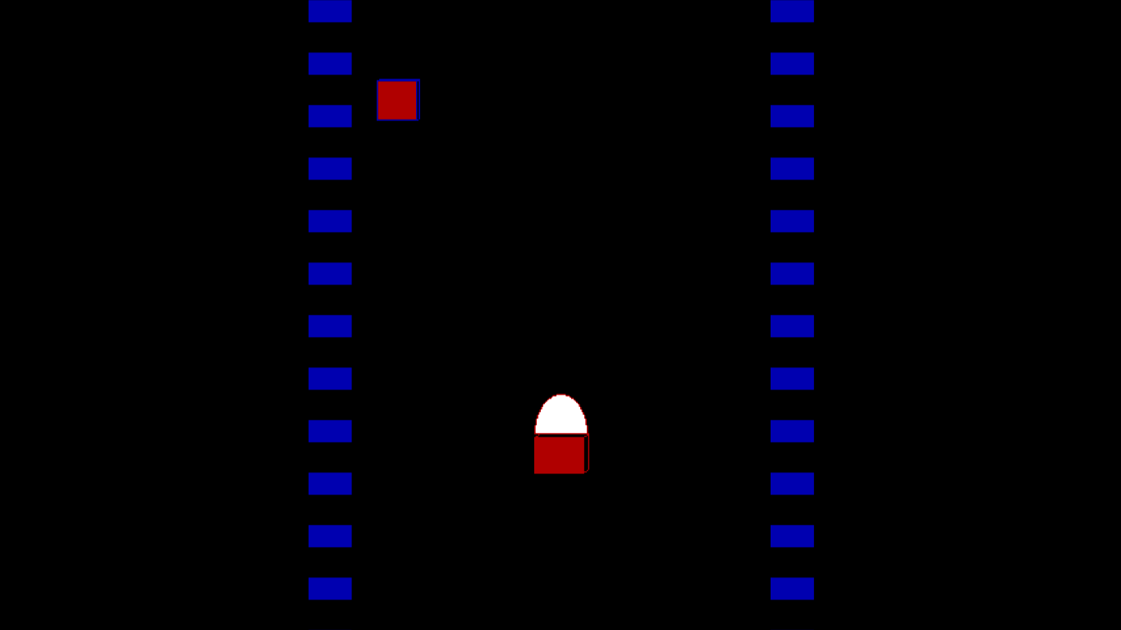

Slide 12
FUTURE EXTENTIONS
This game can have lots of features and cover all the limitations
Also extensions can be done in programming levels or language to make it more efficient and easier

Slide 13
CONCLUSION
Familiar with the application of academic knowledge in project development
Capable to make a small project using the knowledge of Computer Graphics
And hence our objective is fulfilled

Slide 14
THANK YOU!!!

