Slide 1

MongoDB
What is MongoDB?
MongoDB is a popular open-source, NoSQL database that stores data in a document-oriented format. Unlike traditional relational databases, which store data in tables.
MongoDB stores data as JSON-like documents, making it more flexible and scalable.
The name “MongoDB” is derived from the word “humongous”
BSON documents are the format used for data stored in MongoDB

Slide 2


MongoDB
History of MongoDB
MongoDB is a NOSQL database that was developed by 10gen,
a company founded by Dwight Merriman and Eliot Horowitz in 2007.
The first version of MongoDB was released in 2009, and it quickly gained popularity among developers due to its ease of use, scalability and flexibility.
In 2013, 10gen changed its name to MongoDB Inc to better reflect its focus on development of the MongoDB database.

Slide 3
MongoDB
In 2017, MongoDB Inc. Went public, and the company has continued to grow and expand its offerings, including the introduction of a cloud-based database service called
MongoDB Atlas.
Today, MongoDB is used by a wide range of companies and organizations.

Slide 4
MongoDB
JSON Data Format
JavaScript Object Notation
{
"name": “Anuj",
“age": 21,
"gender": "male",
"married": false,
"address": {
"street": "cherry Road",
"city": "salem",
"state": "Tamil Nadu“
},

Slide 5
MongoDB
"hobbies“ : [
{
“name” : “Cooking”
},
{
“name” : “Sports”
}
]
}

Slide 6
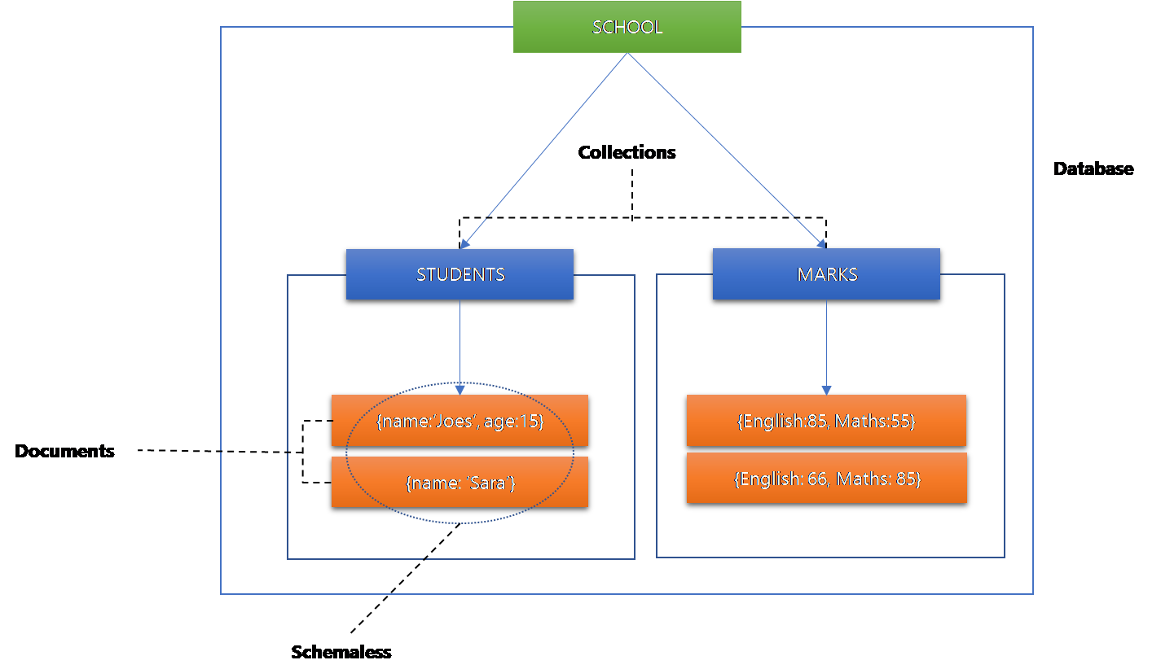
MongoDB
How MongoDB Works?

Slide 7
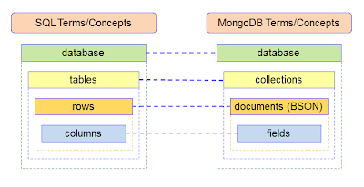
MongoDB
Structure of MongoDB & SQL

Slide 8
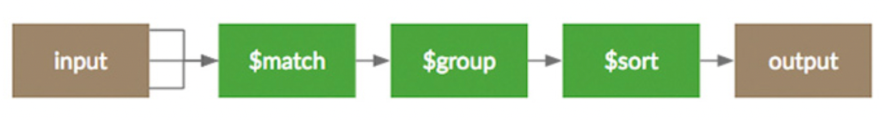
MongoDB
MongoDB Features
Aggregation is a powerful feature in MongoDB that allows you to process and analyze data across multiple documents in a collection. It enables you to perform complex data manipulations, transformations, and calculations on large datasets

Slide 9
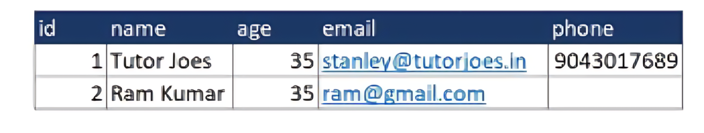
MongoDB
MongoDB Features
MongoDB is a schema-less database, which means that it does not require a pre-defined schema or structure for the data. Unlike traditional relational databases, where data is stored in tables with pre-defined columns and relationships between tables, MongoDB stores data in flexible and dynamic documents.
SQL Schema

Slide 10
MongoDB
MongoDB (schema-less)
{
"id":1,
"name": "Tutor Joes",
"age":35,
"email":"stanley@tutorjoes.in",
"phone": "9043017689“
}
{
"id":2,
"name": “Ram Kumar",
"age":35,
"email":“ram@gmail.com",
}

Slide 11
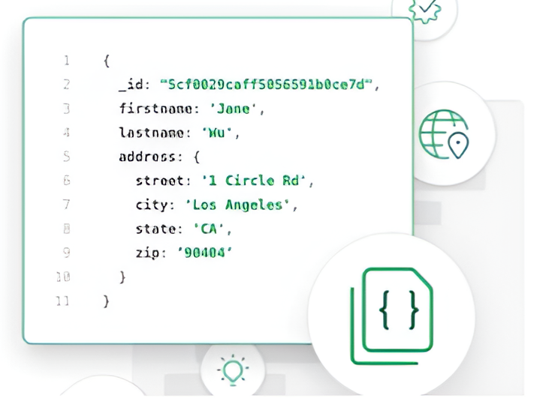
MongoDB
MongoDB Features
MongoDB is document-oriented this means that data is stored in the form of documents, which are similar to JSON (JavaScript Object Notation) objects, instead of being stored in tables with fixed columns and rows like in a traditional relational database. Each document has unique system generated key.

Slide 12
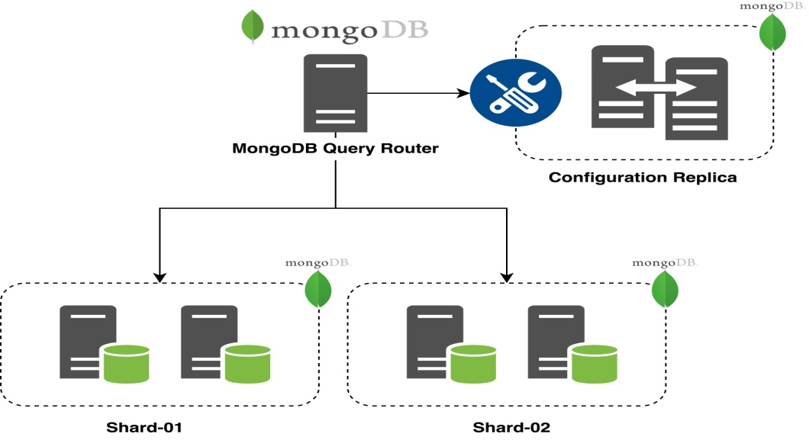
MongoDB
MongoDB Features
Sharding allows MongoDB to handle large datasets and high traffic loads while maintaining high performance and scalability .
Sharding is a type of database portioning that separates very large databases into smaller faster more easily managed part called data shards.

Slide 13
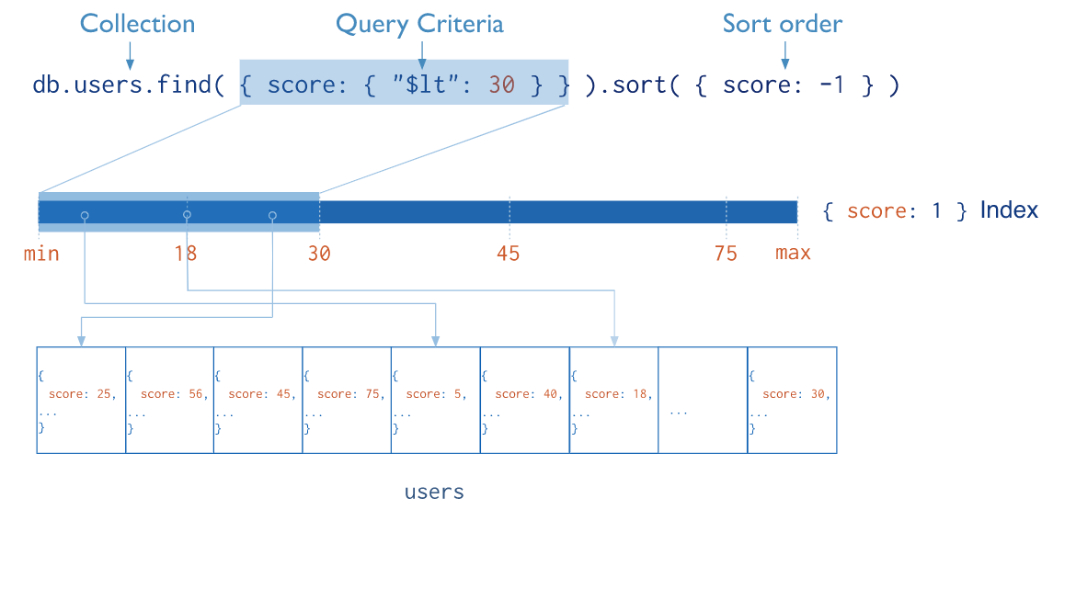
MongoDB
MongoDB Features
Indexing is one of the important option to improve the search performances. so we should index those fields which are matched with our searching criteria.
High Performance MongoDB shows high availability and scalability . It has better query response for indexing and replication

Slide 14
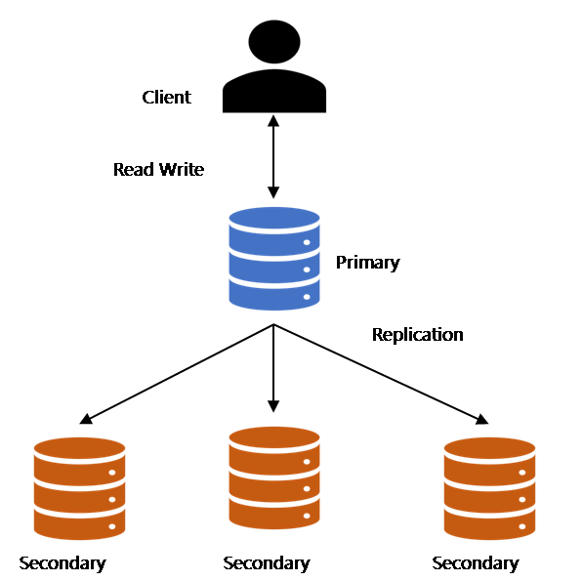
MongoDB
MongoDB Features
Replication: A replica set in MongoDB consists of one primary node and one or more secondary nodes, which replicate the data from the primary node. The primary node is responsible for handling write operations, while the secondary nodes replicate the data from the primary node and can handle read operations. If the primary node fails, one of the secondary nodes is elected as the new primary node

Slide 15
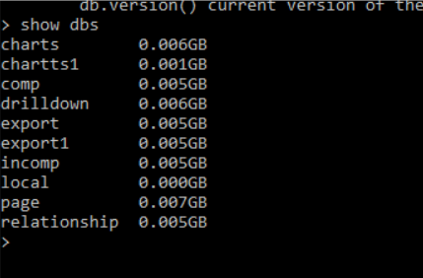
MongoDB
Show All Database
Use below command to get list of all databases.
show dbs or show databases

Slide 16
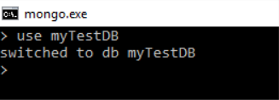
MongoDB
2. Create new database
To create a new database execute the following command.
use DATABASE_NAME

Slide 17

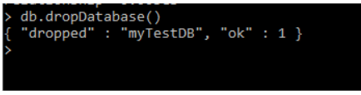
MongoDB
3. Know your current selected database
To know your current working/selected database execute the following command db
4. Drop Database
To drop the database execute following command, this will drop the selected database
db.dropDatabase()

Slide 18


MongoDB
5. Create collection
To create the new collection execute the following commands
db.createCollection(name)
6. To check collections list
To get the list of collections created execute the following command Show collections

Slide 19
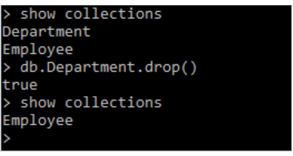
MongoDB
7. Drop collection
To drop the selected collection execute the following command db.COLLECTION_NAME.drop()
8. Insert document in collection
>db.COLLECTION_NAME.insert(document)
To insert single document in selected collection execute the following command

Slide 20
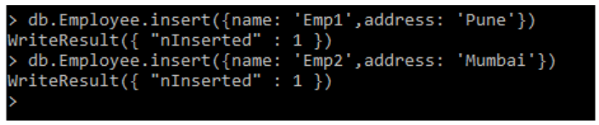
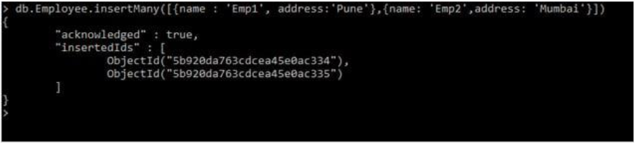
MongoDB
To insert multiple documents in selected collection execute following command

Slide 21
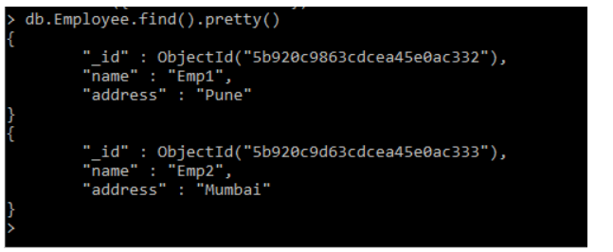
MongoDB
9. Get collection document
To get the list documents in collection execute the following command db.COLLECTION_NAME.find()

Slide 22
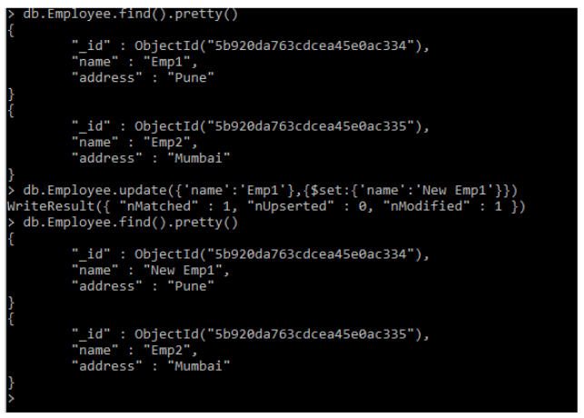
MongoDB
10. Update document
To update the document in collection execute the following command db.COLLECTION_NAME.update(SELECTION_CRITERIA, UPDATED_DATA)

Slide 23
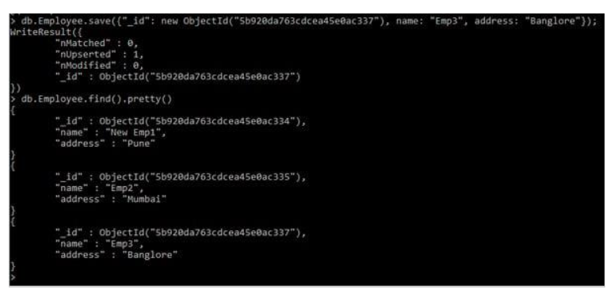
MongoDB
11. Save document
To save document in collection execute the following command >db.COLLECTION_NAME.save({_id:ObjectId(),NEW_DATA})

Slide 24
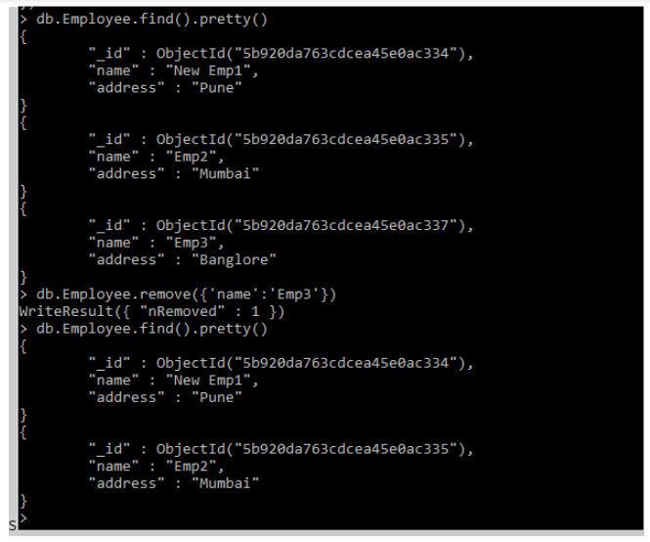
MongoDB
12. Delete document
To delete document in selected collection execute the following command >db.COLLECTION_NAME.remove(DELLETION_CRITTERIA)

