Slide 1
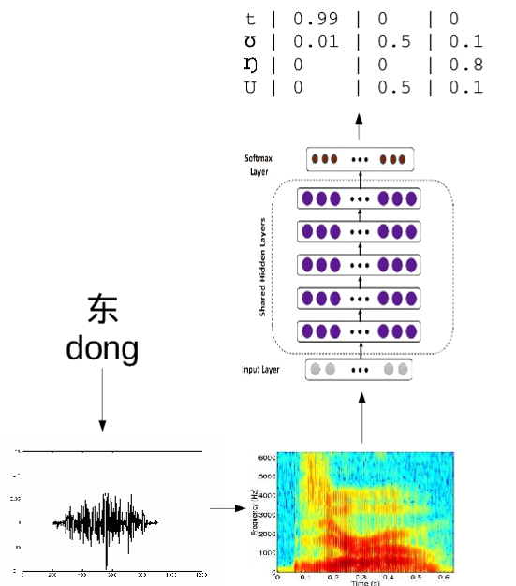
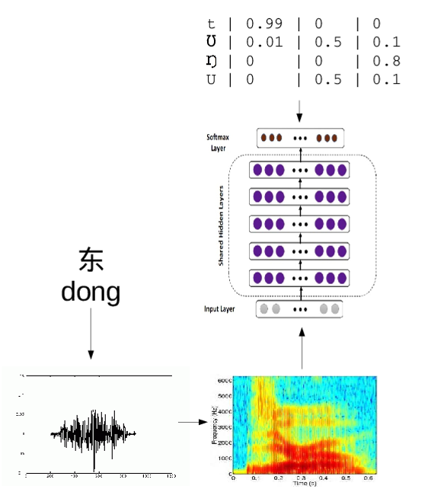
(a) Self-Training: Labeling Phase
(b) Self-Training: Learning Phase

