Slide 1
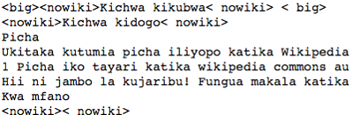
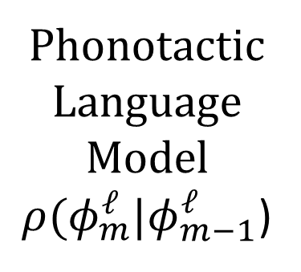
http://isle.Illinois.edu/sst/data/dict/Swahili
a → ɑ
e → ɛ
ny → ɲ
ng’ → ŋ
mb → mb
nj → ndʒ
Phonotactic
Language
Model
$ρ(φ_{m}^{ℓ}|φ_{m−1}^{ℓ}$)

