Slide 1
MTLS

Slide 2
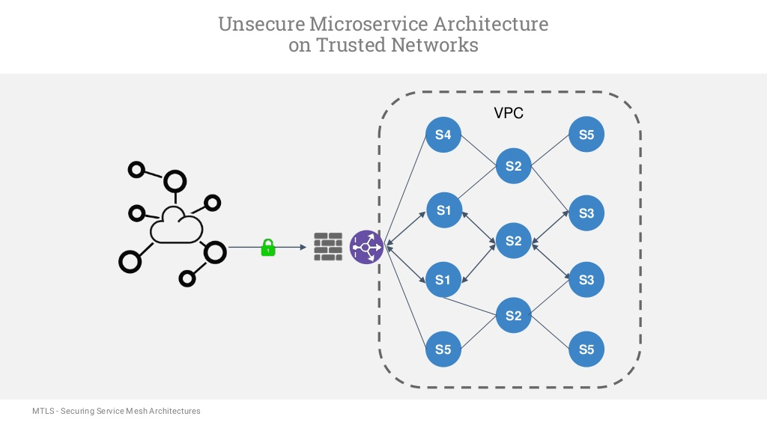

Slide 3
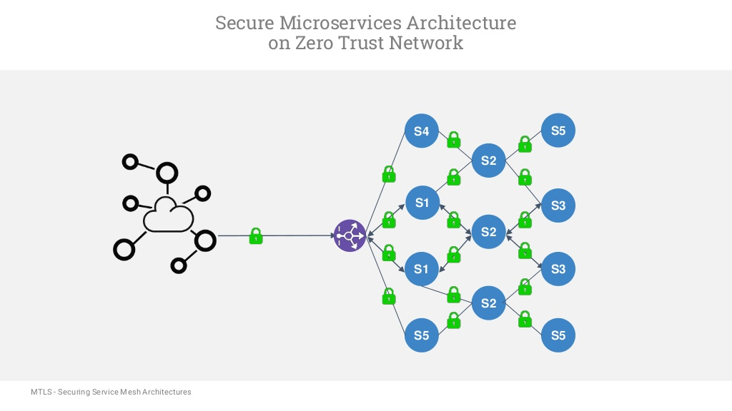

Slide 4
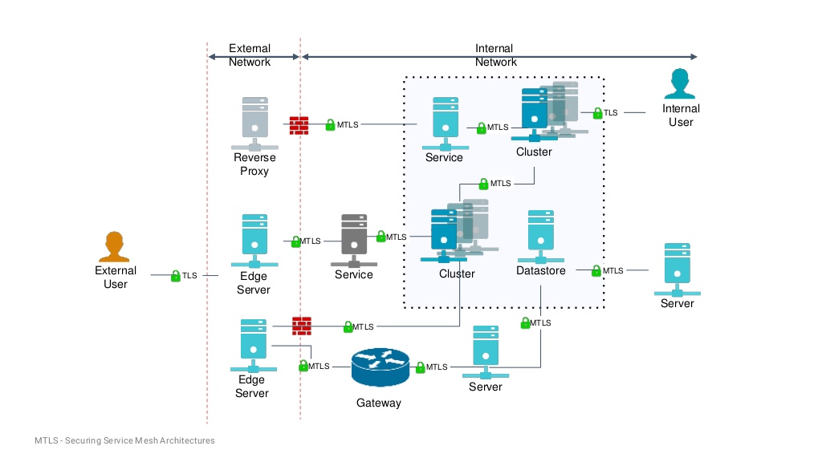

Slide 5
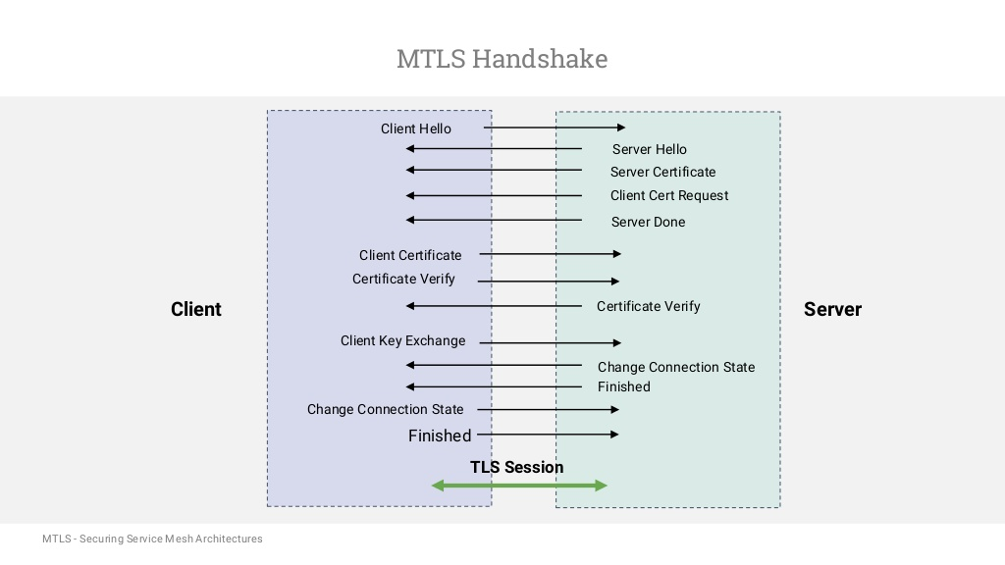

Slide 6
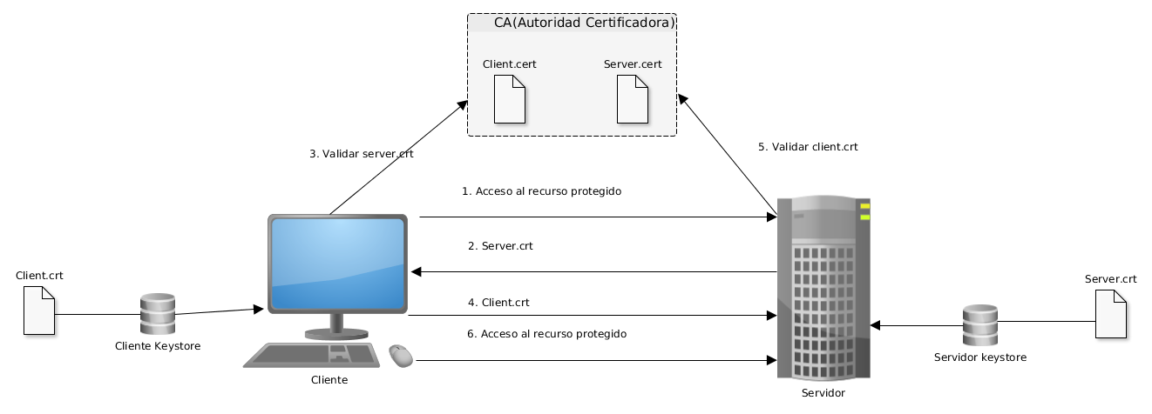

Slide 7
Fuentes
https://www.slideshare.net/lmeirosu/mtls-securing-microservice-architecture-with-mutual-tls-authentication

