Slide 1
Welcome to Terraform Training series

Slide 2

About me
D. Ramesh Reddy
M.tech - Computing Systems and Infrastructure from BITS
15+ years experience in IT Industry
worked for HCL,Mindtree,Infosys,Accenture,ValueMomentum,Swiss Re,Publicis sapient
Roles played – Engineer,Lead,Project manager, Architect, Consultant

Slide 3
Quick Introduction from participants
Name
Are you Working Professional /Student
Prior Experience on terraform -- yes/No

Slide 4
Introduction
Day1 – Terraform Course

Slide 5
What is Terraform ?
Infrastructure as Code (IaC) tool to define cloud & on-prem resources
Uses human-readable, reusable, version-controlled configuration files
Enables a consistent workflow to provision & manage infrastructure lifecycle
Manages low-level (compute, storage, network) and high-level (DNS, SaaS) components
Notes:
Terraform is an Infrastructure as Code (IaC) tool used to define and manage both cloud and on-premises resources.
It uses human-readable, reusable, and version-controlled configuration files to describe infrastructure.
Terraform enables a consistent workflow for provisioning and managing the entire infrastructure lifecycle.
It can manage both low-level components (compute, storage, network) and high-level components (DNS, SaaS).

Slide 6
Terraform – Important Updates / History
Year | Major Update / Release | Key Features Introduced
2014 | Terraform 0.1 Released | • Core CLI workflow (init, plan, apply, destroy)• HCL basics (resources, variables, outputs)• Local state file introduced
2016 | AzureRM Provider v1 Released | • Official Azure support begins• Remote state backends mature• State locking support improves
2021 | Terraform 1.0 (Stability Guarantee) | • Lifecycle rules stable (ignore_changes, create_before_destroy) • Enhanced import/state refactoring • Azure provider >700 resources
2024 | BUSL Licensing & OpenTofu Fork | • Terraform core relicensed under BUSL • OpenTofu project created by community • Terraform 1.7–1.8 cloud + state improvements
BUSL(Business Source License) is a restrictive license HashiCorp adopted in 2023, making Terraform no longer fully open-source.
OpenTofu is the open-source community fork that continues Terraform development under an open license.

Slide 7
Terraform vs ARM Templates vs AWS CloudFormation
Feature | Terraform | ARM Templates (Azure) | AWS CloudFormation
Cloud Support | Multi-cloud (AWS/Azure/GCP/K8s/VMware) | Azure-only | AWS-only
Language | HCL (easy, modular) | JSON (very verbose) | YAML/JSON
State Management | Yes (local/remote + locking) | No (Azure manages implicitly) | Yes (AWS-managed)
Modularity | Strong Modules | Nested Templates | Stacks & Nested Stacks
Terraform sits at the top because it is multi-cloud, more flexible, and has a richer language.
ARM Templates + CloudFormation are cloud-native but restricted to single cloud vendors.

Slide 8
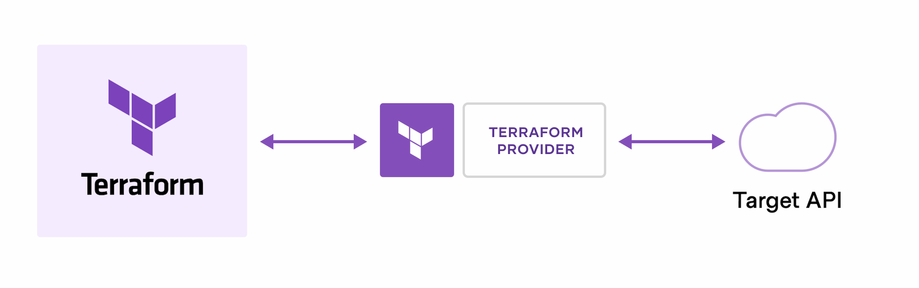
How does Terraform work?
Terraform manages resources through platform APIs
Providers allow Terraform to interact with cloud & service APIs
Enables support for virtually any platform with an accessible API

Slide 9
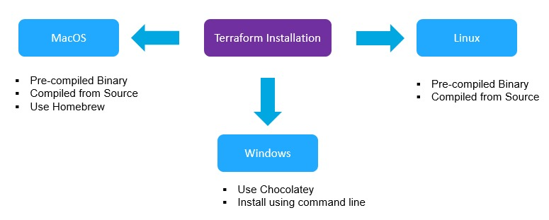
Install Terraform
https://developer.hashicorp.com/terraform/install

Slide 10
Terraform Providers
Plugins that let Terraform interact with service APIs
Work as a driver/bridge to manage resources (Azure, AWS, GCP, Kubernetes, GitHub, etc.)
Thousands of providers supported by HashiCorp & community
Available in the Terraform Registry (AWS, Azure, GCP, Kubernetes, Helm, GitHub, Datadog, etc.)

Slide 11
Several Types of Terraform providers
1. Official Providers (HashiCorp Maintained):
These providers are developed and maintained directly by HashiCorp
Examples: aws , azurerm, gcp, kubernetes, helm.
2. Partner Providers:
These providers are developed and maintained by third-party organizations that partner with HashiCorp.
Examples: Providers for Alibaba Cloud, Oracle Cloud Infrastructure, various SaaS platforms, and enterprise tools.
3. Community Providers:
These providers are developed and maintained by individuals or organizations within the Terraform community.
Examples: Providers for GitHub, Splunk, DataDog, and many other platforms.
4. Custom Providers:
Users can also develop their own custom providers for specific internal systems or unique infrastructure needs not covered by existing providers. These are typically written in Go and leverage the Terraform plugin SDK.
https://registry.terraform.io/browse/providers

Slide 12
Terraform Provider Block (Azure vs AWS)
terraform {
required_providers {
azurerm = {
source = "hashicorp/azurerm"
version = "~> 4.0"
}
}
}
provider "azurerm" {
features {}
}
terraform {
required_providers {
aws = {
source = "hashicorp/aws"
version = "~> 5.0"
}
}
}
provider "aws" {
region = "us-east-1"
}
Link : https://registry.terraform.io/providers/hashicorp/azurerm/latest/docs

Slide 13
Terraform Basics: What goes inside the root directory?
my-terraform-project/
│── main.tf
│── variables.tf
│── outputs.tf
│── providers.tf
│── terraform.tfvars

Slide 14
Can we keep everything in ONE tf file?
Answer : Yes
terraform {
required_providers {
azurerm = { source = "hashicorp/azurerm", version = "~> 4.0" }
}
}
provider "azurerm" {
features {}
}
variable "location" {
default = "eastus"
}
resource "azurerm_resource_group" "rg" {
name = "demo-rg"
location = var.location
}
output "rg_name" {
value = azurerm_resource_group.rg.name
}

Slide 15
If we can write everything in one file, why do we use multiple files?
Because Terraform projects become large.
Having everything in one file becomes unreadable and unmaintainable.
Each file represents one responsibility:
providers.tf — provider blocks
variables.tf — input variables
main.tf — resources
outputs.tf — outputs
locals.tf — computed values
Important Note: Multiple files are for humans, not for Terraform. Terraform loads all .tf files in the folder, in any order, and merges them into a single configuration internally.

Slide 16
Terraform CLI Workflow
Terraform course

Slide 17
Terraform CLI Workflow
terraform init
terraform validate
terraform plan
terraform apply
terraform destroy

Slide 18
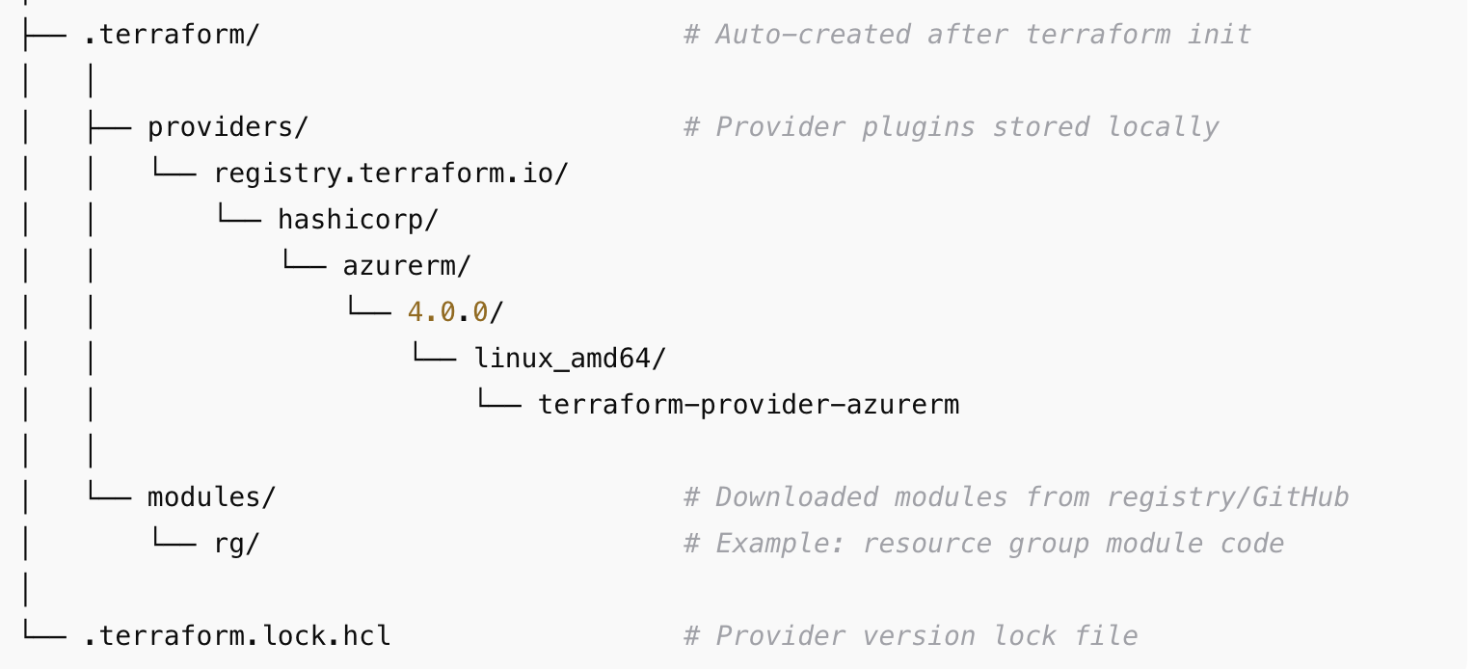
Terraform Init
terraform init is the first command you run in any Terraform project.
it prepares your working directory so Terraform can run other commands like plan andapply.
think of it like setting up all tools and dependencies before building a project.
prepares plugin directory. Keeps providers under .terraform folder
downloads Providers Example: AzureRM, AWS, Kubernetes, GitHub
configures Backend (if any).Remote state like Azure Storage, S3, Terraform Cloud
installs required modules. Local or from Terraform Registry / GitHub
.Terraform directory Should not be committed to Repo
Creates .terraform.lock.hcl -Dependency lock file listing exact provider versions and hashes.
Should be committed to Repo,Because teams & pipelines need the exact same provider version.

Slide 19
LAB:
Providers declaration & Resource Declaration
Run terraform Init and check the output
check Providers downloads
Module Declaration & run terraform init and Validate remote Modules getting Downloaded

Slide 20
Summary
What is Terraform
Terraform History
Difference between Terraform , ARM Templates and Cloud Formation
What is Provider
What is Resource
Terraform Init
Lab:
  Providers declaration
  terraform Init
  Checked how Providers and Modules getting Downloaded in .terraform directory

Slide 21

Day 2
Terraform Series

Slide 22
Topics – Day 2
Terraform Basic Commands
  terraform init (already covered in day1)
  terraform validate
  terraform plan
  terraform apply
  terraform destroy
Lab
  Resources Creation on Azure cloud using Terraform

Slide 23
Terraform validate
terraform validate is a Terraform CLI command that checks whether your configuration files are syntactically correct and internally consistent.
It does NOT contact the cloud provider (Azure, AWS, GCP) and does NOT check if resources actually exist.
It only validates your Terraform code.

Slide 24
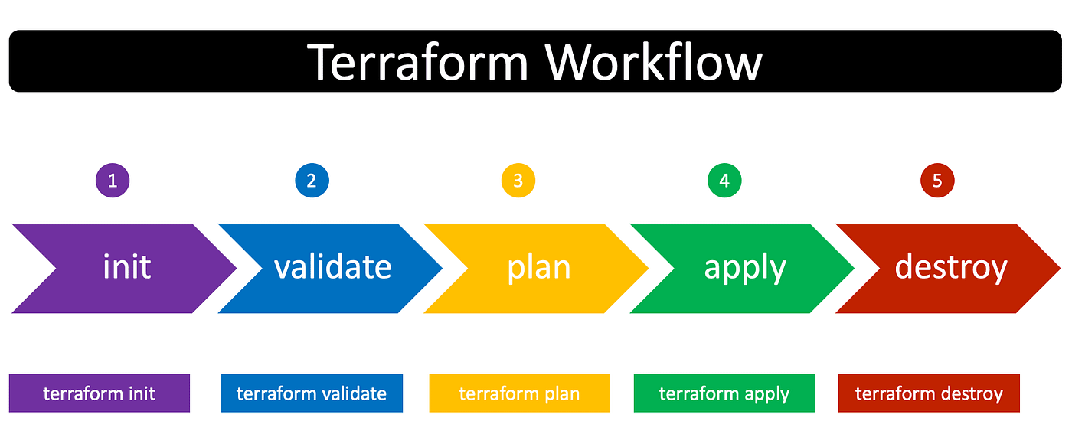
When to Use It
Before terraform plan
In CI/CD pipelines
After editing variables, modules, providers
To catch simple mistakes early

Slide 25
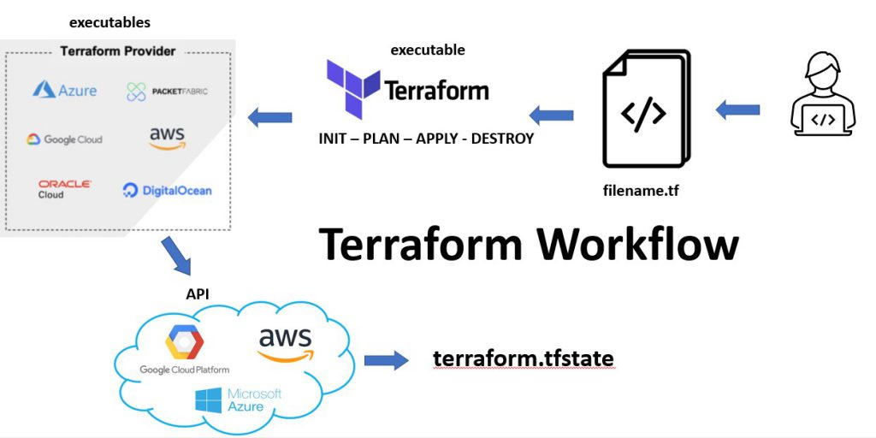
What is terraform plan?
terraform plan shows what changes Terraform will make to your infrastructure before applying them.
Think of it as a preview or dry run to ensure the expected changes are correct.
It does not create, update, or delete resources—it only shows the execution plan.

Slide 26
What does terraform plan do?
Action | Explanation
Reads configuration | Checks .tf files in your project
Reads current state | Local or remote backend state
Calculates changes | Determines what to add, update, or destroy
Displays plan to user | Shows actions before applying them

Slide 27
What is terraform apply?
terraform apply is the command Terraform uses to provision, update, or modify infrastructure based on your Terraform configuration files.
It takes the execution plan and applies it to the target cloud or platform (Azure, AWS, GCP, Kubernetes, etc.) using provider APIs.
Think of it as the “make the changes real” step.

Slide 28
What does terraform apply do?
Action | Description
Reads current state | Determines what exists in cloud
Evaluates configuration | Compares desired config vs state
Executes changes | Creates/updates/deletes resources
Updates state file | Tracks the new real-world state

Slide 29
What is terraform destroy?
terraform destroy is the Terraform command used to delete/destroy all infrastructure resources that were previously created using Terraform.
It reads the state file and removes everything Terraform manages.
Think of it as the teardown / cleanup phase of your infrastructure lifecycle.

Slide 30
What does it do?
Action | Explanation
Reads configuration & state | Understands what resources exist
Shows a destroy plan | Preview of what will be deleted
Deletes resources via provider APIs | Azure, AWS, GCP, Kubernetes, etc.
Updates/cleans the state file | Removes destroyed resources

Slide 31
Resource Block Explained
Provider = azurerm
Resource = Resource Group
Resource Type
Resource Name
resource "azurerm_resource_group" "my-rg"
{
name = "myRg"
location = "West Europe"
}
Block Name
Arguments

Slide 32
Different Type of Blocks
Terraform Block | Purpose
terraform | Version, providers, backend
provider | Configures cloud provider
resource | Creates infrastructure
data | Reads existing resources
variable | Input parameters
locals | Internal values
module | Reusable configurations
output | Export values after deployment
Terraform configuration is structured using different types of blocks, each serving a specific purpose. Below are the main Terraform block types you should know, especially for interviews and real-world usage.

Slide 33
Lab :
Azure resource creation
- terraform validate
- terraform plan
- terraform apply
- terraform destroy

Slide 34
Day2 - Summary
Terraform Basic Commands
  terraform validate
  terraform plan
  terraform apply
  terraform destroy
Lab
  Resources Creation on Azure cloud using Terraform

