Slide 1
Nature of Science
EOC Review

Slide 2
Nature of Science Standards
Students shall demonstrate an understanding that science is a way of knowing.
Students shall design and safely conduct a scientific inquiry to solve valid problems.
Students shall demonstrate an understanding of current life science theories.
Students shall use mathematics, science equipment, and technology as tools to communicate and solve life science problems.
Students shall describe the connections between pure and applied science.
Students shall describe various life science careers and the training required for the selected career.

Slide 3
Nature of Science
1. Explain why science is limited to natural explanations of how the world works

Slide 4
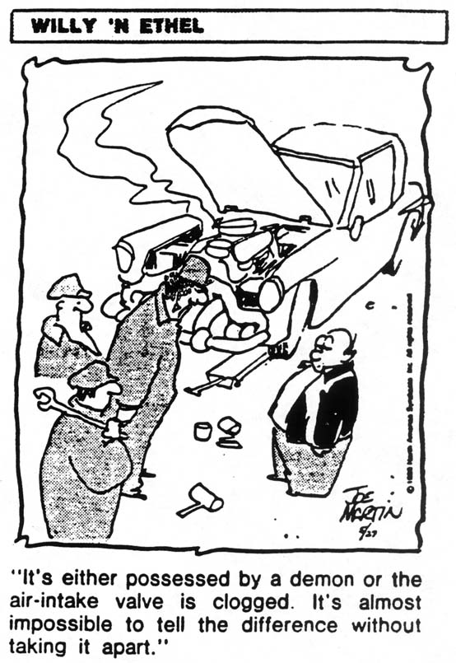
Which is the scientific answer to the problem? Why?

Slide 5
Which is the scientific answer to the problem? Why?
The mechanic can only deal with material, measurable things --- the engine. This is a natural cause which explains the naturally occurring event.
Science is limited to natural explanations of how the world works
How is this different than religious, cultural, or philosophical knowledge?
Review Comparison in the ways of knowing handout

Slide 6
Nature of Science
2. Compare and contrast hypotheses, theories, and laws

Slide 7
See hypotheses, theories, and laws handout

Slide 8
Nature of Science
3. Distinguish between a scientific theory and the term “theory” used in general conversation

Slide 9
A scientific theory, unlike a theory used in general conversation, means that multiple scientists have researched hypotheses, found the same results, and have published their data. Once several scientists in the community agree on the data, the results become a theory. The theory only gets revised when refuting evidence is revealed, or new evidence that supports the theory is presented.

Slide 10
Nature of Science
4. Summarize the guidelines of science:
explanations are based on observations, evidence, and testing
hypotheses must be testable
understandings and/or conclusions may change with additional empirical data
scientific knowledge must have peer review and verification before acceptance

Slide 11
Nature of Science
5. Develop and explain the appropriate procedure, controls, and variables (dependent and independent) in scientific experimentation

Slide 12
A science class performed an experiment to determine the effect of caffeine on pulse rate. 2 groups of 10 people were of the same sex and age. One group was fed 2 cups of decaffeinated coffee each morning at 8:00 AM. The other group was fed 2 cups of regular coffee each morning at the same time. The pulse of all the people was taken for 1 minute at 30 minute intervals for 3 hours.
Using if and then statements, write a possible hypothesis for this experiment:
What is the independent variable for this experiment?
What is the dependent variable for this experiment?
What were the controlled variables in this experiment?

Slide 13
A student wanted to determine whether increasing the amount of a certain brand of fertilizer would increase the growth of grass. She planted bluegrass in several pots of soil. After a month of growth, she trimmed all the pots of grass to the same length. She then added 1 mL of fertilizer to one pot, 2 mL of fertilizer to another pot, 3 mL of fertilizer to the 3rd pot, and 4 mL of fertilizer to the 4th pot. In the 5th pot, she didn’t put any fertilizer. She put all the pots on the same windowsill. She measured the length of the grass in all pots after 10 days.
Using if and then statements, write a possible hypothesis for this experiment:
What is the independent variable for this experiment?
What is the dependent variable for this experiment?
How many experimental groups were there in this experiment? What are they?
Is there a control group? Which is it?

Slide 14
On graph paper, graph this student’s results. Be sure to include the 4 graph requirements:
title, independent variable on correct axis, dependent variable on correct axis, correctly plotted
Points, even increments on the graph (HINT: DRY MIX)
POT | 1 | 2 | 3 | 4 | 5
mL of fertilizer | 1 | 2 | 3 | 4 | 0
Plant growth in mm | 4 | 7 | 1 | 0 | 3

Slide 15
Nature of Science
6. Research and apply appropriate safety precautions (refer to ADE Guidelines) when designing and/or conducting scientific investigations

Slide 16
See lab safety sheet

Slide 17
Nature of Science
7. Identify sources of bias that could affect experimental outcome

Slide 18
Example: A researcher who invested in a carpet cleaning product would be biased in viewing results in an experiment finding the best carpet cleaner involving his product.

Slide 19
Nature of Science
8. Gather and analyze data using appropriate summary statistics

Slide 20
Nature of Science
9. Formulate valid conclusions without bias

Slide 21
Nature of Science
10. Communicate experimental results using appropriate reports, figures, and tables

Slide 22
Nature of Science
11. Recognize that theories are scientific explanations that require empirical data, verification, and peer review

Slide 23
Nature of Science
12. Understand that scientific theories may be modified or expanded based on additional empirical data, verification, and peer review

Slide 24
Nature of Science
13. Summarize biological evolution

Slide 25
Change in allele frequency over successive generations. See evolution powerpoint for more information.

Slide 26
Nature of Science
14. Relate the development of the cell theory to current trends in cellular biology

Slide 27
Cell Theory
All living things are composed of cells
Cells are the basic units of structure and function in living things
New cells are produced from existing cells

Slide 28
Nature of Science
15. Describe the relationship between the germ theory of disease and our current knowledge of immunology and control of infectious diseases

Slide 29
Germ theory of disease is a theory that proposes that microorganisms are the cause of many diseases.

Slide 30
Nature of Science
16. Relate the chromosome theory of heredity to recent findings in genetic research (e.g., Human Genome Project-HGP, chromosome therapy)

Slide 31
Chromosome theory of heritance is the idea that genes, the units of heredity, are physical in nature and are found in the chromosomes

Slide 32
Nature of Science
17. Research current events and topics in biology

Slide 33
Nature of Science
18. Collect and analyze scientific data using appropriate mathematical calculations, figures, and tables

Slide 34
Nature of Science
19. Use appropriate equipment and technology as tools for solving problems (e.g., microscopes, centrifuges, flexible arm cameras, computer software and hardware)

Slide 35
Nature of Science
20. Utilize technology to communicate research findings

Slide 36
Nature of Science
21. Compare and contrast biological concepts in pure science and applied science

Slide 37
The difference between pure and applied science is that pure science is conducted for the sake of knowing (basic cell research), applied science attempts to solve practical problems (engineering, artificial selection)

Slide 38
Nature of Science
22. Discuss why scientists should work within ethical parameters

Slide 39
An experimenter wanted to see if smoking cigarettes caused lung cancer. He found 6 children, all in good health and equal in age. He put 3 of them in chambers with nicotine smoke for 30 minutes a day for a year. He put the other 3 in chambers without smoke for 30 minutes a day for a year. After that, the kids were tested for the presence of cancerous cells in the lung.
Using if and then statements, write a possible hypothesis for this experiment:
What is the independent variable for this experiment?
What is the dependent variable for this experiment?
Could this experiment be performed in real life? Why?

Slide 40
Nature of Science
23. Evaluate long-range plans concerning resource use and by-product disposal for environmental, economic, and political impact

Slide 41
Examine the Kyoto Protocol

Slide 42
Nature of Science
24. Explain how the cyclical relationship between science and technology results in reciprocal advancements in science and technology

Slide 43
Nature of Science
25. Research and evaluate science careers using the following criteria:
educational requirements
salary
availability of jobs
working conditions

