Slide 1
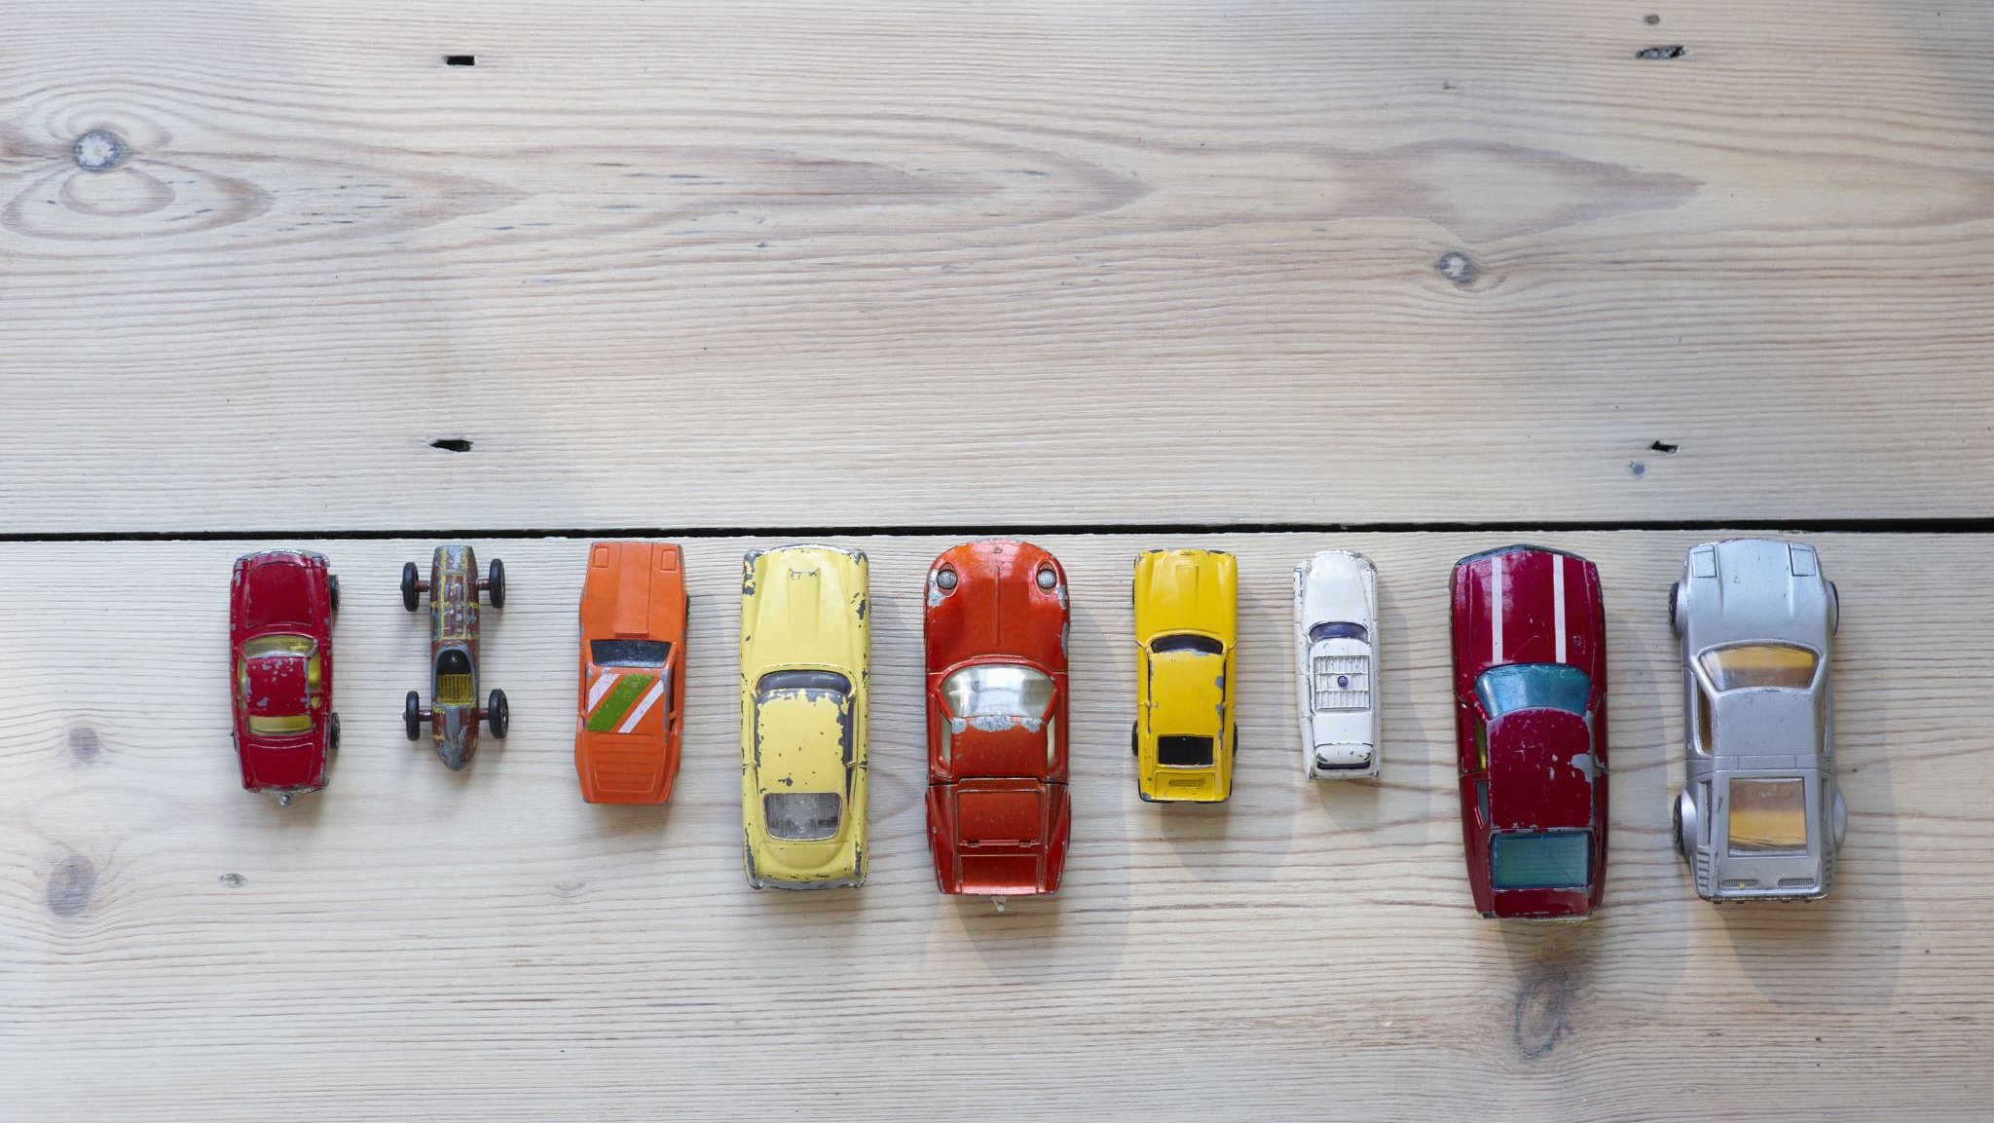
Car Insurance Claims
Bernard Opoku

Slide 2


INTRO
BACKSTORY
PROBLEM
METHODOLOGY
DATA
SOLUTION
RESULT:
SUMMARY
IMPACT
Greyscale
Insurance
Co.
CONCLUSION:
FUTURE WORK
APENDIX

Slide 3
Backstory
Greystone Car Insurance
Problem
Keep auto accident claims low
Aware of accidents
Estimate accidents and claims
Greyscale
Insurance
Co.
INTRO
METHODOLOGY
RESULT
CONCLUSION
Notes:
Due to aware of accidents, Greystone Car Insurance,
A car Insurance startup looking for ways to keep car insurance claims to the minimum before it even goes into operation.

Slide 4
DATA
Past Insurance claims
~10,000 Rows
20 columns
Top Features
Drivers’ age, Vehicle usage, Car type, Occupation
Greyscale
Insurance
Co.
INTRO
METHODOLOGY
RESULT
CONCLUSION
Notes:
Kaggle

Slide 5
1. PRELIMINARY SOLUTION
DESCRIPTIVE
Exploratory Data Analysis
Age
V. Usage
Car Type
Occupation
Greyscale
Insurance
Co.
INTRO
METHODOLOGY
RESULT
CONCLUSION
Notes:
We want to take a look at the data toroghly to see what is causing what

Slide 6
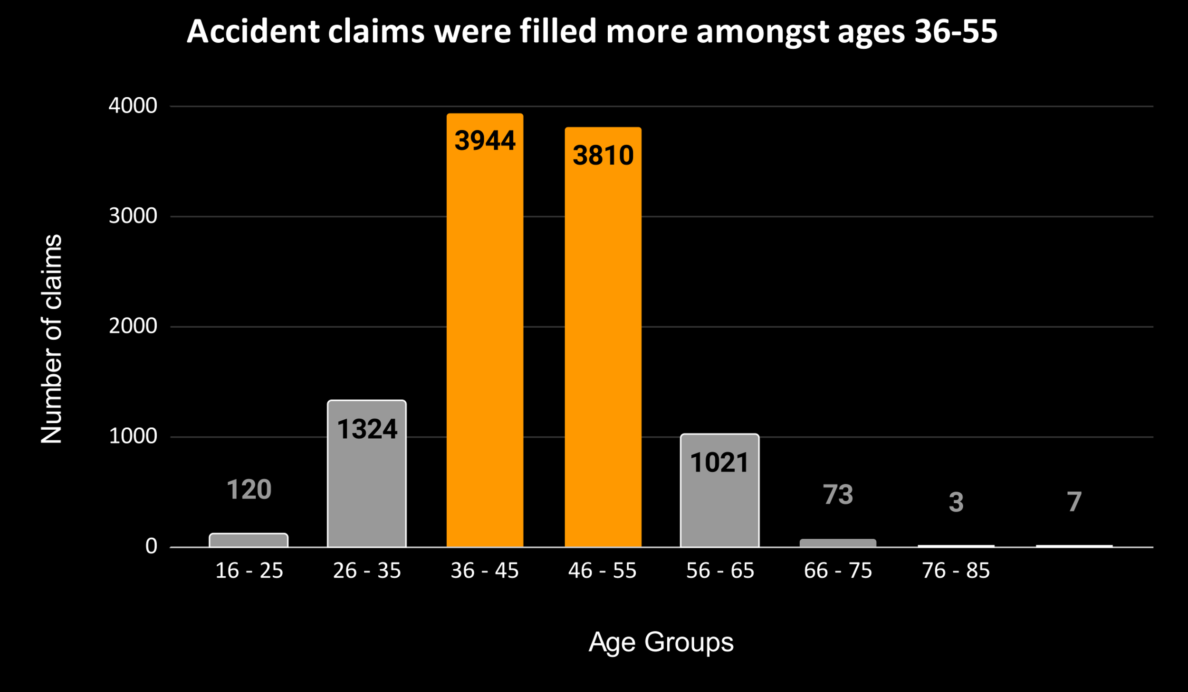
AGE
Middle age group filled most accident claims
Greyscale
Insurance
Co.
INTRO
METHODOLOGY
RESULT
CONCLUSION

Slide 7
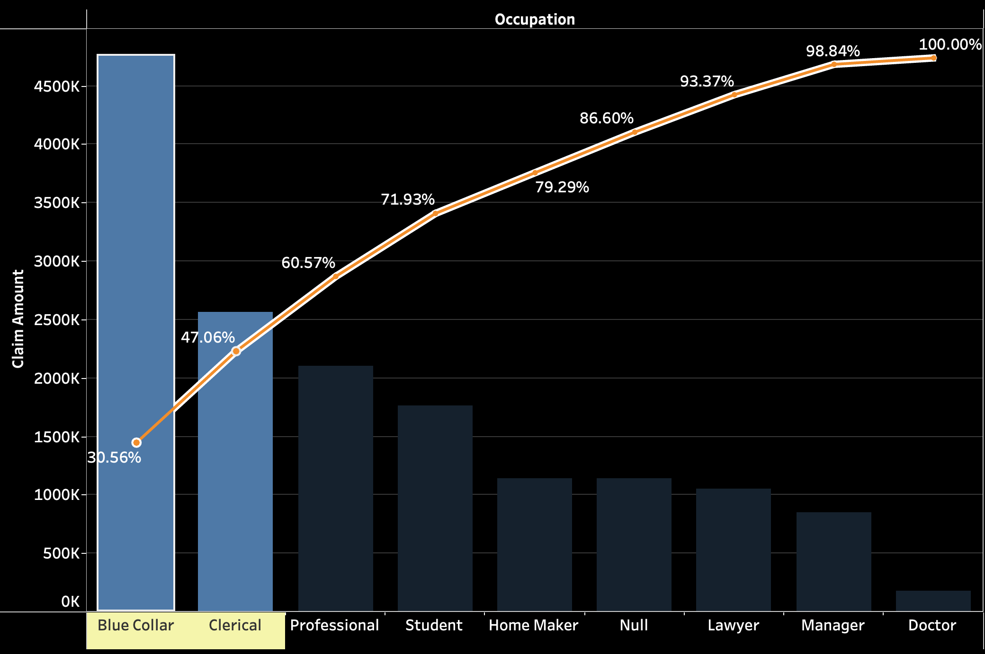
OCCUPATION
People with Blue collar and Clerical jobs claimed almost 50% of the total insurance claims
Greyscale
Insurance
Co.
INTRO
METHODOLOGY
RESULT
CONCLUSION

Slide 8
2. PRELIMINARY SOLUTION
PREDICTIVE
Classification
Age
V. Usage
Car Type
Occupation
Greyscale
Insurance
Co.
INTRO
METHODOLOGY
RESULT
CONCLUSION
Notes:
We want to take a look at the data toroghly to see what is causing what

Slide 9
Direct attention & resources
classifying higher risk customers will inform and give appropriate info
Flaging new applicants
IMPACT
Greyscale
Insurance
Co.
INTRO
METHODOLOGY
RESULT
CONCLUSION
Notes:
Hypothesis: If we get insights of where most claims are coming from and/ predict which customers are likely to get into accidents or make an accident claim, we could reduce the amount of claims by being selective in our insurance application process and also paying more attention and directing some special information and resources to our customers that are within this classified domain

Slide 10



What Did we Learn?
SUV tops in number of claims as well as the amount claimed across all segment of cars
Ages between 36-55 had the highest no. claims
Blue collar as an Occupation had the highest claim while doctors recorded the least.
Greyscale
Insurance
Co.
INTRO
METHODOLOGY
RESULT
CONCLUSION

Slide 11
WHAT SHOULD WE DO?
The Acturials should revisit the premium especially for blue collar customers.
Company can provide some benefit for low claims to attract and maintain the customer
High amount of claims = low profit for premium paid by customers.
Greyscale
Insurance
Co.
INTRO
METHODOLOGY
RESULT
CONCLUSION

Slide 12
Future work
Analyze Data for All Insured
Greyscale
Insurance
Co.
INTRO
METHODOLOGY
RESULT
CONCLUSION

Slide 13
THANKT YOU
Greyscale
Insurance
Co.
INTRO
METHODOLOGY
RESULT
CONCLUSION

Slide 14
Appendix
Greyscale
Insurance
Co.
INTRO
METHODOLOGY
RESULT
CONCLUSION

Slide 15
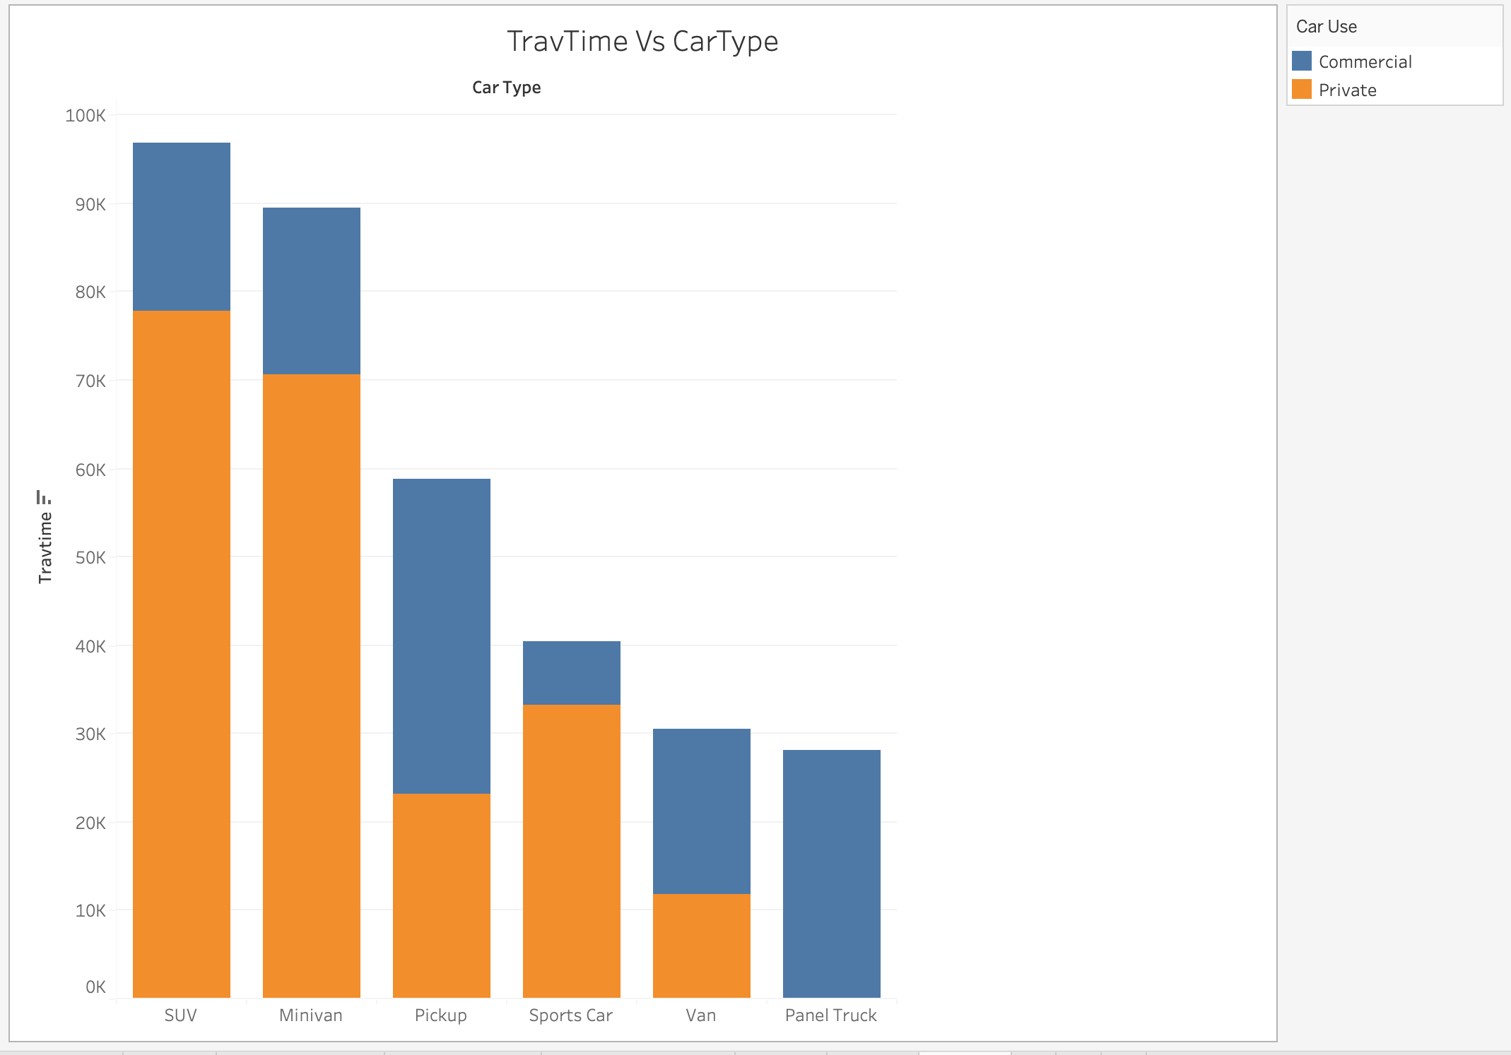
Appendix
Greyscale
Insurance
Co.
INTRO
METHODOLOGY
RESULT
CONCLUSION

Slide 16
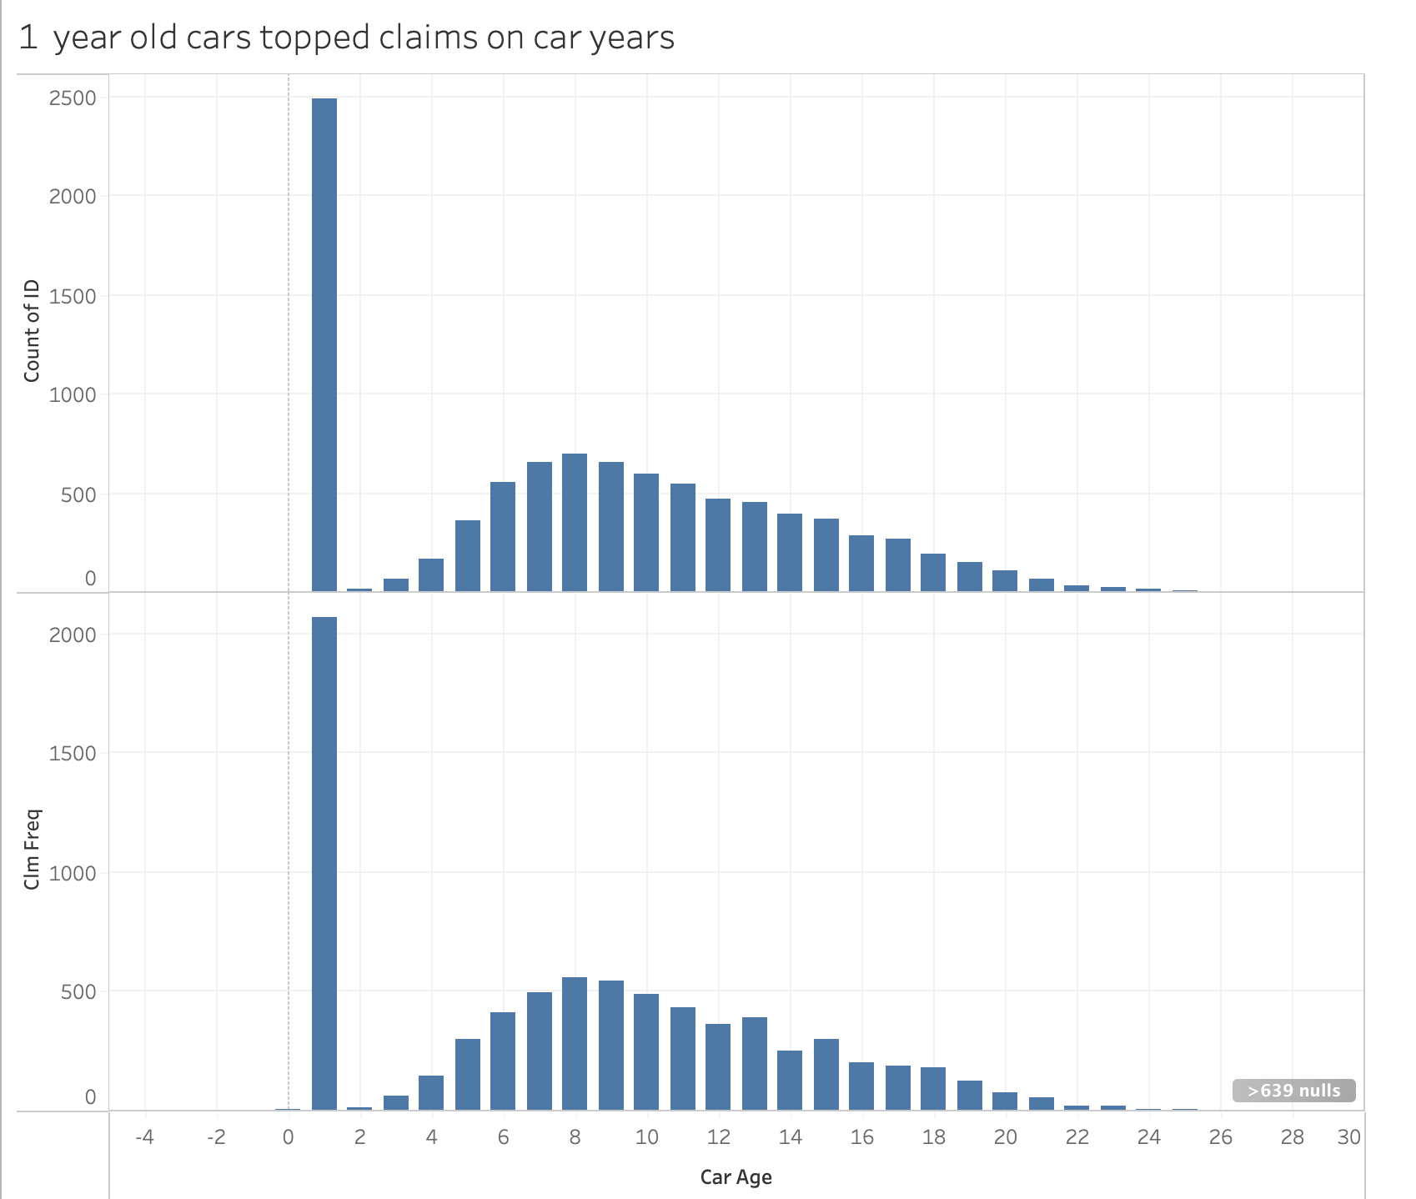
Appendix
Greyscale
Insurance
Co.
INTRO
METHODOLOGY
RESULT
CONCLUSION

