Slide 1


Customer Churn
Bernard Opoku

Slide 2

INTRODUCTION
What is it?
Why does it matter?
What are we going to do?

Slide 3

Procedure
Get our data
Explore the data
Build a model

Slide 4

Data Acquisition & Storage
Data
Telco Dataset-Kaggle
21 Initial Features – Mixed
~10K observations
Storage
SQL Database

Slide 5
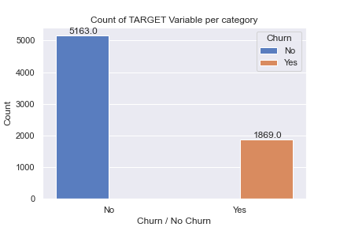
Data Exploration
Imbalance Data

Slide 6
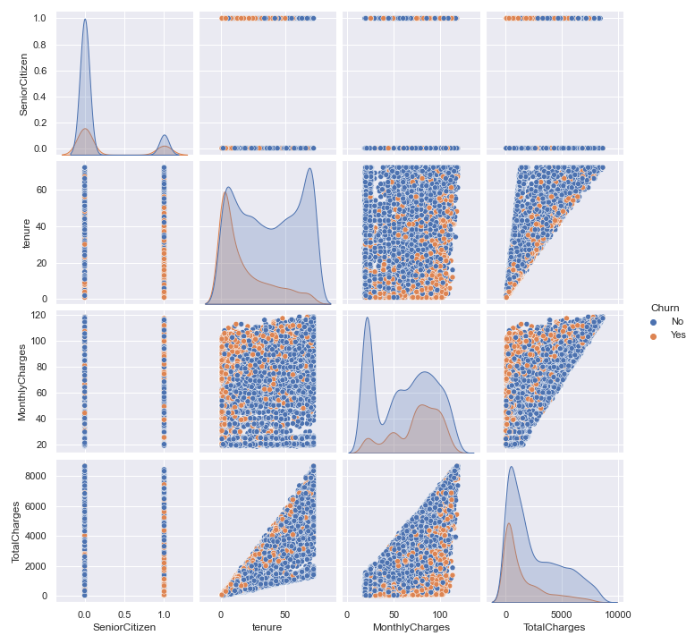
Don’t be tricked

Slide 7
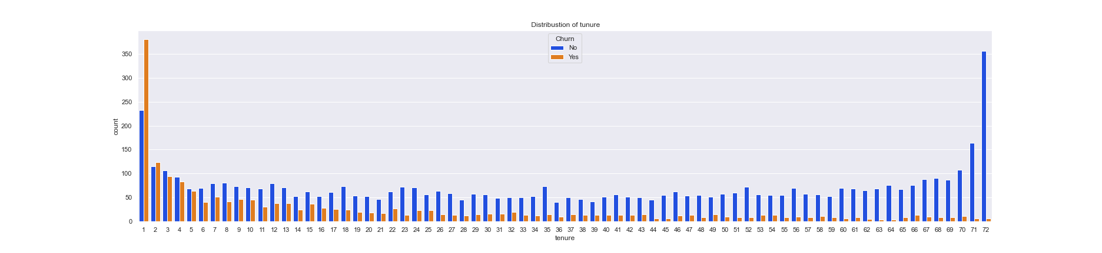
Tenure

Slide 8
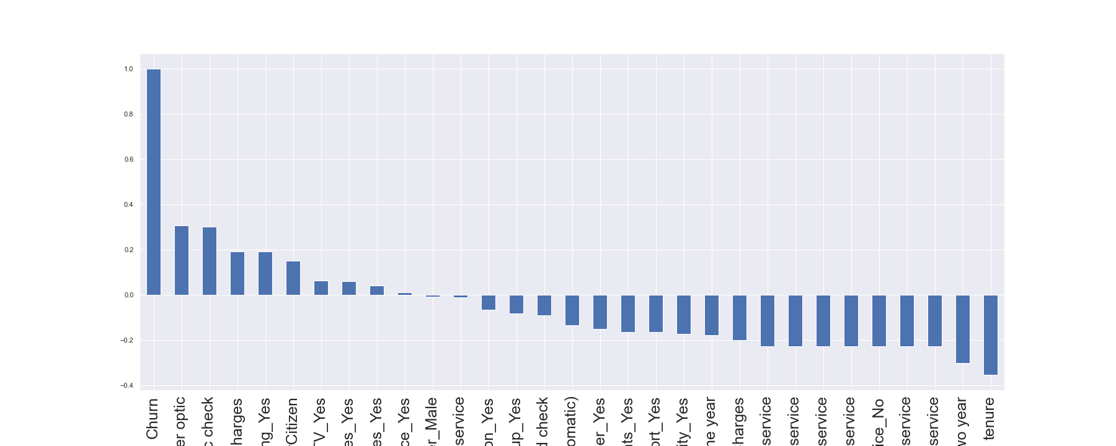
Before Modeling
Any relationship?

Slide 9
Modeling
What do we want to achieve?
What is our use case?
What will be our solution to churn?
Notes:
Metrics
Recall sounds good butttt
But f2 which does not regard precision total

Slide 10
Predictive Modeling
Logistic Regression as baseline
Recall: 0.4328
F2 Score : 0.4636
…Ooopsss!!
SO WHERE FROM HERE?
Test Different Models
Every Model:
Bring in all our our feature
Make them usable by the model (dummy)
Cross- Validation & Hyperparameter Tunning
Class Imbalance Techniques

Slide 11
Class Imbalance Techniques
Threshold Adjustment
Oversampling
SMOTE
ADASYN
Both
Notes:
If we can do one, why cant we do both?

Slide 12
Compare
Model | Base | Class Imbalance Technique CV, GS - Val | Test
Logistic Regression (CV) | F2_Score:0.555 Recall:.534 | F2: 0.770 Threshold = 0.196
KNN | F2 Score: 4.84
Decision Tree | F2 score: 0.539 Recall:0.5320 | F2 score 0.757 Threshold >= 0.200 | F2 Score: 0.710 Threshold >= 0.100
Random Forest | F2 score: 0.535 Recall: 0.506 | F2 Score: 0.770 Threshold >= 0.176 | F2_Score: 0.745 Threshold >= 0.179
XGBoost | F2_Score: 0.697 Recall: 0.813 | Recall score: F2 score: 0.756 | F2 score: 0.734 Threshold >= 0.439

Slide 13
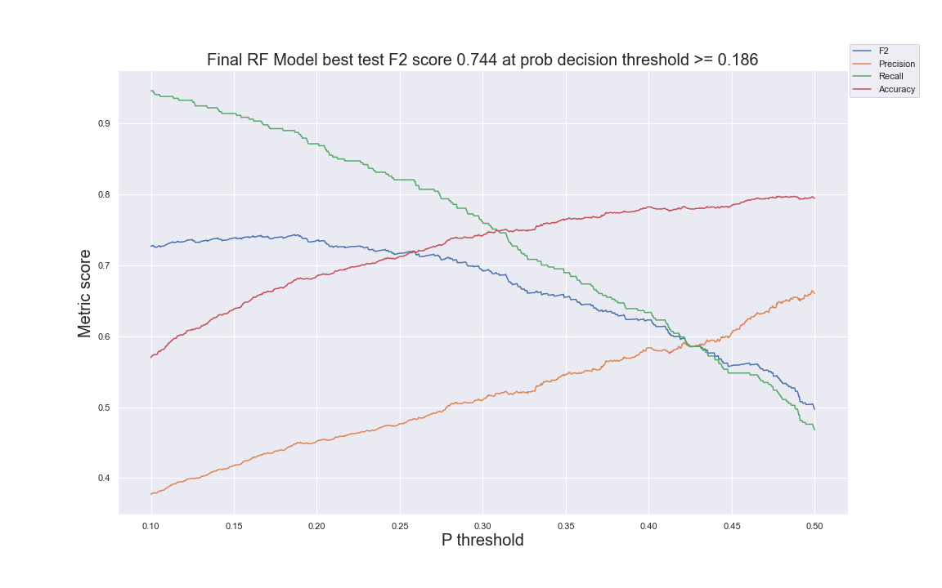
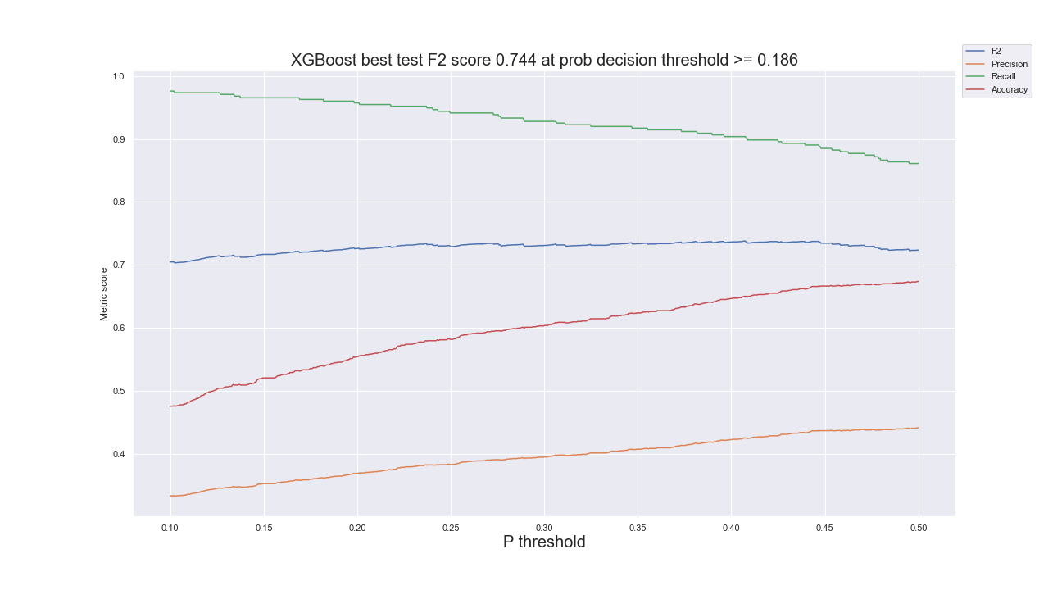
Random Forest vs XGBoost

Slide 14
Winner!
Model | Base | Class Imbalance Technique , CV, GS - Val | Test
Logistic Regression (CV) | F2_Score:0.555 Recall:.534 | F2: 0.770 Threshold = 0.196
KNN | F2 Score: 4.84
Decision Tree | F2 score: 0.539 Recall:0.5320 | F2 score 0.757 Threshold >= 0.200 | F2 Score: 0.710 Threshold >= 0.100
Random Forest | F2 score: 0.535 Recall: 0.506 | F2 Score: 0.770 Threshold >= 0.176 | F2_Score: 0.745 Threshold >= 0.179
XGBoost | F2_Score: 0.697 Recall: 0.813 | Recall score: F2 score: 0.756 | F2 score: 0.734 Threshold >= 0.439

Slide 15
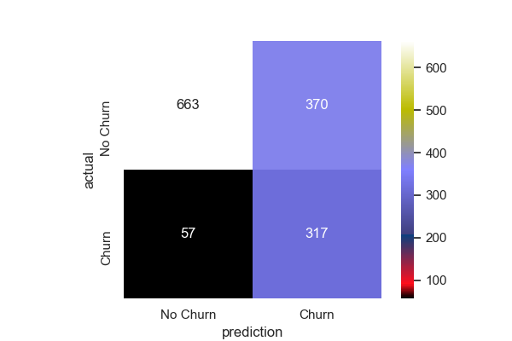
Random Forest
Threshold @ .21
Combine Val and train
Fit
Results: F2 Score - .72

Slide 16

Future Work
More Data
Web app
Deployment

Slide 17
Questions??
Thank you

Slide 18
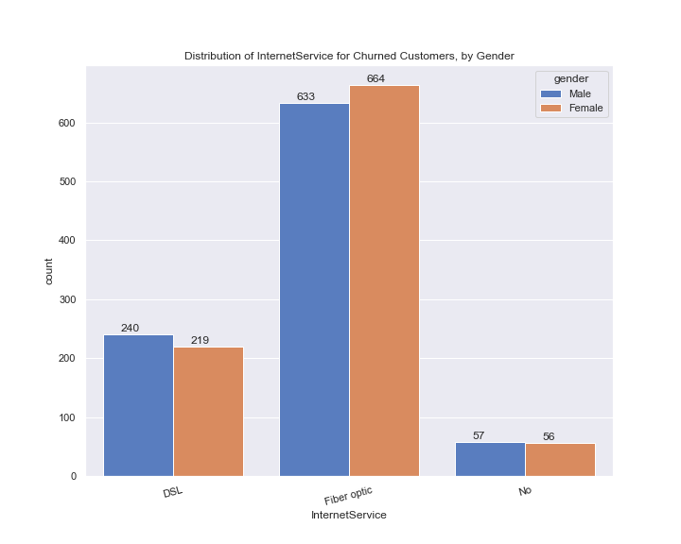
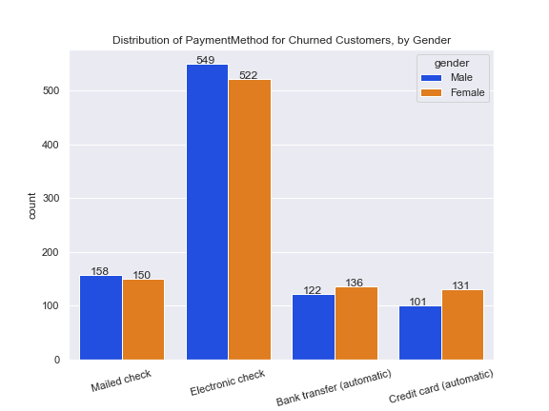
Appendix

Slide 19
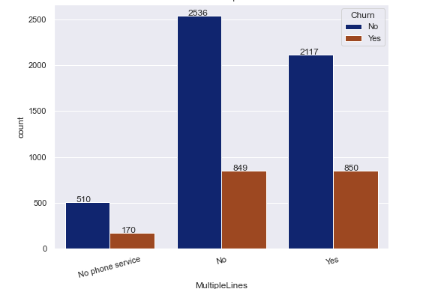
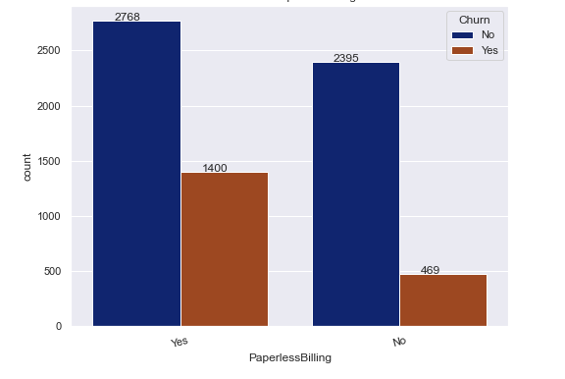
Appendix

