Slide 1

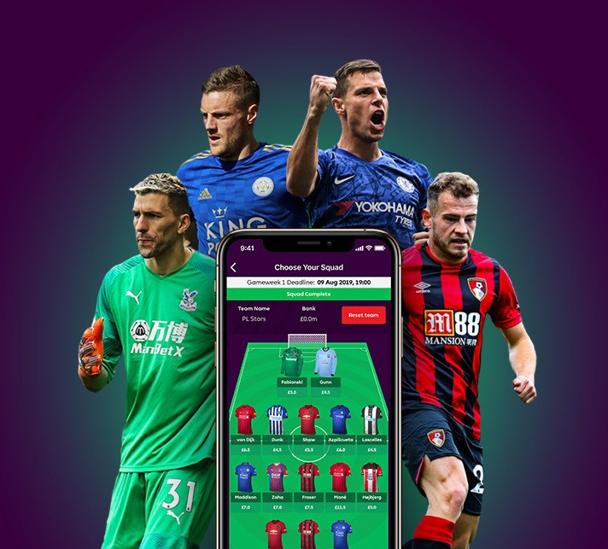
INTRODUCTION
Fantasy Premier League
Point Prediction

Slide 2

Data Acquisition
Fantasy Premier League API
1 season data
Over 700 players for 38 weeks

Slide 3

Storage
Tabular format
Different tables
Connected with a common key

Slide 4



Modeling
Get data
Linear regression model
Save for later

Slide 5


Production
Code cannot die in the notebook
Let’s make a web app
Take input from user
Interact with our model and database

Slide 6
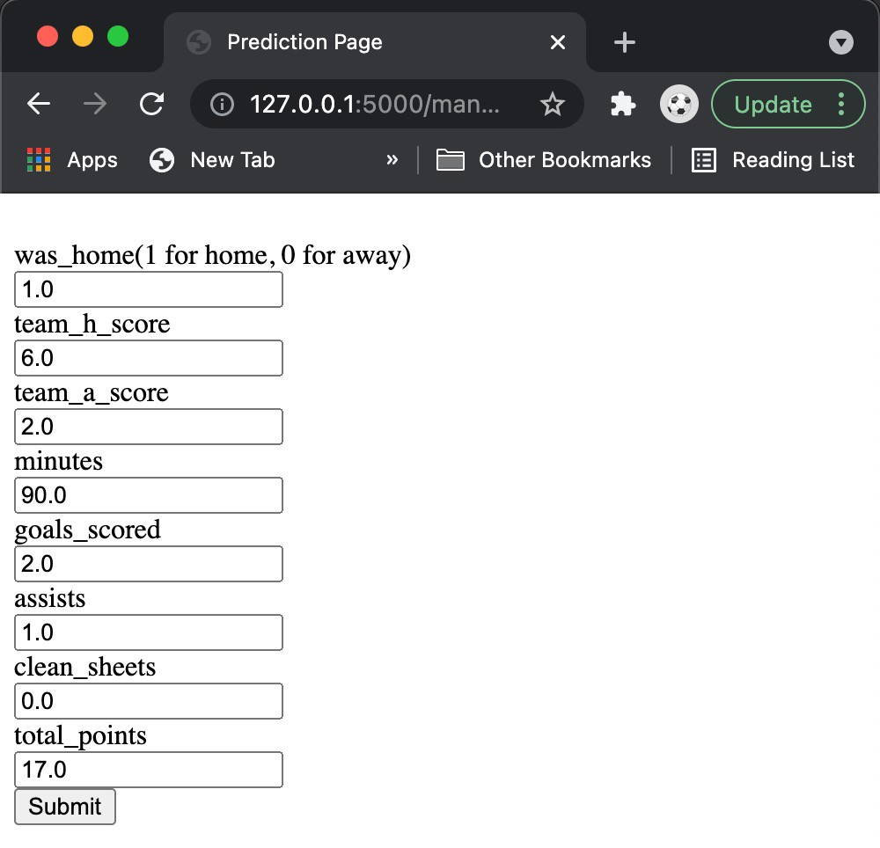
Functionality 1
/manual-predict
Flask posts input to the model from user
Model returns the prediction to flask for user.

Slide 7
Functionality 2
/Semi-Auto-predict
Dropdown menu for selection
User input is used to query the database for
Model receives data to make prediction

Slide 8


Deployment
If we can host it locally, then why not “Globally”
Heroku
Docker

Slide 9

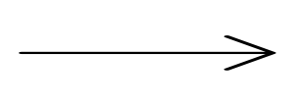



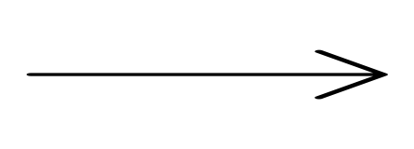
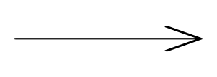
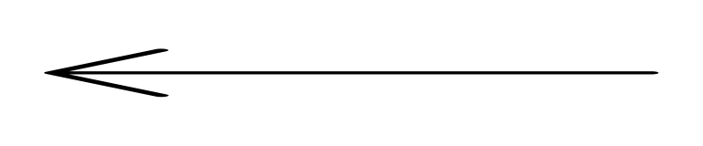
Workflow

Slide 10
https://fantasy-fpl-bernard.herokuapp.com/

Slide 11

Future Work
More Functionality
Make prediction for top n players to score highest
Better styling

Slide 12

Thank you, People!!
Bernard Opoku

