Slide 1

Notes:
[Sources] - Source slide image rendered from user-uploaded deck: /mnt/data/ArcGIS_VRP_Sid_16_Scenarios_Rebuilt_Screenshot_Style(1).pptx (slide 1). - The slide content is carried forward unchanged from the user-provided rebuilt deck.

Slide 2
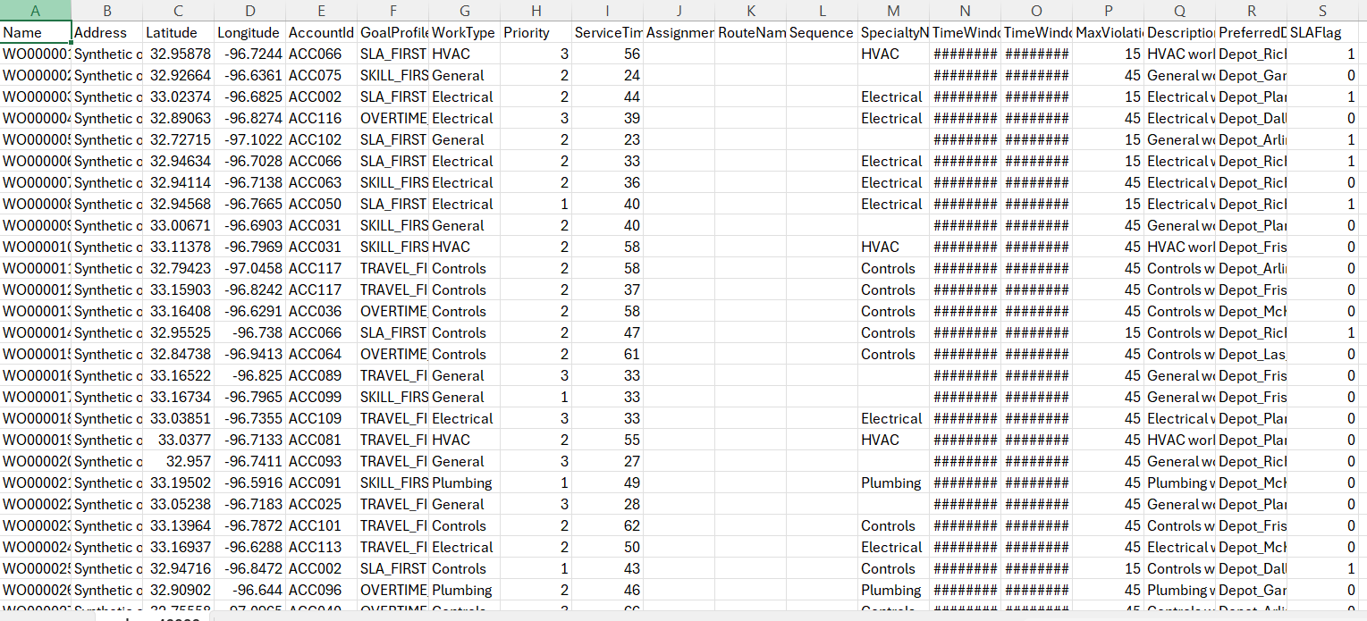
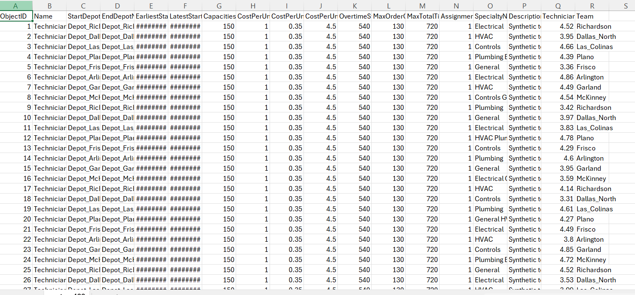
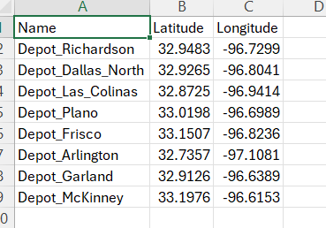
What the PoC prototype is doing
All open work orders and available technicians are solved first as the nightly reference routes, then re-solved after the 16 requirement triggers.
Business objective
Work Orders
Daily timeline (nightly baseline → live updates)
Show how technician routes change when operating conditions shift across execution-aware, real-time, and goal-based scheduling.
T0
Base reference scenario
Core input files
T1
EAS 1 Start variance
orders_40000.csv = work orders
routes_400.csv = technicians, shifts, capacities
depots_8.csv = depot locations
accounts / goal_profiles = business priorities
T2
EAS 2 Finish variance
T3
EAS 3 Skipped stop
T4
EAS 4 Auto re-plan
T5
RT 1 Urgent activity
T6
RT 2 Cancellation
What the prototype now does
T7
RT 3 Duration change
Builds a visual impacted subset, re-solves after targeted event changes, and presents every scenario as a map-plus-card slide that stays fully editable in PowerPoint.
Routes
Depots
T8
RT 4 Shift change
T9
RT 5 Location hours
T10
RT 6 Technician sick
T11
RT 7 Combined live flow
Scenario scope
4 execution-aware
7 real-time
5 goal-based
T12
GB 1 Travel first
T13
GB 2 Quality / specialty
T14
GB 3 SLA first
T15
GB 4 Reduce overtime
T16
GB 5 Customer weights
Notes:
[Sources] - User-uploaded sample screenshot reference: /mnt/data/4c522194-a4c1-4e94-a48b-ebacd32fdfea.png - Daily timeline updated to cover T0 through T16, matching the 16 requirement scenarios.

Slide 3
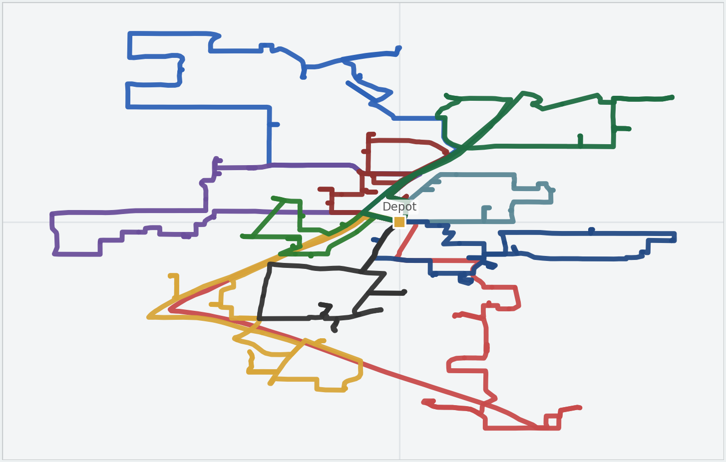
Summary of the PoC input data and workflow
The same sample-deck narrative is kept, but the underlying demonstration universe is now the 40k / 400 synthetic model.
orders_40000.csv
Representative GIS input map
40,000 work orders
customer / location / timing / SLA fields
routes_400.csv
400 technicians
shift windows, capacities, overtime, specialties
depots_8.csv
8 depots
regional start / end anchors for the routes
accounts + goal_profiles
customer-level weighting
travel, SLA, rating, and overtime
Workflow from data to scenario maps
Reference subset used for the demo narrative
90 work orders · 15 routes · 1 depot
Orders, route geometries, and highlighted events are exported from the original notebook maps and reused directly in the deck.
1. Load and validate the full-scale CSV inputs.
2. Build a map-friendly impacted subset from the 40k / 400 universe.
3. Convert tables to ArcGIS features and solve the reference VRP.
4. Re-run the solve after each targeted event or goal-weight change.
5. Present every requirement in the same screenshot-style card layout.
Notes:
[Sources] - User-uploaded original base map HTML: /mnt/data/base_map(1).html or /mnt/data/base_map.html - Input-data summary uses the uploaded CSV filenames and the sample deck workflow narrative.

Slide 4
Baseline reference
Reference plan used as the comparison point for the 16 Sid requirement scenarios.
Original scenario map
Base scenario
15 active routes
90 served orders
Input changed
Routing effect
Status
None
Reference plan
Observed
What changed in the notebook
Nothing was modified. The notebook loads the full-scale synthetic inputs, builds the impacted visualization subset, and solves the base VRP before any requirement event is triggered.
Observed output / interpretation
This reference subset becomes the benchmark for all later comparisons. It keeps the map readable while still representing the larger 40,000 work-order universe.
Reference subset snapshot used as the comparison point.
Metric | Base | Now | Note
Routes | 15 | 15 | subset
Orders | 90 | 90 | served
Stops | 110 | 110 | measured
Reference subset ready for comparison across all later scenarios.
Metric | Base | Now | Note
Universe | n/a | 40k / 400 | source
Subset | n/a | 90 / 15 | demo
Status | n/a | Baseline | T0
Baseline reference
Notes:
[Sources] - User-uploaded sample deck: /mnt/data/Execution Aware ArcGIS VRP PoC v1.0 (2)(3).pptx - User-uploaded original map HTML rendered for this slide: /mnt/data/base_map(1).html or /mnt/data/base_map.html - Slide card content derived from the validated notebook scenario logic.

Slide 5
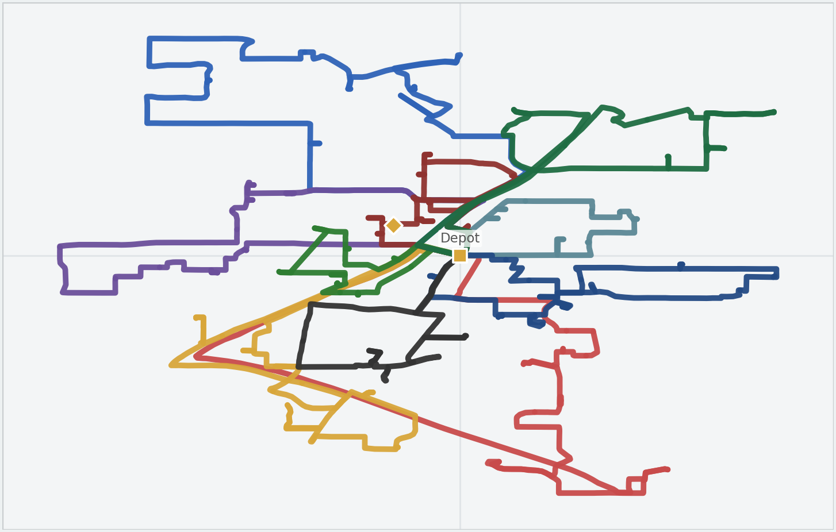
Jobs starting earlier or later than planned
Notebook walkthrough using the original map output for EAS 1.
Original scenario map
Scenario 1 - Start variance
Technician start shifted
+20 min
Input changed
Routing effect
Status
Routes
Timing shift
Observed
What changed in the notebook
Adjust the impacted technician's EarliestStartTime and LatestStartTime by the live variance, then re-solve the impacted subset.
Observed output / interpretation
The subset can keep the same coverage while the impacted route starts later. This is the execution-aware equivalent of the sample traffic-delay slide.
Reference subset snapshot used as the comparison point.
Metric | Base | Now | Note
Routes | 15 | 15 | subset
Orders | 90 | 90 | served
Stops | 110 | 110 | measured
Impacted technician shifts later while subset coverage stays stable.
Metric | Base | Now | Note
Route start | 07:00 | 07:20 | +20 min
Routes | 15 | 15 | stable
Orders | 90 | 90 | served
Jobs starting earlier or later than planned
Notes:
[Sources] - User-uploaded sample deck: /mnt/data/Execution Aware ArcGIS VRP PoC v1.0 (2)(3).pptx - User-uploaded original map HTML rendered for this slide: /mnt/data/eas1_map(1).html or /mnt/data/eas1_map.html - Slide card content derived from the validated notebook scenario logic.

Slide 6
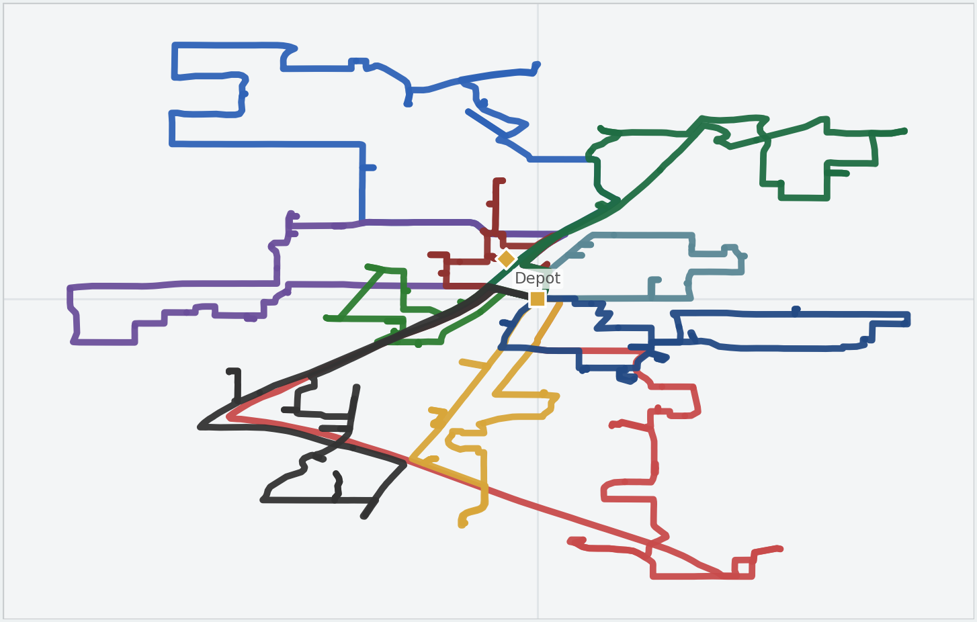
Jobs finishing earlier or later
Notebook walkthrough using the original map output for EAS 2.
Original scenario map
Scenario 2 - Finish variance
Service duration changed
+25 min
Input changed
Routing effect
Status
Orders
Downstream timing
Configured
What changed in the notebook
Update the active order's ServiceTime using the finish variance and re-solve the impacted subset so downstream activities reflect the new duration.
Observed output / interpretation
The key business effect is compression or expansion of downstream slack around the changed stop, not a full-universe re-plan.
Reference subset snapshot used as the comparison point.
Metric | Base | Now | Note
Routes | 15 | 15 | subset
Orders | 90 | 90 | served
Stops | 110 | 110 | measured
Finish variance changes local slack around the impacted order.
Metric | Base | Now | Note
ServiceTime | 30 min | 55 min | example
Routes | 15 | 15 | stable
Orders | 90 | 90 | served
Jobs finishing earlier or later
Notes:
[Sources] - User-uploaded sample deck: /mnt/data/Execution Aware ArcGIS VRP PoC v1.0 (2)(3).pptx - User-uploaded original map HTML rendered for this slide: /mnt/data/eas2_map(1).html or /mnt/data/eas2_map.html - Slide card content derived from the validated notebook scenario logic.

Slide 7
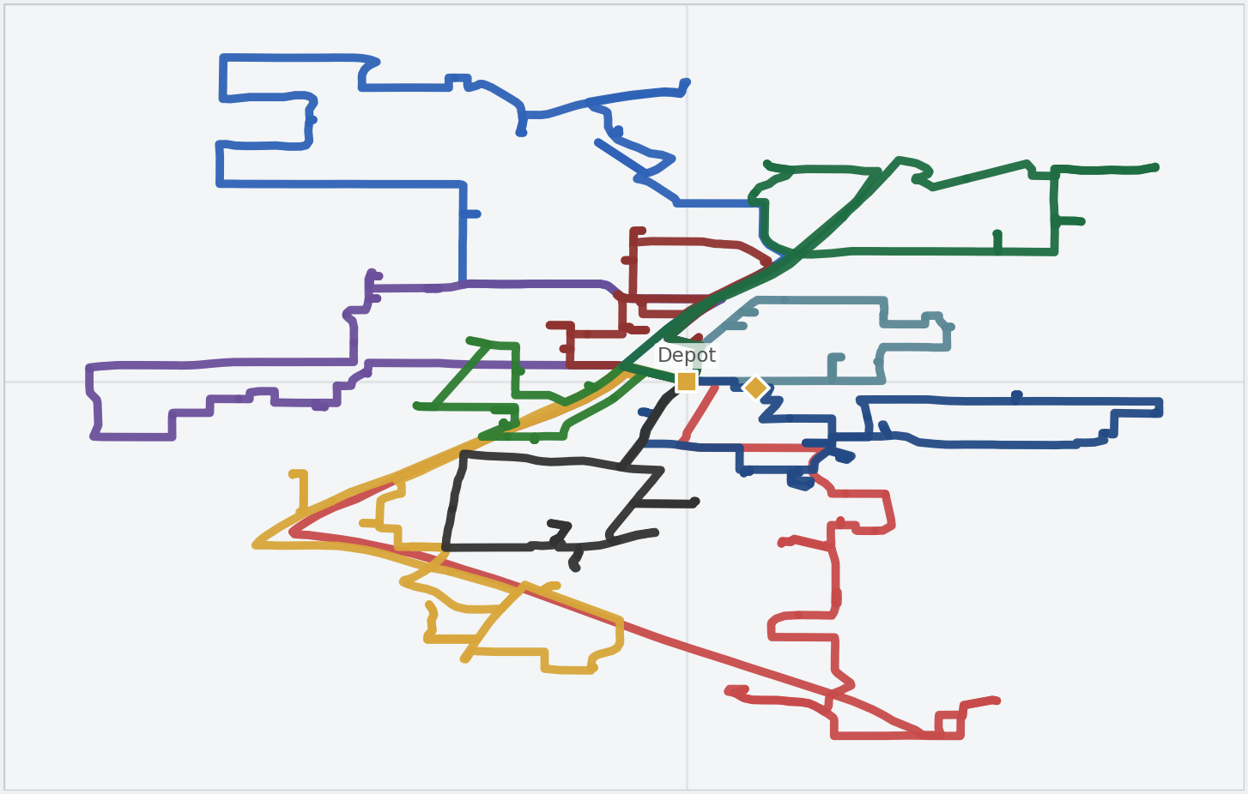
Technicians skipping scheduled job order
Notebook walkthrough using the original map output for EAS 3.
Original scenario map
Scenario 3 - Skipped stop
Skipped stop reinserted
Priority raised
Input changed
Routing effect
Status
Orders
Sequence repair
Configured
What changed in the notebook
Clear any sequence bias for the skipped job, elevate its operational priority, and let re-optimization place it back into the best feasible route sequence.
Observed output / interpretation
The order stays in the problem, but the old sequence is no longer trusted. This is the right execution-aware response to a skipped stop.
Reference subset snapshot used as the comparison point.
Metric | Base | Now | Note
Routes | 15 | 15 | subset
Orders | 90 | 90 | served
Stops | 110 | 110 | measured
Skipped work is reinserted for repair instead of being silently dropped.
Metric | Base | Now | Note
Skipped order | fixed seq. | free | repair
Priority | normal | high | elevated
Coverage | 90 | 90 | served
Technicians skipping scheduled job order
Notes:
[Sources] - User-uploaded sample deck: /mnt/data/Execution Aware ArcGIS VRP PoC v1.0 (2)(3).pptx - User-uploaded original map HTML rendered for this slide: /mnt/data/eas3_map(1).html or /mnt/data/eas3_map.html - Slide card content derived from the validated notebook scenario logic.

Slide 8
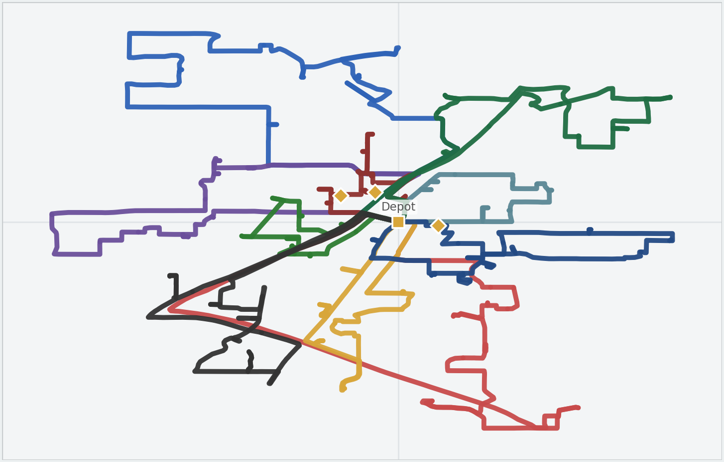
Automatically re-optimize downstream activities
Notebook walkthrough using the original map output for EAS 4.
Original scenario map
Scenario 4 - Auto re-plan
3 live signals combined
1 rolling solve
Input changed
Routing effect
Status
Orders + routes
Combined replan
Configured
What changed in the notebook
Queue the start variance, finish variance, and skipped-job signals together, then run one impacted-subset re-solve so downstream assignments refresh in one pass.
Observed output / interpretation
This is the end-state execution-aware design Sid asked for: automatic downstream repair instead of one-off manual comparison slides.
Reference subset snapshot used as the comparison point.
Metric | Base | Now | Note
Routes | 15 | 15 | subset
Orders | 90 | 90 | served
Stops | 110 | 110 | measured
Automatic downstream repair combines multiple execution signals in one pass.
Metric | Base | Now | Note
Signals | 1 | 3 | combined
Solve mode | manual | rolling | auto
Subset | stable | stable | impacted
Automatically re-optimize downstream activities
Notes:
[Sources] - User-uploaded sample deck: /mnt/data/Execution Aware ArcGIS VRP PoC v1.0 (2)(3).pptx - User-uploaded original map HTML rendered for this slide: /mnt/data/eas4_map(1).html or /mnt/data/eas4_map.html - Slide card content derived from the validated notebook scenario logic.

Slide 9
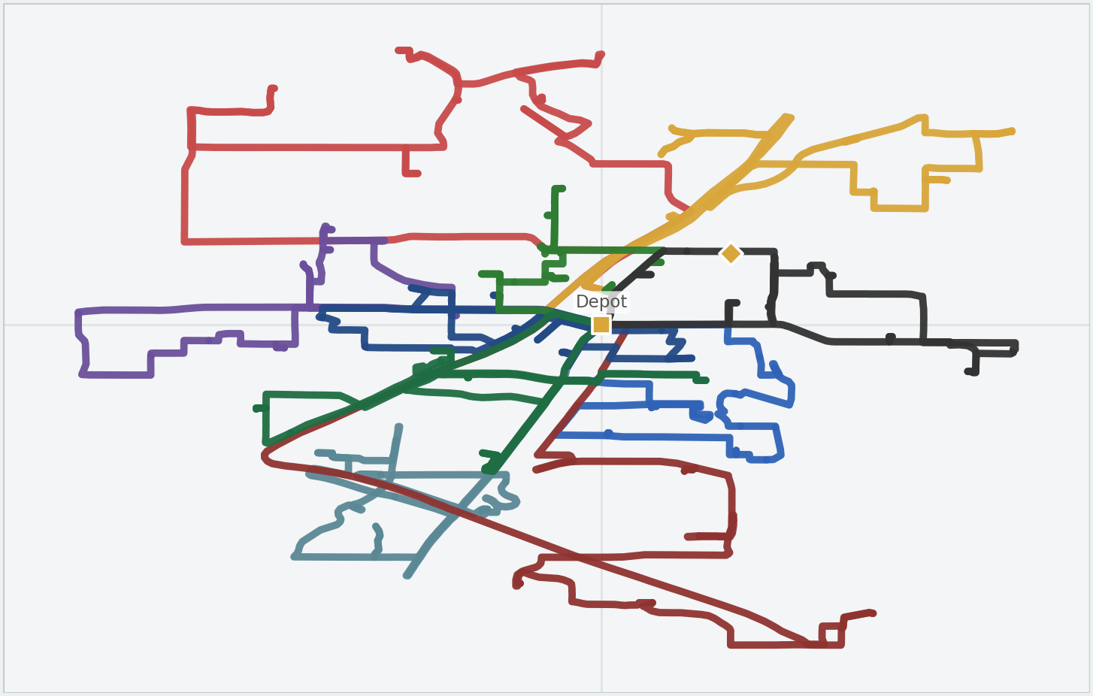
New or urgent activities
Notebook walkthrough using the original map output for RT 1.
Original scenario map
Scenario 5 - Urgent activity
Urgent job inserted
+1 order
Input changed
Routing effect
Status
Orders
Fast insertion
Observed
What changed in the notebook
Add a new high-priority order with a tight time window, specialty, preferred depot, and SLA-first profile, then re-solve the impacted subset.
Observed output / interpretation
The urgent job enters the schedule without a full 40k global re-solve. That is the core real-time behavior Sid wanted.
Reference subset snapshot used as the comparison point.
Metric | Base | Now | Note
Routes | 15 | 15 | subset
Orders | 90 | 90 | served
Stops | 110 | 110 | measured
Urgent activity is absorbed quickly while route count stays stable.
Metric | Base | Now | Note
Orders | 90 | 91 | served
Routes | 15 | 15 | active
Urgent WO | none | inserted | tight TW
New or urgent activities
Notes:
[Sources] - User-uploaded sample deck: /mnt/data/Execution Aware ArcGIS VRP PoC v1.0 (2)(3).pptx - User-uploaded original map HTML rendered for this slide: /mnt/data/rt1_map(1).html or /mnt/data/rt1_map.html - Slide card content derived from the validated notebook scenario logic.

Slide 10
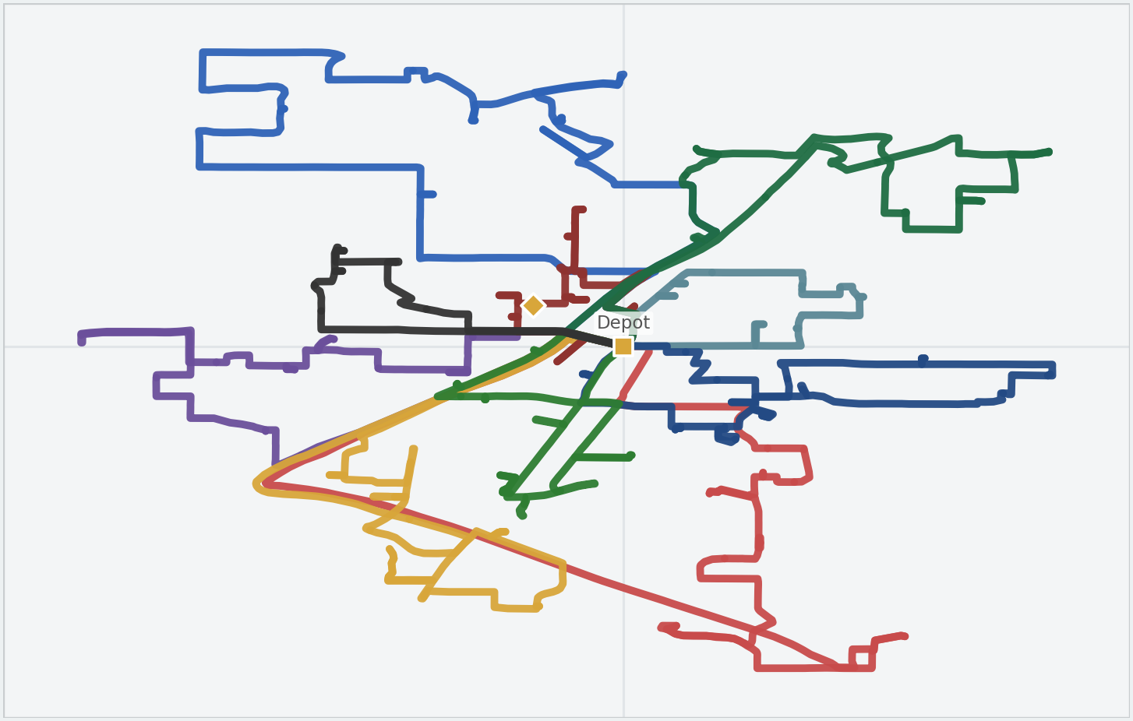
Cancellations
Notebook walkthrough using the original map output for RT 2.
Original scenario map
Scenario 6 - Cancellation
1 order removed
Demand reduced
Input changed
Routing effect
Status
Orders
Demand reduction
Observed
What changed in the notebook
Remove the cancelled order from orders_df and re-solve the impacted subset so route time and sequence compress around the updated demand.
Observed output / interpretation
Capacity is released immediately and the remaining work can rebalance. This mirrors the sample cancellation slide, but at the synthetic-universe scale.
Reference subset snapshot used as the comparison point.
Metric | Base | Now | Note
Routes | 15 | 15 | subset
Orders | 90 | 90 | served
Stops | 110 | 110 | measured
Cancellation frees capacity and reduces served demand in the subset.
Metric | Base | Now | Note
Orders | 90 | 89 | served
Routes | 15 | 15 | active
Cancelled | 0 | 1 | removed
Cancellations
Notes:
[Sources] - User-uploaded sample deck: /mnt/data/Execution Aware ArcGIS VRP PoC v1.0 (2)(3).pptx - User-uploaded original map HTML rendered for this slide: /mnt/data/rt2_map(1).html or /mnt/data/rt2_map.html - Slide card content derived from the validated notebook scenario logic.

Slide 11
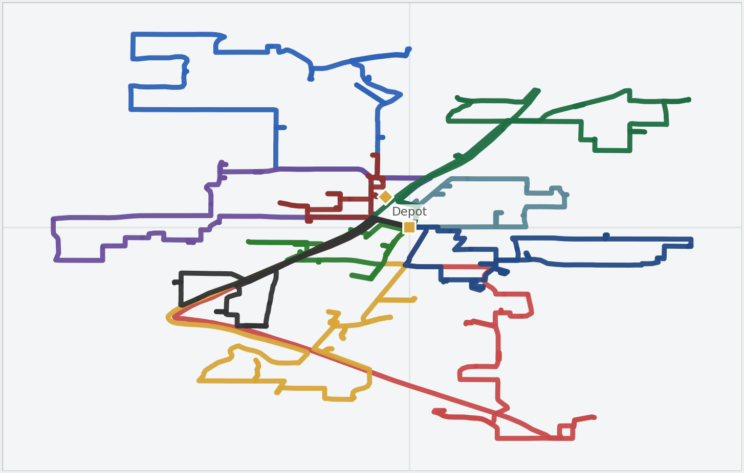
Duration changes
Notebook walkthrough using the original map output for RT 3.
Original scenario map
Scenario 7 - Duration change
Activity duration updated
95 min example
Input changed
Routing effect
Status
Orders
Local timing shift
Configured
What changed in the notebook
Update the affected order's ServiceTime and re-solve the impacted subset to rebalance timing around the changed stop.
Observed output / interpretation
Only the relevant order needs to change. The route timing around that location expands or contracts accordingly.
Reference subset snapshot used as the comparison point.
Metric | Base | Now | Note
Routes | 15 | 15 | subset
Orders | 90 | 90 | served
Stops | 110 | 110 | measured
A local duration edit changes nearby timing without a full-universe rebuild.
Metric | Base | Now | Note
ServiceTime | 30 min | 95 min | edited
Routes | 15 | 15 | stable
Orders | 90 | 90 | served
Duration changes
Notes:
[Sources] - User-uploaded sample deck: /mnt/data/Execution Aware ArcGIS VRP PoC v1.0 (2)(3).pptx - User-uploaded original map HTML rendered for this slide: /mnt/data/rt3_map(1).html or /mnt/data/rt3_map.html - Slide card content derived from the validated notebook scenario logic.

Slide 12
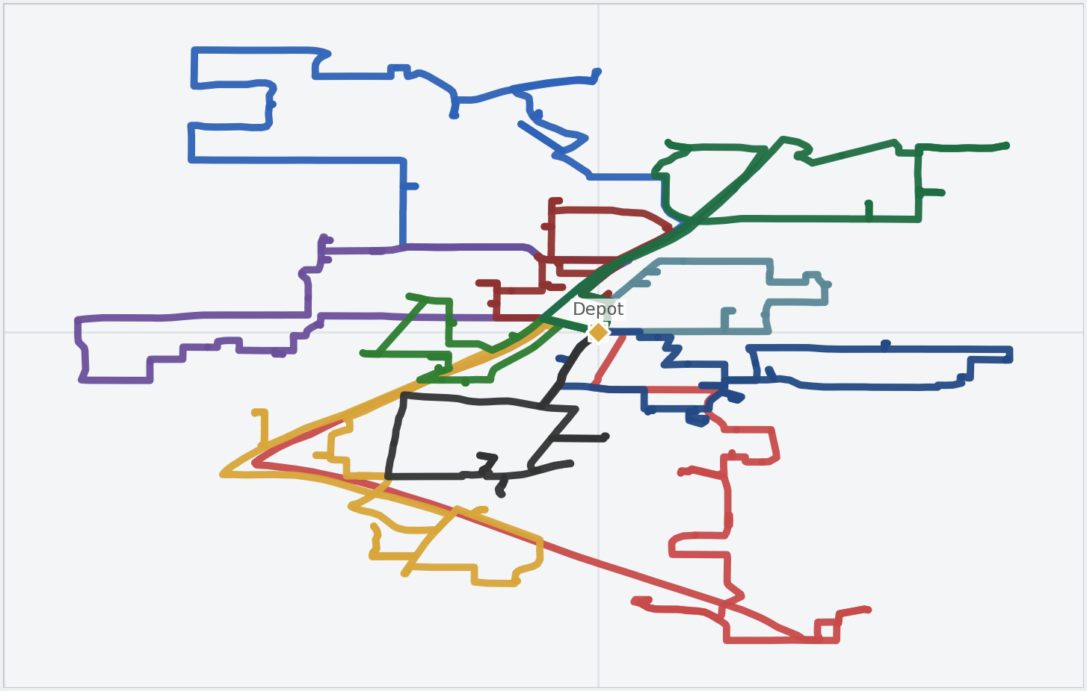
Technician availability or shift changes
Notebook walkthrough using the original map output for RT 4.
Original scenario map
Scenario 8 - Shift change
Shift window changed
+30 / +45
Input changed
Routing effect
Status
Routes
Capacity rebalance
Configured
What changed in the notebook
Shift the technician's start and end window and re-solve the impacted subset so work can move away from the constrained route if required.
Observed output / interpretation
This is more nuanced than removing a route entirely. The technician still exists, but their usable capacity changes in real time.
Reference subset snapshot used as the comparison point.
Metric | Base | Now | Note
Routes | 15 | 15 | subset
Orders | 90 | 90 | served
Stops | 110 | 110 | measured
Shift edits keep the technician in the model while changing usable capacity.
Metric | Base | Now | Note
Start shift | 07:00 | 07:30 | later
End shift | 16:00 | 16:45 | later
Rebalance | none | possible | subset
Technician availability or shift changes
Notes:
[Sources] - User-uploaded sample deck: /mnt/data/Execution Aware ArcGIS VRP PoC v1.0 (2)(3).pptx - User-uploaded original map HTML rendered for this slide: /mnt/data/rt4_map(1).html or /mnt/data/rt4_map.html - Slide card content derived from the validated notebook scenario logic.

Slide 13
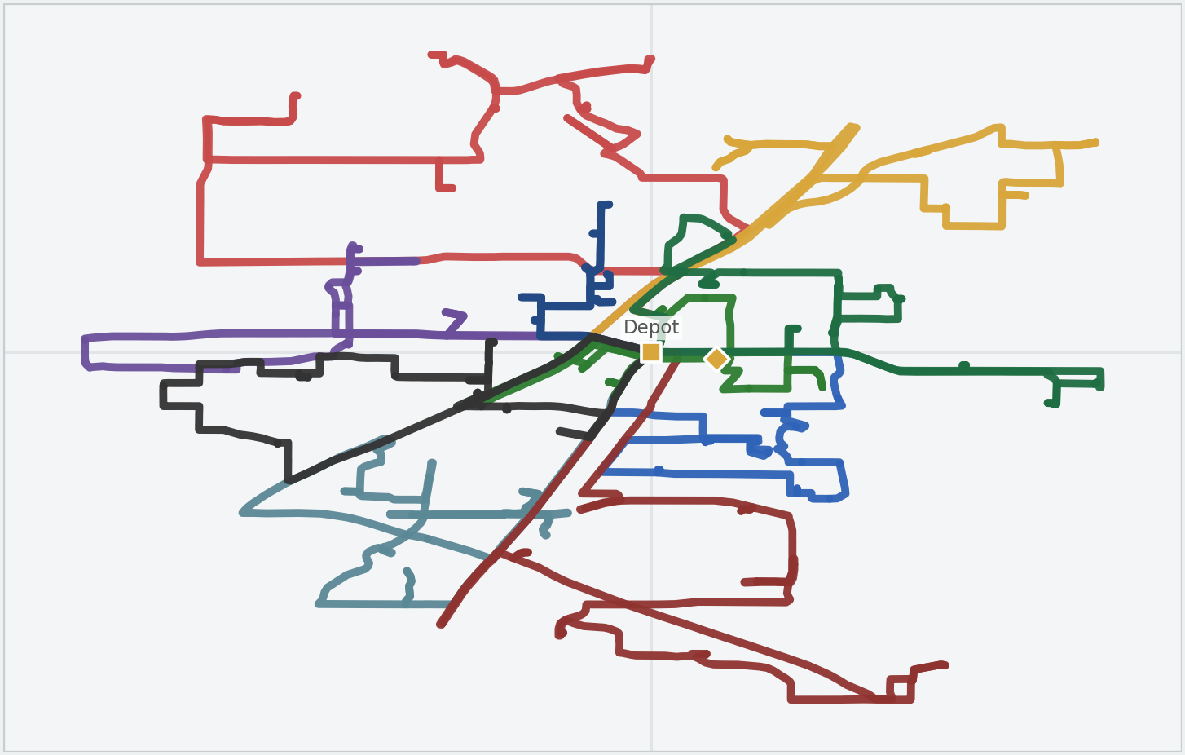
Location hours changes
Notebook walkthrough using the original map output for RT 5.
Original scenario map
Scenario 9 - Location hours
Time window tightened
04:00-08:00
Input changed
Routing effect
Status
Orders
Window constraint
Configured
What changed in the notebook
Edit the order's time window and re-solve the impacted subset using the updated customer-availability constraint.
Observed output / interpretation
This shows that real-time scheduling is not only about technician status; customer-side availability can also force route resequencing or reassignment.
Reference subset snapshot used as the comparison point.
Metric | Base | Now | Note
Routes | 15 | 15 | subset
Orders | 90 | 90 | served
Stops | 110 | 110 | measured
Customer-side availability changes can force automatic resequencing.
Metric | Base | Now | Note
TW start | open | 04:00 | edited
TW end | open | 08:00 | edited
Effect | none | reseq. | window
Location hours changes
Notes:
[Sources] - User-uploaded sample deck: /mnt/data/Execution Aware ArcGIS VRP PoC v1.0 (2)(3).pptx - User-uploaded original map HTML rendered for this slide: /mnt/data/rt5_map(1).html or /mnt/data/rt5_map.html - Slide card content derived from the validated notebook scenario logic.

Slide 14

Technician calls in sick
Notebook walkthrough using the original map output for RT 6.
Original scenario map
Scenario 10 - Tech sick
1 technician removed
Fleet reduced
Input changed
Routing effect
Status
Routes
Fleet reduction
Configured
What changed in the notebook
Drop the unavailable route from routes_df and re-solve the impacted subset using the reduced fleet.
Observed output / interpretation
This is the highest-disruption real-time scenario. The business view is either rebalanced coverage across the remaining routes or a partial solution when the subset is too constrained.
Reference subset snapshot used as the comparison point.
Metric | Base | Now | Note
Routes | 15 | 15 | subset
Orders | 90 | 90 | served
Stops | 110 | 110 | measured
One less route increases disruption and can expose unrouted work.
Metric | Base | Now | Note
Routes | 15 | 14 | active
Coverage | 90 | partial | possible
Impact | normal | high | severe
Technician calls in sick
Notes:
[Sources] - User-uploaded sample deck: /mnt/data/Execution Aware ArcGIS VRP PoC v1.0 (2)(3).pptx - User-uploaded original map HTML rendered for this slide: /mnt/data/rt6_map(1).html or /mnt/data/rt6_map.html - Slide card content derived from the validated notebook scenario logic.

Slide 15
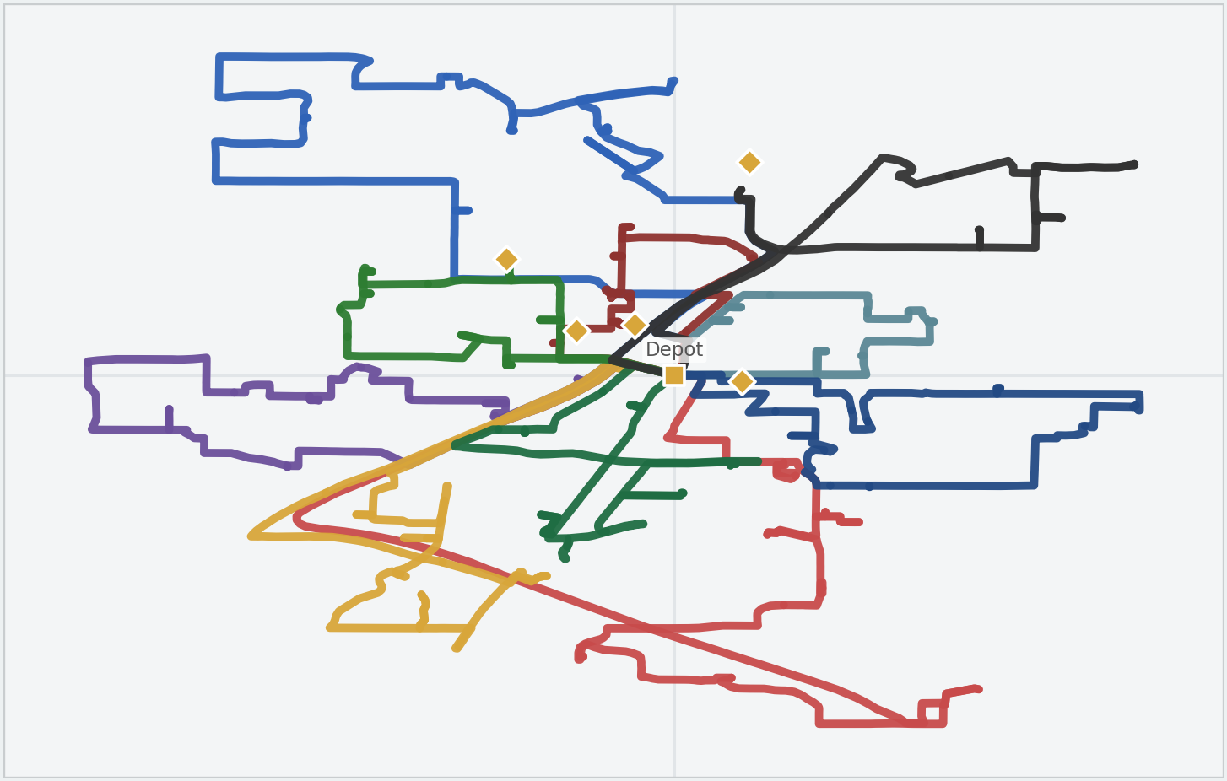
All EAS scenarios included in real-time flow
Notebook walkthrough using the original map output for RT 7.
Original scenario map
Scenario 11 - Combined flow
8 triggers combined
1 rolling solve
Input changed
Routing effect
Status
Event queue
Rolling replan
Configured
What changed in the notebook
Create one event list containing execution-aware and real-time triggers, then run a single impacted-subset re-optimization.
Observed output / interpretation
This is the end-state story for Sid: one near-real-time event pipeline, one impacted-subset solve, and one continuously updated route picture.
Reference subset snapshot used as the comparison point.
Metric | Base | Now | Note
Routes | 15 | 15 | subset
Orders | 90 | 90 | served
Stops | 110 | 110 | measured
A single rolling pipeline orchestrates all live event classes together.
Metric | Base | Now | Note
Event types | 1 | 8 | combined
Solve mode | manual | rolling | live
Subset | reference | impacted | updated
All EAS scenarios included in real-time flow
Notes:
[Sources] - User-uploaded sample deck: /mnt/data/Execution Aware ArcGIS VRP PoC v1.0 (2)(3).pptx - User-uploaded original map HTML rendered for this slide: /mnt/data/rt7_map(1).html or /mnt/data/rt7_map.html - Slide card content derived from the validated notebook scenario logic.

Slide 16
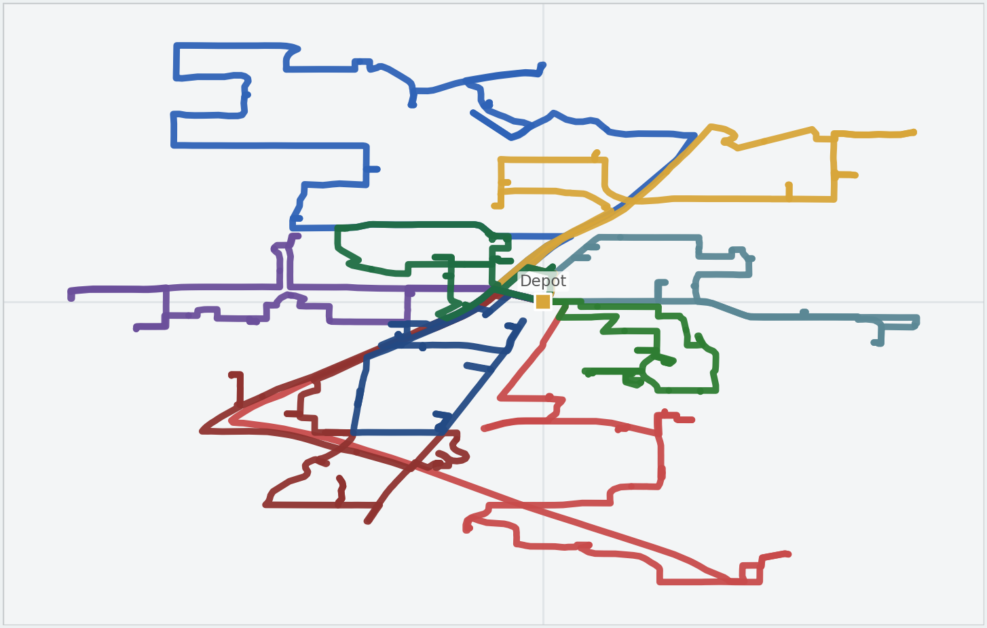
Minimize travel time
Notebook walkthrough using the original map output for GB 1.
Original scenario map
Scenario 12 - Travel first
Travel weighted highest
Goal profile
Input changed
Routing effect
Status
Goal weights
Travel minimization
Configured
What changed in the notebook
Increase the travel-time weight in the route cost structure so the solver prefers more compact route patterns when multiple solutions are feasible.
Observed output / interpretation
This is the cleanest goal-based benchmark: if travel is weighted highest, the route layout should become more geographically compact.
Reference subset snapshot used as the comparison point.
Metric | Base | Now | Note
Routes | 15 | 15 | subset
Orders | 90 | 90 | served
Stops | 110 | 110 | measured
The optimization target explicitly favors shorter travel and tighter clusters.
Metric | Base | Now | Note
Travel weight | base | high | goal
Pattern | neutral | compact | expected
Coverage | 90 | 90 | served
Minimize travel time
Notes:
[Sources] - User-uploaded sample deck: /mnt/data/Execution Aware ArcGIS VRP PoC v1.0 (2)(3).pptx - User-uploaded original map HTML rendered for this slide: /mnt/data/gb1_map(1).html or /mnt/data/gb1_map.html - Slide card content derived from the validated notebook scenario logic.

Slide 17
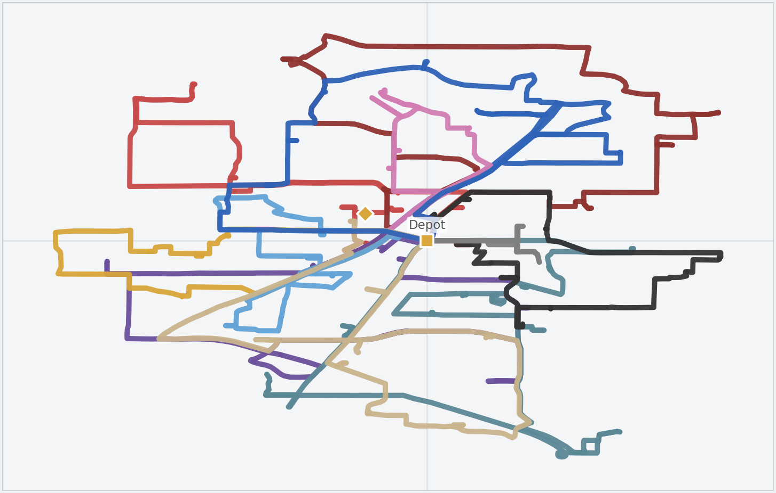
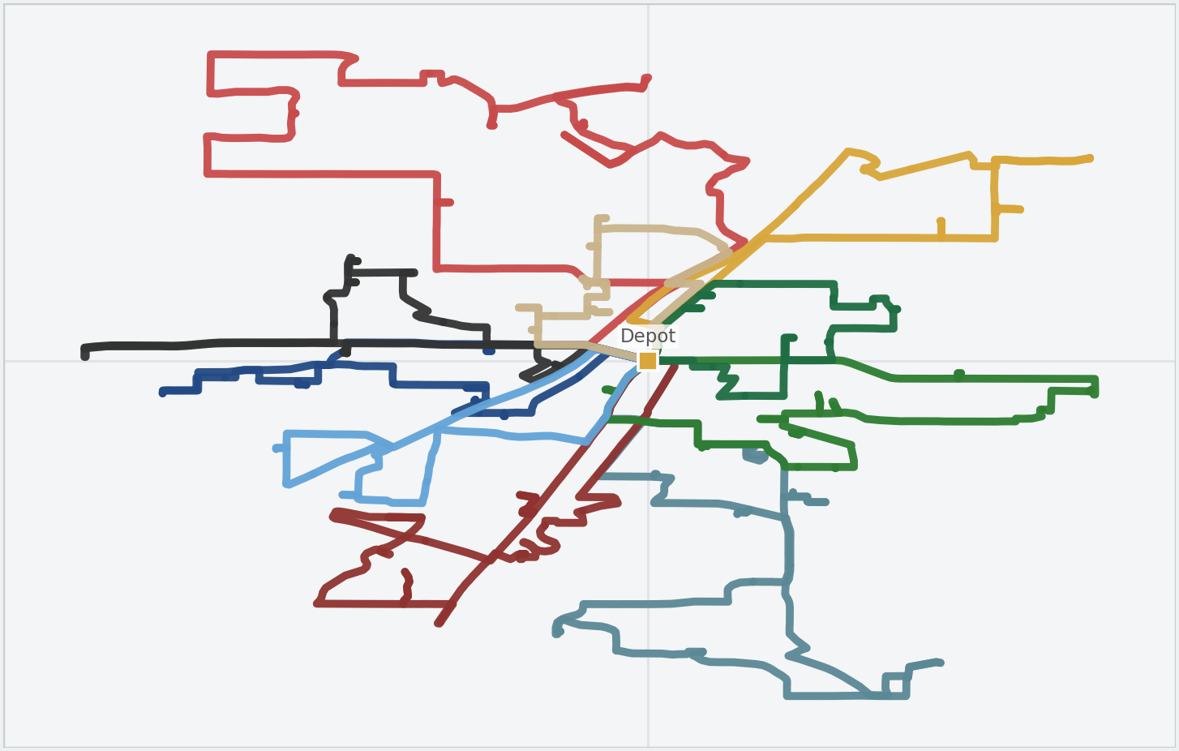
Prefer higher-rated or specialized technicians
Notebook walkthrough using the original map output for GB 2.
Original scenario map
Scenario 13 - Quality / specialty
Technician bias added
Skill matched
Input changed
Routing effect
Status
Weights + skills
Skill-based bias
Configured
What changed in the notebook
Blend technician-rating bias with specialty constraints so premium or typed work is steered toward the technicians best matched to deliver it.
Observed output / interpretation
This single business requirement is represented by two notebook patterns: one for higher-rated assignment bias and one for specialty-constrained assignment.
Reference subset snapshot used as the comparison point.
Metric | Base | Now | Note
Routes | 15 | 15 | subset
Orders | 90 | 90 | served
Stops | 110 | 110 | measured
Specialty view
Quality and specialty preferences make the route plan more technician-aware.
Metric | Base | Now | Note
Rating bias | off | on | weighted
Specialty | soft | matched | typed
Coverage | 90 | 90 | served
Prefer higher-rated or specialized technicians
Notes:
[Sources] - User-uploaded sample deck: /mnt/data/Execution Aware ArcGIS VRP PoC v1.0 (2)(3).pptx - User-uploaded original map HTML rendered for this slide: /mnt/data/gb2_map(1).html or /mnt/data/gb2_map.html - User-uploaded additional original map HTML inset: /mnt/data/gb3_map(1).html or /mnt/data/gb3_map.html

Slide 18
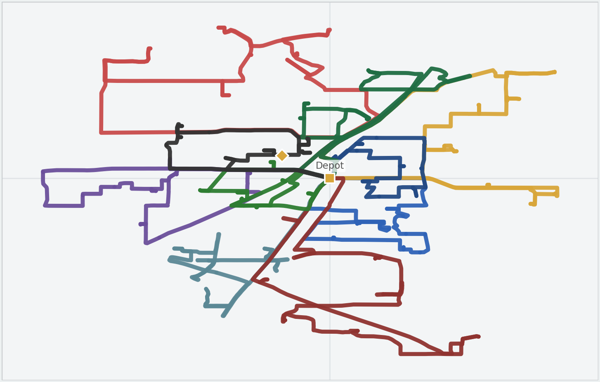
Maximize on-time completion / SLA adherence
Notebook walkthrough using the original map output for GB 3.
Original scenario map
Scenario 14 - SLA first
SLA-sensitive work protected
Violation tightened
Input changed
Routing effect
Status
Weights + SLA
Priority to SLA
Configured
What changed in the notebook
Apply account goal profiles, tighten time-window violation tolerance for SLA-sensitive orders, and re-solve so these jobs are protected first.
Observed output / interpretation
This is the clearest enterprise-value story: optimal is not always the shortest route; sometimes it is the route that protects SLA commitments first.
Reference subset snapshot used as the comparison point.
Metric | Base | Now | Note
Routes | 15 | 15 | subset
Orders | 90 | 90 | served
Stops | 110 | 110 | measured
SLA adherence becomes the dominant optimization target for sensitive work.
Metric | Base | Now | Note
SLA list | none | targeted | orders
Violation | base | tight | tolerance
Goal | neutral | SLA first | weighted
Maximize on-time completion / SLA adherence
Notes:
[Sources] - User-uploaded sample deck: /mnt/data/Execution Aware ArcGIS VRP PoC v1.0 (2)(3).pptx - User-uploaded original map HTML rendered for this slide: /mnt/data/gb4_map(1).html or /mnt/data/gb4_map.html - Slide card content derived from the validated notebook scenario logic.

Slide 19
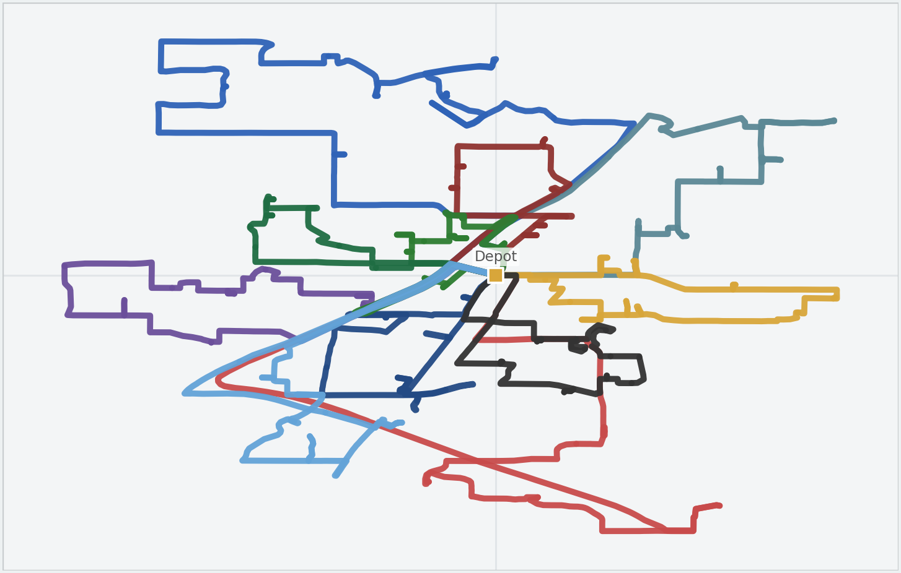
Reduce overtime
Notebook walkthrough using the original map output for GB 4.
Original scenario map
Scenario 15 - Reduce overtime
Overtime penalty raised
Regular time first
Input changed
Routing effect
Status
Route cost
Lower OT usage
Configured
What changed in the notebook
Raise the overtime penalty and move the overtime threshold earlier so the solver uses regular-time capacity first whenever it can.
Observed output / interpretation
The expected route behavior is more balanced regular-time utilization, with overtime becoming a deliberate exception instead of the default outcome.
Reference subset snapshot used as the comparison point.
Metric | Base | Now | Note
Routes | 15 | 15 | subset
Orders | 90 | 90 | served
Stops | 110 | 110 | measured
Overtime becomes a penalized exception instead of the default operating mode.
Metric | Base | Now | Note
OT threshold | base | earlier | edited
OT penalty | base | high | weighted
Effect | neutral | lower OT | expected
Reduce overtime
Notes:
[Sources] - User-uploaded sample deck: /mnt/data/Execution Aware ArcGIS VRP PoC v1.0 (2)(3).pptx - User-uploaded original map HTML rendered for this slide: /mnt/data/gb5_map(1).html or /mnt/data/gb5_map.html - Slide card content derived from the validated notebook scenario logic.

Slide 20
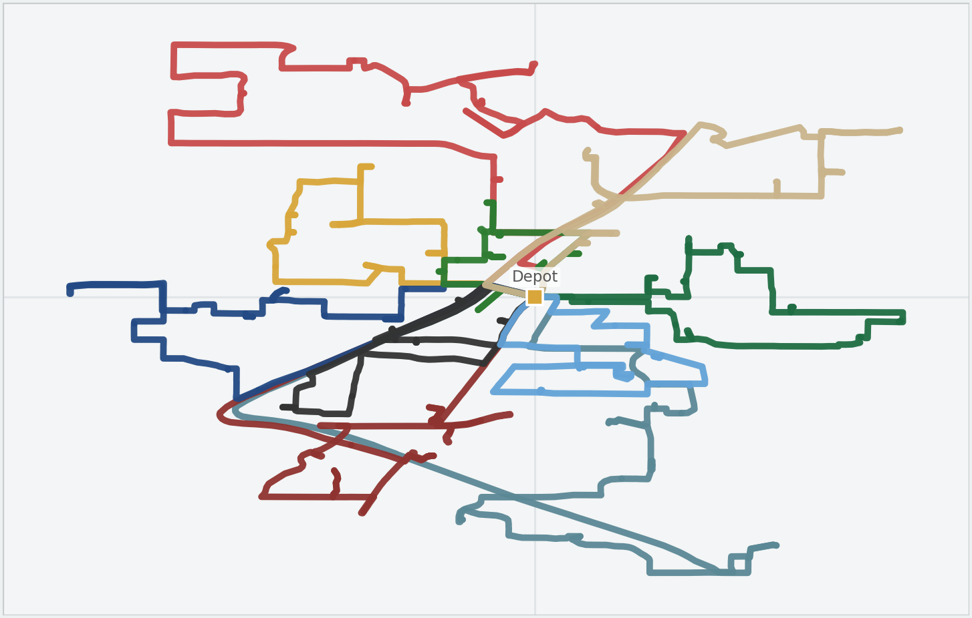
Customer-defined soft-constraint weights
Notebook walkthrough using the original map output for GB 5.
Original scenario map
Scenario 16 - Customer weights
Account profile applied
Custom optimum
Input changed
Routing effect
Status
Account profiles
Customer-specific optimum
Configured
What changed in the notebook
Apply account-level goal profiles and a blended customer weight set across travel, rating, SLA adherence, and overtime, then solve to that customer-specific policy.
Observed output / interpretation
This turns the VRP engine into a configurable optimization service rather than a single hard-coded routing policy.
Reference subset snapshot used as the comparison point.
Metric | Base | Now | Note
Routes | 15 | 15 | subset
Orders | 90 | 90 | served
Stops | 110 | 110 | measured
Each customer can define its own notion of optimal through weighted soft constraints.
Metric | Base | Now | Note
Travel | base | weighted | profile
SLA / rating | base | weighted | profile
Overtime | base | weighted | profile
Customer-defined soft-constraint weights
Notes:
[Sources] - User-uploaded sample deck: /mnt/data/Execution Aware ArcGIS VRP PoC v1.0 (2)(3).pptx - User-uploaded original map HTML rendered for this slide: /mnt/data/gb6_map(1).html or /mnt/data/gb6_map.html - Slide card content derived from the validated notebook scenario logic.

Slide 21
Summary - Base plan vs all 16 scenarios (1/2)
Visual summary of how each scenario affects route timing, service coverage, and business impact.
1. Start variance
2. Finish variance
Biggest timing shift
Biggest demand change
Most workflow change
Routes | Served | Key
15 | 90 | 07:20
Routes | Served | Key
15 | 90 | 55 min
Start variance
(+20 min)
Urgent +1 /
Cancel -1
Auto re-plan
(3 signals)
Detailed comparison
Scenario | What changed vs Base | Routes | Served / Stops | Impacted timing | Operational impact
Start variance | Tech delayed +20 min | 15 | 90 / 110 | 07:20 start | Coverage stable
Finish variance | Service time +25 min | 15 | 90 / 110 | Local slack | Downstream adjusts
Skipped stop | Skipped job reinserted | 15 | 90 / 110 | Seq repair | Missed work retained
Auto re-plan | 3 live signals combined | 15 | 90 / 110 | Rolling repair | Auto downstream update
Urgent activity | Urgent order inserted | 15 | 91 / 111 | Route extends | Urgent work absorbed
Cancellation | 1 active order removed | 15 | 89 / 109 | Route compresses | Capacity rebalanced
Duration change | ServiceTime edited live | 15 | 90 / 110 | Nearby timings | Local resequencing
Shift change | Shift window shifted | 15 | 90 / 110 | Usable capacity | Work can rebalance
3. Skipped stop
4. Auto re-plan
Routes | Served | Key
15 | 90 | Repair
Routes | Served | Key
15 | 90 | 3 signals
5. Urgent activity
6. Cancellation
Routes | Served | Key
15 | 91 | +1 WO
Routes | Served | Key
15 | 89 | -1 WO
Quick comparison to base
Scenario | Comparison to Base | Base subset | Result
Start variance | Same coverage as base | 15 routes / 90 served | Route starts later by 20 min
Finish variance | Same coverage as base | 15 routes / 90 served | Slack expands at impacted stop
Skipped stop | Same coverage | 15 routes / 90 served | Skipped order re-optimized
Auto re-plan | More dynamic | Manual reference subset | One rolling solve refreshes plan
Urgent activity | +1 order vs base | 90 served | Subset absorbs urgent work
Cancellation | -1 order vs base | 90 served | Freed capacity redistributed
Duration change | Same coverage | 15 routes / 90 served | Only local timing changes
Shift change | Route still active | 07:00-16:00 shift | Capacity changes without removal
7. Duration change
8. Shift change
Routes | Served | Key
15 | 90 | 95 min
Routes | Served | Key
15 | 90 | +30/+45
These summary slides keep the same screenshot-style visual pattern as the sample while covering all 16 Sid scenarios.
Notes:
[Sources] - Summary slide content is derived from the corrected 16-scenario editable slide set and the uploaded comparison screenshots.

Slide 22
Summary - Base plan vs all 16 scenarios (2/2)
Visual summary of how each scenario affects route timing, service coverage, and business impact.
9. Location hours
10. Technician sick
Most severe
Most strategic
Highest protection
Routes | Served | Key
15 | 90 | 04-08
Routes | Served | Key
14 | Partial | -1 route
Technician sick
Customer
weights
SLA first
Detailed comparison
Scenario | What changed vs Base | Routes | Served / Stops | Impacted timing | Operational impact
Location hours | Customer window tightened | 15 | 90 / 110 | Window rule | Auto resequencing
Technician sick | 1 tech removed | 14 | Partial | Unrouted risk | Highest disruption
Combined flow | All EAS + RT triggers combined | 15 | 90 / 110 | Rolling replan | Single live flow
Travel first | Travel weight highest | 15 | 90 / 110 | Compact pattern | Drive time minimized
Quality / specialty | Rating bias + skill match | 15 | 90 / 110 | Assignment bias | Best-fit techs favored
SLA first | SLA-sensitive work prioritized | 15 | 90 / 110 | Tighter tolerance | On-time work protected
Reduce overtime | OT penalty raised | 15 | 90 / 110 | Regular time first | Overtime discouraged
Customer weights | Account weights applied | 15 | 90 / 110 | Custom optimum | Each account defines optimal
11. Combined flow
12. Travel first
Routes | Served | Key
15 | 90 | 8 triggers
Routes | Served | Key
15 | 90 | Compact
13. Quality / specialty
14. SLA first
Routes | Served | Key
15 | 90 | Skill fit
Routes | Served | Key
15 | 90 | Protected
Quick comparison to base
15. Reduce overtime
16. Customer weights
Scenario | Comparison to Base | Base subset | Result
Location hours | Customer-side change | Open window | Visit must respect new hours
Technician sick | -1 route | 15 active routes | Remaining fleet may not absorb all work
Combined flow | One pipeline | Reference subset | One pipeline handles all events
Travel first | Target changed | Neutral weighting | Solver favors shorter legs
Quality / specialty | Tech-aware plan | Generic capacity bias | Higher-rated / skilled techs preferred
SLA first | Business goal changed | Travel-balanced plan | SLA commitments dominate choice
Reduce overtime | Cost policy changed | Default OT behavior | Overtime becomes exception
Customer weights | Custom objective | One default policy | VRP becomes configurable service
Routes | Served | Key
15 | 90 | Lower OT
Routes | Served | Key
15 | 90 | Profile
Notes:
[Sources] - Summary slide content is derived from the corrected 16-scenario editable slide set and the uploaded comparison screenshots.

Slide 23
Coverage against Sid's requirements
All 16 explicit requirement rows are now presented with original maps.
Covered
16
Execution-Aware Scheduling
Real-Time Scheduling
Goal-Based Scheduling
☑ Jobs starting earlier or later
☑ Jobs finishing earlier or later
☑ Technicians skipping scheduled job order
☑ Automatically re-optimize downstream activities
☑ New or urgent activities
☑ Cancellations
☑ Duration changes
☑ Technician availability or shift changes
☑ Location hours changes
☑ Technician calls in sick
☑ All EAS scenarios
☑ Minimize travel time
☑ Prefer higher-rated or specialized technicians
☑ Maximize on-time completion / SLA adherence
☑ Reduce overtime
☑ Customer-defined soft-constraint weights
Thank you.
Notes:
[Sources] - Coverage slide updates the sample deck structure from partial coverage to 16/16 requirement-scenario coverage with original maps.

