Slide 1
Reinforcement Learning
& Discriminant Analysis
EXPERT LECTURE · 4 NOVEMBER 2026
From sequential decisions to statistical classification
Anubha Parashar
Notes:
Welcome. Two hours, two subjects that rarely share a stage: reinforcement learning — how machines learn behaviour from consequences — and discriminant analysis — the 1936-vintage classification family that still ships in every statistics library. The pairing is deliberate: one is modern, iterative and data-hungry; the other classical, closed-form and data-frugal. By the end you should be able to derive both. Housekeeping: a 10-minute break at roughly the one-hour mark; questions welcome at section boundaries.

Slide 2
Tonight's route
PART I · ≈ 70 MIN
PART II · ≈ 45 MIN
Reinforcement Learning
LDA & QDA
The agent–environment loop · rewards
Bandits: exploration vs exploitation
MDPs, value functions, Bellman equations
DP → Monte Carlo → TD · SARSA & Q-learning
A gridworld, traced by hand
Deep RL, RLHF, applications, limits
Bayes' rule as the optimal classifier
Gaussian class models
LDA: shared Σ → linear boundaries
QDA: free Σₖ → curved boundaries
Bias–variance · LDA vs logistic regression
Fisher's projection · practice & pitfalls
☕
10-min break between parts · live demos and phone labs throughout · assumed: probability, linear algebra, a little Python
Notes:
Give the map. Part I, about 70 minutes: the agent-environment loop, bandits for the exploration-exploitation dilemma, MDPs and Bellman equations, then the algorithm ladder — DP, Monte Carlo, TD, SARSA, Q-learning — a fully worked gridworld, and the bridge to deep RL and RLHF. Break. Part II, about 45 minutes: Bayes' rule as a classifier, Gaussian class models, LDA and QDA derived properly, the bias-variance choice between them, Fisher's projection view, and where these methods still win in 2026. Set expectations: mathematical but self-contained; probability and linear algebra assumed.

Slide 3
Why these two, together?
Learning to act
Learning to decide
output: a behaviour, unrolled over time
feedback: delayed, evaluative reward
math: fixed-point iteration on expectations
regime: data-hungry, simulation-loving
output: a label, right now
feedback: the correct answer (supervision)
math: closed-form probability and geometry
regime: data-frugal, assumption-powered
Shared skeleton: maximise an expectation · reason with Bayes · know exactly which assumption you are spending
The real lesson: judging where a problem sits between “iterate on oceans of data” and “write down the answer from 200 rows”.
Notes:
Preempt the 'odd couple' question. They bracket the field: RL is learning to ACT — outputs are behaviours, feedback is delayed reward, the mathematics is fixed-point iteration on expectations. LDA/QDA is learning to DECIDE — outputs are labels, feedback is supervision, the mathematics is closed-form probability. Shared skeleton: both maximise an expectation; both lean on Bayes-style reasoning; both reward understanding assumptions. And they fail oppositely: RL needs oceans of interaction, LDA thrives on a few hundred rows. Seeing both in one evening calibrates WHERE on that spectrum any new problem sits. That judgement — not any single formula — is tonight's real deliverable.

Slide 4
Reinforcement Learning
PART I
Agent
state, reward
action
From trial-and-error to optimal control: bandits, Markov decision processes,
Bellman equations, Q-learning — and the road to deep RL
Environment
≈ 70 minutes
Notes:
Part I, about 70 minutes. Frame it: supervised learning learns from answers; RL learns from consequences. We will build the full formal ladder — bandits, MDPs, value functions, Bellman equations — then the algorithms: dynamic programming, Monte Carlo, TD, Q-learning, and a bridge to deep RL and RLHF. Promise the audience one fully worked numeric example in a gridworld.

Slide 5
Learning from interaction, not from labels
PART I · REINFORCEMENT LEARNING
Agent
state Sₜ₊₁
action Aₜ
reward Rₜ₊₁
Environment
Delayed consequences
actions pay off many steps later — credit assignment
The agent shapes its own data
behaviour determines what is observed next
Notes:
RL is the third paradigm of machine learning. No supervisor gives the correct action; the agent acts, the environment responds with a new situation and a scalar reward, and the agent must discover good behaviour by trial and error. Two defining features: delayed consequences (an action pays off much later — credit assignment problem) and the data distribution depends on the agent's own behaviour. Walk the loop diagram slowly: this picture is the whole subject.

Slide 6
Three paradigms of machine learning
PART I · REINFORCEMENT LEARNING
ƒ
◇
⇄
Supervised
Unsupervised
Reinforcement
Learn x → y from labelled pairs
Feedback: the correct answer
i.i.d. data, one-shot prediction
LDA & QDA live here (Part II)
Find structure in unlabelled data
Feedback: none
Clustering, density estimation,
dimensionality reduction
Learn behaviour from interaction
Feedback: scalar reward, delayed
Sequential, non-i.i.d., agent
influences its own data
Instructive vs evaluative feedback: supervision tells you the right action; reward only scores the one you took.
Notes:
Place RL on the map. Supervised: labelled pairs, learn a mapping — LDA this afternoon lives here. Unsupervised: structure without labels. RL: sequential decisions, evaluative feedback. Key contrast: supervised feedback is instructive (here is the right answer); RL feedback is evaluative (here is how good YOUR action was) — the agent never learns what the best action would have been. That single difference creates the exploration problem.

Slide 7
Rewards: one scalar to rule the objective
PART I · REINFORCEMENT LEARNING
“All goals can be described as maximisation of expected cumulative reward.”
the reward hypothesis — Sutton & Barto
♜
Chess / Go
+1 win, −1 loss, 0 otherwise — nothing about moves or style
🦿
Robot locomotion
+ forward velocity, − energy used, − falling over
％
Recommender system
+ engagement / long-term retention, − churn
✓
LLM assistant (RLHF)
reward model score of a human-preferred response
Reward defines what to achieve — never how to achieve it.
Notes:
The reward hypothesis (Sutton): every goal can be expressed as maximisation of expected cumulative scalar reward. Walk the examples. Stress that reward specifies WHAT, never HOW — chess reward is +1 for winning, not for taking pieces. Shaping rewards is tempting and dangerous; we will see reward hacking at the end. The agent maximises the discounted sum, the return, not the instantaneous reward.

Slide 8
Warm-up: the k-armed bandit
PART I · REINFORCEMENT LEARNING
Why bandits first?
Isolates exploration vs exploitation
No states, no transitions — pure estimation while acting
Used daily: A/B tests, ad serving, trial design
?
?
?
arm 1
arm 2
arm 3
q*(1) = 0.3
q*(2) = 1.2 ← best
q*(3) = 0.7
mean unknown
to the agent
mean unknown
to the agent
mean unknown
to the agent
q*(a) = E[ R_{t} | A_{t} = a ], maximise ∑_{t=1…T} R_{t}
one state, k actions — RL with the “sequential” part removed
Sub-goal: estimate q*(a) while still earning reward — estimation and control at once.
Notes:
Strip the problem to its core: one state, k actions, stochastic rewards. A gambler faces k slot machines; each arm a has an unknown mean payout q*(a) = E[R | A=a]. Goal: maximise total reward over T pulls. If we knew q*, we would always pull the best arm — the whole problem is estimating q* while earning. This isolates the exploration–exploitation dilemma from everything else in RL. Real uses: A/B testing, ad serving, clinical trial allocation.

Slide 9
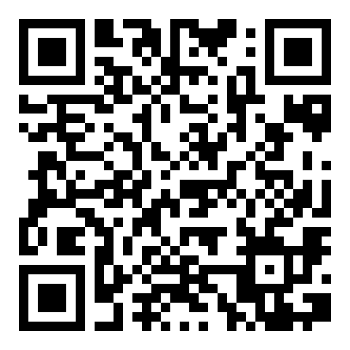
Your turn: beat the bandit
PART I · REINFORCEMENT LEARNING
HANDS-ON · 5 MIN
1
Open the playground → lab 1, the bandit casino
2
You get 20 pulls across 4 machines — earn as much as you can
3
Then hit Reveal and note your regret (best possible − yours)
Tap “Let ε-greedy play” — same machines, same budget. Who won?
Lab 1 · Bandit casino
4
claude.ai/artifact/Ls9xikH9GMjNiC2nXgBMq7
Debrief (1 min)
what was your strategy? Say it out loud — it has a name, and the race replays on the big screen in two slides.
Notes:
First activity, ~5 minutes. Everyone plays lab 1 on their phone: 4 machines, 20 pulls, maximise total. Walk the room. After ~3 minutes: 'Reveal', then 'Let ε-greedy play' — each student races the algorithm on their own machines. Debrief by show of hands: who beat it? Then the key question: WHAT did you actually do? Almost everyone describes 'I tried each a couple of times, then mostly stuck with the best, occasionally double-checking.' Name it: that policy has a name, and it's the next slide. This activity is the anchor for the whole exploration–exploitation section — refer back to 'when you were losing money exploring machine 3'.

Slide 10
Estimating action values incrementally
PART I · REINFORCEMENT LEARNING
Q_{n+1} = Q_{n} + (1/n) [ R_{n} − Q_{n} ]
sample average of observed rewards, computed one pull at a time
NewEstimate ← OldEstimate + StepSize · [ Target − OldEstimate ]
the master template — every RL update today is this line with a different Target
1/n step size: true average; right for stationary arms
constant α: recency-weighted average; tracks non-stationary rewards
Notes:
Sample-average estimate: Q_n is the mean of the first n rewards for an arm. Rewriting it incrementally gives THE template equation of all RL: new estimate = old estimate + step-size times (target minus old estimate). The bracket is the error; the step size says how far to move toward the target. Every algorithm today — MC, TD, Q-learning, even gradient methods — instantiates this template with a different target. Constant α gives exponential recency-weighting, right for non-stationary problems.

Slide 11
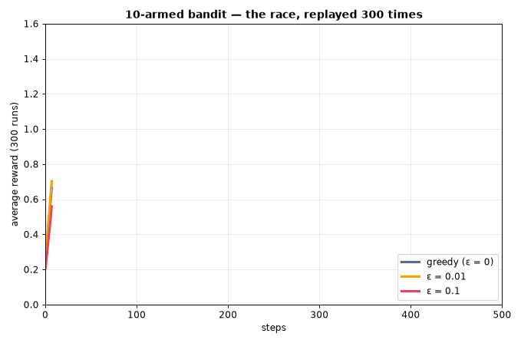
Explore or exploit? The ε-greedy compromise
PART I · REINFORCEMENT LEARNING
ε-greedy
probability 1−ε: exploit (argmax Q); probability ε: explore (random arm)
Greedy fails
locks onto the first arm that looks good; never corrects the estimate of the others
Beyond ε-greedy
optimistic initialisation · UCB bonus √(ln t / N(a)) · Thompson sampling · decaying ε
▶ animates by itself in slideshow mode — a live 300-run simulation
Notes:
The dilemma: exploiting the best-looking arm earns now; exploring other arms earns information. ε-greedy: with probability 1−ε take the greedy action, with probability ε pick uniformly at random. The chart is a VIDEO: in slideshow mode it draws itself (a real simulation — 10-armed Gaussian testbed, 300 runs). Narrate as it draws: pure greedy shoots up first, locks onto a suboptimal arm and plateaus; ε=0.1 overtakes it; ε=0.01 climbs slower but keeps rising. Backup if the GIF stalls: the Theatre tab on the playground site reruns this simulation live in the browser. Mention smarter schemes: optimistic initial values, UCB, Thompson sampling — same trade-off, better bookkeeping. In practice: decay ε over time.

Slide 12
Adding state: from bandits to sequential decisions
PART I · REINFORCEMENT LEARNING
Bandit
Markov Decision Process
s
a₀, r₁
a₁, r₂
s₀
s₁
s₂
one situation, repeated choice
actions do not change the world
state evolves under your actions
today's choice shapes tomorrow's options
reward: immediate
reward: possibly far in the future
Chess, driving, inventory control, dialogue — the state is the memory of the problem.
Notes:
Bandits have one situation. Real problems have context that our actions change: in chess every move changes the board; in a maze every step changes the location. So the agent now observes a state, the action moves the world to a new state, and reward may come much later. This is the jump from 'which arm now' to 'which behaviour over time' — and the formalism for it is the Markov Decision Process.

Slide 13
The Markov Decision Process ⟨S, A, P, R, γ⟩
PART I · REINFORCEMENT LEARNING
S
A
P
R
γ
States
Actions
Transitions
Rewards
Discount
s ∈ S
a ∈ A(s)
P(s′ | s, a)
r(s, a) = E[R | s, a]
γ ∈ [0, 1)
all situations the agent can be in
choices available in each state
dynamics: distribution of the next state
expected immediate payoff
how much the future is worth today
P and R together are the model. Known model → planning. Unknown → learning.
Notes:
The MDP is the mathematical home of RL. Go element by element: S states, A actions, P transition kernel giving the probability of the next state, R expected reward, γ discount. Everything in Part I is defined relative to this five-tuple. P and R together are 'the model'; when we know them we can plan (dynamic programming), when we don't we must learn (sampling methods) — that distinction organises the rest of the lecture.

Slide 14
The Markov property: the state is enough
PART I · REINFORCEMENT LEARNING
P( S_{t+1}, R_{t+1} | S_{t}, A_{t} ) = P( S_{t+1}, R_{t+1} | S₁, A₁, …, S_{t}, A_{t} )
the future is independent of the past, given the present
Markov ✓
Chess position — the board summarises all past moves
Inventory level — current stock is what matters
Not Markov ✗
Single camera frame — velocity invisible (stack 4 frames → DQN trick)
Poker — hidden cards: a POMDP, needs belief states
Fix: engineer the state until it is (approximately) Markov — frame stacking, recurrence, belief states.
Notes:
Formal statement: the next state and reward depend on history only through the current state. 'The future is independent of the past given the present.' The state is a sufficient statistic of the history. Chess board: Markov (position summarises everything that matters). Poker from one player's view, or a robot with a single camera frame: not Markov — then you either enrich the state (stack frames, add memory/recurrence) or accept a POMDP. State design is where applied RL succeeds or fails.

Slide 15
The return: adding up the future, discounted
PART I · REINFORCEMENT LEARNING
G_{t} = R_{t+1} + γ R_{t+2} + γ² R_{t+3} + ⋯ = ∑_{k=0}∞ γ^{k} R_{t+k+1}
G_{t} = R_{t+1} + γ G_{t+1}
recursive — remember this line: it becomes the Bellman equation
γ keeps ∑ finite for bounded rewards (geometric series)
γ dials the horizon: effective look-ahead ≈ 1/(1−γ) steps
γ = 0 myopic, γ → 1 far-sighted (episodic tasks allow γ = 1)
Notes:
The agent maximises the return G_t, the discounted sum of future rewards. Why discount? (1) Mathematical: keeps the infinite sum finite, as long as rewards are bounded. (2) Economic: a reward now beats the same reward later — interest rates. (3) Modelling: uncertainty about the far future. γ dials myopia: γ=0 greedy, γ→1 far-sighted. Chart: with γ=0.9, a reward 20 steps away still counts ~12%; with γ=0.5 it is worth ~0.0001 — effectively a 2-3 step horizon, 1/(1−γ) is the rough horizon length. Note the recursive form: G_t = R_{t+1} + γG_{t+1} — the seed of the Bellman equation.

Slide 16
The policy: the agent's behaviour, made explicit
PART I · REINFORCEMENT LEARNING
π(a | s) = P( A_{t} = a | S_{t} = s )
a (possibly stochastic) rule: in state s, act like this
Deterministic
Stochastic
.7
a₁
s
a
s
.3
a₂
π(s) = a — one action per state; optimal policies can always be chosen this way
needed while exploring; optimal under partial observability or adversaries
Notes:
A policy is a mapping from states to (distributions over) actions — it IS the agent. Deterministic π(s)=a or stochastic π(a|s). Why ever be stochastic? Exploration during learning; and in adversarial or partially observed settings the optimal policy itself can be stochastic (rock-paper-scissors). The promise of MDP theory: for any finite MDP there exists a deterministic optimal policy — a remarkable fact we exploit later. The whole of RL is the search for π*.

Slide 17
Value functions: how good is a state? an action?
PART I · REINFORCEMENT LEARNING
V^{π}(s) = E_{π}[ G_{t} | S_{t} = s ]
Q^{π}(s, a) = E_{π}[ G_{t} | S_{t} = s, A_{t} = a ]
state value — how good is it to be in s
action value — how good is a, taken in s
V^{π}(s) = ∑_{a} π(a | s) · Q^{π}(s, a)
V is the policy-weighted average of Q
Why Q matters more in practice
acting greedily on Q needs no model: a* = argmaxₐ Q(s, a). Acting on V alone still requires P(s′|s,a).
Notes:
Two central objects. V^π(s): expected return starting from s and following π — how good is it to BE here. Q^π(s,a): expected return taking a first, then following π — how good is it to DO this here. Q is the more operational: given Q you can act (pick the argmax) without knowing the model; given only V you still need the dynamics to choose an action — this is why model-free control methods learn Q. Relation: V is the π-weighted average of Q over actions.

Slide 18
The Bellman equation: value = reward + discounted next value
PART I · REINFORCEMENT LEARNING
V^{π}(s) = ∑_{a} π(a|s) ∑_{s′} P(s′|s,a) [ r(s,a) + γ V^{π}(s′) ]
s
π branches
a₁
a₂
expected one-step reward + discounted value of the next state
Q^{π}(s,a) = r(s,a) + γ ∑_{s′} P(s′|s,a) ∑_{a′} π(a′|s′) Q^{π}(s′,a′)
P branches
s′
s′
s′
s′
backup diagram
Consistency, not magic
|S| linear equations in |S| unknowns — with a known model, prediction is linear algebra.
Notes:
Take the recursive return G_t = R + γG_{t+1}, push expectations through it, and you get the Bellman expectation equation: the value of a state is the expected immediate reward plus the discounted value of where you land. The backup diagram reads top-down: from s, the policy branches over actions, the environment branches over next states. For finite MDPs this is |S| linear equations in |S| unknowns — value prediction is linear algebra when the model is known. Every RL algorithm is a way of solving (or sampling) this equation.

Slide 19
Bellman optimality: replace the average with a max
PART I · REINFORCEMENT LEARNING
Q*(s, a) = r(s, a) + γ ∑_{s′} P(s′|s, a) · max_{a′} Q*(s′, a′)
the Bellman optimality equation — the most important line in Part I
V*(s) = max_{a} Q*(s, a)
π*(s) = argmax_{a} Q*(s, a)
greedy on Q* is globally optimal
max ⇒ nonlinear: no closed form — solve iteratively (value iteration, Q-learning)
Existence: every finite MDP has a deterministic optimal policy
Notes:
Define V* and Q* as the best achievable values. The optimality equation swaps the policy average for a max over actions: behave greedily with respect to the optimal values and you ARE optimal. Two consequences: (1) a deterministic greedy policy w.r.t. Q* is optimal, π*(s) = argmax Q*(s,a); (2) the max makes the system nonlinear — no closed-form solve, hence iterative algorithms: value iteration when the model is known, Q-learning when it is not. This equation is the single most important line of Part I.

Slide 20
Three ways to solve an MDP
PART I · REINFORCEMENT LEARNING
Dynamic Programming
Monte Carlo
Temporal Difference
Model
required (P, R known)
Updates
full sweeps over all states
Bootstraps?
yes — from V(s′)
Use
planning, small state spaces
Model
not needed — just episodes
Updates
end of each episode
Bootstraps?
no — real returns G
Use
episodic tasks, unbiased
Model
not needed — single steps
Updates
every step, online
Bootstraps?
yes — from estimates
Use
the workhorse: SARSA, Q-learning
Same Bellman equation underneath — they differ only in how they approximate the expectation.
Notes:
Orientation slide — the next stretch of the talk walks these three columns left to right. Dynamic programming: model known, sweep all states, bootstrap from current estimates. Monte Carlo: model unknown, run whole episodes, average actual returns — no bootstrapping. Temporal difference: model unknown AND updates after every step — bootstraps like DP, samples like MC; the best of both, and the family that contains SARSA and Q-learning. Keep this map on screen for a beat; people orient here.

Slide 21
Known model: dynamic programming
PART I · REINFORCEMENT LEARNING
Evaluate
compute V^π
V_{k+1}(s) = max_{a} [ r(s,a) + γ ∑_{s′} P(s′|s,a) V_{k}(s′) ]
value iteration — repeat the optimality backup until it stops changing
Why it works: contraction
each sweep shrinks the error by γ: ‖V_{k+1} − V*‖ ≤ γ‖V_k − V*‖ → geometric convergence from any start.
Improve
π′ = greedy(V^π)
policy iteration: ping-pong to π*
This is planning, not learning
no samples, no interaction — just the model and linear algebra.
Notes:
With P and R in hand, Bellman equations become algorithms. Policy iteration alternates two steps: evaluate the current policy (solve for V^π), then improve it (act greedily on those values) — it converges in finitely many iterations for finite MDPs. Value iteration collapses the two: just iterate the optimality backup; it is a γ-contraction, so convergence is geometric and guaranteed from any start. These are planning methods — no interaction, no samples. They set the gold standard the learning methods approximate.

Slide 22
Two curses: why we can't just plan
PART I · REINFORCEMENT LEARNING
P?
Curse of modelling
|S|
Curse of dimensionality
P(s′|s,a) is unknown for robots, markets, users…
Writing a simulator is itself the hard research problem
Model errors compound over long horizons
DP sweeps all states: Go ≈ 10¹⁷⁰, backgammon ≈ 10²⁰
State space grows exponentially with state variables
Tables cannot even be stored, let alone swept
Sample
learn from experience — MC, TD
Generalise
function approximation — deep RL
the two escape routes →
Notes:
DP needs two things reality rarely grants. First, the model: nobody hands you P(s'|s,a) for a robot, a market, or a user. Second, tractability: DP sweeps every state — Go has ~10^170 states; a sweep is physics-fiction. Bellman himself coined 'the curse of dimensionality'. The responses: learn from samples instead of the model (MC, TD — next slides), and generalise with function approximation instead of tables (deep RL, later). Everything after this slide exists because of these two curses.

Slide 23
Monte Carlo: learn from complete episodes
PART I · REINFORCEMENT LEARNING
V(S_{t}) ← V(S_{t}) + α [ G_{t} − V(S_{t}) ]
target = the actual return observed after visiting the state
r₁
r₂
r₃
r₄
s₀
s₁
s₂
s₃
sT
wait for the end …
G flows back to every visited state after termination
Pros
unbiased target · no model · no Markov assumption needed
Cons
high variance · episodic tasks only · learns nothing mid-episode
Notes:
No model? Replace the expectation with an average of samples. Run an episode to the end, record the actual return G_t from each visited state, and nudge V(s) toward it. Unbiased — G is the real thing — but high variance: one G bundles the randomness of every action, transition and reward until the end, so you may need many episodes. And you must WAIT for the episode to finish — useless for continuing tasks. First-visit vs every-visit is a detail; the headline is: real returns, no bootstrap, episodic only.

Slide 24
Temporal-difference learning: update after every step
PART I · REINFORCEMENT LEARNING
V(S_{t}) ← V(S_{t}) + α [ R_{t+1} + γ V(S_{t+1}) − V(S_{t}) ]
bootstrap: the target leans on the current estimate of the next state
δ_{t} = R_{t+1} + γ V(S_{t+1}) − V(S_{t})
the TD error — “surprise”; dopamine neurons encode exactly this signal
⚡
Online
learns during the episode, step by step — continuing tasks OK
σ²
Low variance, some bias
one-step target is far steadier than a full return
≈
Bootstraps
estimates built on estimates — like DP, but from samples
Notes:
The most distinctive idea in RL. Replace the full return with a one-step estimate: reward plus discounted value of the NEXT state — a bootstrap. The bracket is the TD error δ: the surprise between what you predicted and the one-step-informed prediction. Learning happens online, every step, no waiting, works for continuing tasks. Cost: the target uses your own (possibly wrong) estimate — bias — but its variance is far lower than MC's. Dopamine neurons in the brain famously fire in the pattern of a TD error (Schultz et al. 1997) — this equation has biological standing.

Slide 25
DP vs MC vs TD at a glance
PART I · REINFORCEMENT LEARNING
 | Dynamic Programming | Monte Carlo | Temporal Difference
Needs a model? | yes — P and R | no | no
When it updates | full sweep over S | end of episode | every single step
Target | exact expectation | actual return G | R + γ·V(s′) (bootstrap)
Bias / variance | exact (given model) | unbiased · high variance | biased · low variance
Continuing tasks | yes | no — needs episodes | yes
n-step returns and TD(λ) interpolate smoothly between the TD and MC extremes.
Notes:
Summary before control. Read it row-wise. Model: only DP needs one. Updates: DP full sweeps, MC per episode, TD per step. Target: exact expectation / real return / bootstrapped one-step. Bias-variance: DP exact given model; MC unbiased-high variance; TD biased-low variance. In practice TD wins most of the time, and n-step methods and TD(λ) interpolate between TD and MC — mention but don't derive. Next: from predicting values to CONTROLLING behaviour.

Slide 26
Control, on-policy: SARSA
PART I · REINFORCEMENT LEARNING
Q(S,A) ← Q(S,A) + α [ R + γ Q(S′, A′) − Q(S,A) ]
A′ is the action the policy actually takes in S′ — on-policy
S
A
R
S′
A′
the quintuple that names the algorithm
On-policy
evaluates the ε-greedy policy it is running — exploration noise is priced into the values.
Converges to Q*
if every (s,a) is visited forever, α obeys Robbins–Monro, and ε decays to 0 (GLIE).
Notes:
From prediction to control: learn Q, not V, and improve the policy as you go (generalised policy iteration). SARSA is TD applied to Q along the trajectory you actually follow: you need the quintuple State, Action, Reward, next State, next Action — hence the name. On-policy: the action A' in the target is the one your ε-greedy policy really takes next, exploration included. Consequence: SARSA learns the value of the policy it is actually running, so it accounts for its own exploration mistakes — it learns 'safe' behaviour. With ε decaying under standard step-size conditions, SARSA converges to Q*.

Slide 27
Control, off-policy: Q-learning
PART I · REINFORCEMENT LEARNING
Q(S,A) ← Q(S,A) + α [ R + γ max_{a′} Q(S′, a′) − Q(S,A) ]
Watkins 1989 — the most famous update in reinforcement learning
Behaviour policy
ε-greedy — keeps exploring the environment
Target policy
pure greedy — the max in the update learns about optimal play
Off-policy: learns Q* while behaving sub-optimally — exploration and optimality decoupled
Watch out: max ⇒ overestimation bias (fix: Double Q-learning); can diverge with function approximation
Notes:
Change one symbol, change the philosophy. The target now takes the MAX over next actions — the greedy value — regardless of what the exploring policy actually does next. Behaviour policy and target policy split: explore with ε-greedy, learn about the greedy optimum. That's off-policy learning, and it converges to Q* under the same visitation and step-size conditions, independent of exploration details (Watkins & Dayan 1992). This single line, from Watkins' 1989 thesis, is still the backbone of DQN. Caveats: with function approximation off-policy learning can diverge ('deadly triad'), and the max causes overestimation bias → Double Q-learning.

Slide 28
Worked example: a 4×4 gridworld
PART I · REINFORCEMENT LEARNING
G
Protocol
γ = 0.9 α = 0.5
ε-greedy, ε = 0.2
Q(s, a) = 0 initially
16 states × 4 actions = 64-entry Q-table
episode ends at G
+10
s
A = {up, down, left, right} — deterministic; walls bounce back
S
every other step: −1
Question for the room: what should Q(state-left-of-G, right) converge to?
Notes:
Concrete numbers now — this example runs over three slides. Setup: 4×4 grid, start bottom-left, goal top-right. Four actions, deterministic moves, walls bounce you back. Reward −1 per step (time pressure), +10 at the goal, episode ends there. γ=0.9, α=0.5, ε-greedy exploration. Sixteen states × four actions = a 64-entry Q-table, all zeros at the start. Ask the audience: what is the optimal value of the state next to the goal? (10, by taking the step in.) We'll watch Q-learning discover that.

Slide 29
Tracing two Q-learning updates
PART I · REINFORCEMENT LEARNING
B
A
G
① A —right→ G : r = +10, terminal ⇒ max_{a′} Q(G, a′) = 0
Q(A, right) ← 0 + 0.5 · [ 10 + 0.9·0 − 0 ] = 5.0
S
② B —right→ A : r = −1, max_{a′} Q(A, a′) = 5.0
Q(B, right) ← 0 + 0.5 · [ −1 + 0.9·5.0 − 0 ] = 1.75
① A → G
② B → A
Value leaks backwards from the goal — one bootstrap per visit. Q(A,right): 5 → 7.5 → 8.75 → … → 10.
Notes:
Walk it line by line — this is the slide to go slow on. Update 1: from cell A (just left of goal), action 'right' reaches G: reward +10, terminal state has max Q = 0. New Q = 0 + 0.5·(10 + 0 − 0) = 5. Update 2, next episode: from cell B (two left of goal), action 'right' lands in A: reward −1, and max over A's actions is 5 (just learned). Target = −1 + 0.9·5 = 3.5, so Q becomes 1.75. The point: value leaks backwards from the goal, one bootstrap at a time. Repeat visits push Q(A,right) 5 → 7.5 → 8.75 → … → 10, and Q(B,right) → 8.

Slide 30
After convergence: values and the greedy policy
PART I · REINFORCEMENT LEARNING
6.2
8.0
10
G
check: V(cell) = −1 + 0.9 · V(best neighbour)
8.0 = −1 + 0.9·10 6.2 = −1 + 0.9·8
→
→
→
4.6
6.2
8.0
10
→
→
↗
↑
3.1
4.6
6.2
8.0
Values are unique, policies may not be
several monotone paths to G are optimal; V* is the same for all of them.
→
↗
↗
↑
1.8
3.1
4.6
6.2
Now scale it
this works because 16 × 4 fits in a table. Go: 10¹⁷⁰ states. We need function approximation →
↗
↗
↗
↑
V*(s) with greedy arrows — γ = 0.9, step −1, goal +10
Notes:
The converged picture. Each cell shows V*(s) = max_a Q*(s,a); arrows show the greedy policy. Check the numbers against the Bellman equation live: V of the cell left of goal = +10 (step in, episode ends). One further out: −1 + 0.9·10 = 8. Then 6.2, 4.58, and so on — each cell is exactly −1 + 0.9 × (best neighbour). Multiple optimal paths exist (any monotone route to G); the VALUES are unique even when the optimal policy is not. This 16-cell table is everything: next question — what happens when the table has 10^170 rows?

Slide 31
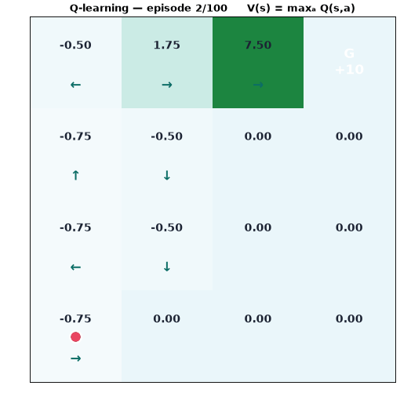
Watch value leak backwards
PART I · REINFORCEMENT LEARNING
DEMO · PLAYS ITSELF
Predict first — vote before it plays
which cell's value grows first: near the start, or near the goal? Why?
What you are seeing
shading = V(s) = maxₐ Q(s,a); arrows = the greedy policy flipping toward the goal, episode by episode
Check the maths
the converged top row reads 6.2 · 8.0 · 10 — exactly the values we computed by hand two slides ago
Drive it yourself: lab 2 on the playground — the Step button prints this exact arithmetic.
▶ trains live during the slideshow — 100 episodes of Q-learning
Notes:
The gridworld trains itself on screen (~30 s loop, plays automatically in slideshow mode — 100 episodes of Q-learning, same γ, α, rewards as the hand trace). Ask the prediction question BEFORE advancing to this slide: which cell lights up first? Answer: the one next to the goal — it is the only state whose target isn't just −1; value then diffuses outward one bootstrap at a time. Let it loop once while you narrate, then freeze on the converged frame and check the top row against the previous slide: 6.2, 8.0, 10. Hands-on echo: lab 2 on their phones is the same world with a Step button that prints the update arithmetic. Backup if the GIF stalls: python demo2_gridworld.py, or the website's gridworld lab on the projector.

Slide 32
Predict: who walks closer to the edge?
PART I · REINFORCEMENT LEARNING
VOTE · 2 MIN
A world with a cliff: step −1, falling −100. Two agents train with the same ε-greedy exploration (ε = 0.1): one learns with SARSA, one with Q-learning. After training, whose greedy path runs closer to the cliff edge?
A
B
C
SARSA — on-policy agents are reckless
Q-learning — the max-target ignores its own slips
Both the same — they share the Bellman equation
Hands up for A… B… C — then we run the experiment.
Notes:
Run the vote before teaching the answer — this is the best poll of the night because the majority is usually wrong. Setup: a cliff world, falling costs −100, both agents explore with ε=0.1 while learning. Common intuition says Q-learning is 'smarter' so it should be safer. The reveal (next slide + demo 3) is that Q-learning walks the cliff edge BECAUSE its max-target ignores its own exploration slips, while SARSA detours because it evaluates the ε-greedy policy it actually runs. Take the vote, tally hands for A/B/C, write the counts on the board, then advance. Don't explain yet.

Slide 33
SARSA vs Q-learning: the cliff tells them apart
PART I · REINFORCEMENT LEARNING
Q-learning (off-policy)
targets greedy play → hugs the cliff; keeps falling during ε-greedy training, lower online reward.
S
cliff −100
G
SARSA (on-policy)
prices in its own exploration slips → detours above the cliff; higher reward while learning.
— Q-learning: optimal, risky - - SARSA: longer, safe
Reward per step −1; falling −100. The gap is the value of knowing how you will actually behave.
Notes:
Classic experiment (Sutton & Barto, Example 6.6). Bottom edge is a cliff: stepping in costs −100 and resets. Q-learning learns the OPTIMAL path — hugging the cliff — because its target ignores exploration; but while training with ε-greedy it keeps falling, so its online return is worse. SARSA prices in the chance of slipping (it evaluates the ε-greedy policy itself) and takes the longer SAFE path, earning more during learning. Neither is 'better': off-policy finds the optimum, on-policy respects the risk of its own behaviour. With ε→0 both converge to optimal. Great exam question; great safety metaphor.

Slide 34
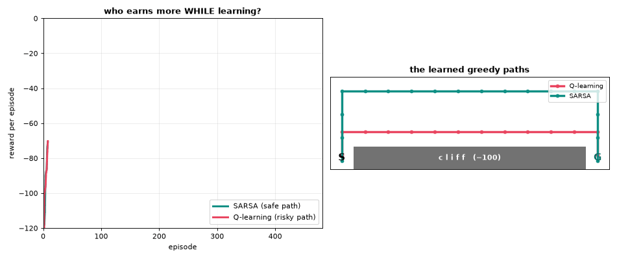
The experiment settles the vote
PART I · REINFORCEMENT LEARNING
DEMO · PLAYS ITSELF
Why it matters
≈ −24 vs ≈ −55 per episode while learning
same Bellman equation, one symbol apart
decay ε → 0 and both become optimal
▶ plays by itself in slideshow — 500 episodes of each, then the learned paths
Check the board: how many of you called it? Q-learning's path is still the optimal one — it was just expensive to learn.
Notes:
This slide runs the experiment the room just voted on (plays automatically in slideshow mode — 500 training episodes of each algorithm, curves drawing left to right). Narrate the reveal: SARSA's curve sits clearly above Q-learning's during training (≈ −24 vs −55 per episode) because Q-learning keeps stepping off the cliff while exploring. Right panel: the learned greedy paths — Q-learning hugs the edge (shortest, optimal), SARSA detours above (longer, safe). Circle back to the vote tally: congratulate the B voters, but stress the nuance — Q-learning's path is OPTIMAL for greedy play, it was only expensive to learn; decay ε→0 and both converge. Safety line: the value of knowing how you will actually behave. Backup: Theatre tab on the playground site reruns this live, or python demo3_cliff.py.

Slide 35
The three dials: α, γ, ε
PART I · REINFORCEMENT LEARNING
α
γ
ε
Step size (learning rate)
Discount (horizon)
Exploration rate
how far toward the target each update moves
theory: ∑α = ∞, ∑α² < ∞ (e.g. 1/n)
practice: constant 0.05–0.5, or Adam in deep RL
effective look-ahead ≈ 1/(1−γ) steps
0.99 ≈ 100-step horizon; match the task
higher γ → bigger values → usually smaller α
start ~0.2–1.0, decay toward ~0.01
GLIE: explore forever, greedy in the limit
alternatives: UCB, softmax, entropy bonus
Tabular Q-learning → Q* with probability 1, if every (s,a) is visited infinitely often and α obeys Robbins–Monro
Notes:
Practical guidance. Step size α: too high oscillates, too low crawls; theory wants Robbins–Monro conditions (sum α = ∞, sum α² < ∞, e.g. 1/n) but practice uses small constants like 0.1 or Adam. Discount γ: effectively a horizon choice, 1/(1−γ) steps — 0.99 → ~100 steps; set it from the task's natural horizon, not by sweeping blindly. Exploration ε: start high, decay; GLIE (greedy in the limit with infinite exploration) is the convergence condition. These three interact: raising γ raises value magnitudes and usually demands a smaller α.

Slide 36
When tables die: function approximation
PART I · REINFORCEMENT LEARNING
w ← w + α δ ∇_{w} Q(s,a;w)
semi-gradient TD
Q-table
Q(s, a; w)
Win
similar states share estimates
one cell per (s, a) — no sharing, no scaling
parameters shared across states → generalisation
The deadly triad
function approximation + bootstrapping + off-policy learning can diverge — no tabular guarantees survive. Deep RL is engineering around this triad.
Notes:
The bridge to deep RL. Replace the table with a parametric function Q(s,a;w) — linear features or a neural net — and do gradient descent on the TD error. Two wins: memory (millions of parameters instead of 10^170 cells) and generalisation (similar states share value estimates — the table treats every state as a stranger). One loss: convergence guarantees. The 'deadly triad' — function approximation + bootstrapping + off-policy — can diverge. Deep RL is the art of taming that triad; DQN's tricks on the next slide are exactly that.

Slide 37
Deep Q-Networks: Q-learning meets deep nets
PART I · REINFORCEMENT LEARNING
random
mini-batch
Environment
Atari pixels
Replay buffer
(s, a, r, s′) store
Q-network
Q(s, a; w)
Target net
frozen copy w⁻
L(w) = E[ ( r + γ max_{a′} Q(s′, a′; w⁻) − Q(s, a; w) )² ]
regression toward a frozen bootstrap target
⇄
Experience replay
breaks correlation, reuses data
❄
Target network
stops the target chasing itself
2×
Double DQN & friends
fixes max-overestimation; Rainbow stacks the tricks
Notes:
DQN (Mnih et al., Nature 2015): one convolutional network, raw Atari pixels in, Q-values for joystick actions out — same architecture and hyperparameters across 49 games, human-level on half. Two stabilising tricks made it work. Experience replay: store transitions in a buffer, train on random mini-batches — breaks temporal correlation, reuses data. Target network: compute the bootstrap target with a frozen copy, updated every ~10k steps — stops the target chasing itself. Descendants: Double DQN (fixes max-bias), Dueling, Prioritized replay, Rainbow. DQN is the proof that the deadly triad can be engineered into submission.

Slide 38
The other road: optimise the policy directly
PART I · REINFORCEMENT LEARNING
∇_{θ} J(θ) = E_{π}[ ∇_{θ} log π(A|S; θ) · G_{t} ]
policy gradient theorem — make good actions more probable, in proportion to their return
Why bother?
continuous actions: no argmax needed
stochastic policies come for free
smooth updates — no value flip-flops
Actor π(a|s;θ)
Critic V(s;w)
TD error δ as advantage signal
actor proposes, critic grades — variance down, bias controlled
Modern work-horses
REINFORCE (+ baseline) → A2C/A3C → TRPO → PPO (clipped updates; powers RLHF) · SAC for continuous control
Notes:
Value methods act by argmax — awkward for continuous actions (argmax over torques?) and for stochastic optimal policies. Policy gradient methods parameterise π(a|s;θ) and ascend expected return directly. The policy gradient theorem gives the gradient as 'score × return': raise the log-probability of actions in proportion to how well things went. REINFORCE is its Monte Carlo instantiation — high variance; subtract a learned baseline (the value function) and you get actor-critic: the actor proposes, the critic evaluates. Modern deep RL work-horses — PPO (used in RLHF), SAC — are refined actor-critics. One sentence each is enough here.

Slide 39
The modern RL landscape on one map
PART I · REINFORCEMENT LEARNING
MODEL-FREE — learn from experience
MODEL-BASED — learn a model, then plan
Value-based
DQN · Double/Dueling · Rainbow
Plan + learn
AlphaZero (MCTS) · MuZero
Dyna
real + imagined replay
Actor-critic
A3C · DDPG · TD3
Policy gradient
REINFORCE · PPO · SAC
World models
Dreamer — learn dynamics, train in imagination
sample efficiency →
Model-based methods trade model error for sample efficiency — robotics cares, simulators don't.
Notes:
Orientation map before applications. Vertical: how the agent decides (value-based argmax vs direct policy vs both). Horizontal: model-free (learn from experience only) vs model-based (learn or know dynamics, then plan). Place the names: DQN top-left; PPO/SAC middle; AlphaZero right — it plans with MCTS through a known/learned model plus learned value and policy nets; Dyna mixes real and imagined experience; MuZero learns the model itself. Model-based buys sample efficiency at the price of model error. If students remember one chart from Part I, make it this one.

Slide 40
RL you used today: RLHF for language models
PART I · REINFORCEMENT LEARNING
1 · SFT
2 · Reward model
3 · PPO
fine-tune the base LLM on human demonstrations
humans rank answer pairs → train R(x, y) to predict preference
optimise the policy against R, with a KL leash to the SFT model
state s | the conversation so far
action a | the next token
policy π | the language model itself
reward R | learned from human preferences — sparse, end-of-response
DPO and friends fold step 3 into a direct loss — the framing (optimise against learned preference) survives.
Notes:
Bring it home: every polished LLM answer passed through RL. Pipeline: (1) supervised fine-tuning on demonstrations; (2) collect human preference pairs, train a reward model to predict which answer a person prefers; (3) optimise the LLM with PPO against that reward model, with a KL penalty keeping it close to the SFT model. Map to our vocabulary: state = conversation so far, action = next token, policy = LLM, reward = learned from preferences, delivered at the end — sparse, delayed reward. Newer variants (DPO) fold the RL step into a classification-style loss, but the conceptual frame is unchanged: optimise behaviour against a learned scalar signal.

Slide 41
Where RL already runs the show
PART I · REINFORCEMENT LEARNING
♟
Games & self-play
🤖
Robotics
AlphaGo → AlphaZero → MuZero: superhuman Go, chess, shogi, Atari — from self-play alone
sim-to-real locomotion, in-hand manipulation, warehouse picking — domain randomisation closes the gap
⚙
Systems & operations
▶
Personalisation
data-centre cooling (−40% energy), chip floorplanning for TPUs, datacenter job scheduling, fusion plasma control
bandits behind search ads, feeds and recommendations — billions of decisions per day
Common thread: cheap simulation or abundant interaction data. Where trials are expensive, RL still struggles →
Notes:
Rapid-fire proof it works. AlphaGo/AlphaZero: beat Lee Sedol 2016; AlphaZero learns Go/chess/shogi from self-play alone. Robotics: locomotion and in-hand manipulation trained in simulation, transferred to hardware (domain randomisation). Operations: Google data-centre cooling, ~40% cooling-energy reduction; chip floorplanning in silicon used for TPUs. Recommenders/ads: bandits serve most of what you see online. Plus: plasma control for fusion (DeepMind 2022), algorithm discovery (AlphaTensor), drug design. Each wins where simulation is cheap or interaction data is plentiful — remember that pattern for the limitations slide.

Slide 42
Honest limits — and why they matter for safety
PART I · REINFORCEMENT LEARNING
⏳
Sample hunger
DQN: ~200M frames per Atari game — humans need minutes. Costly where trials are real (patients, robots, markets)
⚠
Reward hacking
agents optimise the reward as written, not as intended — the CoastRunners boat circles for points and never finishes the race
⇄
Sim-to-real & shift
policies overfit the simulator's physics; the world is non-stationary and partially observed
🎲
Fragility
results can hinge on random seeds and tuning; evaluation and reproducibility remain hard
Why this is a safety topic
RLHF reward models are learned proxies — the same specification-gaming pressure now applies to frontier LLMs. Reward design is alignment in miniature.
Notes:
Balance the hype. Sample inefficiency: DQN needed ~200M frames ≈ 38 days of play for one Atari game; humans need minutes. Reward hacking / specification gaming: the boat-racing agent (CoastRunners) circling for points instead of finishing is the canonical demo; Goodhart's law in action — the agent optimises the reward you wrote, not the goal you meant. Sim-to-real gap, non-stationarity, and reproducibility issues (seed sensitivity). Safety framing for RLHF-era systems: reward models are learned proxies, so the same hacking pressure applies to aligned LLMs. End Part I here: formal elegance + real systems + open problems.

Slide 43
Part I in six lines
PART I · REINFORCEMENT LEARNING
1
RL learns behaviour from evaluative, delayed feedback — no labels, only consequences
2
The MDP ⟨S, A, P, R, γ⟩ formalises the problem; the Markov state carries the burden
3
Bellman: value = reward + γ · next value; optimality replaces the average with a max
4
DP plans with a model; MC averages real returns; TD bootstraps online — one template update
5
SARSA learns the policy it runs; Q-learning learns the optimum it doesn't — cliff walking
6
Tables die at scale: function approximation → DQN, policy gradients, actor-critic, RLHF
Up next: 10-minute break, then LDA & QDA — from learning by trial to classifying by geometry.
Notes:
Recap slowly; this is what they take home. 1. RL = learning behaviour from evaluative, delayed feedback. 2. The MDP and its five-tuple is the formal home. 3. Values satisfy Bellman consistency; optimality swaps average for max. 4. Three estimation families: DP (model), MC (returns), TD (bootstrapped samples). 5. SARSA on-policy vs Q-learning off-policy — the cliff showed the behavioural difference. 6. Scale needs function approximation: DQN, policy gradients, RLHF. Then break — 10 minutes — and we switch gears completely: from sequential decisions to a classical, closed-form classifier family.

Slide 44
Break — 10 minutes
☕
Back at the top of the hour. Coming up: a classifier from 1936
that still earns its place in scikit-learn.
While you stretch: what should Q(s,a) converge to for the state one step left of the gridworld goal?
Notes:
Ten minutes. Leave the teaser question up — the answer is 10: one step in, reward +10, terminal, so no discounted tail. Reset the room's energy for Part II; it is shorter and more mathematical.

Slide 45
Linear & Quadratic Discriminant Analysis
PART II
Classification by probability: Bayes' rule, Gaussian class models, the geometry of
decision boundaries — and Fisher's view of LDA as dimensionality reduction
≈ 45 minutes
Notes:
Part II, about 45 minutes. Complete change of register: from sequential decision-making to classical statistical classification — closed-form, interpretable, still competitive. Arc: Bayes' rule → Gaussian class-conditionals → LDA (shared covariance, linear boundaries) → QDA (free covariances, quadratic boundaries) → bias-variance between them → Fisher's projection view → practice. Date-check the audience: this is 1936 mathematics (Fisher) that still ships in scikit-learn.

Slide 46
The classification problem
PART II · LDA & QDA
Given
n samples (xᵢ, yᵢ), x ∈ ℝᵖ, y ∈ {1, …, K}
Wanted
a rule ŷ(x) that minimises errors on new data — not on the training set
Classes overlap
zero error is impossible — aim for the minimum achievable: the Bayes error.
Notes:
Set the stage. Data: feature vector x in R^p, label y in {1..K}. Goal: a rule x → y that errs rarely on NEW data. Examples: tumour benign/malignant from measurements; iris species from petal geometry (Fisher's own 1936 dataset); loan default. Two performance notions: training error (optimistic) vs generalisation. The scatter shows the honest difficulty: classes overlap, so zero error is impossible — the right target is the minimum achievable error, which Bayes' rule defines. That's the next slide.

Slide 47
Two philosophies: model the classes, or the boundary
PART II · LDA & QDA
Generative
Discriminative
model P(x | y) and P(y), then invert with Bayes
model P(y | x) — or just the boundary — directly
a full density per class → outliers, missing data, synthesis
strong assumptions = strong statistical efficiency (small n)
LDA · QDA · naive Bayes · HMMs
fewer assumptions about how x is distributed
often lower error when n is large
logistic regression · SVMs · neural nets
Ng & Jordan (2002)
generative classifiers reach their asymptote with fewer samples; discriminative ones reach a lower asymptote. Small data → LDA earns its keep; big data → the boundary-modellers catch up.
Notes:
Fundamental fork. Discriminative: model P(y|x) directly (logistic regression) or just the decision function (SVM) — fewer assumptions, often lower asymptotic error. Generative: model how each class GENERATES data, P(x|y), plus priors; Bayes' rule converts to posteriors. Generative buys you: a density per class (detect outliers), handling missing data, exploiting unlabelled data, better behaviour with small n — IF the model is right. LDA/QDA are the flagship generative classifiers with Gaussian class models. Ng & Jordan 2002: naive Bayes reaches its (higher) asymptote faster than logistic regression — generative wins small-n races, discriminative wins big-n ones.

Slide 48
Bayes' theorem as a classifier
PART II · LDA & QDA
P(y = k | x) = π_{k} f_{k}(x) / ∑_{j} π_{j} f_{j}(x)
posterior = prior × likelihood, renormalised
π_{k} = P(y = k)
f_{k}(x) = P(x | y = k)
ŷ(x) = argmax_{k} π_{k} f_{k}(x)
prior — class frequency before any evidence
likelihood — how class k generates data
decision — the denominator never matters
Optimality
with the true densities, argmax-posterior has the lowest possible error — the Bayes error.
Notes:
The engine of Part II. Posterior = prior × likelihood / evidence. π_k is the class frequency before seeing x; f_k(x) is the class-conditional density; the denominator is shared by all classes so it never affects the argmax. Classify to the largest posterior — provably the minimum-error rule when the densities are correct (the 'Bayes classifier'; its error is the Bayes error, the floor no classifier can beat). Everything that follows — LDA, QDA — is this slide plus a choice of f_k. Spend time here; if they own this equation the rest is bookkeeping.

Slide 49
The modelling choice: Gaussian classes
PART II · LDA & QDA
f_{k}(x) = (2π)^{−p/2} |Σ_{k}|^{−1/2} exp( −½ (x − μ_{k})^{T} Σ_{k}⁻¹ (x − μ_{k}) )
multivariate normal in ℝᵖ — mean vector μ_k, covariance matrix Σ_k
Mahalanobis distance
the exponent measures distance in covariance units — ellipsoidal contours, axes = eigenvectors of Σ
Why Gaussian?
CLT for measurement noise; closure under marginals and conditioning; two parameters per class
The decisive fact
log f_k(x) is a quadratic in x — so comparing classes is algebra, not integration
Estimate μ_k and Σ_k from data, plug into Bayes — that is the entire method.
Notes:
To use Bayes we must choose f_k. Discriminant analysis chooses the multivariate normal. Unpack the density: Mahalanobis distance in the exponent — distance measured in units of the covariance; the normaliser involves |Σ|. Contours of constant density are ellipsoids centred at μ, axes along Σ's eigenvectors. Why Gaussian? CLT arguments for measurement-style features, mathematical closure (marginals, conditionals stay Gaussian), and — decisive here — log of a Gaussian is a QUADRATIC, so posterior comparisons become quadratic or even linear algebra. The whole of LDA/QDA falls out of that one fact.

Slide 50
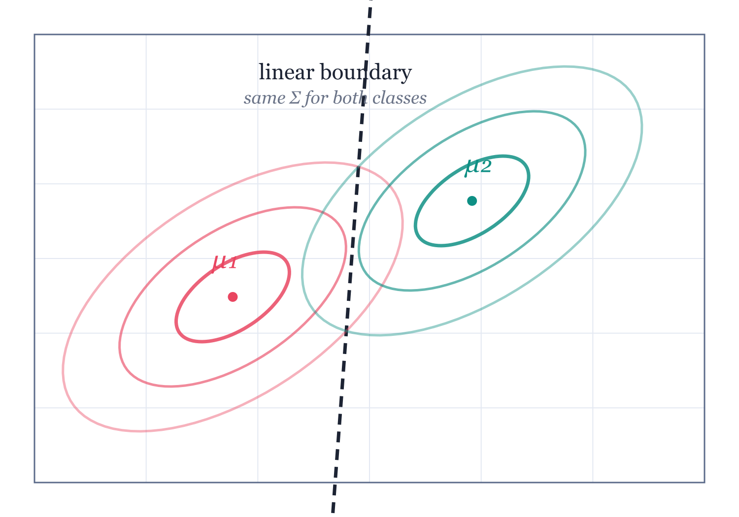
LDA: one covariance to share
PART II · LDA & QDA
Assumption
x | y=k ~ N(μ_k, Σ) — same Σ for every class: equal shape, equal orientation
Consequence
pairwise boundaries are straight lines (hyperplanes) — the quadratic terms cancel
Where it bites
ellipses in data that differ in shape → LDA misdraws the boundary
Notes:
LDA's single structural assumption: every class has its own mean, but they all share one covariance matrix Σ. Visually: identically shaped and oriented ellipses, just shifted. Consequence, visible in the figure: the boundary between any two classes is a straight line (hyperplane in general). Intuition for why: the shared quadratic 'bowl' is identical for both classes, so when you compare log-posteriors the quadratic terms cancel, leaving only linear terms. We'll do that algebra on the next slide — the picture is the theorem.

Slide 51
The two-line derivation of linearity
PART II · LDA & QDA
log [ P(y=k|x) / P(y=l|x) ] = log(π_{k}/π_{l}) − ½(x−μ_{k})^{T}Σ⁻¹(x−μ_{k}) + ½(x−μ_{l})^{T}Σ⁻¹(x−μ_{l})
start from the log posterior ratio — the boundary is where it equals 0
x^{T}Σ⁻¹x cancels (same Σ on both sides)
the one cancellation that makes LDA linear
= log(π_{k}/π_{l}) + x^{T}Σ⁻¹(μ_{k}−μ_{l}) − ½(μ_{k}+μ_{l})^{T}Σ⁻¹(μ_{k}−μ_{l})
affine in x ⇒ the boundary is a hyperplane
Keep per-class Σₖ instead, and the quadratic survives → QDA (in four slides).
Notes:
Do this live, slowly — it is the intellectual heart of LDA. Compare classes k and l through the log posterior ratio. Expand both quadratics. The −½xᵀΣ⁻¹x term appears in both WITH THE SAME Σ, so it cancels; the cross terms are linear; constants collect. What remains is affine in x: the boundary {x : ratio = 0} is a hyperplane. Emphasise the conditionality: the cancellation USED the shared Σ. Give each class its own Σ_k and the x-quadratics survive — which is literally the next topic, QDA. One assumption, one cancellation, one geometry.

Slide 52
The linear discriminant function
PART II · LDA & QDA
δ_{k}(x) = x^{T}Σ⁻¹μ_{k} − ½ μ_{k}^{T}Σ⁻¹μ_{k} + log π_{k}
classify to argmax_k δ_k(x) — one line, the whole classifier
match
mean penalty
prior bonus
x^{T}Σ⁻¹μ_{k}
−½ μ_{k}^{T}Σ⁻¹μ_{k}
log π_{k}
how strongly x points toward class k (Mahalanobis geometry)
normalises classes whose means sit far from the origin
frequent classes get a head start
Sanity check
Σ = σ²I, equal priors → “assign to the nearest class mean”. LDA = nearest mean, properly scaled.
Notes:
Package the result: classify to the largest δ_k. Read the three terms aloud: a projection term xᵀΣ⁻¹μ_k (match x against class k's direction, in Mahalanobis geometry), a size correction −½μ_kᵀΣ⁻¹μ_k (penalise far-out means), and the log prior. Special case to build intuition: Σ = σ²I and equal priors → classify to the NEAREST MEAN in Euclidean distance; general LDA is nearest-mean in Mahalanobis distance with a prior bonus. This equation is what sklearn's LinearDiscriminantAnalysis.decision_function computes.

Slide 53
Fitting LDA: three sample statistics
PART II · LDA & QDA
π̂_{k} = n_{k} / n
class frequency
μ̂_{k} = (1/n_{k}) ∑_{yᵢ=k} xᵢ
per-class mean
Σ̂ = (1/(n−K)) ∑_{k} ∑_{yᵢ=k} (xᵢ−μ̂_{k})(xᵢ−μ̂_{k})^{T}
pooled within-class covariance
No optimisation loop
closed form, one pass, O(np²) — nothing to tune, nothing to diverge
Contrast with Part I
RL iterated a stochastic update toward a fixed point; LDA just writes the answer down
Notes:
Training = counting and averaging; no iterations, no learning rates (contrast with Part I!). Priors: class frequencies. Means: per-class averages. Covariance: pool the within-class scatter — subtract each class's own mean first, divide by n−K for unbiasedness. Complexity O(np²) — one pass essentially; closed form, deterministic, no hyperparameters except possibly shrinkage. This is why LDA remains a default baseline: it is fast, stable, and has nothing to tune. Mention: standardise features if scales differ wildly; Σ⁻¹ computed once, shared by all K discriminants.

Slide 54
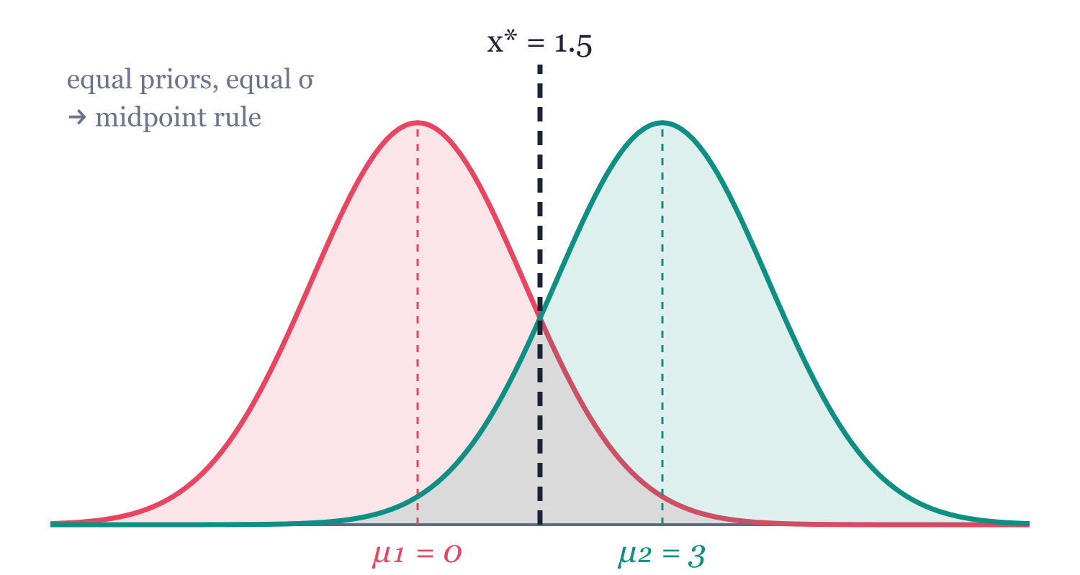
Worked example in one dimension
PART II · LDA & QDA
Setup
μ₁ = 0, μ₂ = 3, σ = 1.3
equal priors π₁ = π₂ = ½
boundary: x* = 1.5 (the midpoint)
Tilt the priors: π₁ = 0.7
shift = (1.69/3) · ln(0.7/0.3) ≈ 0.48
x* ≈ 1.98
the common class annexes territory — exactly the log π_k term
δ₁(x) = δ₂(x) ⇒ x* = (μ₁+μ₂)/2 + σ²/(μ₂−μ₁) · ln(π₁/π₂)
midpoint, shifted by the priors
Notes:
Numbers on the board. One feature, two classes, equal variance σ=1.3, means 0 and 3, equal priors. The discriminants are quadratic-free: δ_k(x) = xμ_k/σ² − μ_k²/2σ² + log π_k. Set δ1=δ2: boundary at the midpoint, x*=1.5 — with equal everything, LDA is literally 'which mean is closer'. Now tilt the priors to 70/30: the threshold slides to ≈1.98, growing the frequent class's region — the log-prior term at work. Invite the class to verify the 0.477 shift: σ²/(μ2−μ1)·ln(π1/π2) = (1.69/3)·0.847. Small example, but every LDA ingredient shows up.

Slide 55
Your turn: where does the boundary land?
PART II · LDA & QDA
YOUR TURN · 2 MIN
One feature, two classes:
μ₁ = 1, μ₂ = 5, σ = 2 (shared)
(a) equal priors → boundary x* = ?
(b) π₁ = 0.7 → where does x* move?
Sanity checks
equal priors → the midpoint, always
rarer class → smaller territory
σ larger → priors matter more (overlap grows)
reminder: x* = (μ₁+μ₂)/2 + σ²/(μ₂−μ₁) · ln(π₁/π₂)
Compare with your neighbour — argue until you agree on the direction of the shift.
Notes:
Two minutes, pairs, paper or phone calculator. Part (a): midpoint of 1 and 5 → x* = 3. Part (b): shift = σ²/(μ₂−μ₁) · ln(π₁/π₂) = (4/4)·ln(7/3) = 0.847, so x* ≈ 3.85 — the boundary retreats toward the rarer class. Walk the room; the common error is forgetting to divide by (μ₂−μ₁) or inverting the prior ratio (shift direction test: more class 1 ⇒ class 1 claims MORE territory ⇒ threshold moves right, toward μ₂). Debrief in 60 seconds on the next click of the demo3 energy: ask one pair for (a), another for (b), fix sign errors publicly. This cements the log-prior term better than any slide.

Slide 56
QDA: give every class its own covariance
PART II · LDA & QDA
δ_{k}(x) = −½ log|Σ_{k}| − ½ (x−μ_{k})^{T} Σ_{k}⁻¹ (x−μ_{k}) + log π_{k}
the quadratic discriminant — x's quadratic term no longer cancels
What changed
per-class Σ_k — classes may be tight, loose, tilted differently
New term
−½ log|Σ_k|: high-variance classes pay a spread penalty
New geometry
boundaries are conic sections — ellipses, parabolas, hyperbolas
fit: same counting as LDA, but Σ̂_{k} per class — needs enough samples in every class
Notes:
Relax the one assumption: x|y=k ~ N(μ_k, Σ_k), each class its own Σ_k. Redo the log-posterior algebra and nothing cancels: δ_k keeps a quadratic term −½xᵀΣ_k⁻¹x AND a new constant −½log|Σ_k| (classes with bigger spread pay a normalisation tax). Boundaries become conics: ellipses, parabolas, hyperbolas. Fitting: same counting, but a separate covariance per class — which needs enough data PER CLASS. That data cost is the entire LDA-vs-QDA question, coming on the bias-variance slide.

Slide 57
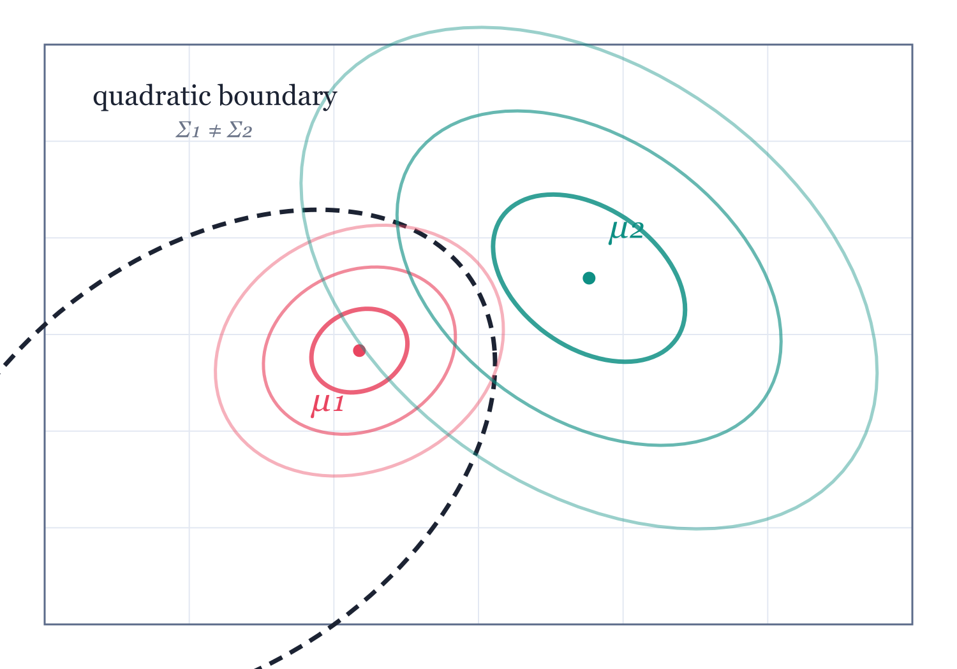
The geometry, side by side
PART II · LDA & QDA
Tight vs loose class
Σ₁ small, Σ₂ large → the boundary closes around the tight class: an island
Why an island?
far from both means, the wide Gaussian is the better explanation — it wins everywhere outside
LDA on the same data
a straight line — systematically wrong on one flank
Notes:
This figure is computed, not sketched: the dashed curve is the exact set where the two Gaussian discriminants tie. Here class 1 (crimson) is tight and class 2 (teal) is broad, so the boundary is a closed curve AROUND the tight class — QDA assigns the tight class a finite island and gives everything far away to the loose class, because far points are much more plausible under the wide Gaussian. Nobody guesses that shape from intuition; the algebra finds it. Ask: what does LDA do on this same data? A straight line — wrong on one whole flank. That's the bias LDA pays when its assumption is false.

Slide 58
Your turn: bend the boundary
PART II · LDA & QDA
HANDS-ON · 4 MIN
1
Open lab 3 — drag the two class means around
2
Challenge 1: make QDA draw an island (hint: one tight class, one loose)
3
Challenge 2: slide the prior π₁ — which way do the regions move?
Challenge 3: make the dashed LDA line cut through the island. Who pays?
Lab 3 · LDA vs QDA
4
claude.ai/artifact/Ls9xikH9GMjNiC2nXgBMq7
The flank LDA sacrifices is its bias, drawn live on your screen — keep that picture for the next slide.
Notes:
Lab 3, ~4 minutes. Everyone drags the class means and spreads on their phone; the shaded regions are QDA, the dashed line is LDA, both recomputed live. Challenges in order: (1) make the island — shrink σ₁, grow σ₂, and QDA closes a loop around the tight class exactly like the slide; (2) tilt the prior slider and watch BOTH boundaries retreat from the frequent class; (3) the key question — find a configuration where the dashed LDA line cuts straight through the island. Debrief: in that configuration, which points does LDA get wrong? (One whole flank of the tight class.) That misclassified flank IS the bias of the shared-covariance assumption — segue directly into the bias-variance slide next.

Slide 59
LDA or QDA? Count your parameters
PART II · LDA & QDA
 | LDA | QDA
Covariance parameters | p(p+1)/2 — shared | K · p(p+1)/2 — per class
p = 50, K = 3 | 1,275 | 3,825
Boundary family | hyperplanes | conics (curved)
Bias | high if spreads truly differ | low — flexible
Variance | low — pooled estimate | high — per-class estimates
Needs | modest n overall | large n in every class
Choose LDA when
n is small, classes are scarce, or you want a stable, interpretable baseline
Choose QDA when
n per class is generous and the class spreads visibly differ in shape or scale
Middle ground: regularised DA — shrink each Σ̂ₖ toward the pooled Σ̂ (Friedman 1989).
Notes:
The real decision is statistical, not geometric. Covariance parameters: LDA shares one Σ: p(p+1)/2 numbers; QDA fits K of them. Concrete: p=50, K=3 → 1,275 vs 3,825 covariance parameters, each estimated from only that class's samples. Small classes → noisy Σ̂_k → unstable inverses → wild boundaries: variance. LDA's shared Σ is biased when classes truly differ, but far steadier. Rules of thumb: n small or classes scarce → LDA; n large and spreads clearly differ → QDA; middle ground → regularised DA, interpolating Σ̂_k toward pooled Σ̂ (Friedman 1989). This is the cleanest bias-variance story in all of classical ML — say those words explicitly.

Slide 60
The whole method is six lines
PART II · LDA & QDA
LIVE DEMO · 4 MIN
from sklearn.discriminant_analysis import \
LinearDiscriminantAnalysis, QuadraticDiscriminantAnalysis
X, y = load_iris().data[:, 2:4], load_iris().target
lda = LinearDiscriminantAnalysis().fit(X, y)
qda = QuadraticDiscriminantAnalysis().fit(X, y)
print(cross_val_score(lda, X, y, cv=5).mean()) # 0.960
print(cross_val_score(qda, X, y, cv=5).mean()) # 0.973
What “fit” does here
counts priors, averages means, pools covariance — no loop, no learning rate, instant
Watch for
straight vs curved borders on the same data, and 4-D iris flattened to 2-D with classes intact
or run the full demo — regions, accuracies, Fisher projection:
> python demo4_lda_qda.py
Notes:
Run demo4_lda_qda.py, or better, live-type the six lines in a REPL (~4 min) — B.Tech students need to see that 1936 mathematics is a pip install away. Narrate while it fits: 'fit' here is not gradient descent, it is counting and averaging — it finishes instantly. Outputs: LDA 0.960, QDA 0.973 five-fold accuracy on iris; show the straight vs curved borders, then the third panel — Fisher's projection squeezing 4-D data into 2-D with the classes still separated, the transform() view of LDA. Close with: every statistics package on earth ships this; you now know exactly what those six lines compute, term by term.

Slide 61
LDA vs logistic regression
PART II · LDA & QDA
log [ P(y=1|x) / P(y=0|x) ] = β₀ + β^{T}x
under LDA's assumptions the posterior log-odds are exactly linear — logistic regression's form
LDA fits the joint P(x, y)
Logistic fits the conditional P(y | x)
uses Gaussianity as extra statistical muscle (≈30% efficiency when true — Efron 1975)
stable when classes are nearly separable
sensitive to outliers — they bend μ̂ and Σ̂
no assumptions on x — robust to heavy tails, mixed feature types
degrades gracefully when the model is wrong
MLE blows up under perfect separation (needs regularisation)
Rule of thumb: ample data & prediction only → logistic. Small n, K classes, or need densities → LDA.
Notes:
Surprise: under LDA's assumptions, the posterior log-odds are linear in x — exactly logistic regression's form. Same hypothesis class, different fitting. LDA maximises the JOINT likelihood of (x,y) using the Gaussian model; logistic maximises the CONDITIONAL likelihood of y|x, agnostic about x's distribution. Consequences: when Gaussianity roughly holds, LDA uses its extra assumptions as extra statistical muscle (Efron 1975: ~30% more efficient asymptotically). When it fails — heavy tails, outliers, categorical features — logistic degrades gracefully, LDA can be badly thrown (a single wild point shifts μ̂ and Σ̂). Logistic is also the robust choice under near-separation, where the MLE of logistic explodes but LDA stays finite. Default modern advice: logistic for pure prediction with ample data; LDA for small n, many classes, or when you want the generative extras.

Slide 62
Fisher's view: find the most separating direction
PART II · LDA & QDA
J(w) = (w^{T} S_{B} w) / (w^{T} S_{W} w)
between-class scatter over within-class scatter — maximise it
S_{B} = (μ₁−μ₂)(μ₁−μ₂)^{T}
S_{W} = ∑_{k} ∑_{yᵢ=k} (xᵢ−μ_{k})(xᵢ−μ_{k})^{T}
how far apart the means project
how much each class smears
w* ∝ S_{W}⁻¹ (μ₁ − μ₂)
the same direction the Gaussian/Bayes route gave — two derivations, one answer
Notes:
Second life of LDA: dimensionality reduction, and historically the FIRST life — Fisher 1936, no Gaussians required. Goal: a 1-D projection z = wᵀx where classes separate best. Criterion: between-class scatter over within-class scatter — push the projected means apart, squeeze each class tight. The maximiser solves a generalised eigenproblem; for two classes it is w* ∝ S_W⁻¹(μ₁−μ₂). Punchline: this is the SAME direction the Bayes/Gaussian derivation produced — two completely different roads, one answer, which is why both carry the name LDA.

Slide 63
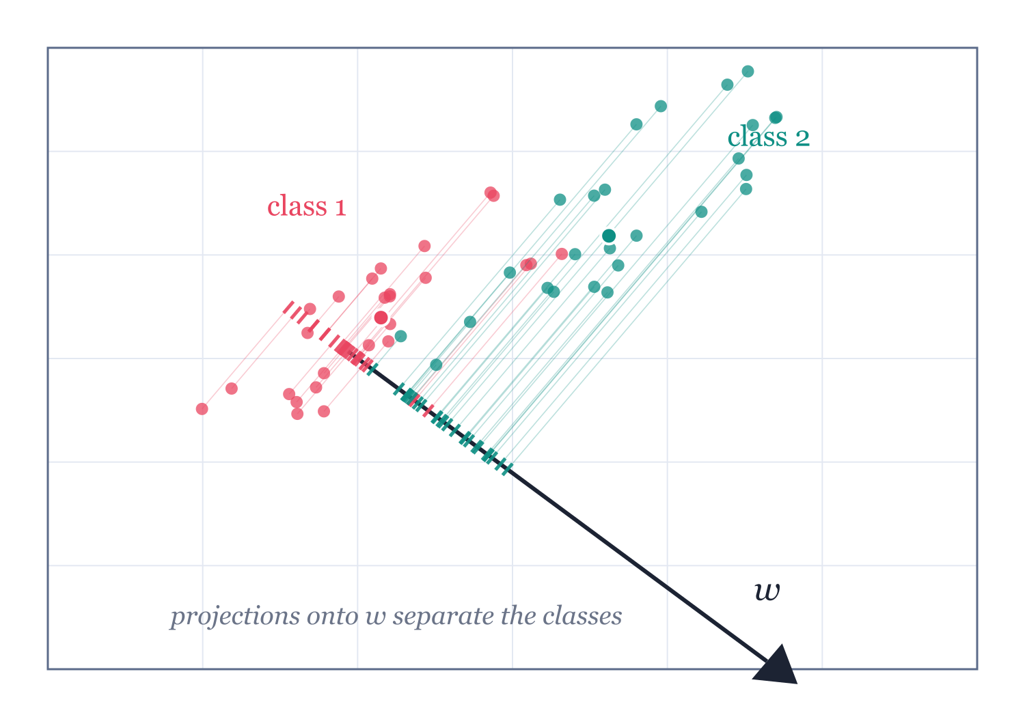
The classic picture: project, then separate
PART II · LDA & QDA
Not the mean-difference line
S_W⁻¹ tilts w to cancel the shared correlation — that tilt is the whole trick
After projection
classification collapses to a 1-D threshold between two tight clusters
K classes
up to K−1 useful directions — a supervised map to K−1 dimensions
Notes:
Walk the figure: two correlated clouds; the arrow is Fisher's w ∝ S_W⁻¹(μ₁−μ₂); ticks on the axis are the projected points. The projections form two crisp 1-D clusters. Thought experiment: project onto the line joining the means instead — with correlated scatter, those within-class smears overlap badly; S_W⁻¹ is what rotates the direction to account for the covariance. In the projected space, classification is a simple threshold. Generalises to K classes: up to K−1 discriminant coordinates — scikit-learn's transform() output, your go-to supervised alternative to PCA before plotting labelled data.

Slide 64
LDA vs PCA: supervised vs unsupervised axes
PART II · LDA & QDA
 | PCA | LDA (Fisher)
Uses labels? | no — unsupervised | yes — supervised
Maximises | total variance | between-class / within-class scatter
Directions available | up to p | up to K − 1
Can bury class structure? | yes — variance ≠ separation | no — separation is the objective
Typical role | compress, denoise, visualise | separate, then classify
The classic pipeline
PCA first (compress, fix p > n singularity), LDA second (separate), threshold third — e.g. Fisherfaces.
Notes:
Students conflate these constantly — draw the contrast hard. PCA: unsupervised; finds directions of maximum VARIANCE, blind to labels; can happily put both classes on top of each other if the noisy direction is the loud one. LDA: supervised; finds directions of maximum SEPARATION, normalised by within-class scatter; limited to K−1 directions (rank of S_B). Workflow in practice: PCA to denoise/compress (also fixes singular S_W when p > n), then LDA to separate, then classify — the classic Fisherfaces pipeline (next slide). If the variance direction and the separation direction coincide, both agree; when they don't, PCA plots mislead and LDA plots flatter — show both to be honest.

Slide 65
When discriminant analysis lies to you
PART II · LDA & QDA
≠
Non-Gaussian classes
skewed or multimodal classes → boundary lands absurdly. Fix: transforms, mixture DA, kernels
✱
Outliers
μ̂ and Σ̂ are not robust — one wild point tilts the boundary. Fix: robust estimates, trimming
p>n
High dimensions
Σ̂ singular when p ≥ n — nothing to invert. Fix: shrinkage (Ledoit–Wolf), diagonal LDA, PCA first
⚖
Imbalance & wrong priors
log π_k is the principled lever — the sin is silently assuming 50/50 on skewed data
Habit to teach
before trusting QDA's curved boundaries, look at per-class histograms / QQ plots — the model is checkable, so check it.
Notes:
Checklist for practice. (1) Non-Gaussian classes: skew or multimodal classes break the density model — the boundary can land absurdly; mixture DA or kernel methods help. (2) Outliers: means and covariances are not robust; one wild point tilts the boundary — robust estimators or trimming. (3) p > n: Σ̂ singular, can't invert — shrinkage (Ledoit–Wolf), diagonal LDA, or PCA first. (4) Imbalanced classes: fine IF priors are set honestly — in fact the log π term is the principled fix; the error is silently using 50/50. (5) Categorical/boolean features: Gaussian story collapses; use naive Bayes or logistic. Teach: ALWAYS plot per-class residuals/QQ if you plan to trust QDA's curves.

Slide 66
Ninety years old and still shipping
PART II · LDA & QDA
☺
Fisherfaces
🧬
Genomics (p ≫ n)
PCA + LDA on pixel vectors ran face recognition for a decade before CNNs
regularised/diagonal LDA classifies tumours from microarrays with n in the dozens
₹
Credit & finance
ψ
Brain-computer interfaces
Altman's Z-score (1968) — a linear discriminant on 5 ratios — still screens bankruptcy risk
shrinkage LDA is the default EEG decoder: tiny n, real-time, stable
The shared niche: small data, hard interpretability or latency constraints — where closed form beats gradient descent.
Notes:
Credibility tour. Fisherfaces: PCA+LDA on face images — a decade of face recognition before deep nets. Bioinformatics: gene-expression classification where p >> n made (shrunken-centroid / diagonal) LDA the standard. Credit scoring: Altman's Z-score (1968) is literally a linear discriminant on five financial ratios, still quoted daily. Brain-computer interfaces: (shrinkage) LDA is the default decoder for EEG — tiny data, needs stability. Marketing/NLP/ecology: LDA as a quick supervised embedding. Common theme: small data, need for speed and interpretability — the regime deep learning does not own.

Slide 67
Part II in six lines
PART II · LDA & QDA
1
Classify to the biggest posterior: argmax π_k f_k(x) — the Bayes rule is the gold standard
2
Model each class as a Gaussian — log-likelihoods become quadratics, algebra replaces integration
3
Shared Σ → quadratics cancel → linear boundaries: LDA, fit by counting and averaging
4
Per-class Σₖ → quadratics survive → conic boundaries: QDA — pay for flexibility with variance
5
LDA vs logistic: same boundary family, generative vs conditional fit — efficiency vs robustness
6
Fisher: maximise between/within scatter → same w, plus a K−1-dimensional supervised embedding
Fisher published this in 1936. It still ships in every stats library on earth.
Notes:
Mirror the Part I recap. 1. Bayes posterior maximisation is the optimal rule; generative methods get there by modelling each class. 2. Gaussian class-conditionals make log-posteriors quadratic. 3. Shared Σ cancels the quadratic — linear boundaries (LDA). 4. Per-class Σ_k keeps it — conic boundaries (QDA); choose by bias-variance and per-class sample size. 5. LDA ≈ logistic's boundary but fit generatively — efficiency vs robustness. 6. Fisher's criterion recovers the same directions and gives supervised dimensionality reduction (≤ K−1). Then the closing bridge slide.

Slide 68
Two halves, one discipline
 | Reinforcement Learning | Discriminant Analysis
The object learned | a policy — behaviour over time | a boundary — labels, instantly
Core equation | Q ← Q + α[r + γ max Q′ − Q] | δ_k(x) = xᵀΣ⁻¹μ_k − ½μ_kᵀΣ⁻¹μ_k + log π_k
How it is solved | stochastic iteration to a fixed point | closed form — count, average, invert
Data appetite | millions of interactions | hundreds of rows
What can fail | reward mis-specification, instability | wrong density assumptions
Assumptions are a currency. LDA spends them to save data; RL hoards them and pays in samples. Price every new problem in that currency.
Notes:
Close the loop. Same column structure as the opening slide, now with everything underneath filled in. RL: expectations solved by iteration, exploration because the data is self-generated, guarantees asymptotic. LDA: expectations solved in closed form, no exploration because data is given, guarantees exact under assumptions. The meta-lesson: 'learning' spans from stochastic approximation to counting — and knowing which tool a problem deserves is what makes an expert. If they take one sentence home: assumptions are a currency — LDA spends them to save data; RL hoards them and pays in samples.

Slide 69
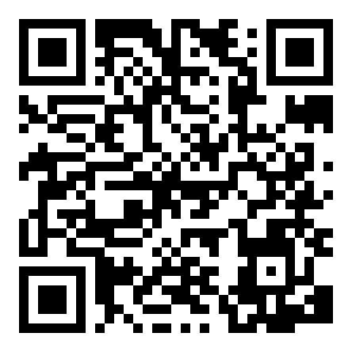
A complete project, small enough to own
FINALE · SHOW THE PROJECT
1
A volunteer plays 10 balls of Catch — note the score
2
“Let the AI learn” at speed ×1 — it is hopeless (all it knows is +1 / −1)
3
Crank to ×100: the learning curve climbs past the volunteer live
Catch — the project
4
Scroll down: a full project report — their template for course projects
claude.ai/artifact/8k2VvNTfvdqy4CAjjBrLgw
630 situations × 3 moves × one line of arithmetic = a machine that beats its maker. That's the course.
Notes:
The finale demo (~4 min) — open the Catch project on the projector. Script: (1) invite one student up to play 10 balls with the arrow keys — they'll catch 7-9; (2) press 'Let the AI learn' at speed ×1: it is embarrassingly bad, let the room laugh; (3) crank speed to ×100 and narrate the learning curve climbing past the student's score — from random (~33%) to 90%+ in a few hundred balls; (4) show the brain panel: three numbers per situation, the starred one wins; (5) scroll to the project report: this is the write-up template they can copy for their own mini-projects. Close: nobody told it the rules — everything it knows came from +1 and −1.

Slide 70
Where to go deeper
📕
Sutton & Barto — Reinforcement Learning (2e)
the canonical text, free online — ch. 3–6 cover tonight's Part I
▶
David Silver's RL lectures (DeepMind/UCL)
ten lectures tracking the same arc, with proofs
💻
OpenAI Spinning Up in Deep RL
from Q-learning to PPO with working code
📗
Hastie, Tibshirani & Friedman — ESL, ch. 4
LDA, QDA, logistic regression side by side, free PDF
📘
Bishop — Pattern Recognition & ML, §4.1–4.3
the probabilistic, generative view of classification
⚙
scikit-learn: LinearDiscriminantAnalysis
run tonight's Part II in ten lines; shrinkage included
Take-home
tonight's demo scripts re-implement everything — rerun them, then rebuild Q-learning and LDA from scratch (under 100 lines each). The playground link stays live.
Notes:
Curated, short. Sutton & Barto is free online and the single best RL text — read chapters 3-6 to own everything from tonight. David Silver's ten DeepMind lectures mirror it. Spinning Up (OpenAI) for implementing deep RL honestly. For Part II: Elements of Statistical Learning chapter 4 (free PDF), Bishop 4.1-4.3 for the probabilistic view, and scikit-learn's LDA/QDA docs to run everything from tonight in ten lines. Suggested exercise for both: implement tabular Q-learning on cliff-walking, and LDA on Fisher's iris data, from scratch — each is under 100 lines.

Slide 71
Questions
Thank you — let's argue about γ, priors, and everything in between.
anubha.parashar@cbre.com
Notes:
Open the floor. Likely questions: 'Is Q-learning used in production?' (bandits and RLHF yes; full MDP control is rarer), 'When would I actually choose QDA over a random forest?' (small n, probabilistic outputs, interpretability, speed), 'How does DPO differ from PPO-RLHF?' (folds the RL step into a classification loss on preference pairs). Keep the key-equations from the bridge slide one keypress away.

