Slide 1
Introduction to BIDS
Dragan Rangelov

Slide 2
Share the love
You can find all materials for this event on GitHub
github.com/draran/BIDS_tutorial

Slide 3
Brain Imaging Data Structure - BIDS
bids-specification.readthedocs.io
The current stable version is 1.4.0
Specifies standards for:
File naming
Organising folders
Recording metadata
Outcomes:
Increases reproducibility
Facilitates re-use of data

Slide 4


Slide 5
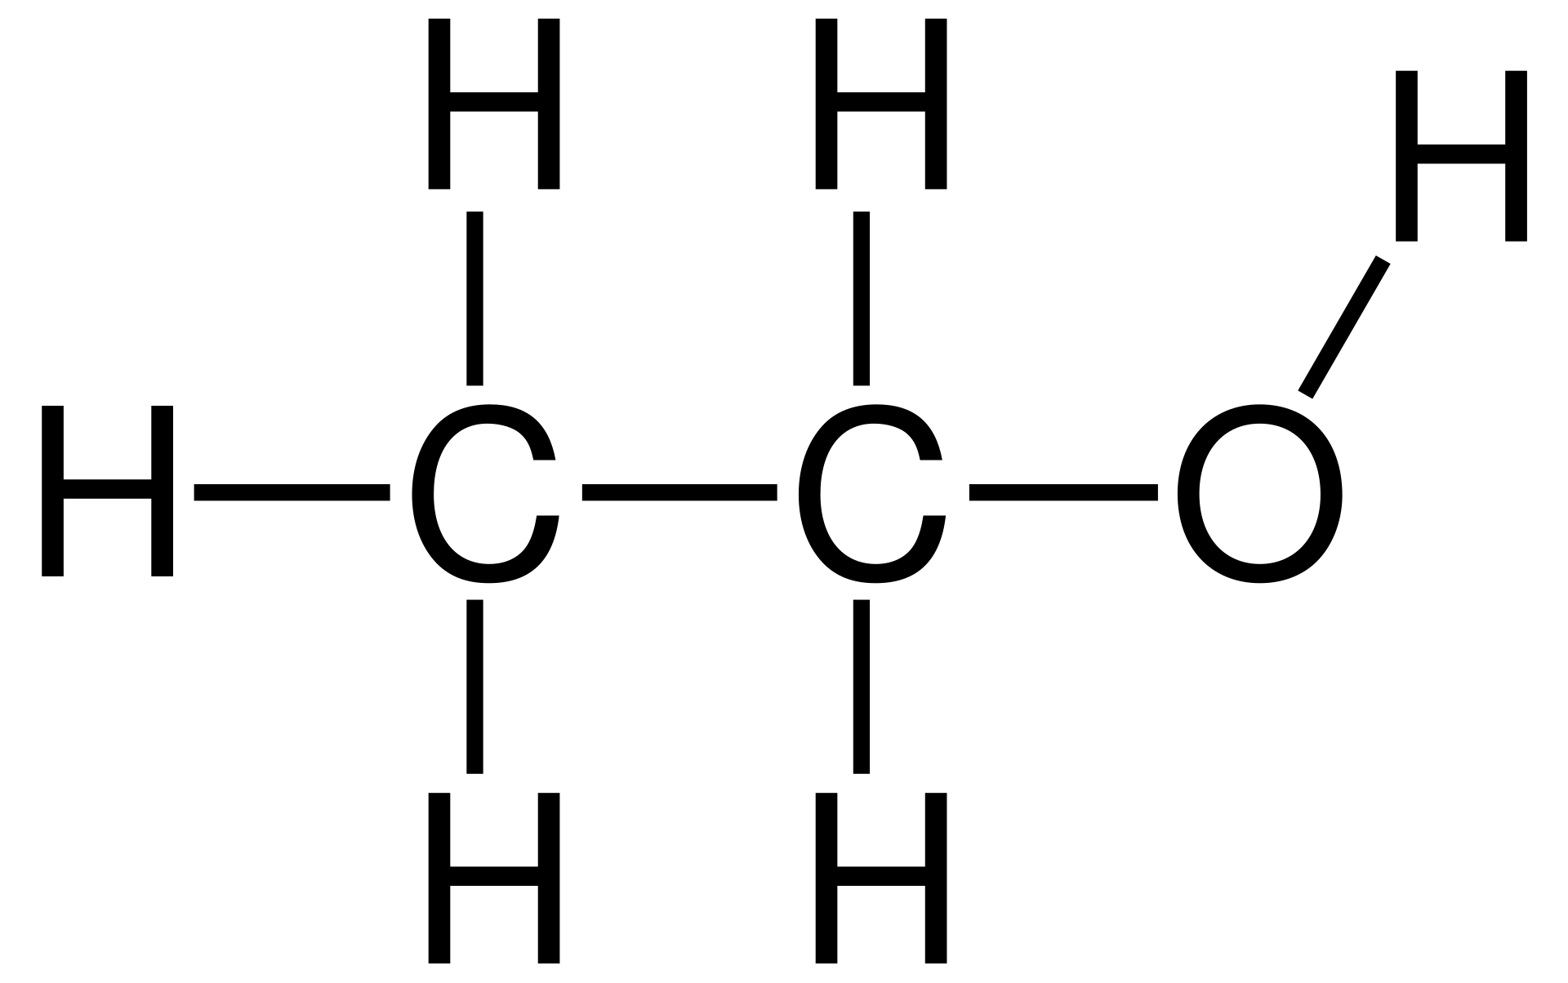
Broader context – community perspective
Facilitates open science
Open exchange and re-use of ideas, methods, data and analyses algorithms
With appropriate citations (you can cite datasets, or you will be able to)
Using a well-defined vocabulary
Similar to the naming system in organic chemistry
Name defines the nature of the named entity
And implies many of its properties
ETHANOL - booze
Two carbon atoms = ETH
Single link between them = AN
Hydroxyl group = OL

Slide 6
Narrow context – individual/lab perspective
PhD students
Don’t have to re-invent the wheel (s001_eeg.txt, vp_ABX_eye.tsv.gz, etc.)
Post-docs
Can substantially speed-up their workflow by using automated pipelines
Lab heads
Can hire a new person with minimal costs in knowledge-transfer
All
Can quickly archive data and analyses and share them with the community
Can re-use freely (as they already do), but in a well-defined way

Slide 7
Bad stuff
Takes time to get familiar with
Requires change in the existing workflows
Minimal for PhDs
Substantial for post-docs
Lab heads – well …
There are still no standards for some types of data/data analyses
Heavy focus on “classic” neuroimaging – fMRI
But, there are groups developing analogous standards for all sorts of data

Slide 8
How does it work

Slide 9
What’s in a name? All
Folder structure:
Source data – the original data, frozen in time
Raw data – unprocessed data, transformed in a more convenient data format
Derivatives – all analysed data
Scripts – data analyses scripts
Export – my addition, location to export figures, tables, etc., to be used in publications (manuscript, presentations, posters)
README.txt – free form description of the dataset
CHANGES.txt – history of changes to the dataset
dataset_description.json - structured description of the dataset

Slide 10
Short primer on JSON data format
JavaScript Object Notation (or Jason)
Language-independent format, a text file with ”.json” extension
That is organised in a specific way:
Attribute-value pairs, “task”: “Stroop”
Such files can be easily parsed by most (all?) programming languages
And read in as a language-specific data structure:
MATLAB – structure
Python – dictionary
R - data frames (lists, too)

Slide 11
JSON data format
What you cannot do with JSON
Cannot evaluate statements, e.g., x = cos(theta)
Cannot check for syntax errors (easily)
Because – it’s a simple text file
What you can do with JSON
Store anything that can be converted to strings (which is a lot/if not all)
Can organise structured metadata easily

Slide 12
Raw data
Modality-specific data
Will depend on the nature of the acquired data
Behaviour, fMRI, EEG/MEG, eye-movements, questionnaires, …
Metadata – json files
fMRI – hardware specifics, sequence parameters, etc. …
EEG - hardware specifics (filters, sampling frequency, manufacturer, etc.)
You get the idea
This is boring and tedious (if not impossible) to create by hand
There are tools that automate this process (dcm2niix, mne-python)

Slide 13
Task data – also part of raw data
Used in task-based neuroimaging (broadly defined)
As opposed to resting-state neuroimaging
Describe timing and other properties recorded during the imaging session:
Essentially list of triggers (for EEG) or events (for fMRI)
Onset, duration
BUT, you can add other data as well – eye-data, reaction times, etc.
Which later on facilitates cross-modal analyses

Slide 14
Physiological and other continuous recordings
Eye position / Respiration / heart beat / GSR

Slide 15
File formats
Imaging data:
MRI – nifti
MEG – no consensus
(i)EEG – edf, biosemi, brainvision, eeglab
Other data:
Compressed tab-separated values (tsv.gz) text files

Slide 16
Organisation of files and folders
Clear separation of data and metadata:
fMRI data file (e.g., nifti)
Accompanying (sidecar) json file
Matching file names, different extensions
The file names are prescribed using fields containing pairs of values, separated by a hyphen “-”:
Subject field: sub-<subID>
Session field: ses-<sesID>
Site field: unspecified
Task field: task-<taskID>
Modality field: keyword, e.g., ‘bold’, ‘physio’, ‘events’
Different fields are separated by an underscore “_”.

Slide 17
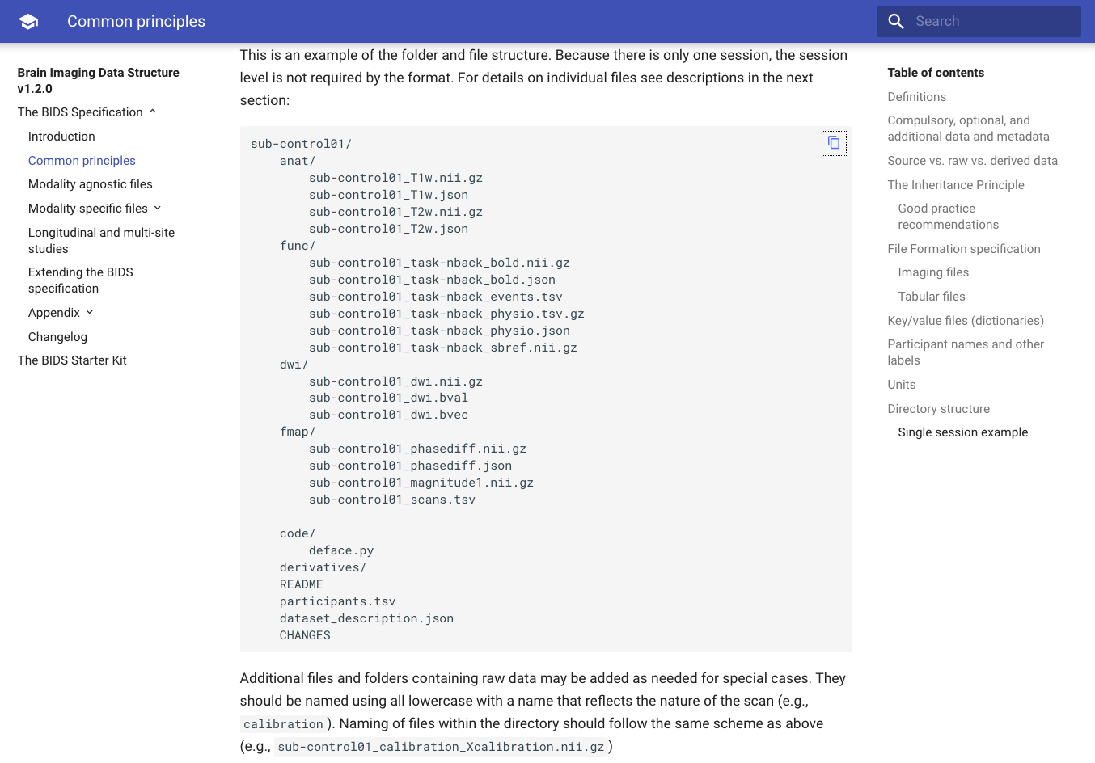

Slide 18
Metadata inheritance principle
Each dataset inherits more general metadata:
If all participants performed a single task, e.g., “Stroop”, then the task description applies to all of them
Single task.json file
This can be overridden at any level:
If there were two paradigm versions, one more general, the other a fall-back option, this can be overwritten on an individual basis.
Inheritance is made easy, as the file naming is cumulative.

Slide 19
The best reason to use BIDS - automated pipelines
FMRIPREP
Uses only open software (nipype) in python
Fully automated data pre-processing pipeline (with some parameter selection)
Relies on BIDS metadata and data organisation

Slide 20
Some useful/inspiring links
openneuro.org – storage of datasets (successor of openfmri)
datalad.org – continuous versioning/integration of datasets
cognitiveatlas.org – knowledgebase (ontology) of cognitive science
Concepts (e.g., abstractive reasoning, etc.)
Tasks (e.g., backward masking, etc.)
Disorders
Theories
cogpo.org – cognitive paradigm ontology (specifies tasks in cognitive sciences)

Slide 21
Demo

