Slide 2
Pilot Challenge #2 Healthcare Data Exchange
Challenge: How can we design a standard data exchange between the public and private sectors that will improve healthcare management?
Challenge Winner: Niels Lagerweij,
Hans van der Graaf, André van Cleeff, Frank van Grinsven

Slide 3
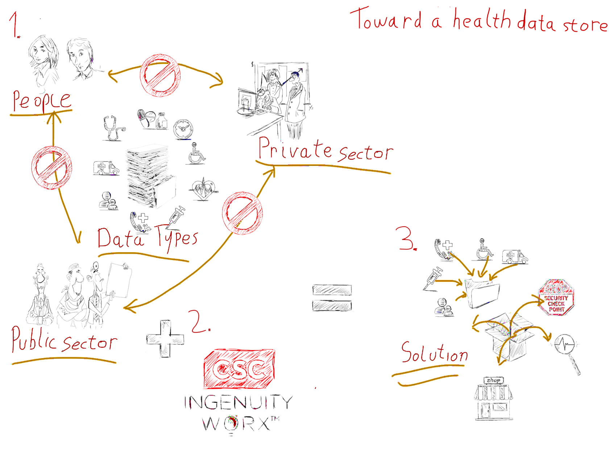

Slide 4
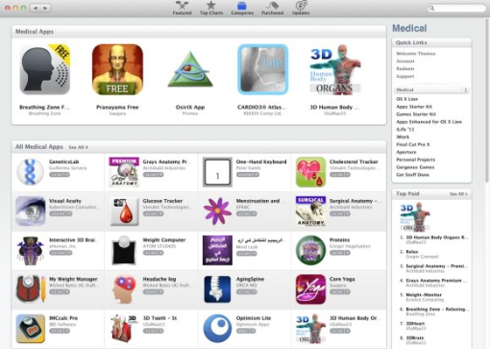
Here Is the Solution
Interfacing
Consent
Health Data Store
Shopping Cart
Data Transformation
Big Data Analytics

Slide 5
Roadmap
Build MVP (Land)
Extend
Expand
Build Consent Module
Extend Solution by Gradually Adding Features and Providers
Add Data Analytics Function
Build UI and Shop
Run Pilot Analytics Project
Connect and Provide First Data Providers
Launch Healthcare Analytics aaS
3 Months
3 – 6 Months
1 – 3 Months

