Slide 2
Pilot Challenge #1 Adaptive Sourcing
Challenge: What are the visionary and best practices for allowing governments to benefit from the power and flexibility of the cloud?
B
2
G
Challenge Winner: Tom Fusting

Slide 3
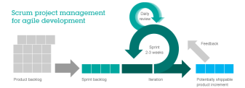

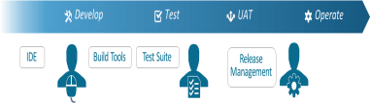
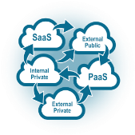


Transforming Contracting for the Agile, As-a-Service, and DevOps World with Adaptive Sourcing
Agile Development
As-a-Service
Utility
Contracting Officer Templates & Best Practices
DevOps Automated Delivery
Hybrid Clouds
APIs
Integration & Automation
Open Source Software Innovation
Legacy Contract Models Don’t Support Next-Gen IT

Slide 4
What Fundamental Changes Are Needed?
1
FFP, CPFF, T&M
Supplier-Defined FUP, VUP, via BPA
From
To
Via
Resources
Time
Contents
2
Contract Structural Barriers
Collaboration via Joint Incentive SLAs
From
To
Via
Dev
Ops
Infinite and Highly Integrated Continuous Loop of Dev Ops
3
Manual CO Approvals, Slow
Auto Policy-Based Governance, Instant
Approval
Amount > 1,000
To
From
Employee
?
CODE
CODE
Manager
Dev
QA
UAT
Need more info
VP
Adaptive Sourcing Manifesto: Aligning Contract Models to Enable Effective Delivery of Agile, DevOps, and Cloud

Slide 5



Adaptive Sourcing Initiative Recommended Roadmap
Engage AFEI ADAPT, PSC, AWS
Improving
Branding
CSC Adaptive Sourcing Working Group
Risk
Third-party assoc. contributions
Publish and Evangelize
PWin
ADAPT working group
Enlist FAR, Pricing, and AGM expertise with vision of possible
Revenue
FedTech, FCW, GCN,CIO.org
The Adaptive Sourcing Manifesto ― Top 10 List
Early adopters at DHS, GSA, FAA, Navy
Acquisition and Business Policy Council (ABPC)
Brief AGMs, IGMs, and Sales to shape capture
Brief at AFEI Conference
Partner
Develop
Market
Partner, Develop, and Market the Adaptive Sourcing Manifesto to Realize Promises of CSC’s Next-Gen IT Strategy for Our Customers

Slide 6
THANK YOU

