Slide 1
Stock Performances in Nasdaq– A predictive outlook
Logan Roach and Diganta Rashed

Slide 2
overview
Introduction
Methodology
Prediction Model
Best Stocks for Purchase
Overview

Slide 3
INTRODUCTION
Objective to form best possible portfolio
Top 5 performing stocks from 2022 NASDAQ high tech stocks results
Model provides idea of what factors are important in assessing well performing stocks
Price comparative to market cap, price change, share volume, etc.

Slide 4
Method
Linear Model – What factors directly influence the price?
Understanding relationships = clearer picture of what we can use to predict
Prediction based on given factors = accurate model of highest earning stocks

Slide 5
Operation strategy
Relationships
Prediction
Outcome
Multiple Regression Models to understand relationships between different data points
​Finding what directly impacts the price and movement of stocks
Using Predictive Functions to identify the performance of stocks given their share value and price changes through 2022
Using multiple regression models to generate most accurate prediction of performance
Summarizing and presenting findings of analysis to identify best performing stocks
With prediction outcome, allocating funds evenly to the top 5 highest performing stocks

Slide 6
Regression outcomes and criteria
Based on multiple regression models, best variables to consider:
Price Change, Earnings Per Share, Market Cap, Price Percentage Change, Beta Value (Market Volatility)
Given the values, we can observe trends, significance, and order stock information
Observe P values to identify what elements are statistically significant in our model

Slide 7
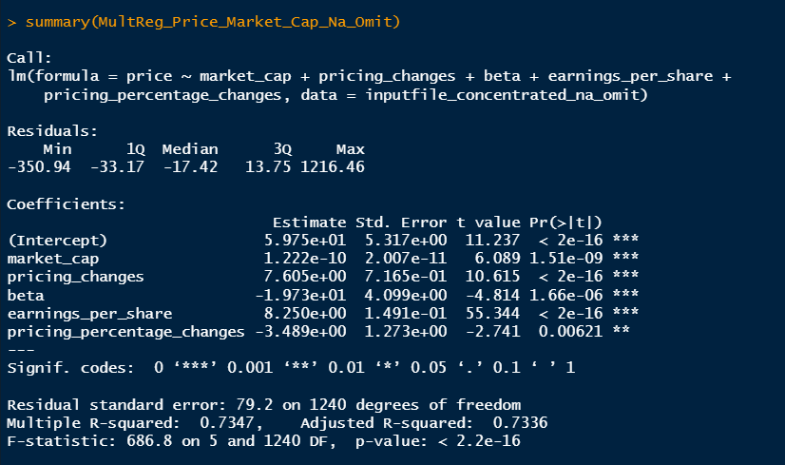
Linear Model, Multiple Regression
Based on the p-values, the most relevant predictors were:
Market Cap
Pricing Changes
Beta (measure for market volatility)
Earnings Per Share
Percentage Changes in Pricing
These variables are all important markers in assessing how to select the most desirable stock

Slide 8
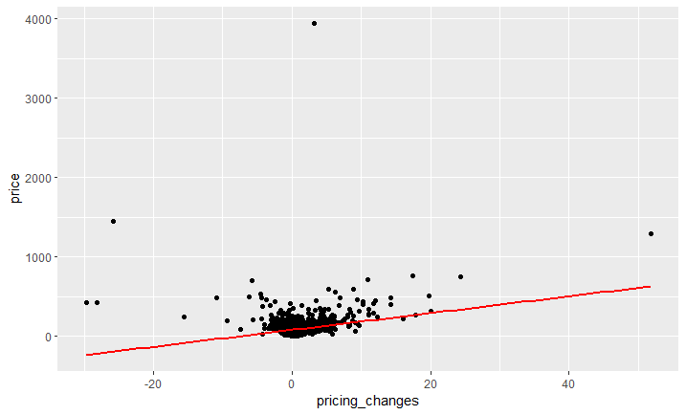
Stock Price Change In dollars Relationship on Stock Price
A weak positive relationship between price and pricing changes is seen in the plot (right).
As expected, an increase in the change of price results in an increase in the overall price.

Slide 9
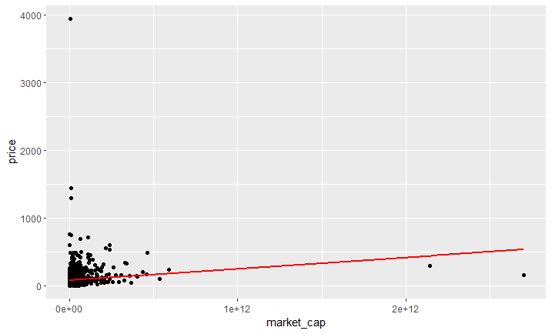
Market Cap (Volume) Relationship to Overall Stock Price
There seems to be a weak positive relationship between the market cap and the price of a stock.
This would make sense because confidence in the stock would result in more investors purchasing the stock leading to an increase in price.

Slide 10
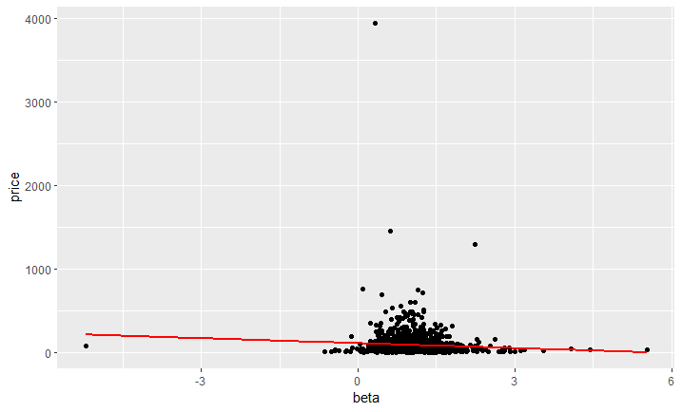
Beta (Measure of Stock Volatility) Relationship to Price of the Stock
There seems to be a weak negative correlation between the price of a stock and associated measure of volatility relative to the market (beta).
Volatility can shake the confidence of investors looking to purchase stock in company which would lead to a decrease in the price as investors look to invest in more secure investments.
This potentially indicates a higher priority towards stability than maximizing profit.

Slide 11
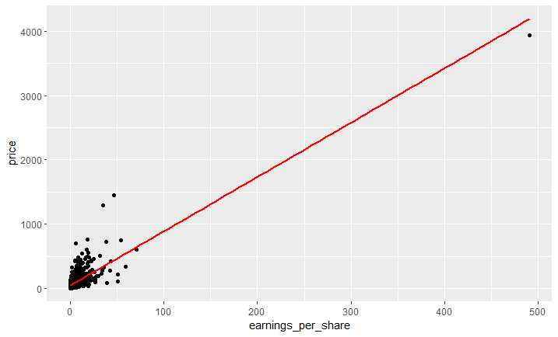
Relationship of Earnings Per Share on the OveraLl Price of the Stock
There seems to be a mildly strong relationship between price and earnings per share for a company's stock.
A strong earnings report would send a strong buy signal to investors, especially regarding the volume of shares a stock has in the market or earnings per share.

Slide 12
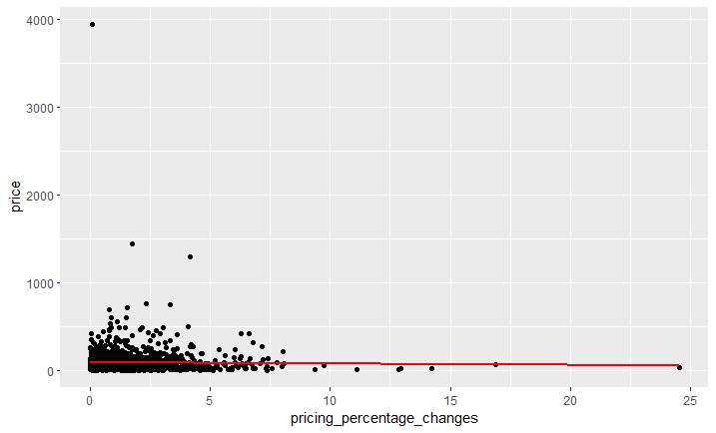
Relationship between the percent price change and The Overall Stock Price
There seems to be a very weak negative correlation between the price of a stock and the pricing percent change in the stock price.
The percentage change in price can be seen as another way to view volatility although to a lesser extent than the beta (measure of volatility relative to the market).

Slide 13
Top 5 stocks For the Portfolio
 | symbol | name | price | pricing_changes | pricing_percentage_changes | market_cap | earnings_per_share | annualized_dividend | symbol_yield | beta
 | BC^C | Brunswick Corporation 6.375% Notes due 2049 | 136.18 | 110.18 | 423.77 | 239200000 | 64429.55052 | 1.764814815 | 6.546296296 | 1
 | BKNG | Booking Holdings Inc. Common Stock | 2185.21 | 105.03 | 5.05 | 88723042324 | 28.12 | 0.98 | 1.715 | 1.21
 | MELI | MercadoLibre, Inc. Common Stock | 1041.44 | 89.1 | 9.36 | 51808022899 | 1.69 | 1.9456 | 4.624 | 1.51
 | AMZN | Amazon.com, Inc. Common Stock | 3009.07 | 61.74 | 2.09 | 1.51127E+12 | 64.78 | 1.088 | 0.408 | 1.11
 | TPL | Texas Pacific Land Corporation Common Stock | 1295 | 51.81 | 4.17 | 10030260625 | 34.84 | 12 | 0.93 | 2.24

Slide 14
SUMMARY
Top 5 performing stocks based on our findings:
BC^C = Brunswick Corporation
BKNG = Booking Holdings Inc. Common Stock
MELI = MercadoLibre, Inc.
AMZN = Amazon Inc.
TPL = Texas Pacific Land Corporation Common Stock
Based on graphical model and considering outliers, these are best options to buy

Slide 15
And if our statistics aren't convincing, here's another approach...
https://www.youtube.com/watch?v=wz-PtEJEaqY
**DISCLAIMER – POTENTIALLY NSFW**

