Slide 1
Welcome

Slide 2
Medical Management system
Name : Devani Drashti
Exam no : 4064
Project Guide :prof nainesh sir

Slide 3
1. Project description :
main purpose is that make sales report and billing.
shop holder easily get every data and information .
shop holder easily manage there every customers .
Fast access bill and report evry time and anywhere .
Groser can manage every product and there deteils.
Retailer get information about product availability.
Admin can login and logout . .
second main purpose is fast process and save time.

Slide 4
2 .Technologies used :
Front-end languages : .
HTML .
CSS .
Java script .
Bootstrap .
Back – end languages : .
PHP .
MYSQL database .

Slide 5
3. Existing system and its drowback :
first and main is time consumption . .
chances of errors and data processing time. .
Required more time to complete user requirement.
It will incerese updating is complicated. .
security of data were not maintain . .

Slide 6
4. Requirement gethering and analysis :
- Usability : .
This section includes all of those requirements the effect usability . We get the response is within seconds . The Software must have a simple, user – friendly interface so customers can save time and confusion. .
-Reliability : .
The system is more reliable because of the qualities that are inherited from chosen platform
java. The code built by using java is more reliable. .
-Supportability : .
The system is more reliable because of the qualities that are inherited from the chosen the
platform java. The code built by using java is more reliable. .

Slide 7
- Implementation : .
The system is implemented in web environment. The apache tomcat is used as the web server and windows XP professional is used as
the platform. .
- Interface : .
The user interface is based on the web browser. The application is developed using JSP and HTML along with DHTML. The Interface
design is aimed at flexible front – end communication to provide the
user with clear information in user – friendly interface is planned.

Slide 8
5 .Data flow diagram /UML :
6. Database design :
7. Input design :
8. Output design :

Slide 9
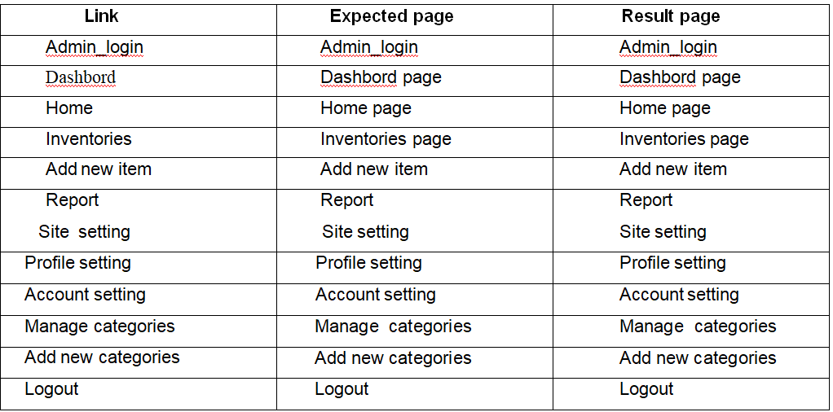
9. Testing :

Slide 10
10. Limitations :
The objective of this project is to organize store details medical like stocks, medicines, expense, sales and others.
The medical store management system is developed as application program for reducing manual work managing medical store. .
The medical store management system is developed as application program for reducing manual work managing medical store. .

Slide 11
Thank you

