Slide 1




Project Title: Super Store Analysis
Team ID - CU_CP_Team_10108
Team Leader Name: Drashti Patel
Team Member 1: Drashti Patel

Slide 2

Project Objectives
To contribute to the success of a business by utilizing data analysis techniques, specifically focusing on time series analysis, to provide valuable insights and accurate sales forecasting.

Slide 3
Problem Statement
Superstores handle large volumes of sales data across products, customers, and regions.
Managers struggle to clearly understand which products or areas generate profits and where losses occur.
Traditional reports fail to offer deep, actionable insights in an easy-to-understand manner.
The company finds it hard to decide where to focus marketing, inventory, and discount strategies due to unclear sales patterns.
Our project aims to build a data analysis solution using historical sales data to uncover key insights.
By analyzing sales trends, regional performance, customer segments, and product categories, we help the business optimize decisions.
The tool will visualize insights using interactive dashboards, making sales performance monitoring simple and effective.
This solution supports management in making informed decisions to increase profitability and minimize operational inefficiencies.

Slide 4
Project overview - Introduction
What is Superstore Insights:
A dashboard built using “Power BI” for interactive sales analysis and reporting.
How It Works:
Imports historical superstore sales data (CSV/Excel format).
Cleans and preprocesses data (handling missing values, date formats, etc.).
Analyzes key metrics: sales, profit, discount, quantity.
Segments data by region, customer type, category, sub-category.
Visualizes trends, top-performing products, and regional performance.
Provides interactive dashboards for real-time business monitoring.

Slide 5
End User
Target Audience:
Retail store managers and business owners
Sales and marketing teams
Financial analysts seeking product and regional insights
Inventory and supply chain planners.
User Benefits:
Quick insights into sales and profit trends
Clear and interactive data visualizations for easy understanding
Identification of best-selling products and underperforming regions
Supports strategic planning in discounts, marketing, and inventory management

Slide 6
Wow Factor in Solution
Dynamic Sales Breakdown:
Breaks down sales data into categories, sub-categories, and regions for clear insights.
Interactive UI:
Users can filter by region, category, time range, and customer segment to visualize specific trends instantly.
Real-Time Performance Monitoring:
Dashboards update automatically as new sales data is imported, providing always up-to-date insights.

Slide 7
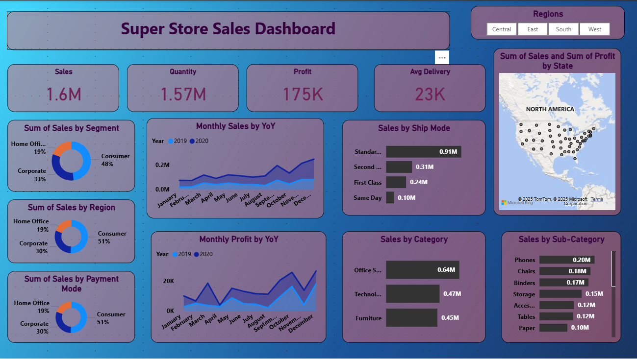
Result / Outcomes
​

Slide 8
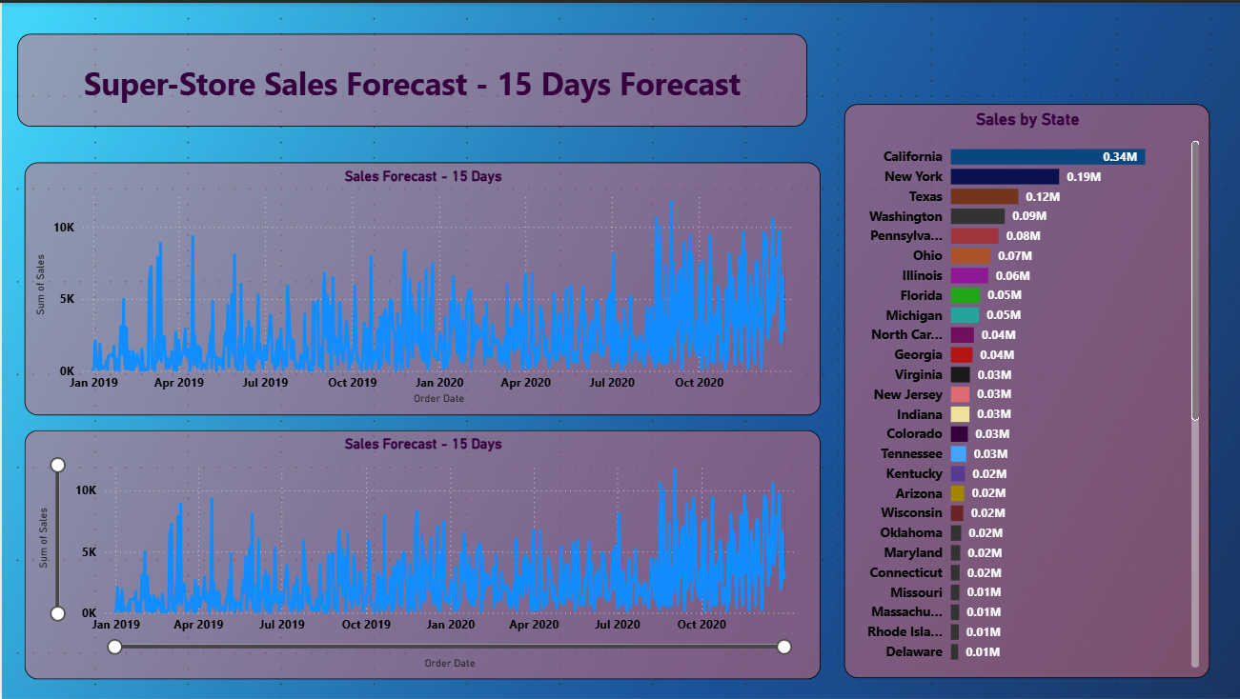
Result / Outcomes (Cont.)
​

Slide 9
Conclusion
Project Success:
Successfully developed an interactive sales analysis tool using Power BI to visualize sales, profit, discounts, and regional trends.
Key Takeaway:
The solution transforms complex sales data into clear, actionable business insights for strategic decision-making.
Learning Points:
Gained practical experience in sales data cleaning and preparation.
Improved skills in building interactive dashboards using Power BI.
Understood the importance of data-driven insights in retail business management.

Slide 10
Future Perspective
Improvements/Expansions:
Integrate predictive models for sales forecasting (e.g., ARIMA, ML-based models).
Include customer segmentation using clustering algorithms.
Expand analysis to cover returns, inventory management, and supply chain optimization.
Enable real-time data sync from live databases for up-to-date insights.

Slide 11
GitHub Link
https://github.com/drashtpatel/Super-Store-Analysis-by-using-Power-Bi.git

Slide 12
Thank you...!
Notes:
12

