Slide 1

Twist & Pulse
Ephemeral Adaptation to Improve
Icon Selection on Smartphones
Antoine Ponsard, Kamyar Ardekani, Kailun Zhang
Frederic Ren, Matei Negulescu, Joanna McGrenere
Notes:
Hello everyone. Today I will present a work that was done during my masters at UBC, with Joana McGrenere.

Slide 2
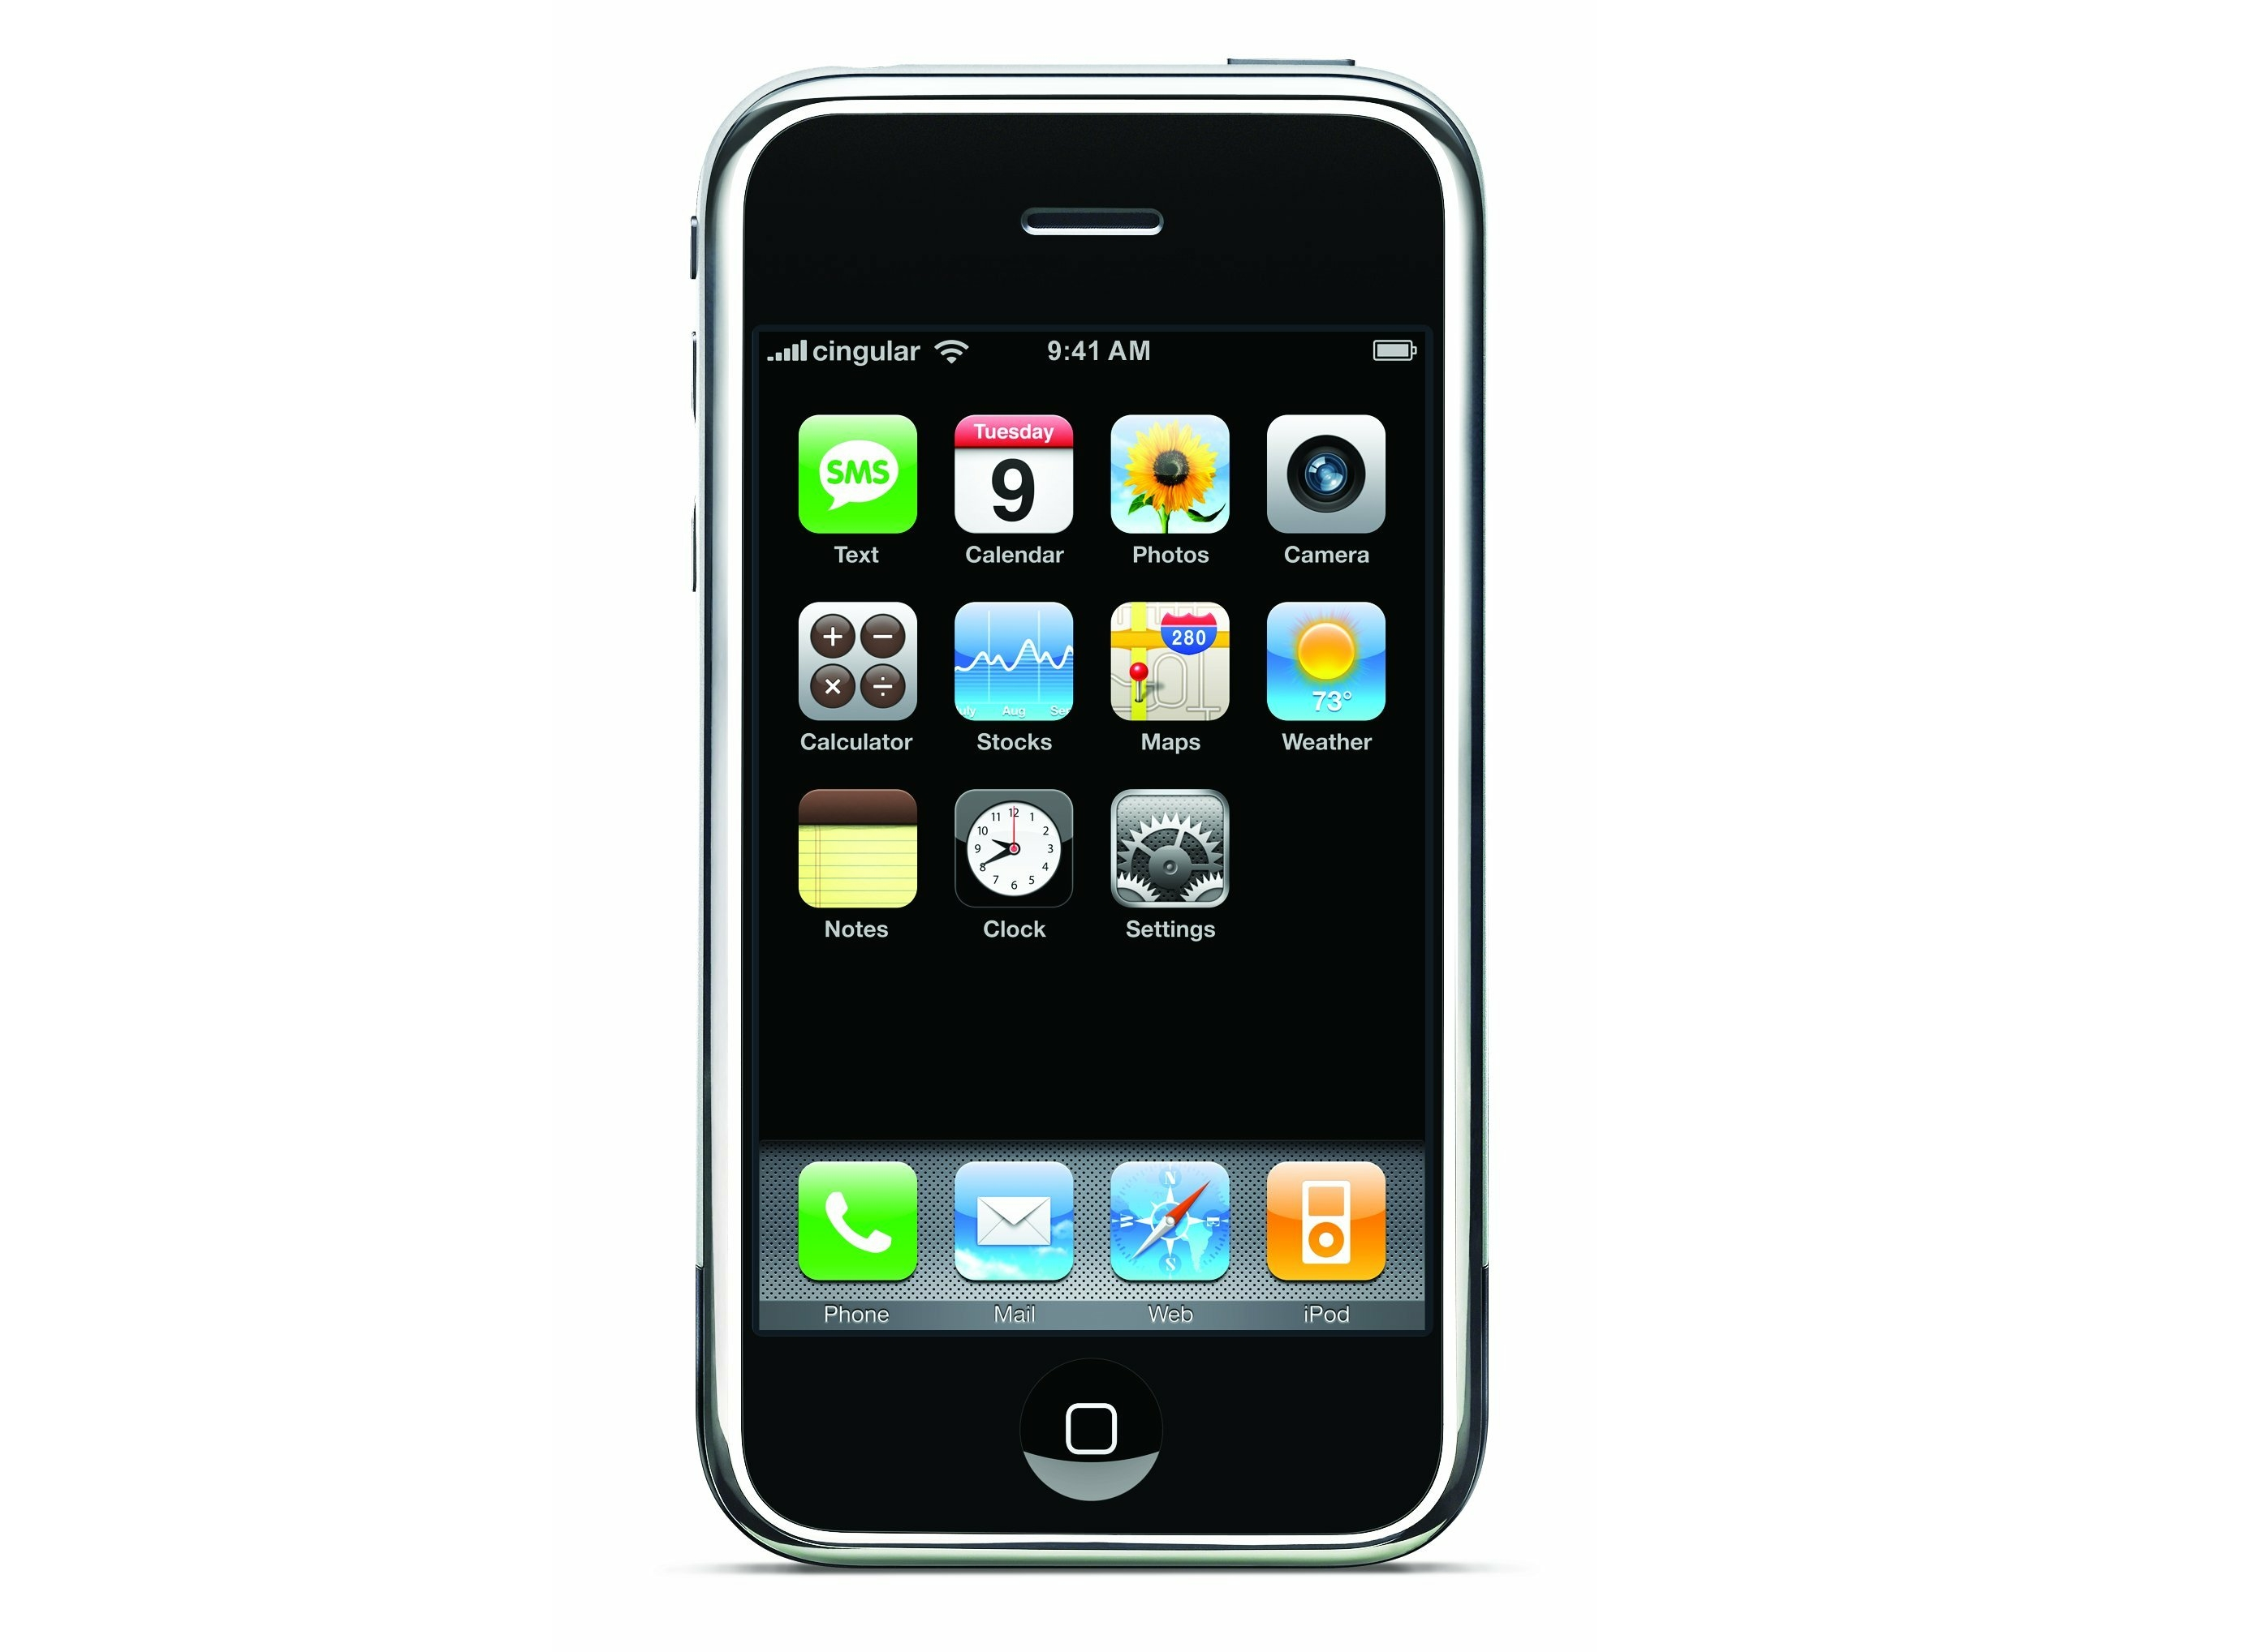
Notes:
The first iphone popularized the idea of tapping large icons to launch apps

Slide 3

Notes:
Let’s play a game. How quickly can you find this icon?

Slide 4





























Notes:
There are a lot of such apps

Slide 5
Notes:
it’s something we all do many times a day.

Slide 6
Patterns of use
Context-aware
Notes:
The good news is: our smartphone can learn patterns of use, and various sensors make them context-aware

Slide 7
Notes:
Let’s play again, but this time with the help of a prediction algorithm

Slide 8
Notes:
Much more effective

Slide 9
Notes:
It’s too good to be true: as long as computer can’t read our minds, they won’t be able to know exactly which app we want to use.

Slide 10
application candidates
Notes:
We can’t highlight just that one icon; but we can predict that it will be among a set of icons

Slide 11
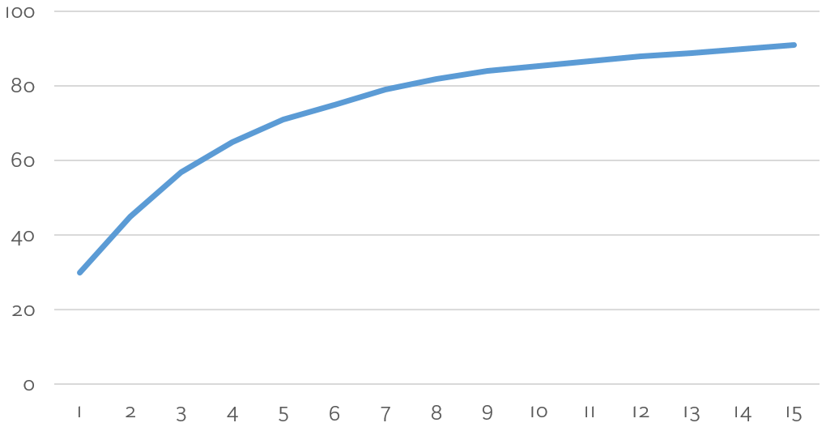
Prediction algorithms
prediction
accuracy
(%)
> 80%
# application candidates
Shin et al. (2012)
Notes:
Accuracy: probability that the app you’re looking for is among the set of application candidates
The more application candidates, the higher the chance they contain the correct app From previous research, we must predict multiple apps to have good accuracy

Slide 12
Notes:
So in practice, it won’t look like this

Slide 13
Notes:
but more like this
annoying in everyday use

Slide 14
Attentional draw
Distraction
Notes:
Key insight

Slide 15
How to convey algorithmic predictions to the user
while balancing attention and distraction?
Notes:
Our research question is:

Slide 16
distraction
attention
1. Design process
2. Experiment

Slide 17
distraction
attention
1. Design process
2. Experiment

Slide 18
Ephemeral adaptation
1. adapt the interface for a short time 2. revert it back to its normal state
Findlater et al. (2005)
Notes:
Findlater and colleagues

Slide 19
Ephemeral adaptation
Cheese
Cheese Wine Bread
Gruyère
Comté
Emmental
Abondance
Tomme
Reblochon
Mont d’Or
Tamié
Brie
Pont l'Evêque
Camembert
Boursin
Findlater et al. (2005)
Notes:
adaptation in the temporal domain
• spatial consistency
• fails gracefully when prediction is wrong
In the original paper, used only fade-in

Slide 20
distraction
attention
1. Design process
2. Experiment

Slide 21
Preattentive visual properties
processed in parallel by visual system
Notes:
leverage the human visual systems
process in parallel
color, orientation, size, and even the amount of blur

Slide 22
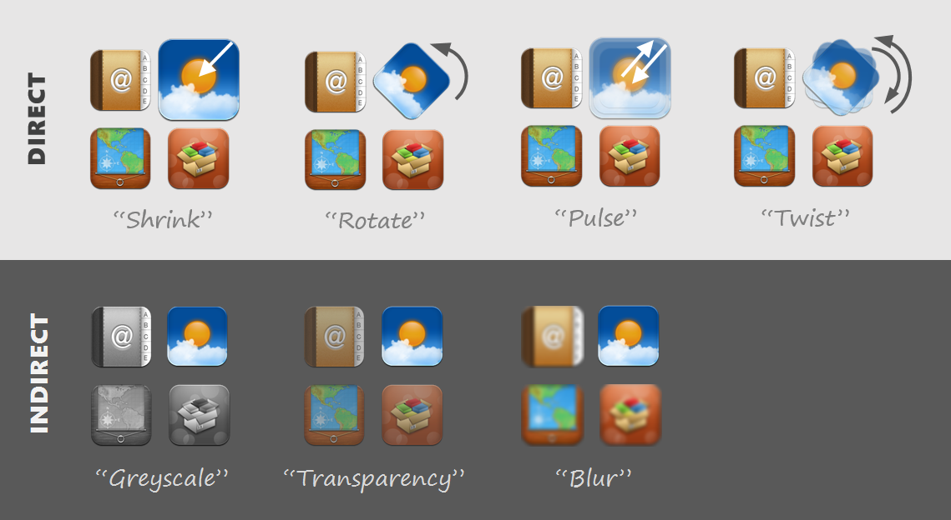

Slide 23
ephemeral adaptation
preattentive properties
1. Design process
2. Experiment

Slide 24
Effects
Pages
Accuracy
Twist, Pulse, Control
3 pages, 6 pages
80%, 95%
12 participants
480 trials each

Slide 25
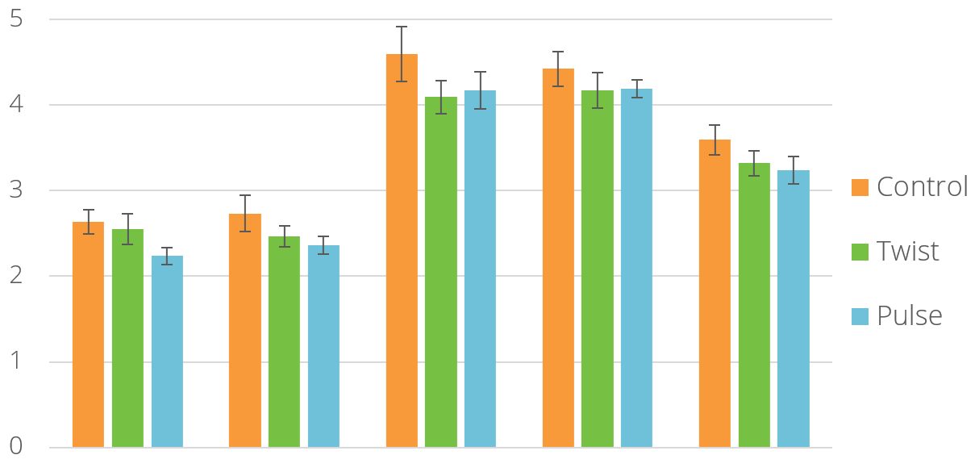
Twist and Pulse faster than Control
*
*
seconds
80%
95%
80%
95%
Overall
3 pages
6 pages
Notes:
8 to 10%, similar to the original paper

Slide 26
3 Pages faster than 6 Pages
seconds
80%
95%
80%
95%
Overall
3 pages
6 pages

Slide 27
No effect of Accuracy
seconds
80%
95%
80%
95%
Overall
3 pages
6 pages
Notes:
fewer but more costly errors at 95%

Slide 28
No effect of accuracy
4x less errors at 95% than 80%...
…but more costly at 95%
Notes:
one possible explanation is…
more research is needed

Slide 29
Subjective results
11/12 Pulse > Control
9/11 Pulse > Twist
8/11 Pulse less distracting than Twist

Slide 30
Ephemeral highlighting for icon selection
Preattentive visual properties — motion
Twist & Pulse faster (8-10%) and preferred
Notes:
To conclude,

Slide 31

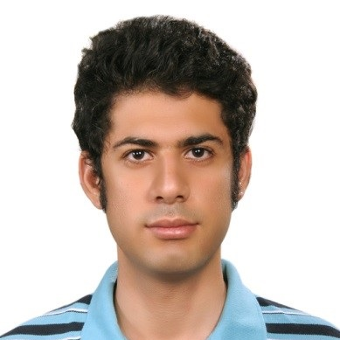
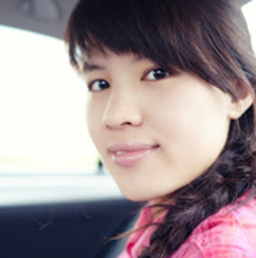
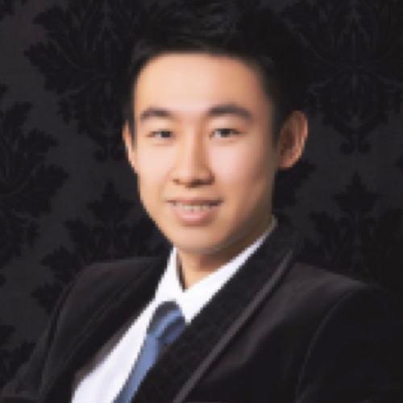


Antoine Ponsard
Kamyar Ardekani
Kailun Zhang
Frederic Ren
Matei Negulescu
Joanna McGrenere

Slide 32
Twist & Pulse
Ephemeral Adaptation to Improve
Icon Selection on Smartphones
antoineponsard.com
aponsard@cs.ubc.ca
Antoine Ponsard, Kamyar Ardekani, Kailun Zhang
Frederic Ren, Matei Negulescu, Joanna McGrenere

