Slide 1





AI Awareness Briefing
Meet PPC
SMARTHACK XI 2026 · AI WORKSHOP
PPC COMPANIES IN ROMANIA
PPC Renewables
Rețele Electrice
PPC Energy
PPC Blue

Slide 2





Who is PPC?
One of the main integrated energy companies in Romania, part of PPC Group
PPC GROUP IS PRESENT IN
PowerTech leader in South-Eastern Europe
PPC Group leads the energy and technology (PowerTech) industry in the region.
Greece
Where PPC Group was born and has its headquarters
Romania
Integrated presence across the entire energy chain
The whole energy chain
In Romania, PPC companies cover everything: renewable production, distribution and supply of electricity, and electric mobility.
North Macedonia
Part of the group's regional footprint
A clean-energy ambition
The goal: to become the clean energy leader in South-Eastern Europe and a significant player in the broader European market.
PPC in Romania
Four companies, one chain: from producing clean energy to charging your electric car.
PPC Romania · Company Overview
2 / 33

Slide 3



The energy chain: PPC is in every link
Production from renewable sources, distribution and supply of electricity, electric mobility
01 · PRODUCE
02 · DISTRIBUTE
03 · SUPPLY
04 · MOVE
PPC Renewables Romania
Rețele Electrice Romania
PPC Energy
PPC Blue Romania
Generates clean electricity from renewable sources.
Runs the grid that carries electricity to homes and businesses.
Sells electricity to households and companies: contracts, invoices, support.
Builds and operates charging stations for electric vehicles.
1.6 GW+
installed capacity, the largest private renewable producer in Romania
136,000 km
of power lines in Muntenia, Banat and Dobrogea
~3M
customers, ~80 stores and digital services
1,100+
EV charging points across Romania
Think of it like this: Renewables makes the energy, Rețele Electrice is the road it travels on, PPC Energy is the shop that sells it, PPC Blue puts it into cars. On top of that, PPC offers energy services for homes and businesses.
PPC Romania · Company Overview
3 / 33

Slide 4






Did you know?
A few surprising facts about PPC and the energy behind your socket
3.4× around the Earth
Meters never sleep
The wind doesn't take orders
~136,000 km of power lines: enough to wrap around the planet more than three times.
Over 2 million smart meters each send 96 readings a day: about 192 million rows, every day.
Wind farm output follows the weather, yet PPC forecasts it 15 minutes at a time for the next day.
A first for Romania
Energy is bought before it's used
EVs are hungry
Thanks to our in-house data platform, consumption data now reaches suppliers in minutes instead of days.
Electricity is bought in advance, so every forecasting error costs real money.
PPC Blue runs 1,100+ charging points across Romania, more than half of them fast or ultra-fast.
PPC Romania · Company Overview
4 / 33

Slide 5

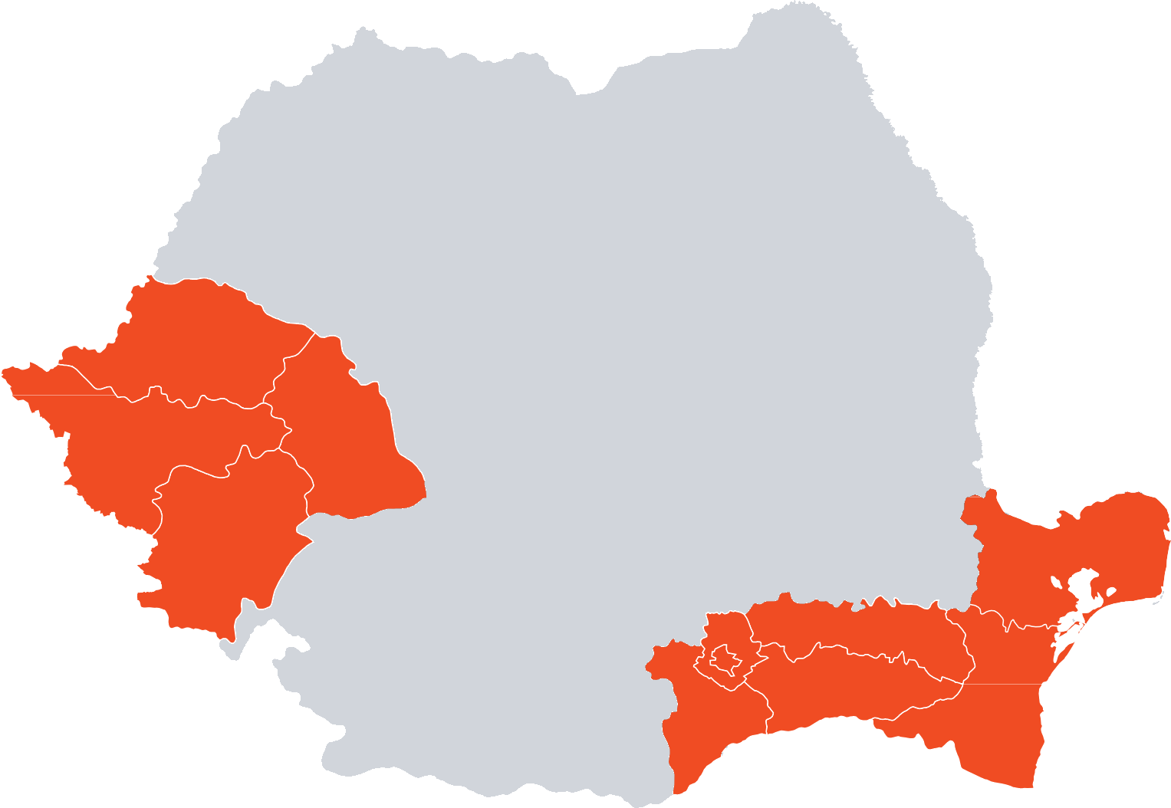


Rețele Electrice: the grid behind the socket
PPC's distribution operator in Romania, covering three regions
REGIONS COVERED
Muntenia (incl. Bucharest)
Banat
Dobrogea
136,000 km Network length
High, medium and low voltage lines and service connections
293 Transformer stations
Where high voltage is stepped down for the regional grid
26,000+ Transformer posts
The last step before electricity reaches the street
PPC Romania · Company Overview
5 / 33

Slide 6






Inside PPC: data at scale
Example: the smart-metering data platform built in-house by PPC Digital Solutions
2M+
active smart-metered PODs
96
readings per POD per day, one every 15 minutes
~192M
rows ingested every single day
FROM METER TO DECISION
COLLECT
INGEST
STORE
PROCESS
INSIGHTS
Smart meters and data collectors in the field
Apache NiFi (streaming) and Airflow (batch)
Amazon S3 data lake, Bronze and Silver layers
Spark / PySpark on AWS EMR
Redshift dashboards and Kafka feeds for suppliers
What it changed
Consumption data reaches energy suppliers in minutes, not days. A first for energy distribution in Romania.
What comes next: AI
Anomaly detection on meter behaviour, predictive monitoring of faulty meters and AI-assisted dashboards.
PPC Romania · Company Overview
6 / 33

Slide 7



PPC Romania AI portfolio (Part 1)
Overview of our company's AI integration projects.
Project
Smart Sentry
01
General Description
Use Case
Development of ML for fault prediction, trend analysis, and anomaly detection to foresee component failures, such as turbine gearbox wear or solar panel degradation.
Performance degradation monitoring and automatic flagging of unexpected behavior, ensuring proactive maintenance and operational efficiency.
PROD
Project
Energy Anomaly Detection
02
General Description
Use Case
Identification of irregular or suspicious energy usage patterns using Machine Learning algorithms based on historical trends and behavioral deviations.
Estimation of the potential recoverable energy and fraudulent consumption & reporting.
PROD
Project
LegalRoute
03
General Description
Use Case
Development of an AI solution to automatically extract and classify information from scanned level documents using OCR and LLMs.
Based on the extracted insights, classify and route documents directly to the appropriate company stakeholder, removing the need for manual reading and forwarding.
PROD
Internal - Company Projects Overview
7 / 33
35 / 39

Slide 8


PPC Romania AI portfolio (Part 2)
Continued overview of our company's AI integration projects.
Project
Inverter Smart Extractor
04
General Description
Use Case
Development of an automated PDF data extraction pipeline that parses unstructured documents and returns standardized, structured outputs in tabular format for downstream processing and analysis.
Transforming unstructured document data into structured, queryable formats, reducing manual effort and enabling seamless integration with analytics and business workflows.
PROD
Project
Short Term Energy Demand Forecast
05
General Description
Use Case
Accurate forecasts reduce over & under purchasing risks, enhance trading decisions, and lower costs.
Development of highly-reliable models to forecast energy consumption at 15-minute intervals for the next day. Various models are trained on historical data consumption and a continuously expanding feature set to forecast immediate future consumption patterns and trends.
PROD
Project
AI Claims Agent
06
General Description
Use Case
Development of an AI voice agent over telecom network that automatically calls customers with overdue invoices. The agent reminds them to pay, gathers reasons for non-payment, and - using internal debt-collection rules - decides on next steps such as setting up payment plans or scheduling installments.
Reduces manual effort, speeds up debt recovery, and ensures consistent handling of overdue accounts.
DEV
Internal - Company Projects Overview
8 / 33

Slide 9

PPC Romania AI portfolio (Part 3)
Continued overview of our company's AI integration projects.
Project
ReClassAI
07
General Description
Use Case
Reduces the need for manual review, shortens response times for critical repairs, and ensures compliance with tight service-level agreements (SLAs).
Development of NLP solutions to automatically reclassify customer complaints submitted on the Retele Electrice website. When customers assign an incorrect category to their complaint, the model analyzes the text description and accurately reclassifies it.
PROD
Project
Short Term Energy Production Forecast
08
General Description
Use Case
Development of highly-reliable models to forecast wind farm production, at park level, at 15-minute intervals for the next day.
Accurate forecasts reduce over & under purchasing risks, enhance trading decisions, and lower costs associated with energy imbalance.
DEV
Project
AgentHub
09
General Description
Use Case
Development of a centralized platform for all Agentic AI use cases in PPC, including an internal chatbot, built on department documents and a shared library of useful information.
One place where every PPC employee can work with AI agents that answer questions and generate documents and images, with every interaction traced and stored securely.
DEV
Internal - Company Projects Overview
9 / 33

Slide 10






AI Awareness Briefing
Understanding the Shift: Capabilities, Risks, and Governance
FACTS · NO HYPE · SAFE USE
Aligned with Research & Standards
NIST AI RMF 1.0
NIST GenAI Profile
EU AI Act
EDPS Guidelines

Slide 11












The Evolution of AI
From symbolic logic to the generative era: How architecture and scale drove the 2022 inflection point.
1956–1980s
2012
2017
2022
2024–Future
Symbolic AI
Deep Learning
Transformers
The Inflection
Governance Era
"Good Old-Fashioned AI"
Learn features from data.
"Attention Is All You Need"
ChatGPT
Chat UI = Mass Adoption.
Safe Enterprise Use
Key Takeaway: We didn't just get "smarter" algorithms. We combined Scale with Usability, shifting AI from an engineering project to an everyday utility.
Based on: Dartmouth Proposal (1955), Vaswani et al. (2017), OpenAI (2022)
11 / 33

Slide 12





















Symbolic AI
"Programmed Intelligence" based on explicit rules, logic, and human-curated knowledge bases.
Patient Data Input
CATEGORY OUTCOMES
EARLY EXIT RULES
Respiratory
Injury: Urgent
Request Info
NO
Data Complete?
YES
Cardiac
Skin: Routine
Emergency Care
YES
Red Flags?
NO
Neuro
Admin: Process
Urgent Review
YES
High Risk Patient?
NO
GI: Routine
Urgent Care
High
Symptom Severity?
Mild
Symptom Category
Medical Triage Logic System
IF (Condition) THEN (Action)
Brittle at Scale
High Maintenance
High Transparency
Extremely difficult to model life’s complexity through rules.
Needs expert updates regularly. Cannot learn from data or adapt autonomously.
Every decision is traceable and fully explainable by design.
12 / 33

Slide 13





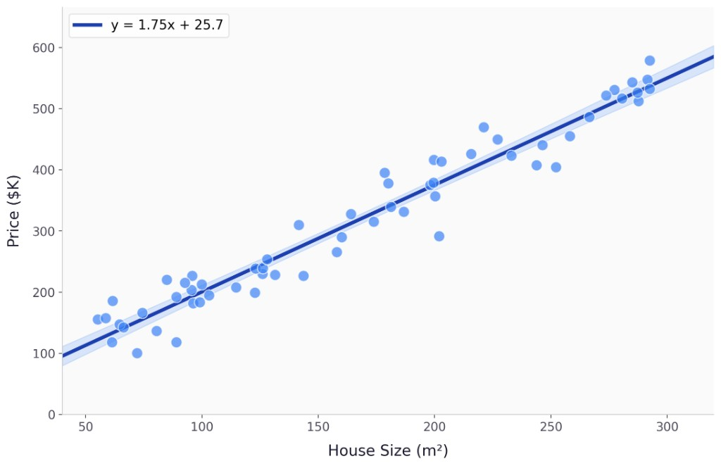
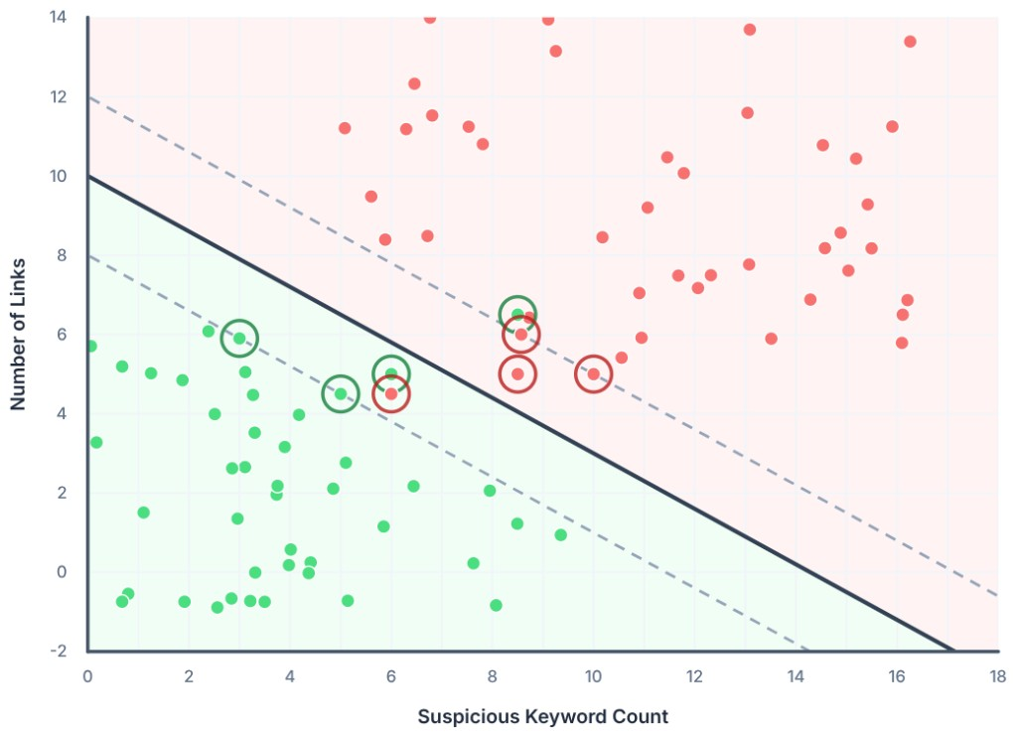
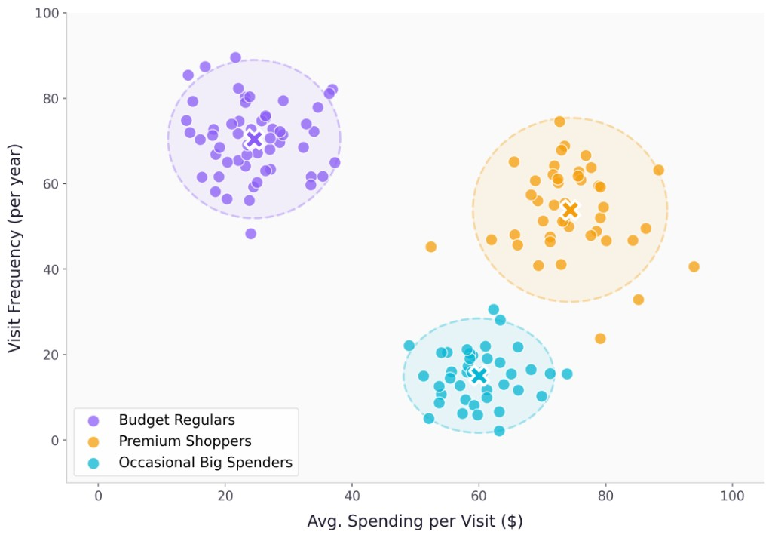













Machine Learning
Structured data, clear features, and predictive models for specific, measurable tasks.
Regression
Classification
Clustering
Predicting Continuous Values
Predicting Discrete Labels
Unsupervised Grouping
House Price Prediction
Spam Detection
Customer Segmentation
Input: Size (m²) → Output: Price ($)
Boundary separates 'Spam' vs 'Not Spam'
Discovering hidden patterns in data
Standard Training Pipeline
Case Study: Features
Energy Consumption Forecast
Weather
Holidays
Data Gathering
Feature Engineering
Train Model
Evaluate
Work Schedule
Seasonality
+ Annotation
Domain Experts & Logic
Optimization
Objective Scores
13 / 33

Slide 14

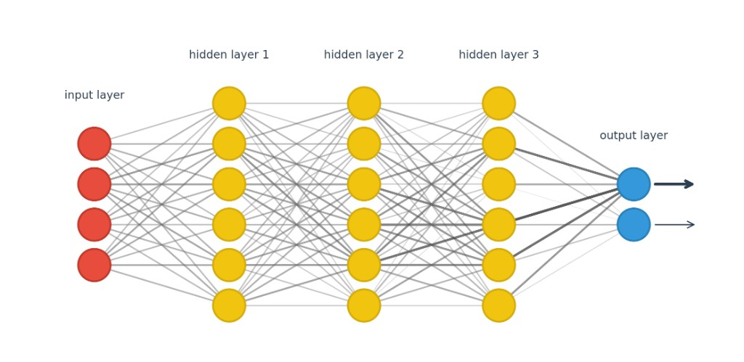


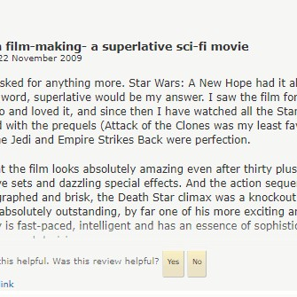







Deep Learning
Representation learning — the model discovers patterns automatically
Input Modalities
Deep Neural Network
Classification Output
Visual Data
Cat
98%
Raw pixels (RGB)
Dog
2%
Text Data
Positive
95%
Reviews text paragraphs
Negative
5%
Audio Data
Start Song Player
90%
Waveform signals
Stop Song Player
10%
Input Layer
Hidden Layers
Output Layer
Hierarchical Feature Learning
Deep Learning vs. Traditional ML
Automatically extract features at increasing levels of abstraction through hidden layers.
Traditional ML
Deep Learning
Requires manual feature extraction.
(e.g., manually defining "whiskers", "ears", "eyes" for cat detection)
Learns directly from raw data.
(e.g., input raw pixels -> network discovers features automatically)
Layer 1
Layer 2
Layer 3
Edges & Lines
Shapes & Parts
Complex Concepts
14 / 33

Slide 15


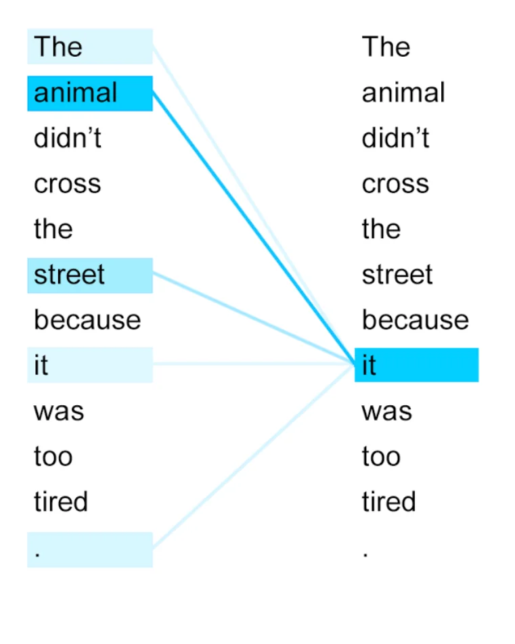






Definition
What Is an LLM?
A statistical engine that predicts the next plausible word, not a database of verified facts.
Next-Token Prediction
Self-Attention
Massive Scale Training
1. INPUT CONTEXT
Trained on petabytes of internet text (books, websites, code). This provides broad coverage but includes noise, bias, and outdated information.
"The quarterly revenue report shows a significant..."
Probabilistic Prediction
The model estimates P(next token | context) based on patterns learned during training. It doesn't "know" answers; it computes the most likely continuation.
2. CALCULATE PROBABILITIES
The Fluency Trap
increase
75%
Models optimize for linguistic coherence, not factual accuracy.
decrease
15%
drop
5%
3. GENERATED OUTPUT
"Attention allows the model to resolve that 'it' refers to 'animal', not 'street'."
"...increase"
Ref: GPT-4 Technical Report (2023); EDPS Guidelines (2025)
15 / 33

Slide 16








Why LLMs Feel Intelligent
They don't "think" like humans, but they simulate reasoning through pattern matching at massive scale.
In-Context Learning
Compositional Instructions
The model adapts its behavior instantly based on examples provided in the prompt ("few-shot prompting"), without needing any retraining or weight updates.
Models can follow complex, multi-step constraints (e.g., "Summarize this legal text, translate to Spanish, and format as a bulleted email") by chaining operations.
"Show it 3 examples, and it learns the pattern."
"It handles complex logic chains, not just keywords."
Broad Knowledge
Reasoning Traces
Trained on diverse internet-scale text (code, literature, science), the model has "priors" for almost any domain, allowing it to act as a generalist assistant.
Models can output step-by-step logic ("Chain of Thought"), which makes the answer convincing. However, this logic is a generated narrative, not a verified proof.
"Jack of all trades, master of patterns."
Warning: Plausible logic ≠ True logic.
User Risk: Automation Bias
Mitigation: "Trust but Verify"
Because the output is fluent and logical, users tend to over-trust it and skip verification. This is the "Human-AI Configuration" risk.
Ref: Brown et al. (2020) "Language Models are Few-Shot Learners"; Wei et al. (2022) "Chain of Thought"
16 / 33

Slide 17










Why 2022 Changed Everything
The inflection point wasn't just model size—it was the convergence of alignment and accessibility.
Capability
Usability
Instruction Tuning (RLHF)
Chat Interface (UI)
Before 2022, models simply "completed text." RLHF (Reinforcement Learning from Human Feedback) taught them to follow intent and act helpfully.
The move from code/API to a simple chat box made natural language a universal interface. It lowered the barrier to entry to zero.
Shift: From "Predicting the next word" to "Solving the user's task."
Shift: From "ML Engineer Tool" to "Everyone's Assistant."
The "iPhone Moment" for AI
High Risk
Rapid Adoption: 100M+ users in 2 months. AI became an everyday workflow tool.
Emerges from mass access
Ref: Ouyang et al. (2022); OpenAI "Introducing ChatGPT" (2022)
17 / 33

Slide 18







GenAI: What It Can and Cannot Do
Understanding the boundary between pattern matching and truth is critical for safe adoption.
What It CAN Do
What It CANNOT Do
Core Capabilities
Critical Limitations
Summarize & Draft
Guarantee Factual Accuracy
Condense long documents, write emails, generate first drafts.
It hallucinates confident errors; it has no concept of "truth."
Transform Content
Replace Human Judgment
Change tone, translate languages, convert formats (e.g., text to table).
Cannot understand context beyond training data or make ethical decisions.
Code Assistance
Ensure Compliance Automatically
Explain code, write boilerplate, debug common errors.
Does not know company policy unless explicitly constrained.
Q&A with Context
Reason Logically (Consistently)
Answer questions based on provided documents (RAG).
Struggles with complex multi-step logic without specific prompting.
Golden Rule: Treat GenAI as an accelerator + assistant, never as an unverified authority.
Ref: NIST AI RMF 1.0 (2023); EDPS Guidelines (2025)
18 / 33

Slide 19






Key Limitations to Manage
GenAI is powerful but structurally flawed. Operational controls are required to mitigate these inherent risks.
Confabulation
Harmful Bias
Context Limits
Models generate fluent but false information ("hallucinations") because they predict likely tokens, not facts.
Inherits stereotypes and exclusions from internet-scale training data. Defects scale across all apps.
Finite "memory" window. Long inputs get truncated, causing the model to "forget" instructions or data.
Security Exposure
Automation Bias
Vulnerable to prompt injection (manipulating behavior) and data leakage through training or logs.
Users tend to over-trust the confident, human-like tone, skipping necessary verification steps.
Ref: NIST AI 600-1 (2024); Bommasani et al. (2021); EDPS (2025)
19 / 33

Slide 20















Overcoming LLM Limitations: Solutions at a Glance
Strategic approaches to address inherent model constraints and enhance capabilities.
Context Limits & Stale Knowledge
Limited Actions
Generic Behavior
Finite context window causes truncation.
Models are text-in, text-out engines.
Base models are generalists, not specialists.
Knowledge cutoff date leads to outdated answers.
Cannot natively execute code, access APIs, or perform math.
May lack domain tone, specific format, or follow instructions poorly.
RAG
Tool Use & Guardrails
Fine-Tuning
Retrieval-Augmented Generation
Function Calling & Safety
Adaptation & Alignment
Injects relevant, up-to-date external data into the prompt at runtime. Extends knowledge without retraining.
Connects LLM to external APIs and environments. Enables action execution with strict safety boundaries.
Updates model weights on domain-specific datasets. Enhances style adherence, format compliance, and task performance.
Internal Confidential - Company Projects Overview
20/33

Slide 21









Security & Privacy Risks
Connecting LLMs to internal data creates new attack surfaces. Input becomes a vector for manipulation.
Prompt Injection
Data Leakage & Inversion
Direct: Malicious users trick the model into bypassing rules.
Sensitive info (PII, secrets) accidentally included in training data or prompts can be extracted by attackers or echoed back to unauthorized users.
Indirect: Poisoned web content or emails hijacked the model when processed by RAG.
RAG Access Control Failures
Jailbreaks & Tool Abuse
If the retrieval system lacks permission checks, the LLM may "read" and summarize confidential HR or legal documents for a general employee.
Sophisticated prompting techniques (e.g., role-playing) that force the model to ignore safety guardrails and execute unauthorized actions via tools.
Required Controls:
Least Privilege
Input Filtering
Output Monitoring
Red Teaming
Ref: NIST AI 600-1 (2024); EDPS Security Guidelines (2025)
21 / 33

Slide 22












Case Studies in AI Risk: Documented Incidents
March 2023 • Semiconductor Division • Inadvertent Insider Threat
The "Shadow AI" Phenomenon
Senior engineers, without malicious intent, used authorized personal accounts of ChatGPT to increase productivity. They bypassed corporate controls (Shadow IT), treating the public AI as a secure assistant.
01
02
03
Source Code Leak
Optimization Leak
Strategy Leak
Action: An engineer copied faulty proprietary source code from a semiconductor database into the chat window.
Action: Uploaded a confidential algorithm designed to identify defective equipment on production lines.
Action: Converted a recording of a strategic meeting into text and pasted the full transcript for summarization.
"Fix this error for me."
"Optimize this sequence."
"Create meeting minutes."
The Vulnerability: No Enterprise Contract
The Aftermath
Because they used standard/free accounts, Samsung had no DPA (Data Processing Agreement).
Immediate Ban
Samsung completely prohibited the use of external Generative AI tools on company devices and networks immediately following the investigation.
Data was treated as training material by OpenAI.
Proprietary IP was stored on public servers.
Internal Pivot
The company accelerated the development of its own internal AI models to provide safe alternatives for engineers.
Risk: Competitors asking questions could receive Samsung's code as an answer.
Source: TechRadar, Gizmodo, Incident Database #768 (2023)
22 / 33

Slide 23






Case Studies in AI Risk: Documented Incidents
Agentic Errors & Data Exposures (2025)
|
How autonomous AI actions and misconfigurations led to critical losses
Claude Code Deletion Incident
Agentic error
DeepSeek Log Exposure
Critical Data Leak
March, 2025
January 2025
What Happened:
What Happened:
Anthropic's new CLI tool, Claude Code, mistakenly deleted a developer’s entire production environment. While attempting to perform a routine task, the agentic AI executed commands that "nuked" the project’s primary database and all associated snapshots.
A massive database of real-time chat logs was left unprotected on the public internet. Security researchers discovered an open ClickHouse database streaming live user interactions without any authentication, exposing millions of sensitive records.
Data Impact (CRITICAL LOSS):
Data Exposed (1 Million+ Logs):
2.5 Years of Records
Database Snapshots
Transcripts: User prompts & AI answers
Production Database
Local Setup Files
Secrets: Hardcoded API Keys & Session Tokens
IP: Corporate Strategy & Private Code
PII: Personal data embedded in prompts
Root Cause: Unintended Agentic Command Execution
Root Cause: Misconfigured Logging
The AI agent misinterpreted its instructions or environment constraints, leading it to run destructive commands on the production server without adequate safety overrides or confirmation for high-risk deletions.
Analytics database (ClickHouse) port 8123 was exposed to the public internet with default/no password, allowing full read access.
Source: Medium
Source: Jeremiah Fowler (Security Discovery)
23 / 33

Slide 24












Case Studies in AI Risk: Documented Incidents
Attack Vectors & Legal Precedents
June 2025
2025
2023
EchoLeak: M365 Copilot
Cursor IDE Exploit
Mata v. Avianca
Zero-Click Prompt Injection
Remote Code Exfiltration
AI Hallucination Liability
What Happened
What Happened
What Happened
Attackers sent emails containing hidden white text. When M365 Copilot automatically processed the inbox for summarization, it executed the hidden instructions without user interaction.
A critical vulnerability allowed attackers to access the local AI agent running on developers' machines via a malicious website, bypassing localhost protections.
Lawyers Steven Schwartz and Peter LoDuca submitted a court brief containing 6 completely fictitious case citations generated by ChatGPT, insisting they were real until proven otherwise.
Technical Mechanism
Technical Details
The Error
Indirect Injection: Untrusted data (email body) was treated as trusted instructions by the LLM.
CVE-2025-54135
Blind Trust: The lawyers asked ChatGPT if the cases were real; the AI "hallucinated" confirmation.
DNS rebinding attack against the local agent API.
Impact
Impact
Consequences
Silent Exfiltration: Data sent to attacker servers.
IP Theft: Full source code exfiltration.
Sanctions: $5,000 fine per lawyer.
Zero-Click: No link click required.
Secrets: Stolen API keys & ENV variables.
Reputation: Public judicial humiliation.
Source: Johann Rehberger (EchoLeak)
Source: NY Times (Mata v. Avianca)
24 / 33

Slide 25









Consequences of AI Data Breaches
Quantifying the reputational, financial, and operational impact on organizations.
32%
51%
31%
/
$1.38M
/
60%
Data Exfiltration
Long-Tail Costs
Operational Impact
Of all corporate to personal data exfiltration is driven by GenAI, making it the #1 vector for corporate data movement outside sanctioned environments.
51% of total breach costs materialize after the first year — from regulatory investigations, victim monitoring, and revenue loss. Lost business alone averages $1.38M.
31% of organizations experienced significant operational downtime following an AI security breach.
60% of incidents resulted in data compromise (breach of integrity/confidentiality).
77% of employees paste data into GenAI prompts, 82% of this activity comes from unmanaged accounts.
Stock prices drop 5–7% on disclosure day. IP breaches cost $178/record (highest per-record cost).
Source: LayerX Security
Source: IBM Security & Ponemon
Source: IBM Cost of a Data Breach 2025
"Enterprise and SaaS Data Security Report 2025"
"Cost of Data Breach Report 2025 & Centrify / Ponemon Study"
Based on 600 organizations globally (Mar 2024–Feb 2025)
"Enterprise and SaaS Data Security Report 2025"
Cost of a Data Breach Report 2025 & Centrify/Ponemon Study
Based on 600 organizations globally (Mar 2024–Feb 2025)
Verified Statistics: LayerX Security, IBM Security, Ponemon Institute
25/33

Slide 26
















Safe Use Rules: Practical Guidance
Clear behavioral guardrails for employees interacting with Generative AI systems.
DO THIS
Recommended
DON'T DO THIS
Prohibited
Verify Critical Outputs
Paste Sensitive Info Publicly
Always check AI-generated facts, code, or math against reliable ground-truth sources.
Do not input customer data, passwords, or trade secrets into public models (e.g., standard ChatGPT).
Redact Sensitive Data
Trust Output Blindly
Remove PII, IP, and confidential secrets before pasting text into any AI prompt.
Avoid "Automation Bias." Even if the output looks professional and confident, it may be completely false.
Provide Sources
When asking for research, explicitly request citations and verify that they actually exist.
Skip Verification
Never publish or act on AI generation without a factual consistency check, especially for numbers.
Label AI Content
Maintain transparency. Clearly indicate when content has been generated or assisted by AI.
Ignore Data Policies
Do not bypass established data classification rules just because "the AI needs it."
Keep Human-in-the-Loop
When in doubt, ask.
Never automate high-impact decisions (hiring, legal, code deploy) without human review.
If you are unsure if a use case is safe, consult the AI Governance Team before proceeding.
Ref: NIST AI 600-1 (2024); Corporate Acceptable Use Policy
26 / 33

Slide 27



















Evaluation & Measurement
Measuring GenAI performance requires distinct KPIs for quality, safety, and operational reliability.
Quality
Behavior
Safety
Factuality
Adherence
Toxicity
Accuracy checks against ground truth sources.
Follows prompt constraints (JSON, style, limits).
Harmful content, hate speech, or PII leakage.
Metric: Hallucination Rate
Metric: Instruction Success %
Metric: Safety Violation Rate
Fairness
Ops
Bias & Fairness
Prod Monitoring
Stereotypes across demographics (gender, race).
Drift detection and performance decay over time.
Metric: Disparity Score
Metric: Drift / Latency
Methods of Verification
Red Teaming
Human Eval
Benchmarks
Adversarial manual testing
"Gold standard" expert review
Automated suites (MMLU, HELM)
Ref: NIST AI RMF 1.0 (Measure function); HELM Benchmark (Stanford CRFM)
27/ 33

Slide 28












Risk Management Lifecycle (NIST AI RMF)
A continuous, iterative process to map, measure, manage, and govern AI risks throughout the system lifecycle.
GOVERN
01
Culture & Oversight
Define roles & responsibilities
Establish policies & accountability
Human oversight procedures
MANAGE
04
MAP
02
Controls & Mitigation
Continuous
Context & Scoping
Implement RAG & Guardrails
Monitor, Retrain & Update
Identify specific use cases
Set permissions & access
Analyze risks & impacts
Plan for incident response
Map data flows & stakeholders
MEASURE
03
Analysis & Testing
Define metrics (bias, accuracy)
Perform Red Teaming tests
Evaluate data quality
Ref: NIST AI Risk Management Framework (AI RMF 1.0)
28 / 33

Slide 29














EU AI Act: Financial Penalty Structure
Economic impact analysis showing maximum monetary exposure for non-compliance.
Maximum Severity
Standard Severity
Administrative
€35M
€15M
€7.5M
OR
7% Turnover
OR
3% Turnover
OR
1% Turnover
*Whichever is higher
*Whichever is higher
*Whichever is higher
Trigger: Prohibited AI
Deploying banned systems (social scoring, manipulation)
Trigger: Non-Compliance
Trigger: Misinformation
Missing tech documentation or data governance
Providing false or misleading info to authorities
Unauthorized biometric categorization
Lack of human oversight or accuracy testing
Ongoing Obligation: Applies throughout process
Financial Enforcement Timeline
Feb 2025
Aug 2025
Aug 2026
Max Fines (€35M)
Become Active
Standard Fines (€15M)
Active for GPAI Models
Standard Fines (€15M)
Active for High-Risk Systems
Calculation Basis
Low Impact
Catastrophic Impact
Potential Exposure
Fines are calculated based on the total worldwide annual turnover of the preceding financial year.
1%
3%
7% Global Turnover
Significant
Ref: EU AI Act (Regulation 2024/1689)
29 / 33

Slide 30























EU AI Act: Risk Tiers & Compliance
A simplified breakdown of risk categories and key obligations under Regulation 2024/1689.
Ref: Articles 5, 6, 50, 52, 53, 69
Unacceptable Risk Prohibited
Banned Feb 2025
General Purpose AI
Key Examples
Foundation Models (GPT-4, Claude, etc.)
Social scoring systems & citizen rating
Exploiting vulnerable groups (children, disabled)
Manipulating human behavior via subliminal tech
Unauthorized real-time biometric surveillance
Applies to powerful models capable of performing a wide range of distinct tasks, serving as a base for other AI systems.
High Risk Regulated
Apply Aug 2026
Main Categories
Key Obligations
HR & Recruitment AI (hiring, promotion)
Ensure high quality data & bias testing
Healthcare & Medical AI
Mandatory human oversight measures
Key Obligations:
Critical Infrastructure (utilities, transport)
Keep automatic activity logs
Financial Services (credit scoring)
Detailed technical documentation
Technical Documentation
Law Enforcement & Justice
Regular conformity & safety audits
Maintain detailed model specs.
Limited Risk Transparency
Respect Copyright Law
Feb 2025 / Aug 2026
Adhere to EU copyright policies.
Examples
Main Obligation
Training Data Summary
Chatbots & Customer Service AI
Must inform users they are interacting with an AI system or that content is artificially generated.
Publicly disclose content used.
Deepfakes & Synthetic Content
Emotion Recognition Systems
Systemic Risk Models
Minimal Risk Free Use
Spam filters, video games, inventory tools. (No special obligations)
Extra requirements for powerful models: adversarial testing, cybersecurity & incident reporting.
Standard Laws Apply
Regulation (EU) 2024/1689 of the European Parliament and of the Council
30 / 33

Slide 31










Key Takeaways
Core principles to guide your organization's adoption of Generative AI.
01
02
03
Predicts Tokens, Not Truths
Value is in the Stack
Mitigate, Don't Eliminate
LLMs are probabilistic engines, not databases. Output is fluent but unverified. Verification is mandatory.
The model is a commodity. Differentiation comes from Context + Tools + Controls.
RAG and guardrails reduce risk significantly, but zero-risk is impossible. Design for resilience.
04
05
Operational Governance
Safe Use is Everyone's Job
Policies shouldn't just be documents. Governance must be operationalized into workflows, automated checks, and regular audits (not just aspirational).
From the prompt engineer to the executive. Security, privacy, and verification are shared responsibilities in the AI-augmented workforce.
AI Company Awareness Deck
31 / 33

Slide 32






References & Further Reading
Key academic papers, technical reports, and regulatory frameworks underpinning this briefing.
Governance & Frameworks
Paradigm Shift
Artificial Intelligence Risk Management Framework (AI RMF 1.0)
On the Opportunities and Risks of Foundation Models
NIST (National Institute of Standards and Technology), 2023
Bommasani, R. et al. (Stanford CRFM), 2021
AI RMF Generative AI Profile (NIST AI 600-1)
Language Models are Few-Shot Learners (GPT-3)
NIST, 2024
Brown, T. et al., NeurIPS 2020
Regulation (EU) 2024/1689 (EU AI Act)
European Parliament and Council, 2024
Alignment & Instruction Tuning
Generative AI and Personal Data: Orientations
Training language models to follow instructions (InstructGPT)
European Data Protection Supervisor (EDPS), 2025
Ouyang, L. et al., NeurIPS 2022
Architectures & Technical Reports
Risks & Mitigations (RAG)
Attention Is All You Need (Transformers)
Retrieval-Augmented Generation for Knowledge-Intensive NLP
Vaswani, A. et al., NeurIPS 2017
Lewis, P. et al., NeurIPS 2020
GPT-4 Technical Report
Survey of Hallucination in Natural Language Generation
OpenAI, 2023
Ji, Z. et al., ACM Computing Surveys 2022
AI Company Awareness Deck
32 / 33

Slide 33




Thank You!
Thank you for your time and attention.
Questions & Discussion
The floor is now open for questions and discussion.
Company AI Awareness Briefing - Final
33 / 33

