Slide 1
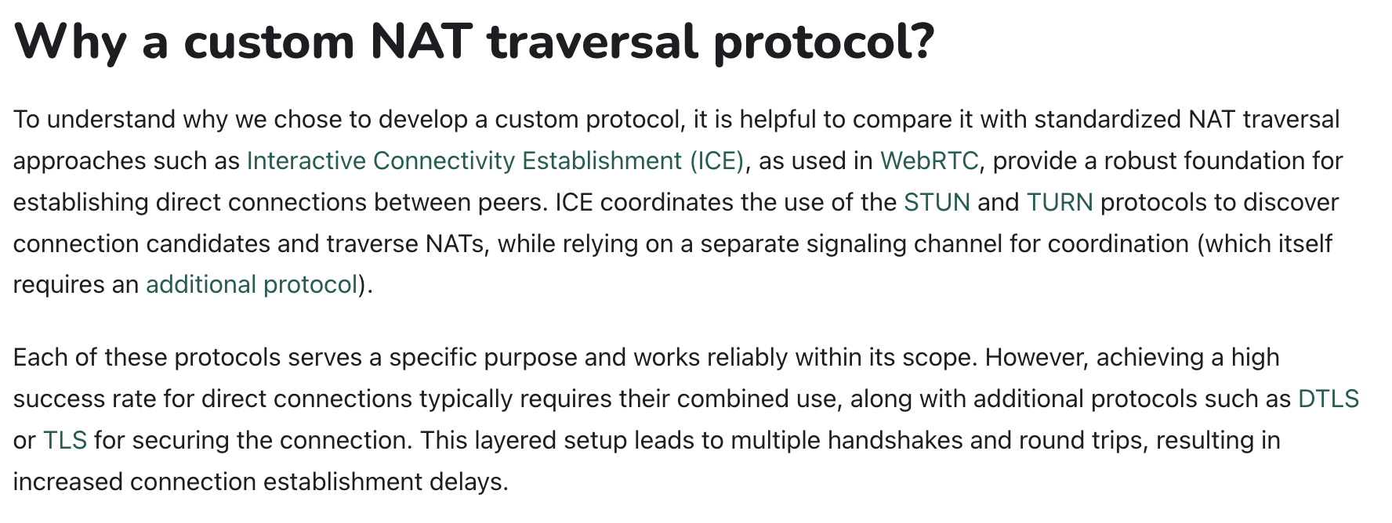


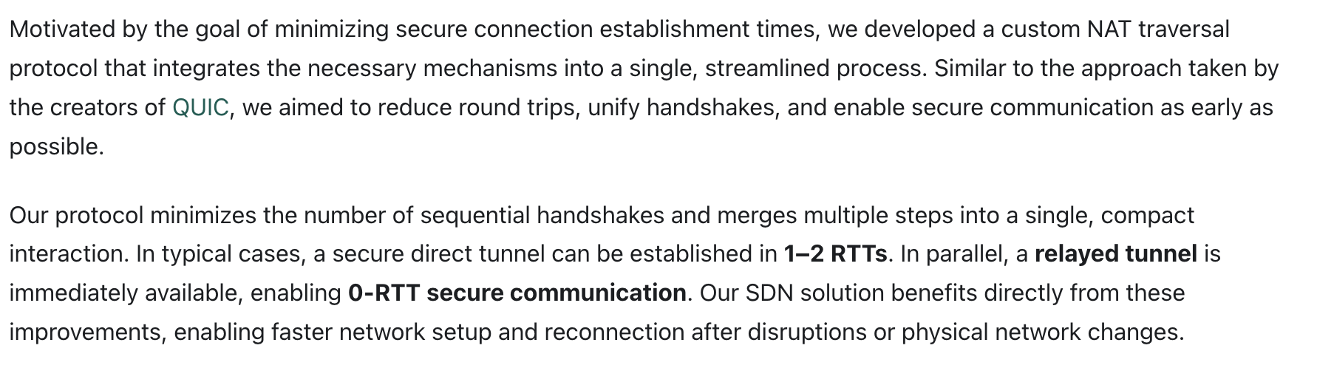
Relayed Communication
Super Peer
(1) Publish Information (2) Connection Request
(3) Connection Response
Connection Response (3)
(1) Publish Information
(4) Connection Establishment
Node Peer A
Direct Communication
Node Peer B
Control Plane
Data Plane

Slide 2






Creation
Distribution (File/HTTP)
Admin
Network Config
(authorized devices, access policies, network routes, …)
Home Network
Office Network
The Internet
Personal Notebook
Firewall
Firewall
Office Workstation
Smart Home Server
File Server
Control Plane
Data Plane (drasyl Traffic)
Data Plane (non-drasyl Traffic)

Slide 3
applications
applications
daemon
OS

