Slide 1
LEAD SERVICE LINE INFRASTRUCTURE NEEDS
Where are lead service line infrastructure needs greatest across U.S. states?
EPA 2026 Q2 inventory | 43,993 complete-report Community Water Systems | 50 states and DC
Known Replacement Inventory
Identification Need
Lead service lines plus galvanized lines requiring replacement
Lead Status Unknown lines that still require material identification
Unknown does not mean lead
Infrastructure management stages
1
Unknown
2
Identify material
3
Classify
4
Replace where required
The analysis keeps replacement workload separate from unresolved identification workload.
Source: U.S. EPA, 2026 Q2 Service Line Inventory
1
Notes:
Research question: Where are lead service line infrastructure needs greatest across U.S. states? Known Replacement Inventory equals Lead plus Galvanized Requiring Replacement. Identification Need equals Lead Status Unknown. Unknown lines still require material identification and must not be interpreted as confirmed lead. Analytical sample: 43,993 Community Water Systems that reported all required service-line types, limited to 50 states and the District of Columbia.

Slide 2
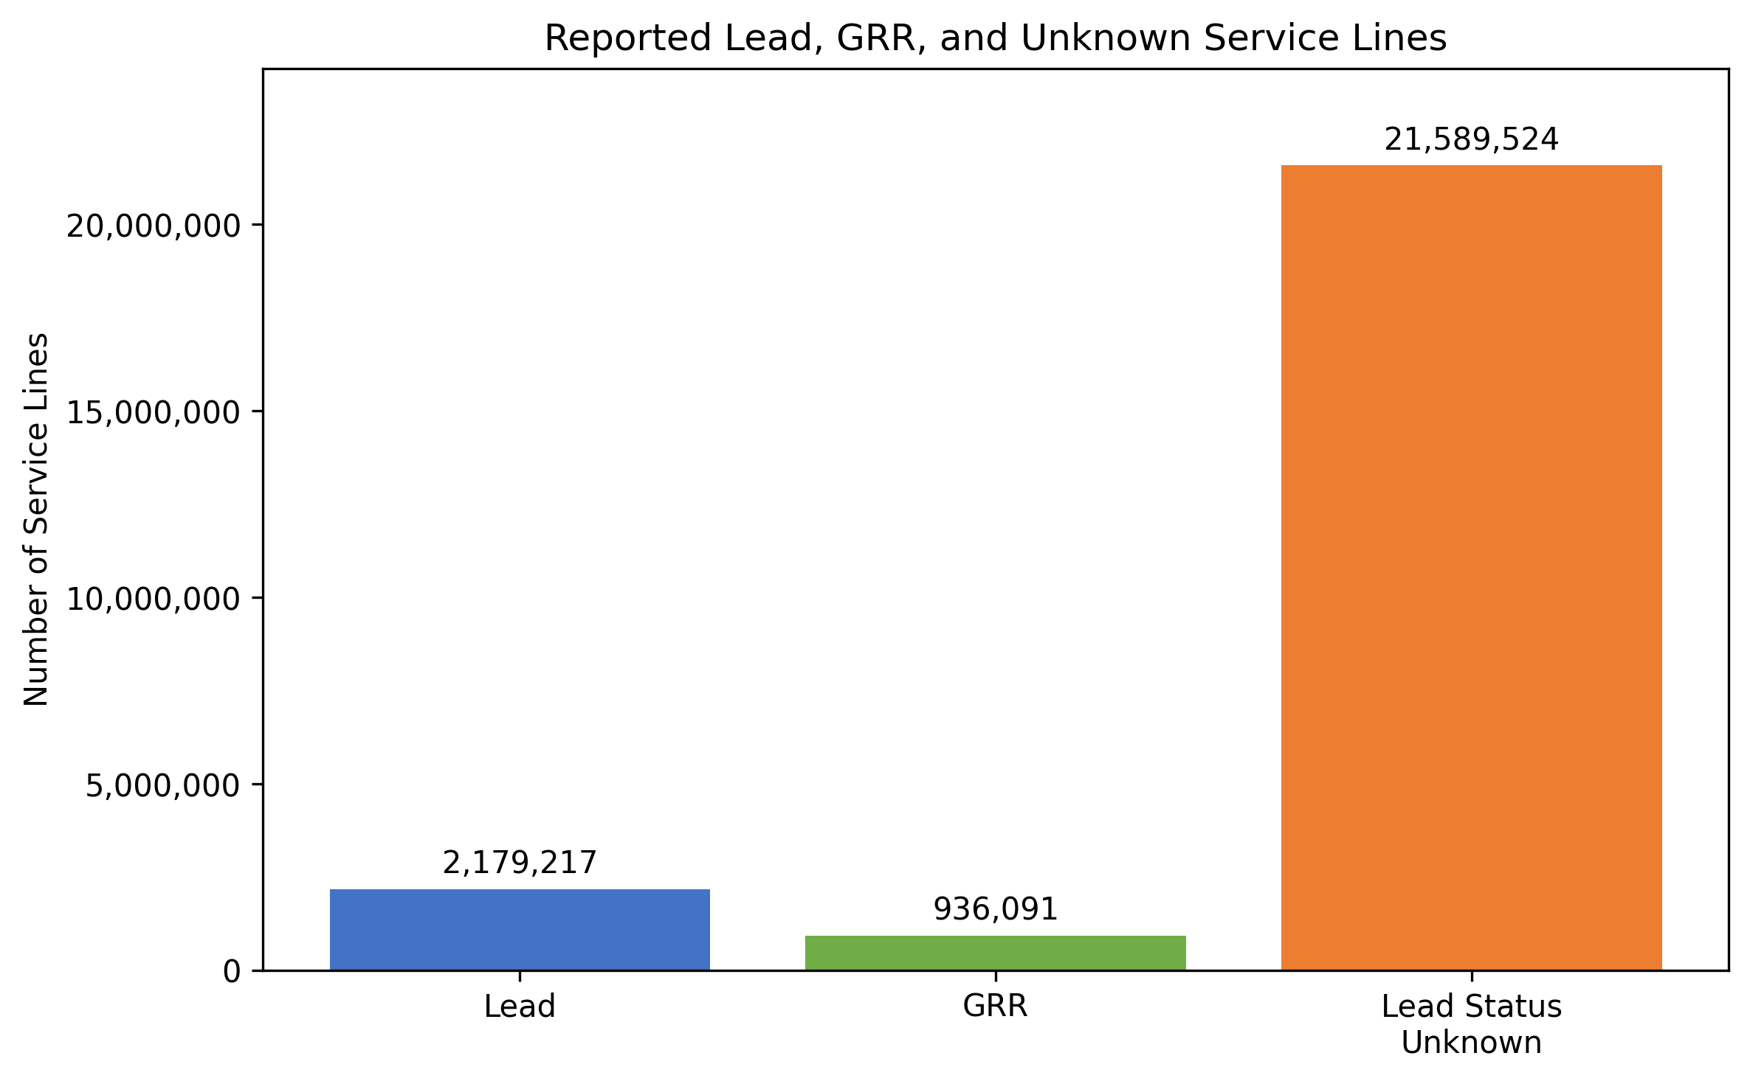
NATIONAL SCALE
Unresolved identification inventory is nearly seven times larger than known replacement inventory
3.1M
Known Replacement service lines
21.6M
Lead Status Unknown service lines
Unknown lines require identification. They are not confirmed lead lines.
Source: U.S. EPA, 2026 Q2 Service Line Inventory. Counts reflect the analytical sample.
2
Notes:
National totals in the analytical sample: 2,179,217 Lead service lines; 936,091 Galvanized Requiring Replacement service lines; 3,115,308 Known Replacement service lines; and 21,589,524 Lead Status Unknown service lines. The Unknown inventory is about 6.9 times the Known Replacement inventory. Unknown does not mean lead.

Slide 3
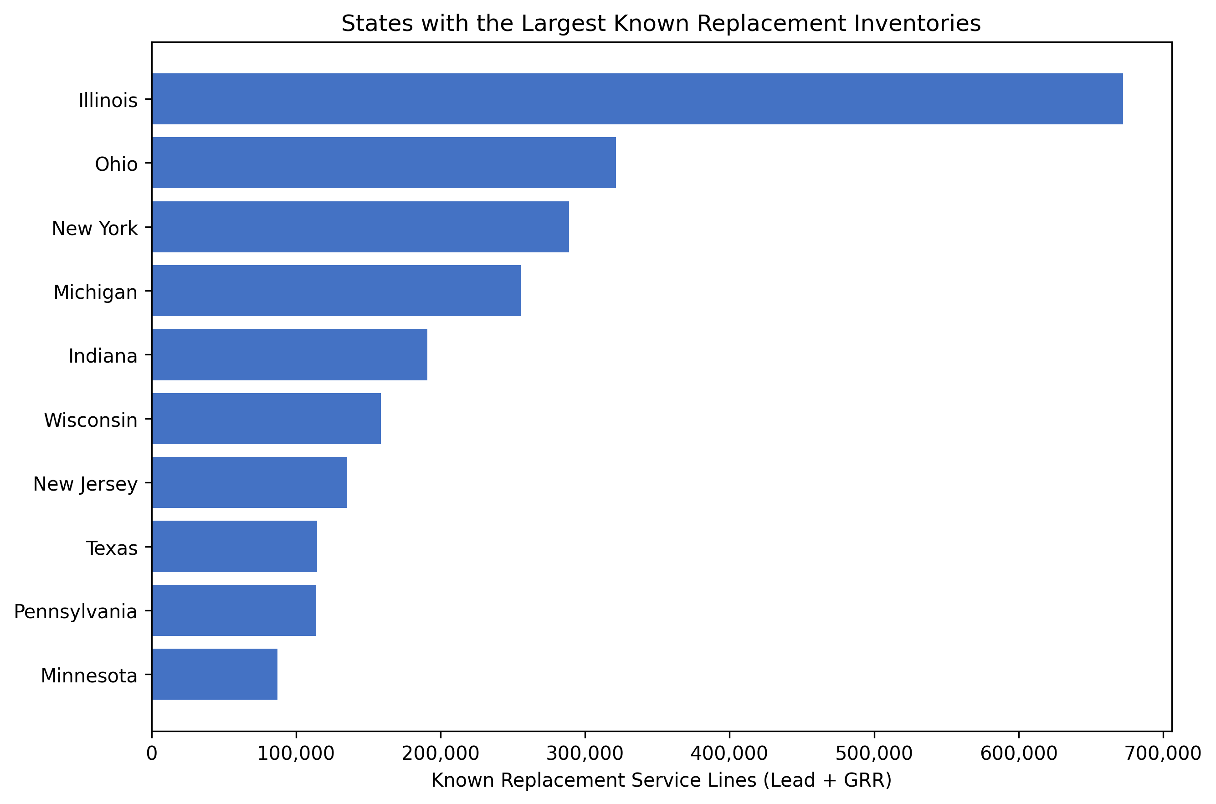
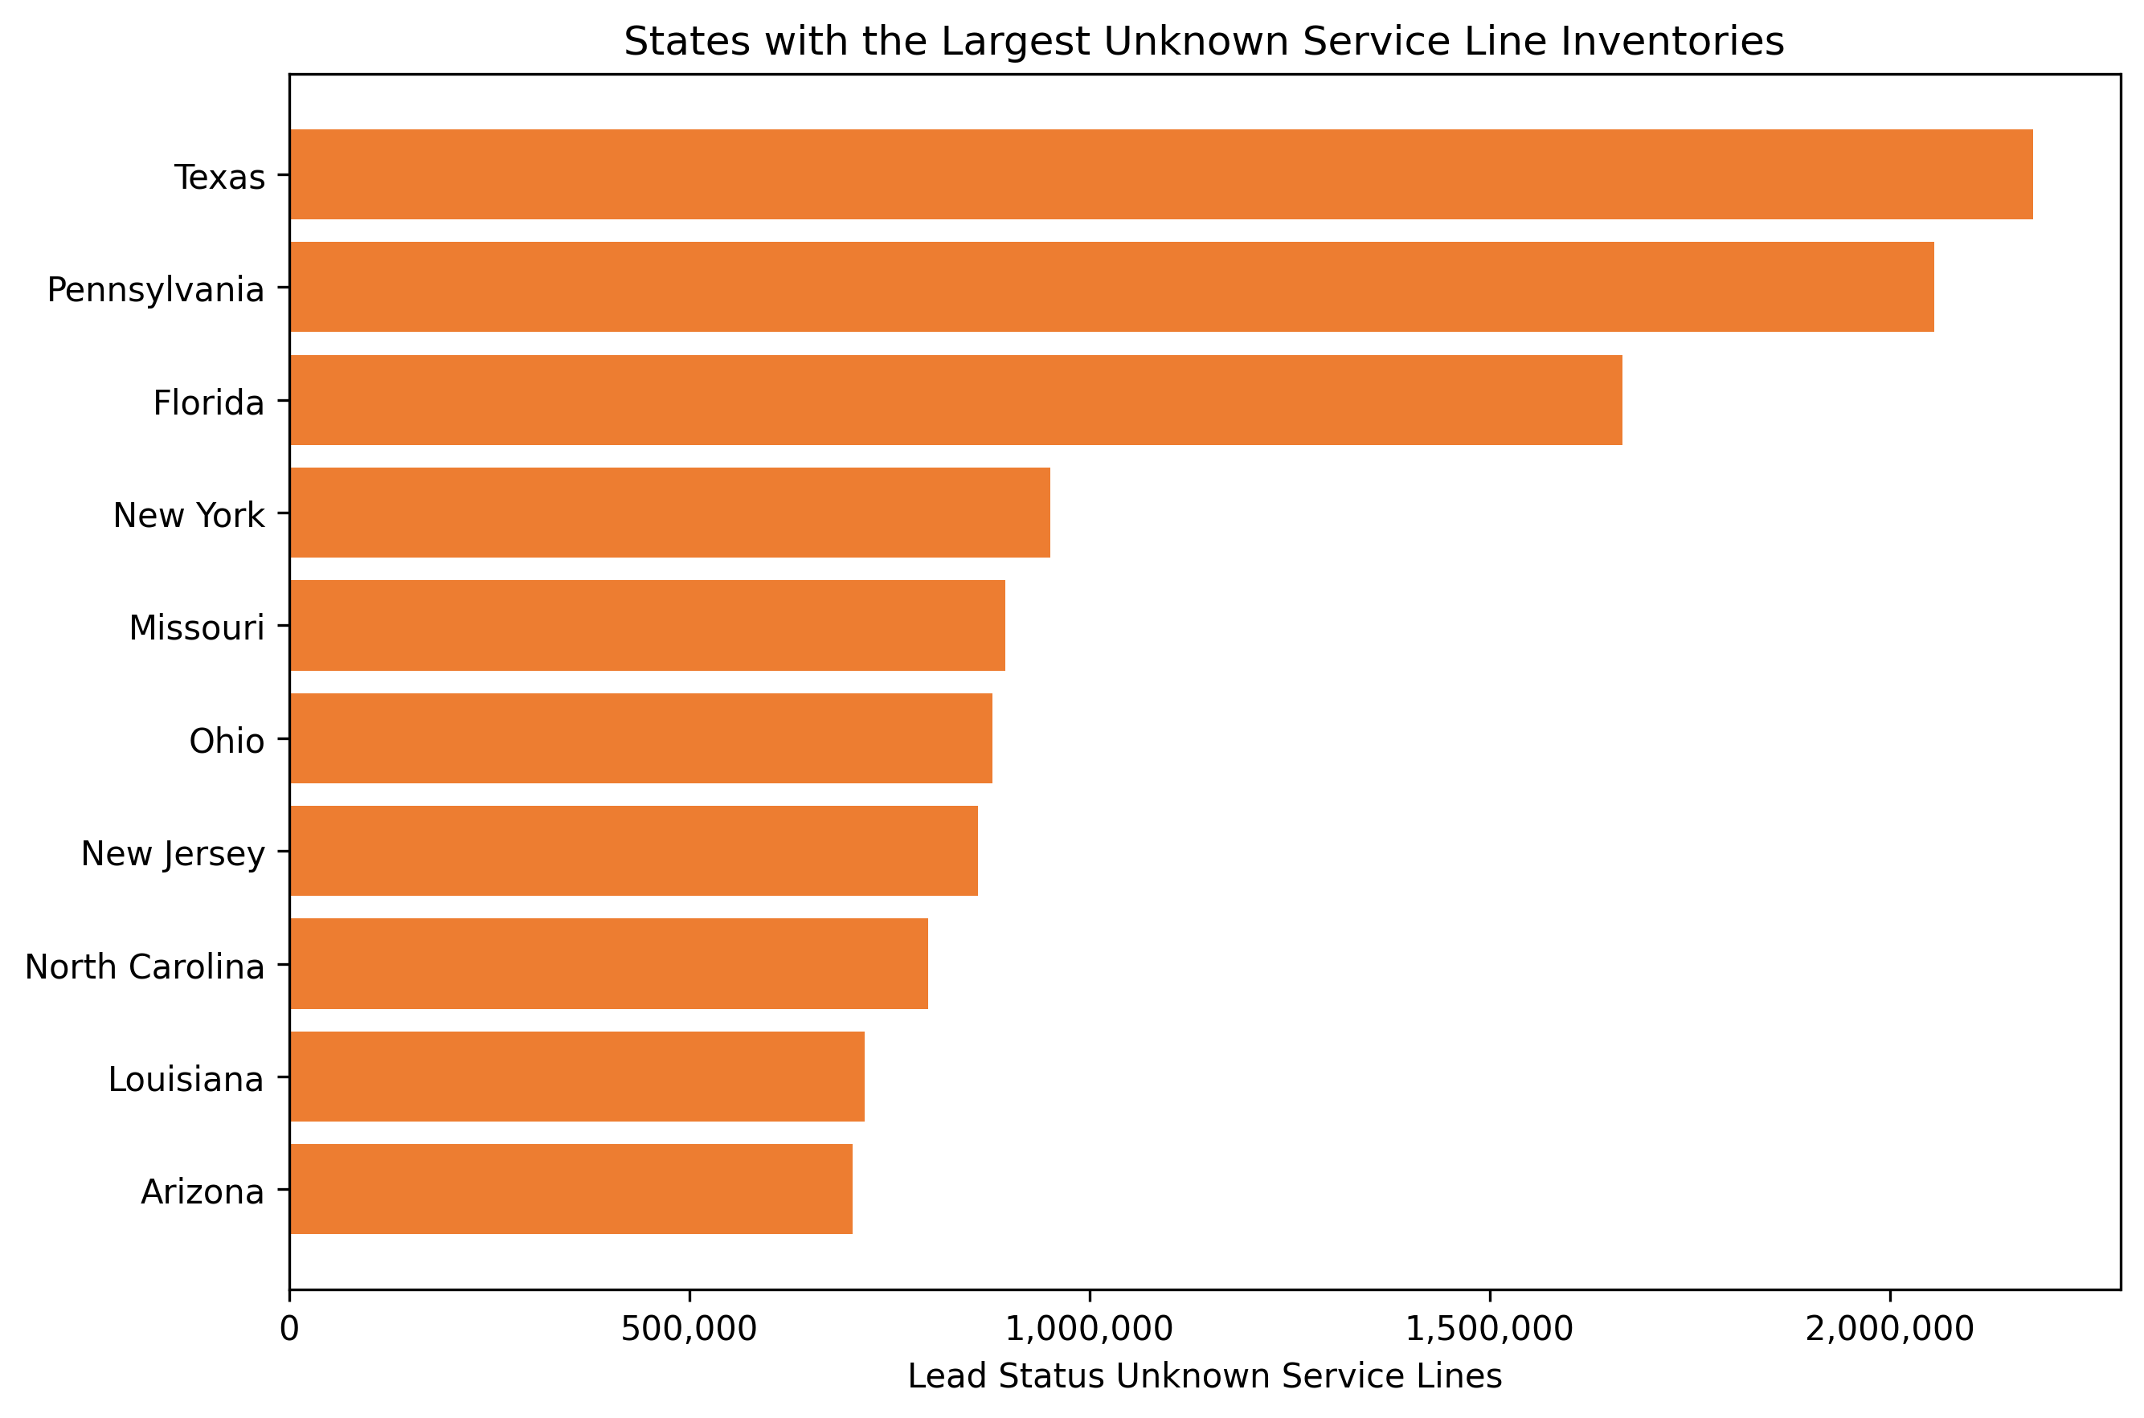
STATE-LEVEL COMPARISON
Replacement and identification workloads concentrate in different states
Illinois leads Known Replacement at 672,210
Texas and Pennsylvania lead Identification Need
Five states appear in both raw top 10 lists: New Jersey, New York, Ohio, Pennsylvania, and Texas
Source: U.S. EPA, 2026 Q2 Service Line Inventory
3
Notes:
Known Replacement leaders: Illinois 672,210; Ohio 321,502; New York 289,055. Identification Need leaders: Texas 2,178,881; Pennsylvania 2,055,512; Florida 1,665,928. Only five states appear in both raw top 10 lists: New Jersey, New York, Ohio, Pennsylvania, and Texas.

Slide 4
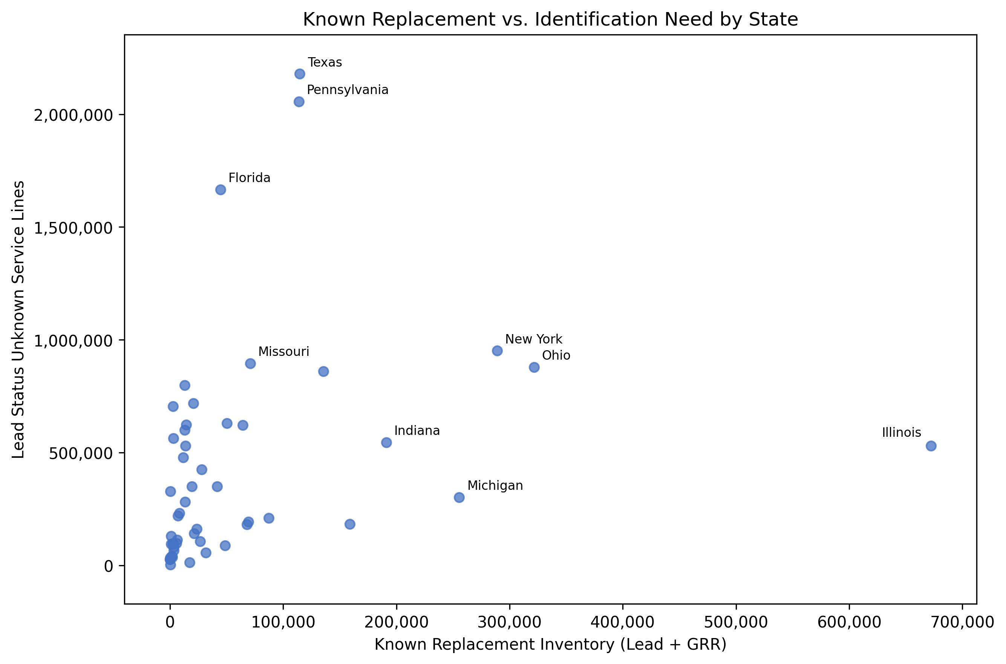
RELATIONSHIP BETWEEN NEEDS
High replacement and identification needs do not always occur together
Illinois
672,210 known replacement lines; 529,706 unknown
Texas and Pennsylvania
About 114,000 known replacement lines each; more than 2.0 million unknown
Ohio and New York
Relatively high on both dimensions
The pattern is descriptive and does not establish a cause.
Source: U.S. EPA, 2026 Q2 Service Line Inventory
4
Notes:
Each point represents one state or the District of Columbia. Illinois has the largest Known Replacement Inventory, while Texas and Pennsylvania have much larger Unknown inventories. Ohio and New York are relatively high on both dimensions. These patterns may reflect different stages of identification and replacement, but the chart does not establish a causal explanation.

Slide 5
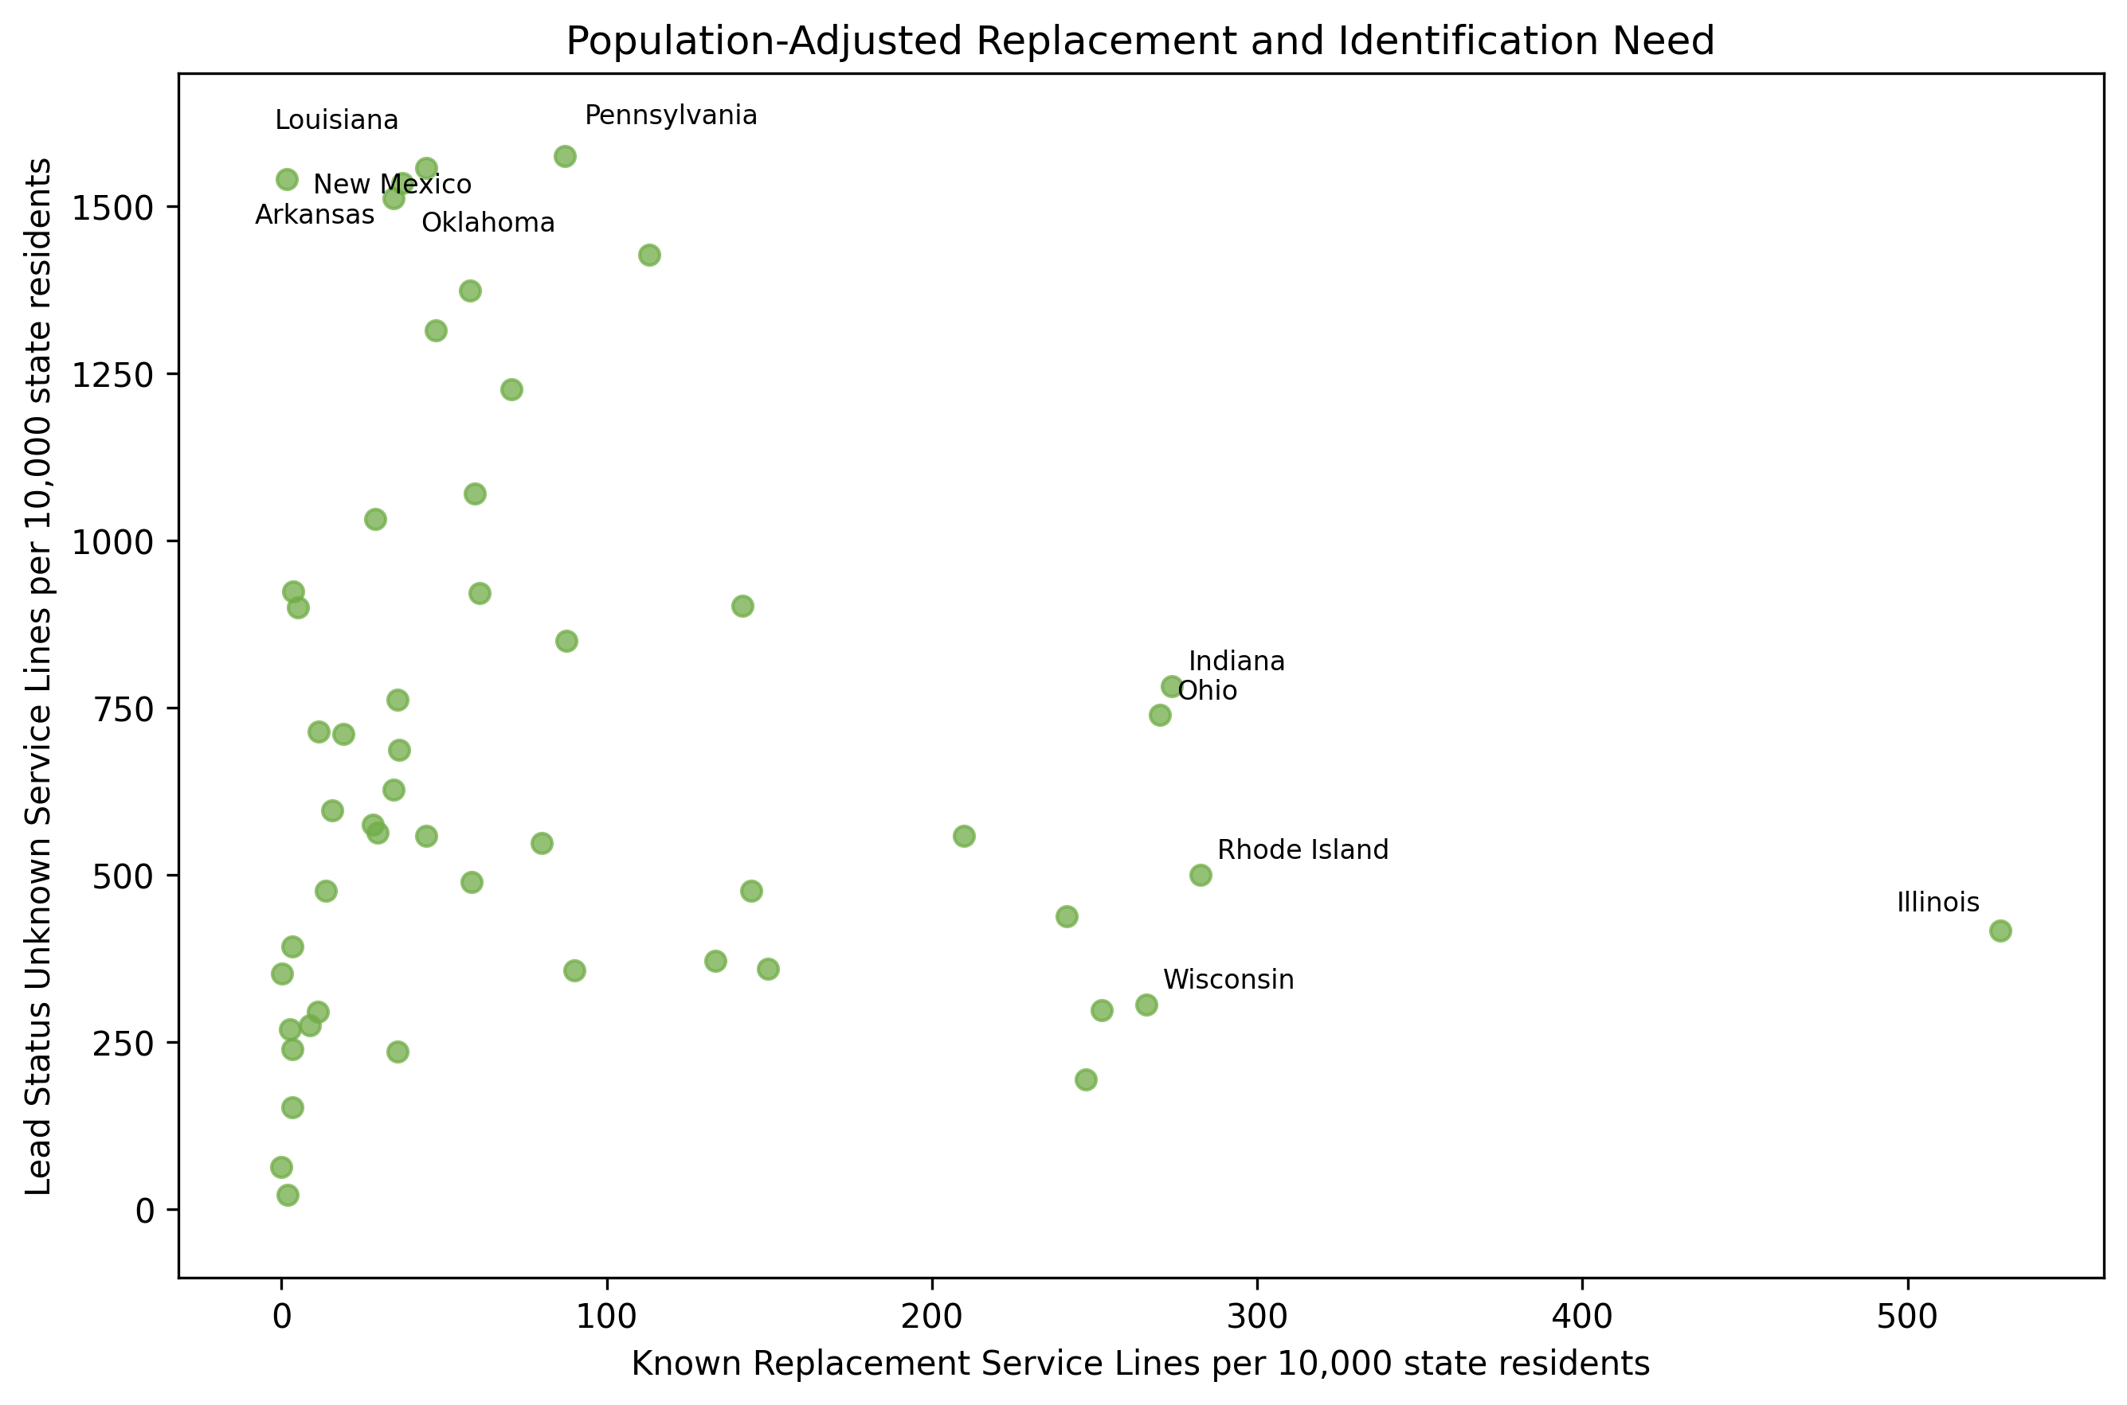
POPULATION CONTEXT
Population adjustment changes which states stand out
Raw and normalized top 10 overlap
6 of 10
3 of 10
Known Replacement
Unknown
How to read the two views
Raw totals show overall workload. Per-capita values show inventory relative to state population.
Practical implication
Use both views to identify where deeper utility-level investigation may be valuable.
Important limitation
Unknown does not mean lead. State inventories do not measure household exposure or water quality.
Recommended next question: How do state and utility needs align with available funding and local capacity to complete service-line replacement?
Sources: U.S. EPA 2026 Q2 inventory; U.S. Census Bureau July 1, 2025 resident population estimates
5
Notes:
Population adjustment uses 2025 Census resident population as a state-size benchmark for 2026 Q2 EPA inventory data. Illinois remains highest for Known Replacement at 528.5 per 10,000 residents. Pennsylvania leads Unknown at 1,574.0 per 10,000 residents. Six of the raw Known Replacement top 10 remain after normalization; only three of the raw Unknown top 10 remain. Per-capita values are contextual rates, not affected-customer or exposure rates. Recommended next question: How do state and utility identification and replacement needs align with available funding and local capacity to complete service-line replacement?

