Slide 1
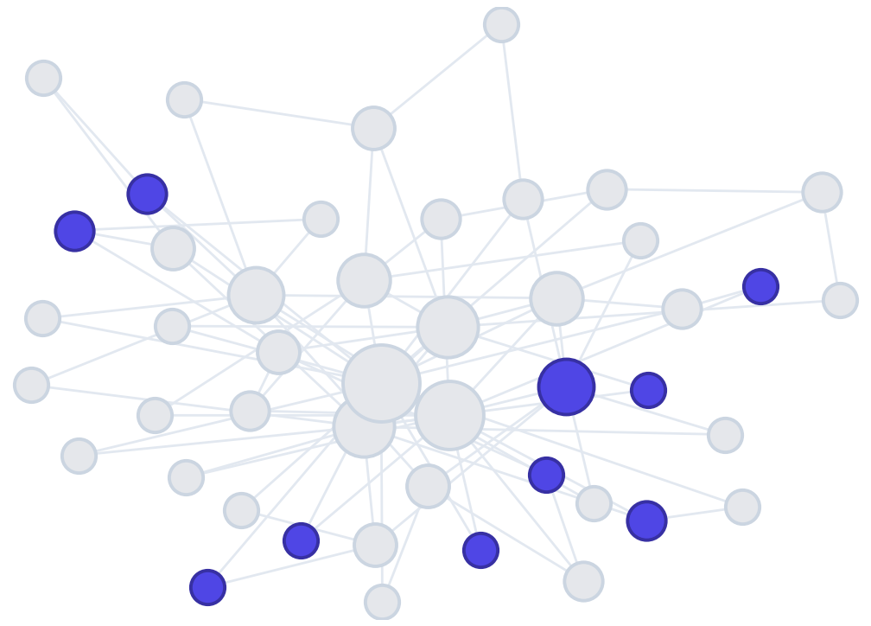
Odesa I. I. Mechnikov National University
Faculty of Mathematics, Physics and Information Technologies
COURSEWORK · 2026
Fraud detection
in the Ethereum network
with machine learning methods
Author: Uliana O. Hrab
Third year · speciality 113 “Applied Mathematics”
Supervisor: Cand. Sc. (Phys.-Math.), Assoc. Prof. Ye. M. Strakhov
Notes:
Good afternoon. The topic is how machine learning can catch fraudsters in the Ethereum network. I will walk you from the problem to the result.

Slide 2

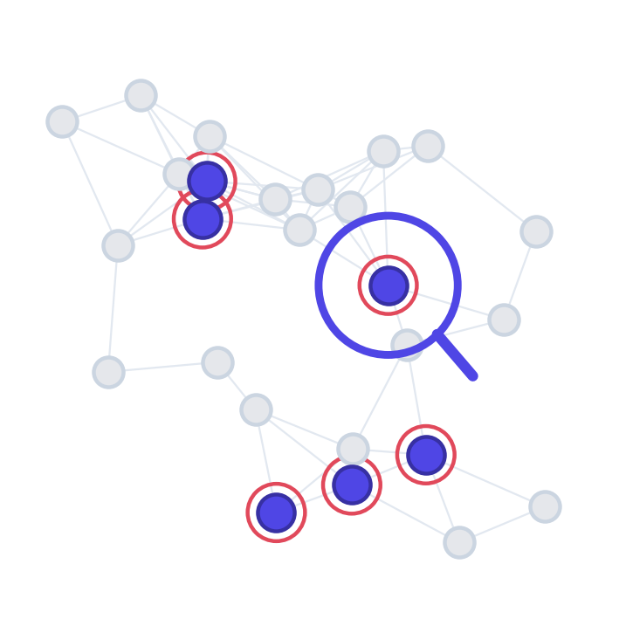

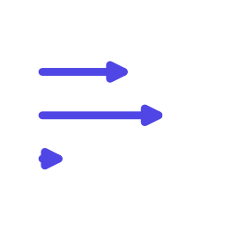

Why this matters
Fraud is growing
phishing, Ponzi schemes, fake tokens
Accounts are pseudonymous
an address does not show who is behind it
CONTEXT
Millions of transactions a day
a scale manual review cannot reach
Manual checking does not work
automatic detection methods are needed
The opening - the whole transaction history is public, so it can be turned into features and used to train a model.
02
/ 14
Notes:
Why this hurts: a lot of money, a lot of fraudsters, and the addresses are anonymous. You cannot check millions of transactions by hand. The way in: the whole history is open.

Slide 3
AIM AND WORK DONE
What was done
The aim was to build and compare fraud-detection models and to evaluate them correctly, without data leakage.
✓
analysed the data and ran an exploratory analysis
✓
trained and compared four models by cross-validation
OVERVIEW
✓
found and removed data leakage (grouped split)
✓
selected the best model - LightGBM
✓
engineered features and a preprocessing pipeline
✓
measured its quality on the held-out test set
03
/ 14
Notes:
A short list of what the work covers: from data analysis to the pipeline, training and evaluating the best model. The aim, said out loud: build the models and evaluate them honestly, without leakage.

Slide 4
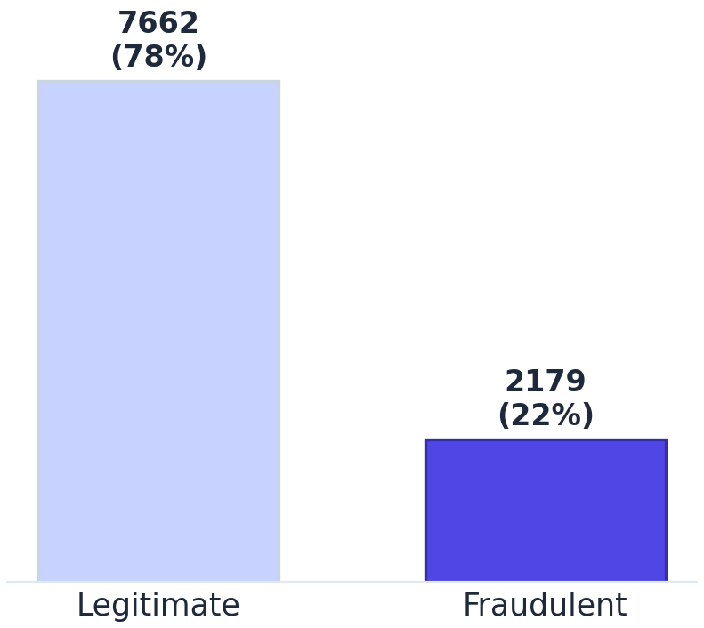




WHAT ARE WE PREDICTING?
The dataset
An open Kaggle dataset built from real Ethereum addresses.
One row is an account with a transaction history; we predict whether it is fraudulent.
9841
accounts
DATA
50
numeric features
78 / 22
% legitimate / fraudulent
50 features in four groups:
Counters
Time-based
Ether volumes
ERC20 tokens
04
/ 14
Notes:
Real addresses from Kaggle. Almost 10 thousand accounts, 50 features, and a skew: fraudsters are only about a fifth. The features fall into four meaningful groups.

Slide 5
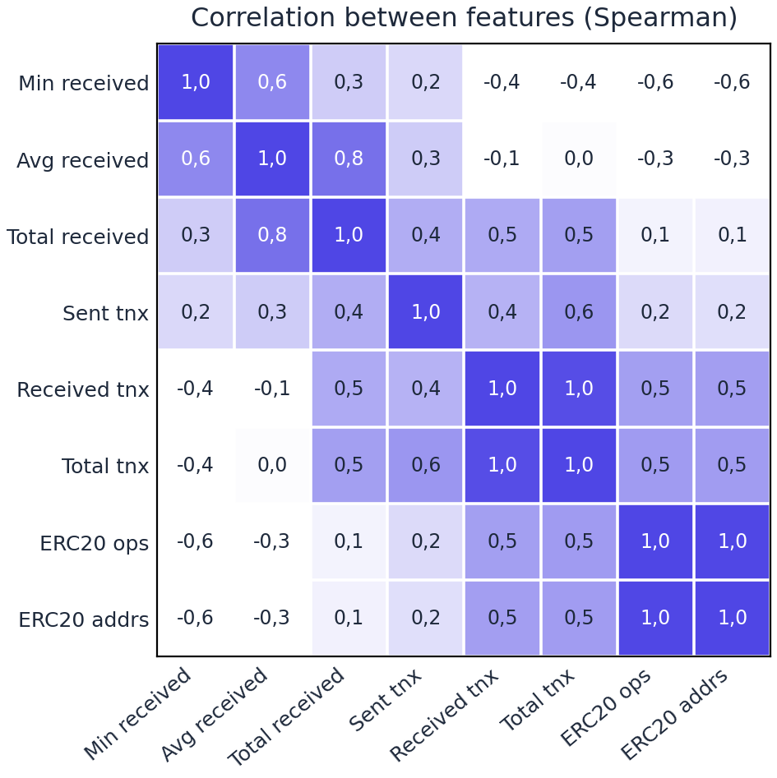
HOW THE FEATURES RELATE
Exploratory analysis
Features cluster by meaning
→ volumes · counters · ERC20
DATA ANALYSIS
21 pairs of identical columns
→ all-zero ERC20 duplicates -> kept (harmless)
Correlation with the label < 0.95
→ no single feature gives the class away
05
/ 14
Notes:
I checked how the features relate to each other. The groups are visible: transaction counters correlate with each other, ERC20 features with each other; some columns are outright identical (all-zero ERC20) - I kept them, trees do not mind redundancy. The key point: no feature correlates with the label above 0.95, so nothing simply gives the answer away. Identical ROWS are the next slide.

Slide 6
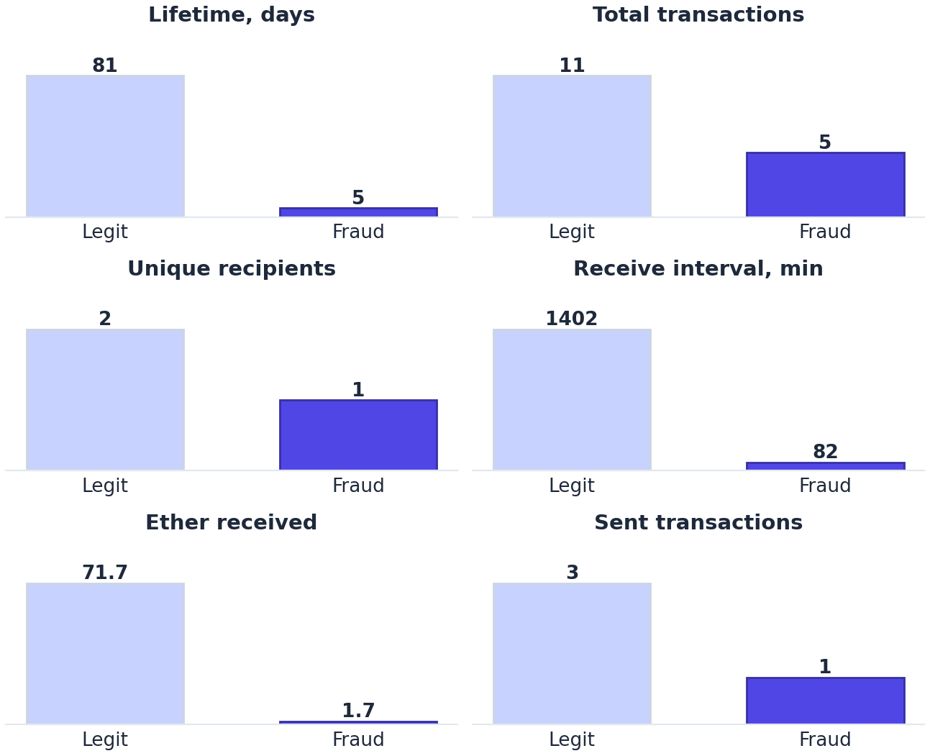
WHAT THE ANALYSIS SHOWED
Fraudsters behave differently
Feature median | Legit | Fraud
Lifetime of activity, days | 81 | 5
Total transactions | 11 | 5
Unique recipients | 2 | 1
Ether received | 71.7 | 1.7
DATA ANALYSIS
Shorter lives, fewer operations, a narrower circle of addresses.
06
/ 14
Notes:
Fraudsters really do behave differently: they live days rather than months and make fewer operations with a narrower circle of addresses. Visible in the table and in the charts.

Slide 7
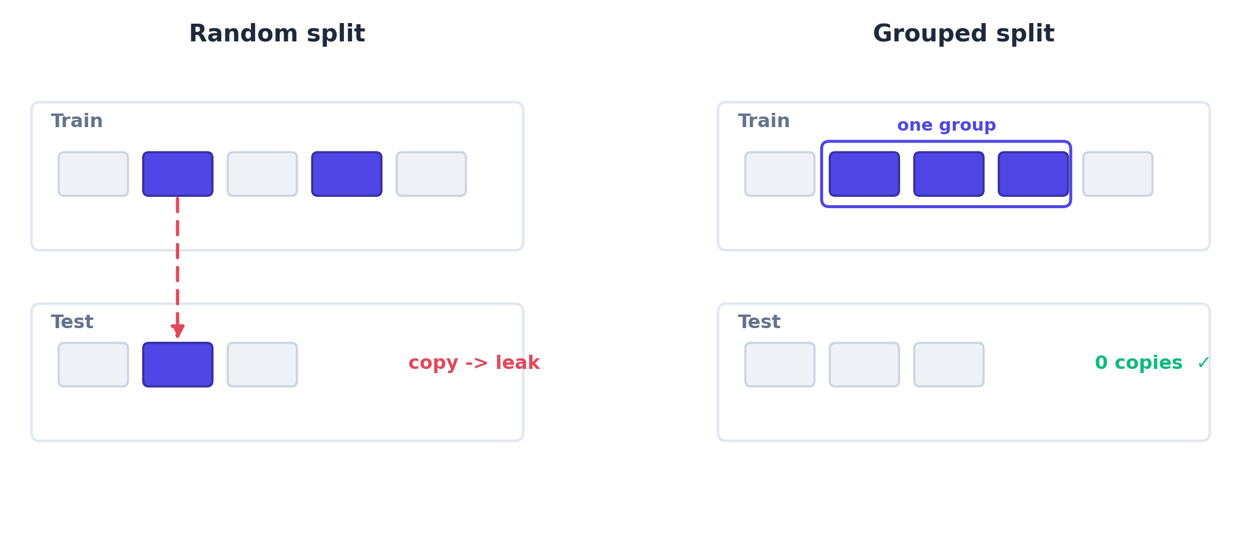
CAN THE METRICS BE TRUSTED?
Duplicates and data leakage
574
duplicate rows
28
profiles (~92% fraudulent)
5.7%
of the test set = copies from train
CORRECTNESS
07
/ 14
Honestly: the grouped split made the evaluation correct; the metrics barely moved, so they came from the features themselves, not from peeking.
Notes:
The honest part. I found duplicates; under an ordinary split the copies land in both train and test, so the metrics cannot be trusted. I fixed it with a grouped split. The surprise: the numbers barely moved, so the scores came from the features. But without checking I would not have known that.

Slide 8
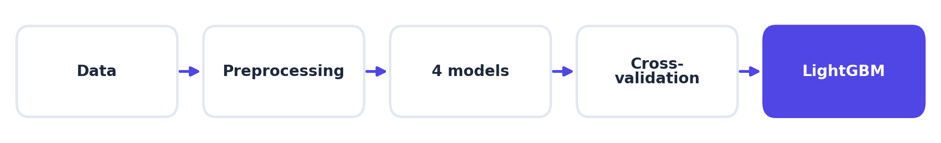
Feature engineering and preprocessing
PIPELINE
New features
→ logs of skewed · flags for sparse · ratios
ColumnTransformer
→ numeric: median + standardisation; one-hot
The principle: the pipeline is fitted on the training sample only, so test statistics never seep into training.
08
/ 14
Notes:
New features suggested by the analysis, one shared preprocessor. The principle examiners like to ask about: everything is fitted on the training sample only, otherwise it is leakage again, just a quieter kind.

Slide 9
Models and metrics
Four models, class weights for the imbalance:
Why is PR-AUC the main metric?
Logistic regression
✗
Accuracy — share of correct answers
always say “not fraud” -> 78% for free
Random forest
MODELS
≈
ROC-AUC — area under the ROC curve
inflated by the 78% legitimate rows
XGBoost
LightGBM
✓
PR-AUC — precision-recall
looks at the rare class - the fraudsters
Selection - by five-fold grouped cross-validation, not on the test set.
Under imbalance PR-AUC is the most honest.
09
/ 14
Notes:
Four models, imbalance handled with class weights. I selected the best one on cross-validation, not on the test set. The main metric is PR-AUC: accuracy gives 78% just by guessing “not fraud”, ROC-AUC is inflated by the legitimate rows, and PR-AUC looks at the fraudsters themselves.

Slide 10
ALL MODELS SIDE BY SIDE
Model comparison
Model | Precision | Recall | F1 | ROC-AUC | PR-AUC
Logistic regression | 0.719 | 0.940 | 0.815 | 0.982 | 0.947
Random forest | 0.979 | 0.986 | 0.983 | 0.9996 | 0.9987
XGBoost | 0.982 | 0.986 | 0.984 | 0.9998 | 0.9992
LightGBM | 0.986 | 0.989 | 0.987 | 0.9998 | 0.9994
RESULTS
Precision · Recall · F1 balances the two · ROC-AUC / PR-AUC are areas under the curves
Takeaway: the three ensembles are practically level and strong, logistic regression is clearly behind - the ensembles did not win by chance.
10
/ 14
Notes:
All models side by side. The three ensembles are practically level and strong, logistic regression is clearly behind. The ensembles winning is not an accident of one split.

Slide 11
WHY LIGHTGBM
Model strengths and weaknesses
Logistic regression
+ simple and easy to interpret
– linear: low precision, many false alarms
Random forest
+ robust, needs almost no tuning
– larger and slower than boosting
MODELS
XGBoost
+ very accurate tree boosting
– sensitive to hyperparameter choice
LightGBM ★ chosen
+ best balance of quality, fast and compact
– (the gap to the other ensembles is within noise)
11
/ 14
Notes:
Why LightGBM. Logistic regression is simple but linear, so many false alarms. The forest is reliable but heavier. XGBoost is accurate but fussy about settings. LightGBM gave the best balance of quality and speed, so I chose it; the gap to the other ensembles is within noise.

Slide 12
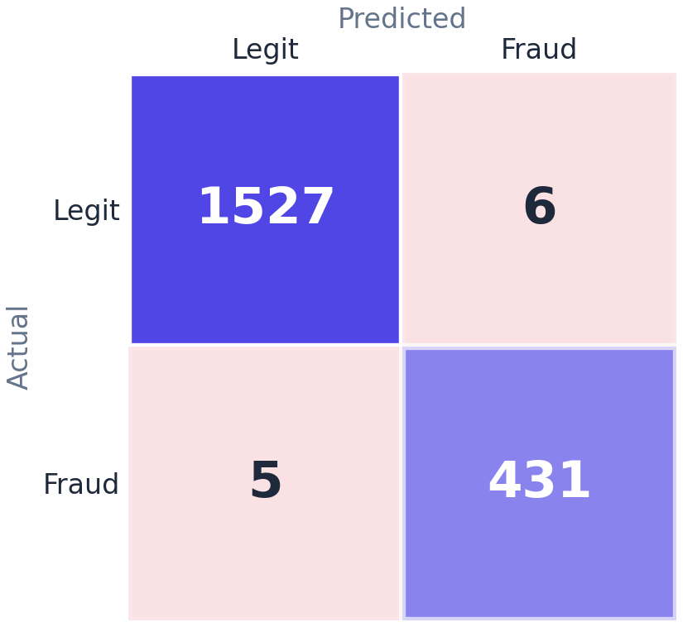
THE BEST MODEL
LightGBM on the test set
Cross-validation winner: LightGBM
RESULTS
0.986
precision
0.989
recall
0.999
PR-AUC
Out of 436 fraudsters only 5 were missed, with 6 false alarms.
12
/ 14
Notes:
The winner is LightGBM. On the test set it is close to perfect: five of 436 fraudsters missed and six false alarms. For a monitoring system that is a good place to be.

Slide 13
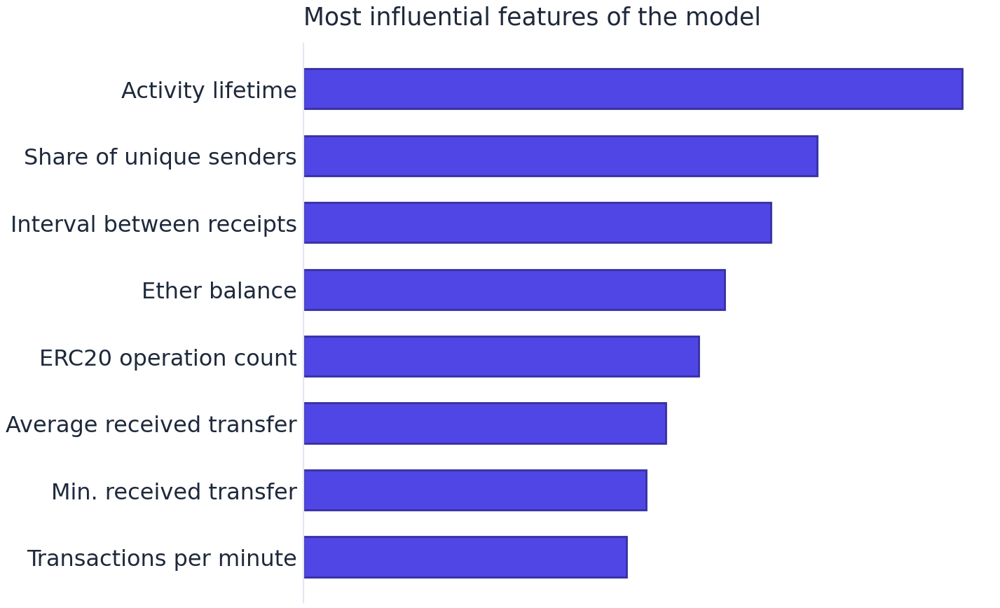
WHY IT TURNED OUT THIS WAY
Analysis of the results
Ensembles ≫ the linear model
→ the data has non-linear structure
ANALYSIS
Logreg: high recall, low precision
→ many false alarms
Recall is the metric that matters
→ missing a fraudster costs more
13
/ 14
Notes:
Why: the data is non-linear, so the trees handle it and the linear model does not. The metric that matters most is recall. And the most influential features are the same ones that separated the classes best in the exploratory analysis.

Slide 14
Conclusions and next steps
Leakage found and removed
the grouped split is the methodological core of the work
LightGBM: recall 0.989
only 5 fraudsters missed on the test set
The pipeline is reproducible
the saved preprocessor and model classify new accounts
CONCLUSIONS
Next steps:
Hyperparameters
random / Bayesian search to lift quality
Decision threshold
balance a miss against a false alarm
SHAP
explain individual model decisions
Online monitoring
flag suspicious accounts in real time
14
/ 14
Notes:
Three points to close on: leakage found and removed, a near-perfect LightGBM, and a reproducible pipeline. Where to go next: tuning, the decision threshold, SHAP explanations and online monitoring.

Slide 15
Thank you for your attention
Happy to take questions
Notes:
Thank you. Happy to take questions.

